Slide 1


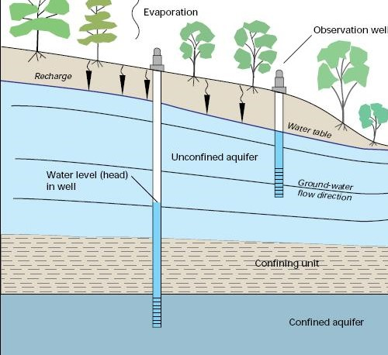
NATIONAL INSTITUTE OF TECHNOLOGY SIKKIM
Inno-Hustlers
Ground Water Level Predictor

Slide 2
Content:
Inno-Hustlers
Introduction
Overview
Need
Solution
Software Approach
Hardware Collaboration
Flowchart
Diagrammatic Representation
Technical Stack

Slide 3
Introduction:
Inno-Hustlers
Groundwater is a crucial resource for agriculture and industrial needs. In the contemporary world, it is required to sensible usage of resources and we need to find better alternative ways for feasible extraction of resources.
Drought has been consistently affecting many parts of India. But, we have plenty of water resources to overcome this problem. To tackle this situation ,we need efficient water resource allocation , planning and management .Overcoming the water-related issue would be easy if we have a good understanding of the existing groundwater availability. We present a participatory approach to report water availability and depth levels of groundwater. Having a record of this data will not only allow us to monitor but also have a better understanding ,planning and control over groundwater extraction and its use.

Slide 4
Overview:
Inno-Hustlers
Our approach to this problem is that we would transmitter and receiver to throw and collect acoustic waves.
We would use seismic wave generator to transmit the wave and use geophone sensor to collect the reflected wave.
This project overall simplifies the complexity and reduce the risk of failure in detection of groundwater.

Slide 5
Need:
Inno-Hustlers
We observe many times when drilling for the borewell fails due to absence of groundwater at that location .And so efforts and capital are wasted .So, to minimize the risk of failure we need new and advanced technology .
There are places(non-uniform) under the ground where groundwater is sufficiently present but due to lack of the technology we fail to detect it .

Slide 6
Solution:
Inno-Hustlers
We can implement this methodology that may be successful and may save many efforts and money of the people .It can be implemented by collaboration of both hardware and software .
The hardware part of the project will have the mechanism of transmitting and receiving the waves .
The wave generated by hardware is sent below the ground and receiver will collect the reflected wave from the groundwater surface. And the delay occurred between transmitting and receiving will help us to know about the depth at which the groundwater is present .
In case the groundwater is not present at that location wave will not be reflected back and it will die out .

Slide 7
Software Approach:
Inno-Hustlers
We will have standard reference set of data already existing for a location sufficiently rich in groundwater.
The parameter taken here are :
Temperature
Soil Moisture
Rainfall
Humidity
Altitude above sea level
The same parameter will be taken from user of a particular location. Then both the value that is reference value from the user input will be compared. After that if the value matched with standard reference value or lie in the range prescribed then we would conclude that groundwater is existing there.

Slide 8
Hardware Collaboration:
Inno-Hustlers
The hardware part of the project will have the mechanism of transmitting and receiving the waves .
The wave generated by hardware is sent below the ground and receiver will collect the reflected wave from the groundwater surface. And the delay occurred between transmitting and receiving will help us to know about the depth at which the groundwater is present .
In case the groundwater is not present at that location wave will not be reflected back and it will die out .
The data obtained by hardware component is fed into the software by interfacing hardware and software and after that software process the data and get us the output.

Slide 9
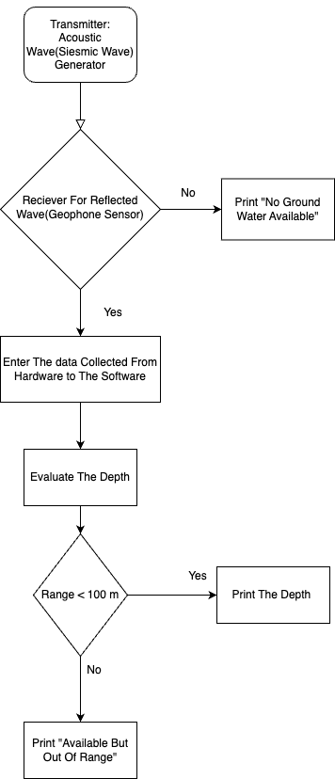
Flowchart:
Inno-Hustlers

Slide 10
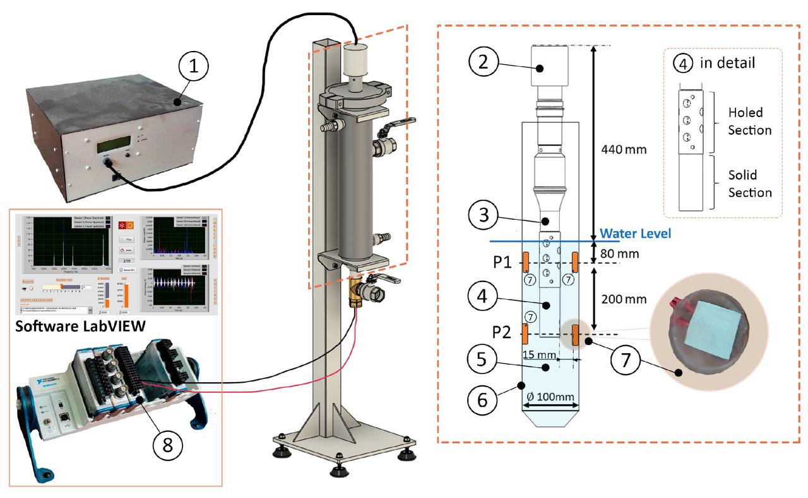
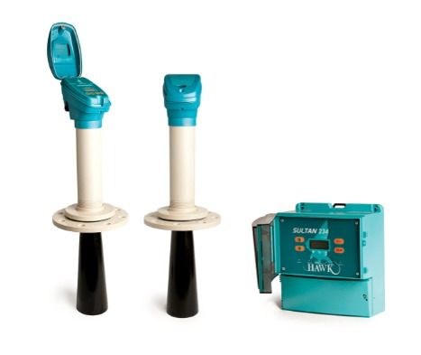
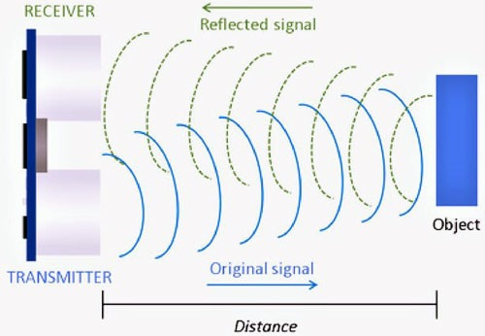
Diagrammatic Representation:
Inno-Hustlers
Acoustic Wave
Generator
1.ultrasonic power supply;
2. transducer;
3. booster 1:2.0;
4.acoustic radiator;
5. liquid media;
6. chamber;
7. piezoelectric sensor;
8. data acquisition treatment, and signal processing system.

Slide 11
Technical Stack:
Inno-Hustlers
Generating acoustic waves in the frequency range of 10-100 Hz for geophysical surveys, including groundwater detection, is typically achieved using seismic sources designed to create controlled vibrations or shocks in the ground.
To use a piezoelectric transducer as a transmitter to generate seismic waves (acoustic waves) for detecting groundwater levels, you would need a specific type of piezoelectric transducer designed for seismic or geophysical applications.
Geophones as a receiver are the most suitable sensors for detecting acoustic waves penetrating the Earth to identify groundwater levels in land-based surveys.
Seismic data acquisition system or a computer with DAQ software(e.g. LabView) is generally the best choice for comprehensive data collection and display of geophone sensor data in professional surveys. For simpler, more portable setups, oscilloscopes or portable devices with graphical displays can be effective.

Slide 12
Link:
https://youtu.be/DAXTawhw82s?si=oQZPKSAuHoc8B1Sc
http://www.blackboxai.com/
https://youtu.be/DAXTawhw82s?si=oQZPKSAuHoc8B1Sc
/https://youtu.be/A_D-G97RrZE?si=wsegNDvEVnadPVNu

