Slide 1


CAKE BOUTIQUE
PREPARED BY
AKSHAT CHHAYA (19DIT008)
DEEP THAKKAR (19DIT074)
Under Guidance Of
Krishna Patel Mohammed Bohra
Assistant Professor Assistant Professor
CSE,DEPSTAR CE,DEPSTAR
CHARUSAT CHARUSAT

Slide 2
AKSHAT CHHAYA
19DIT008

Slide 3
PROJECT DEFINITION
“We are required to create an Android based application for a cake designer which has a simple user interface to display major flavors and all flavors in a single scrollable list and appropriate interface for profile management”
As mentioned above in the project defination it is clear the we have developed an Android based mobile application for a cake designer.
This application is required to have a user interface which is simple yet elegant and on par with Android Material design concepts.
The application is authentication based and uses the REST API and token based authentication for seamless login experience.

Slide 4
ABOUT PROJECT
This project is based on Android mobile development platform.
We have developed a cake shop app.
The app has an home screen where hot flavors are displayed in a card container.
Then app has an integrated App drawer.
In our App we have used concept of navigation Ui and fragments for better performance.
The App has a single activity instance i.e MainActivity.
And has 3 different Fragments Home Fragment,All flavors fragment and Password change fragment.
This way App doesn’t need to frequently keep on changing the Activities and hence in single activity we can display multiple fragments.

Slide 5
CONTINUED......
In this app we have implemented an API based server communication for modular coding practices.
We have wrapped volley api into our own api and this way via lazy loading or Asynchronous loading we optimize the application performance.
In this app we have implemented a simple yet powerful mechanism of Navigation UI for seamless navigation between pages and for better overall performance as mentioned in earlier slide.
We have developed this application keeping in mind all age groups and hence interface is kept as simple as possible.

Slide 6
PRIVACY
Here is how we implement privacy in our App are as follows:
Authentication based application
Sessions based login for lesser login requirement
JSON web token based authentication.
Username as payload strategy to protect other credentials from leakage.
No credentials stored on device for better security.
REST based backend to provide optimized responses.
Minimal server and application contact for better security

Slide 7
Tools and Technology used
Majorly we have used Android for application and on backend some other supporting tools are used.
AndroidX jetpack library (Java Based)
Volley for network based requests
Navigation UI
Nodejs (14.0.0)
MongoDb(4.2.9)
Mongoose
Express JS
JSON WEB token

Slide 8
DEEP THAKKAR
19DIT074

Slide 9
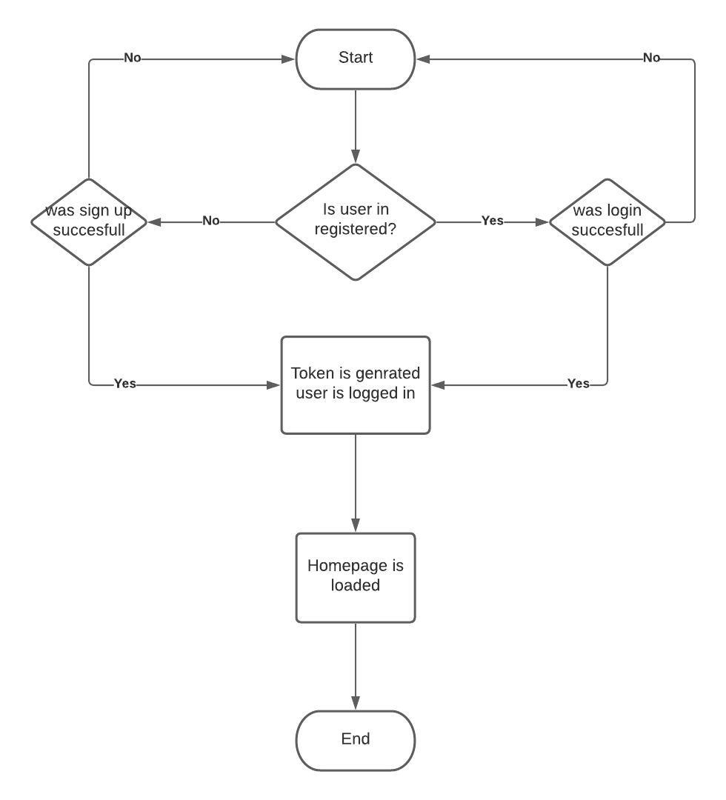
System flow chart login

Slide 10
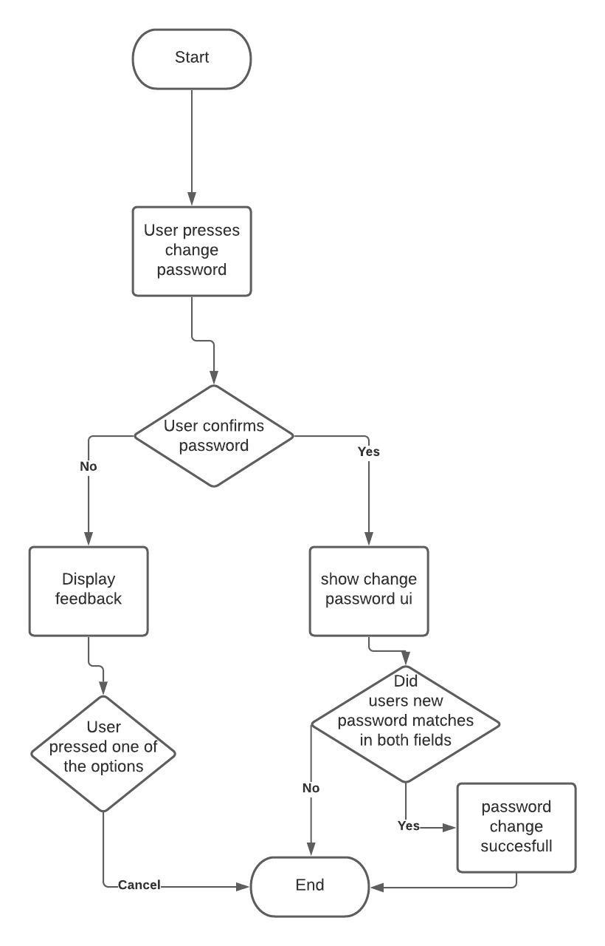
System flow chart (change password)

Slide 11
Future scope of project
In future following may be the possible additions in the project
Cake ordering mechanism and order management system for owner
Integrated payments user interface for cake ordering facility.
Google AR CORE integration for 3d preview of cakes.
Online review system for cakes and flavors.
Cake customization for custom cakes from clients.
Cake customization estimation calculator.

Slide 12
Limitations
As we all know that no system in world is perfect and our system is no exception in that.
We have some limitations which we think can be of concern are as follows:
Bases on network latency and network speeds the response time for application ,the application may behave weirdly if not provided proper network.
Application uses shared preferences for storing token for rooted devices this may cause security concerns though our token is encrypted and even after decrypting it still as payload username is used so no security concerns but for stipulated time (i.e 2hours) the other app may get access to our API given that they are able to decrypt the token.
No order management or cake ordering system. Though we know that this is a limitation it remains in future scope to develop any such component and facility.

Slide 13

DEMONSTRATION
Wait a sec while we start the demo!

Slide 14
THANK YOU

