Slide 1


Eureka Vs Consul
Avinash Srivastava

Slide 2
Eureka comes from the Netflix OSS and was added to one of the Spring Cloud release pipelines.
Consul.io comes from HashiCorp and is maintained by both HashiCorp and the open source community. Consul.io was also added to a Spring Cloud release pipeline.
Other zookeeper(Apache)
etcd
osgi
snoop
kubernates(google)

Slide 3
What is Eureka
Eureka is a REST (Representational State Transfer) based service that is primarily used in the AWS cloud for locating services for the purpose of load balancing and failover of middle-tier servers. We call this service, the Eureka Server.
Netflix Eureka is a service registry. It provides a REST API for managing service-instance registration and for querying available instances.

Slide 4
What is consul
Consul is a distributed, highly available, datacenter-aware, service discovery and configuration system. It can be used to present services and nodes in a flexible and powerful interface that allows clients to always have an up-to-date view of the infrastructure they are a part of.
Consul provides many different features that are used to provide consistent and available information about your infrastructure. This includes service and node discovery mechanisms, a tagging system, health checks, consensus-based election routines, system-wide key/value storage, and more.

Slide 5
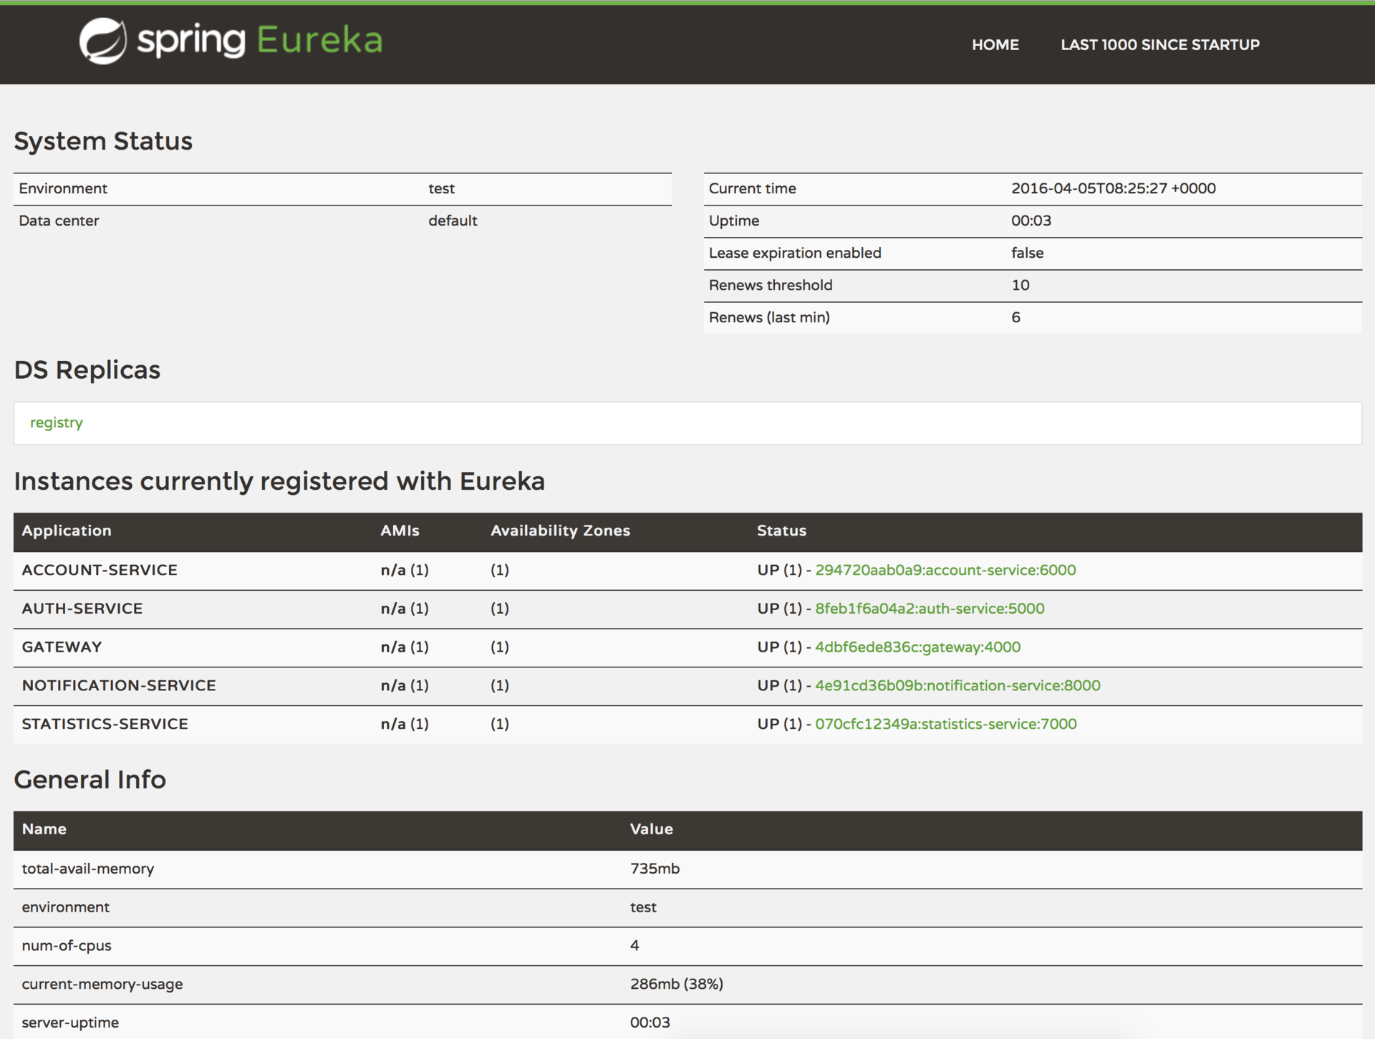
Eureka Dashboard

Slide 6
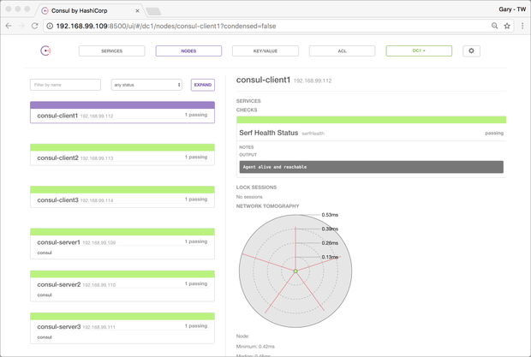
Consul Dashboard

Slide 7
Criteria | Eureka | Consul
Spring Cloud integration | Yes - Angel SR3 | Yes – Brixton
Management in Container | There are Docker targets. However, based on documentation, I’m not clear on configuration of peers. | Yes. The API implies Docker support.
Health monitoring of Endpoints | Yes. Removal of failed after 90 minutes (configurable) | Yes. Removal after 72 hours. (Fixed)
Multiple Datacenter | Possible | Yes per application documentation.
DNS support | No. Would require another package. | Yes. Built in.
Polyglot support | Requires addition of Sidecar. | Built in support

Slide 8
HTTPS | Possible but not used in Netflix | Yes. Keygen and other configuration done via Consul CLI
Endpoint Update method | Delta content with occasional full content | Always full content
Recommended Number per datacenter | 2 or more instances of Server connected as Peers | 3-5 instances per Datacenter with ability to connect Datacenters.
Circuit Breaker | Supported with Hystrix and code modification | Not available
Health Check data collection | Hystrix with HystrixDashboard. Aggregation via Turbine. | Built in to the Consul.io web access page.

Slide 9
Eureka:
- AP (weak consistency), state is replicated with “best effort”
- Services are registered with one server, which attempts to replicate to other servers
- Service registrations have a TTL, and clients must heartbeat
- Reads are routed to any server, can be stale or missing data
- Scales well due to low coordination, especially when server failures relatively rare
- Fails if all servers down
Consul
- CP (strong consistency), state is replicated using Raft
- Services registered with any server, but written via Raft to a quorum
- Registrations have complex health checks, including gossip failure detection instead of heartbeating
- Reads routed to any server, consistent by default but stale reads can be requested
- Stale reads scale well, Consistent reads scale to tens of thousands per second
- Consistency offers locking and cluster coordination
- Lots more features (health checking, locking, KV, federation, ACLs)
- Fails if a majority of servers down
Both are capable as a service discovery tool and both integrate with Spring Cloud and the RestTemplate injection.

Slide 10
Why Consul ?
The focus on scriptable configuration allows for better container management.
Eureka requires either external Configuration Server or multiple configuration files.
The options for securing communications is more advanced.
Eureka requires creating application with security settings desired. Default will allow HTTP only. Registration of end points assumes http but can be forced to https with code.
Support for non-REST endpoints via DNS. This would allow database and other resource connections.
Eureka presumably would do this through ZUUL and/or Sidecar.

Slide 11
Consul provides a toolkit of features needed to support a service oriented architecture. This includes service discovery, but also rich health checking, locking, Key/Value, multi-datacenter federation, an event system, and ACLs. Both Consul and the ecosystem of tools like consul-template and envconsul try to minimize application changes required to integration, to avoid needing native integration via SDKs. Eureka is part of a larger Netflix OSS suite, which expects applications to be relatively homogeneous and tightly integrated. As a result, Eureka only solves a limited subset of problems, expecting other tools such as ZooKeeper to be used alongside.

Slide 12
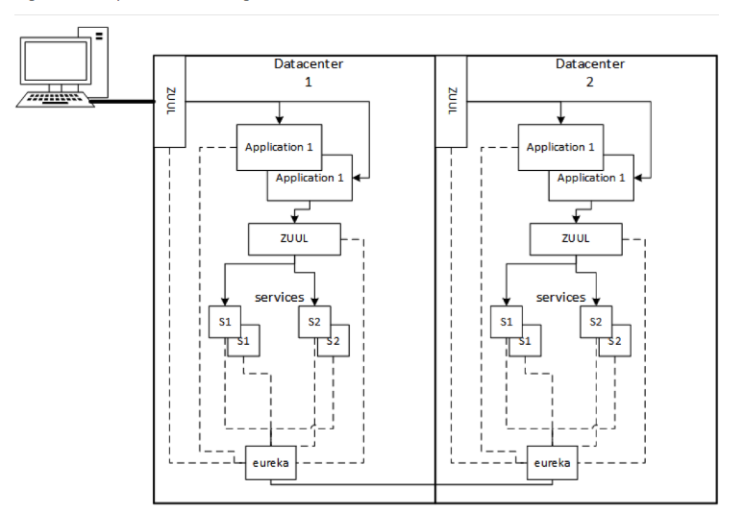
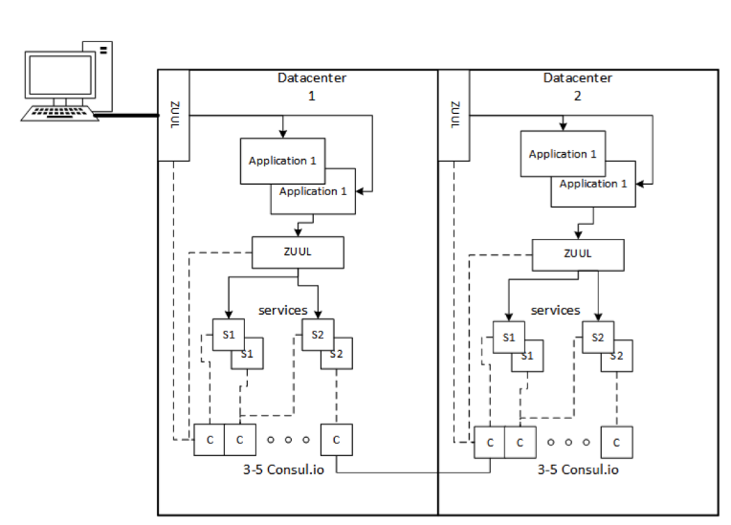
Eureka Consul
Configuration

Slide 13
Other Discovery solution
ZOOKEEPER
http://zookeeper.apache.org/
ZooKeeper is an Apache project providing a distributed, eventually consistent hierarchical configuration store.
ZooKeeper originated out of the world of Hadoop, where it was built to help in the maintenance of the various components in a hadoop cluster. It is not a service discovery system per se, but is instead a distributed configuration store that provides notifications to registered clients. With this, it is possible to build a service discovery infrastructure, however every service must explicitly register with ZooKeeper, and the clients must then check in the configuration.
Netflix have invested a lot of time and resources into ZooKeeper, and so a significant amount of Netflix OSS projects have some ZooKeeper integration.
Other Discovery solution

Slide 14
ZooKeeper is a well understood clustered system. It is a consistent configuration store, and so being well designed and built, a network partition will cause the smaller side of the partition to shut down. For that reason, you must choose whether consistency or availability is more important to you.
If you do choose a consistent system for service discovery, such as Zookeeper, then you need to understand the implications on your services. You have tied them to the lifecycle of the discovery system, and also exposed them to any failure conditions it may have. You should not assume that 'consistent' means free from failure. Zookeeper is among the older cluster managers, and consensus (pun intended) is that it’s implementation of master selection is robust and well behaved.
If you do choose to use ZooKeeper, investigate the Netflix OSS projects, staring with Curator https://github.com/Netflix/curator as a first point of call, and only use bare ZooKeeper if they don’t fit your needs.
Since Zookeeper is mature and established, there is a large ecosystem of good quality (mostly!) clients and libraries to enrich your projects.

Slide 15
ETCD
http://www.etcd.io
Etcd is an HTTP accessible key/ value store. In that, it is similar in concept to ZooKeeper and the K/V portion of Consul. It functions as a distributed, hierarchical configuration system, and can be used to build a Service Discovery system.
It originally grew out of the CoreOS project, is maintained by them and recently achieved a stable major release
Simplicity Itself Recommends:
If you are primarily using HTTP as your communication mechanism, then Etcd can’t be easily beaten. It provides a well distributed, fast HTTP based system, and has query and push notifications on change, via long polling.

