Slide 1

Cloud Data
Your Data
Store it | Use it
Avinash Srivastava
Bring d change | Live d future
Verizon ..with | be Everywhere..!!!

Slide 2

One time customer will purchase Huge data for week/month/Year
And based on his plan he can use that data .

Slide 3
1. Suppose customer purchased the Data for month as he is on vacation there he can use more data for social and personel. But suddenly urgent work came n he has to back on work that tym he cannot use the data as he think he lost his money and data and he can curse company too.
2.A business man who is more active on social sites and trading shares and love to watch online videos.As he knows his monthly usage of data then also he will get burden to recharge his plan every month.

Slide 4
3. Students purchase the data plan for a month as he got pocket money and suddenly in mid of plan his xams came as he needs to concentrate on xam, he will go offline for a period of days but his data too gone he cannot use it again and also he cannot share the data with his family who dont hav xams.
As today is 30th my data validity gonna over for my plan and from tomorrow to next xam there is big gap, so to refresh i want data pack to online but again for that i hav to purchase monthly plan or costly plan for my account.

Slide 5
4. Common man uses data carefully and they use
It efficiently. Some tym they purchase more and unable to use that data And also And Data wastage. For using 1 hr in day for month I need to pay huge. Customer think they could use those data later but that tym validity over.

Slide 6
5. Ladies/girls, they want more attentions n also selfie xperts wants there each moments to be shared with world. Coz of parties etc in mid of data plan they finish their data on 22nd of month.May be to activate her next plan she can wait for her salary to come n then purchase.
Till then she is block as there is no proper plan of data n controller of cutomer over it.

Slide 7
Its force rule that if u purchased use it otherwise it will go in dump. There is no proper structure or plan to plan the usage of their data and hav control over data packs.
And So many problems...............!!!

Slide 8

Cloud Data ....A solution for ur every problems!!!
Buy it one time use it anytime!!!

Slide 9




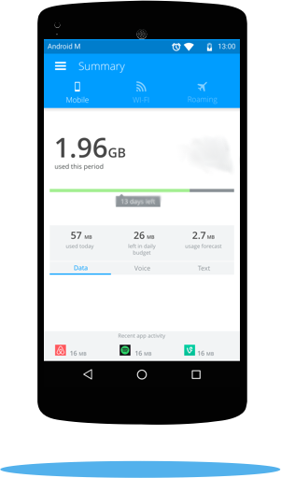
100 Gb
For 3 months
Squeezing 10 gb for 10 days

Slide 10
Multiple Plans for multiple groups of people.
Buy one time huge data pack and use it in your style.
Subscribe 1/2/3/6Month/Year plans and boom online.

Slide 11
Features
1. After purchasing plans whenever u want u squeeze it from cloud to ur account how much u want as u need.
2. Too busy dont want to use data no problem push back ur remaimng data from ur account to cloud use it later.
3. More social means more data u need take as much can from ur cloud.
4. Cloud Pack about to over but no money , no problem send signals to ur friend for data and borrow from him.
Friend also not providing take loan from verizon cloud.

Slide 12
5. Cloud data validity about to over but there is so much left over data ...Worryyingg!!!
Dont worry Either gift to ur friend or we extend based ur days based on ur package.

Slide 13
Business behind This...
1.We can attract customer in different way as they think they got full control over data.
2.We can hav advertisemnt on the cloud data app as many users will definately push/pull data from cloud app.
3. As customer buys huge data so he will be verizon customer for long time.
4. We can offer for both postpay/prepay.

