Slide 1

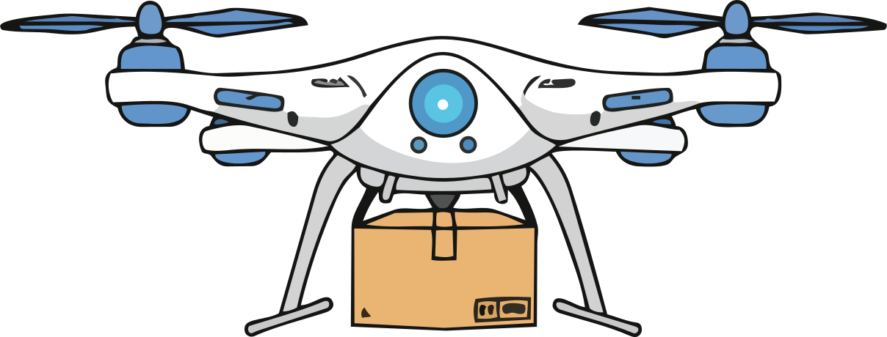
Learning Under Constraints
KnowledgeQuarry · Convoke 8.0
Problem 02 (ML Engineering)
Disha Malhotra
Disha Rathore

Slide 2
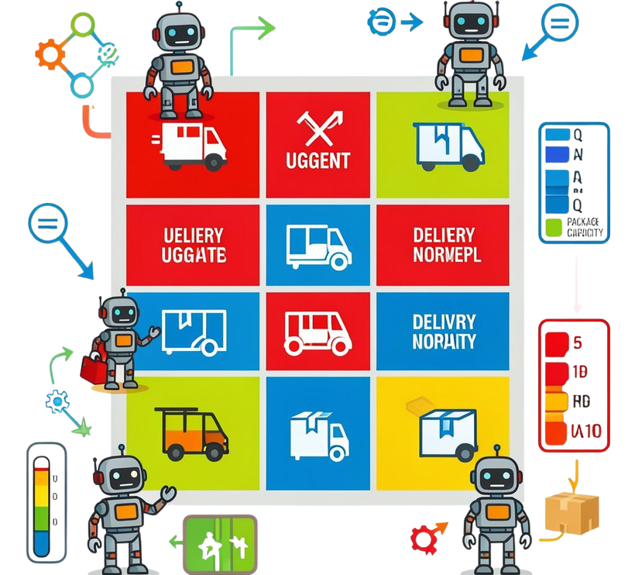
Introduction
Our goal: optimize multi-agent deliveries under limited energy and capacity using reinforcement learning. Episodes simulate a 10×10 warehouse with 8 tasks.
We apply Q-Learning (ε-greedy) to learn assignment and dispatch policies, comparing against Random and Greedy nearest-task baselines.

Slide 3
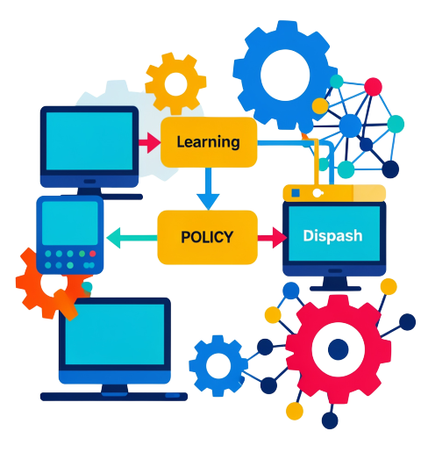
01
Methodology

Slide 4
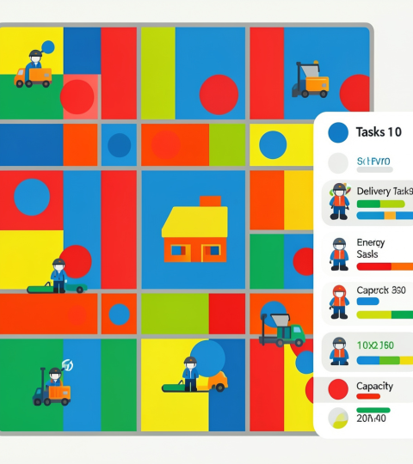
Environment Design
10×10 warehouse grid with a central depot. Each episode has 8 delivery tasks .
State encodes tasks remaining, urgency, agent energy %, and capacity used, all discretised. Visual dashboard shows grid, task locations, and agent positions.

Slide 5

Agent Specifications
Two agent types: Drones : fast, capacity 3, battery 40 steps; Ground Robots : slower, capacity 8, energy 120 steps.
Actions: drone picks up nearest task, robot picks up nearest task, drone goes to depot to deliver, robot goes to depot to deliver. Design emphasizes trade-offs between speed, capacity, and energy.

Slide 6
Q-Learning Setup
Learning uses Q-Learning with ε‑greedy exploration. Hyperparameters: lr=0.15, gamma=0.95, ε decay=0.992.
State discretised: tasks remaining, urgency, agent energy %, capacity used. 4 actions: assign to drone, assign to robot, dispatch urgent, move to depot, idle. 600 training episodes.

Slide 7

02
Evaluation

Slide 8
Reward & Metrics
Reward: +15 delivery, +3 pickup, −0.2 per step, −25 exhaustion.
Key metrics: total deliveries, average reward per episode, completion time, exhaustion rate, and stability of the learning curve.

Slide 9
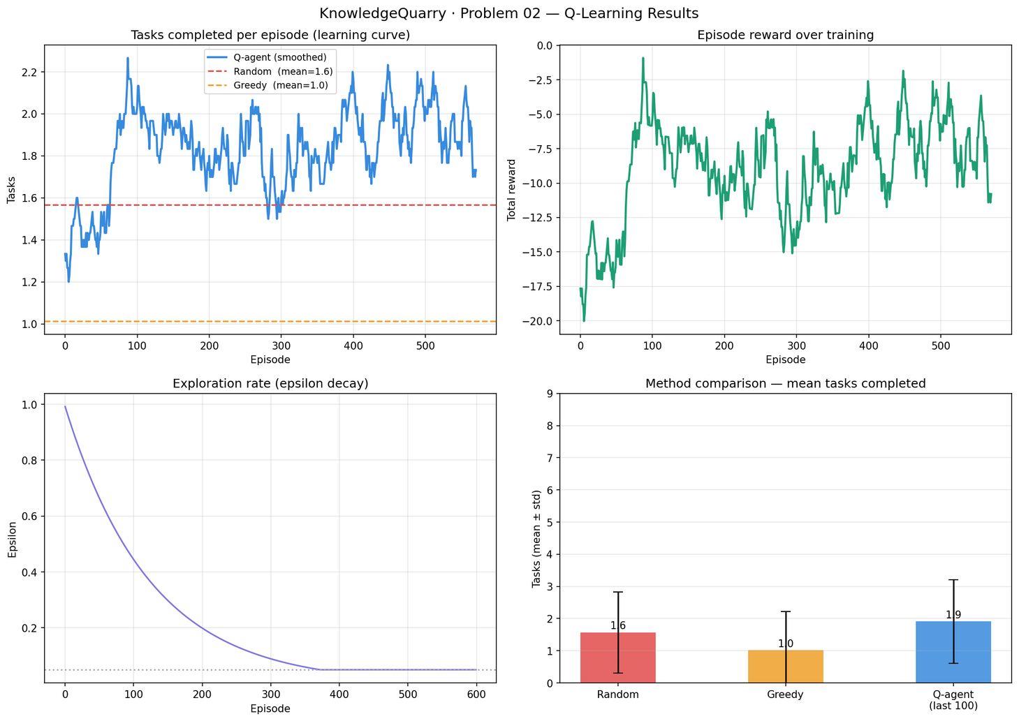
Baseline Comparison
Q-agent 1.91, Random 1.57, Greedy 1.01, +21.9% improvement

Slide 10
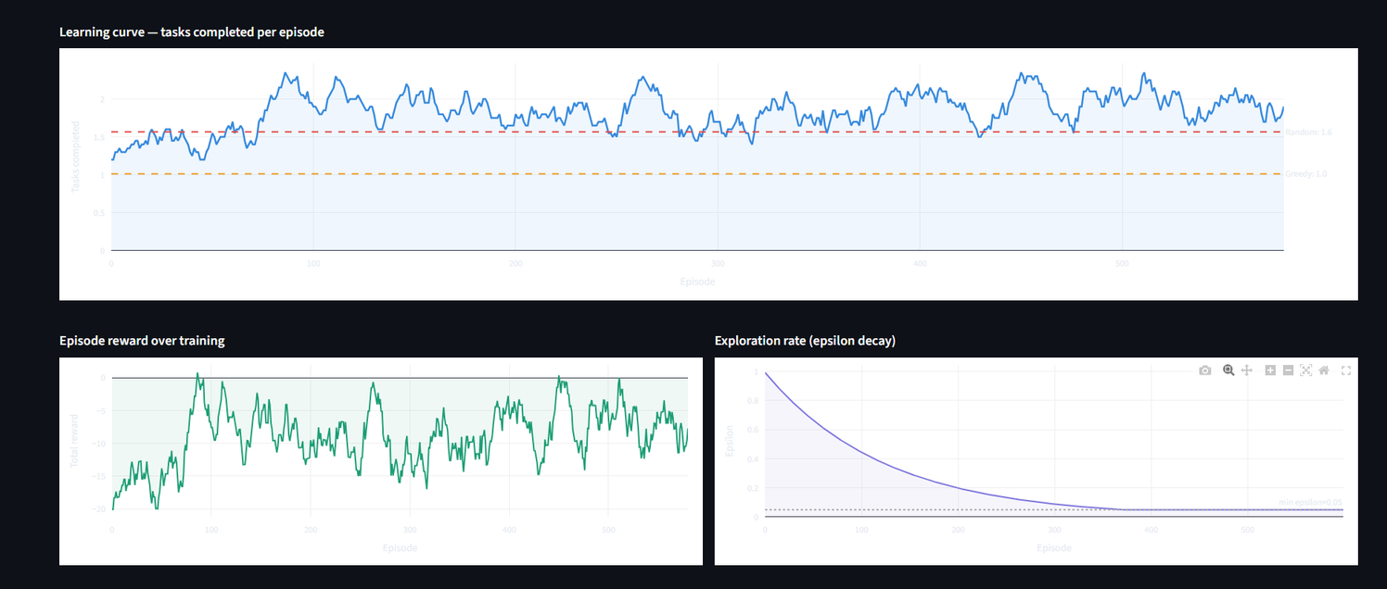
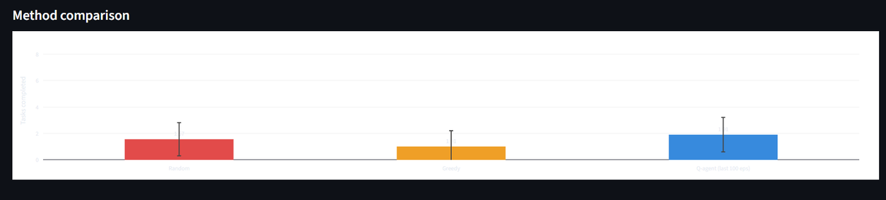
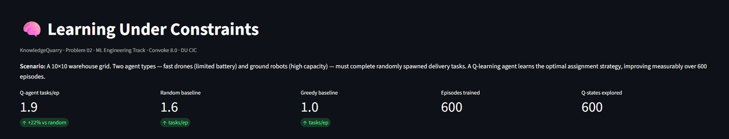
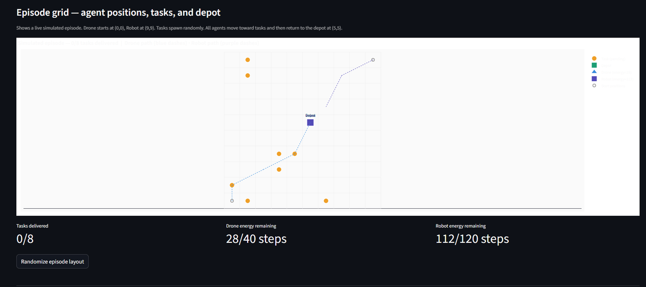

Slide 11
Conclusions
Preliminary solution demonstrates learning under resource constraints with measurable gains over baselines.
Deliverables: Q-agent achieves 1.91 tasks/episode vs 1.57 random baseline : a 21.9% improvement, with a clear upward learning curve from episode 1.

Slide 12
THANKS!

