Slide 1
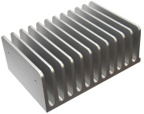
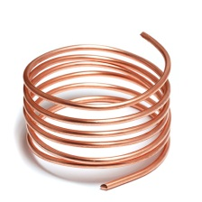
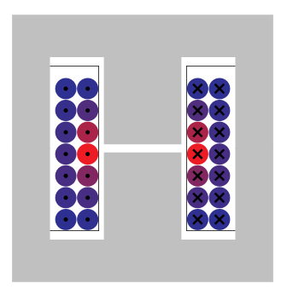
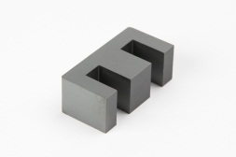
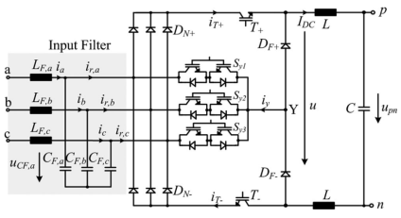
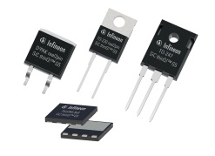
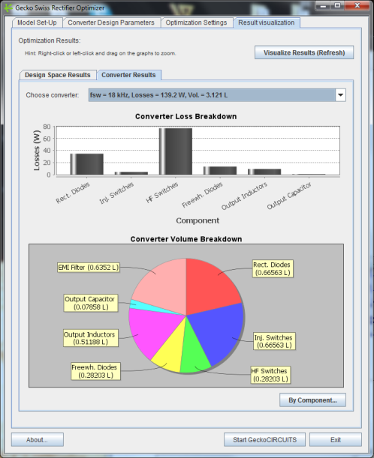
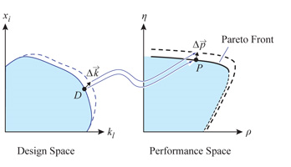
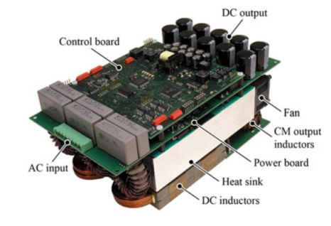


Gecko Swiss Rectifier Optimizer
1/150
FREE Feature Demonstrator Application
Download at http://www.gecko-simulations.com/apec2015
Circuit simulation
(electrical & thermal)
Component Design Space
Magnetic simulation
(with thermal model)
Optimization Algorithm
Optimized Maximum-Efficiency Converter

Slide 2
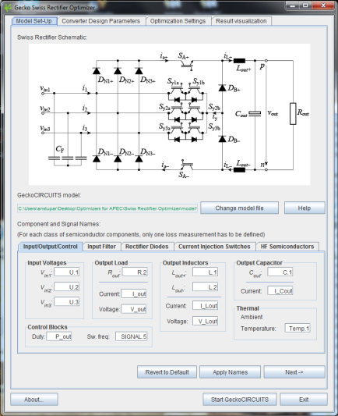
Quick Introduction
The Gecko PES Swiss Rectifer Optimizer is a free, feature demonstrator Java application build on top of GeckoCIRCUITS and GeckoMAGNETICS for finding the highest efficiency Swiss Rectifier Design within a given design space:
It showcases features in development (e.g. converter optimization)
that will become available in upcoming Gecko-Simulations products;
2) It demonstrates how custom applications can be built on top of
GeckoCIRCUITS and GeckoMAGNETICS, to solve specific real-world
problems in power electronics.
This is shown on the example of the Swiss Rectifier, a three-phase PFC rectifier topology developed at the Power Electronics Systems Laboratory at ETH Zurich:
The Gecko PES Swiss Rectifier Optimizer allows you to define a design space for each converter component, and then using evaluations through simulations and an optimization algorithm, it finds the maximum efficiency converter design.

Slide 3
IMPORTANT!
This presentation gives a Quick Introduction to using the Swiss Rectifier Optimizer. No detailed manual is supplied, since after this introduction using the program should be relative straight-forward and self-explanatory.
Also, “Help” buttons are available at almost every stage of the program’s interface, which give a more detailed explanation of the available options.
BEFORE STARTING THE PROGRAM, please read the file README_FIRST.txt, supplied with the application and in the same directory as this presentation.
Feel free to send questions and comments to andrija.stupar@gecko-simulations.com

Slide 4

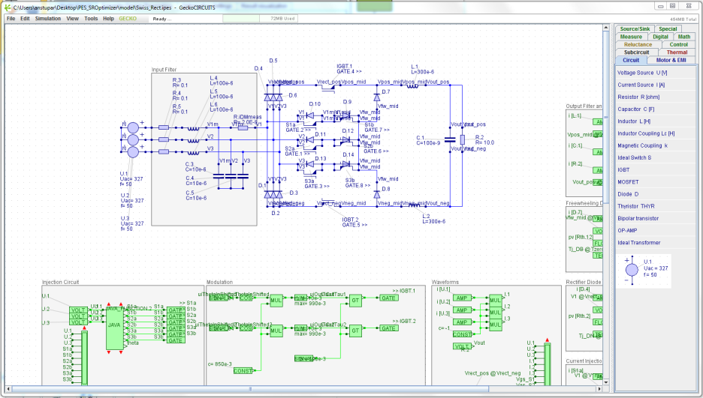
Specifying the GeckoCIRCUITS Simulation Model
► The Optimizer uses a model of the Swiss
Rectifer in GeckoCIRCUITS to extract
electrical and thermal waveforms
► In the first tab (Model Set-Up), the names
of the various converter components and
measurement signals must be defined
► The default names work with the default
supplied model – if using it, no change to
the input field in this tab are necessary
► Click “Start GeckoCIRCUITS” to open the model

Slide 5
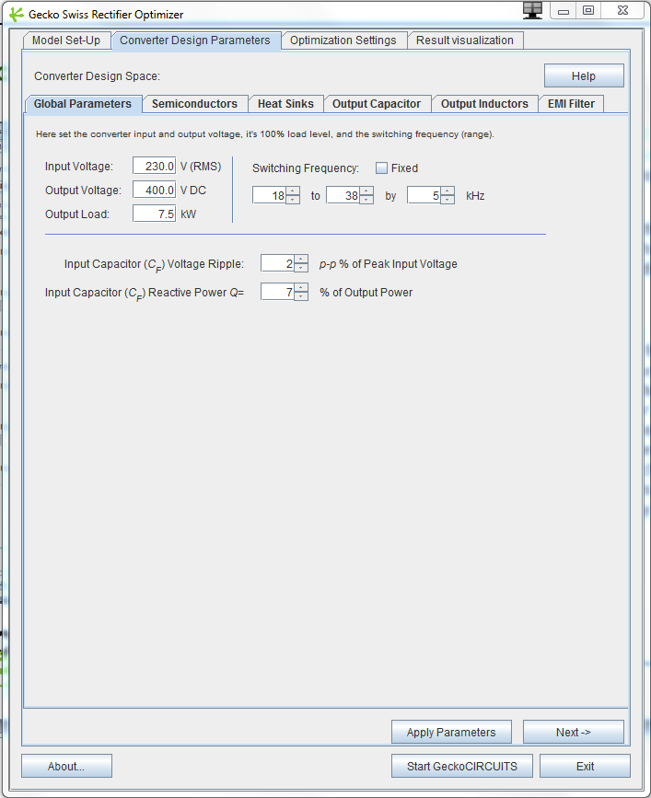
Specifying the Design Space
► In the next tab (Converter Design
Parameters), you are then
guided, step-by-step, to define
the design space of the converter
► Some parameters are fixed for
each optimization (e.g. input
voltage, output load, etc.)
► Most parameters (e.g. switching
frequency) are variable, and you
can specify a range, the
increment for that range (e.g.
frequencies from 18 to 50 kHz in
increments of 2 kHz), or fix
those parameters to one value

Slide 6
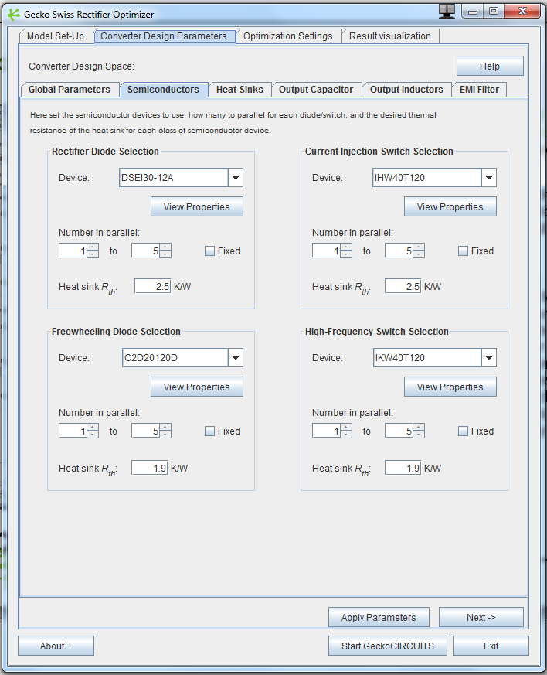
Specifying the Design Space – Semiconductors
► You can select from a list of
available diodes or switches, for
each class of semiconductor device
in the rectifier
► The variable parameter is the number
of devices used in parallel to
implement each switch or diode
(increment is by 1)
► You must specify a thermal
resistance of the heat sink for each
device. Note: this is the thermal
resistance of the “piece of heat
sink” under each particular device,
i.e. if there are 5 switches in
parallel, it is the thermal resistance
under each of the five switches (so
the total underneath all 5 is the
single resistance divided by 5)

Slide 7
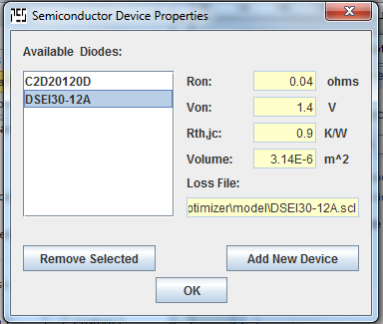
Specifying the Design Space – Semiconductors
► You must give a reasonable thermal resistance value, otherwise temperatures (and losses) will be unrealistically high or
unrealistically low
► By clicking on “View Properties”, the detailed properties of the selected semiconductor are shown – here you can examine all the devices available by default and
compare their basic properties, and
add new devices of your own
► NOTE: newly added devices are not saved to disk (when you close the
program, they disappear)
► Each device MUST have a GeckoCIRCUITS loss file (.scl)

Slide 8
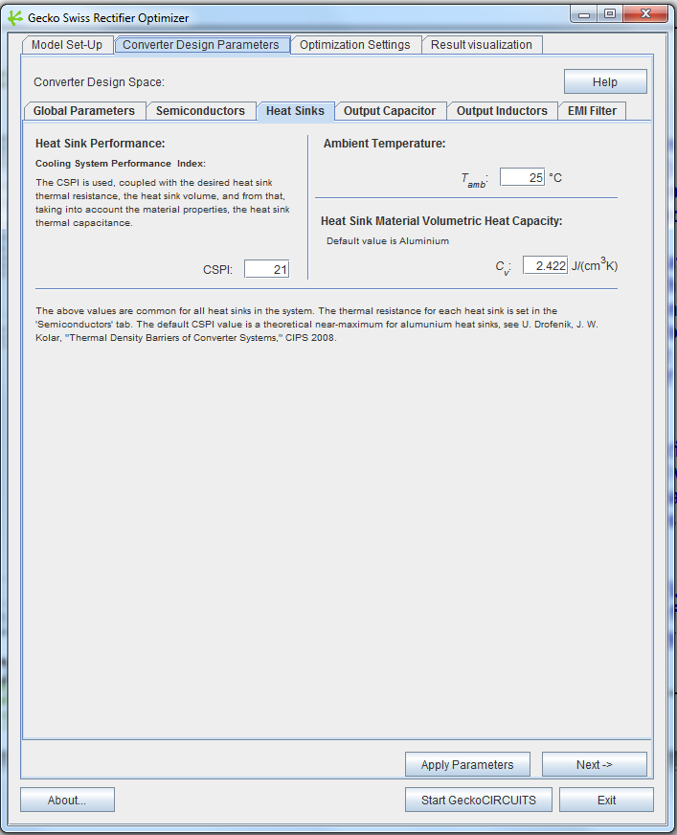
Specifying the Design Space – Heat Sinks
► For the heat sink, a cooling system performance index (CSPI) and a volumetric heat capacity of the material must be specified
► The CSPI is used to calculate the heat sink volume using the specified thermal resistances from the previous tab – therefore, a different (separate) heat sink is assumed for each class of semiconductors
► The volumetric heat capacity is then used with this calculated volume to calculate the thermal capacitance of the heat sink (which goes into the simulation model)
► Fans are not considered (i.e. their losses), the effect of the fan is assumed accounted for by the CSPI

Slide 9
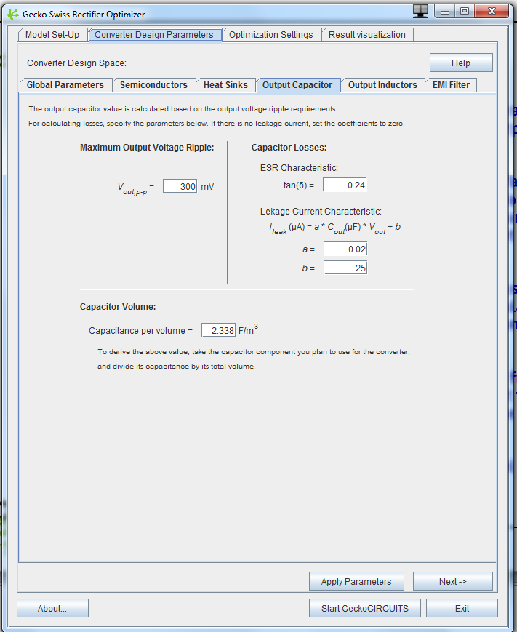
Specifying the Design Space – Output Capacitor
► Here a very important parameter is specified – maximum output voltage ripple
► Furthermore a tan-delta factor can be specified for conduction losses, and a simple (not really universal) model for leakage current losses is also specifiable
► A volumetric constant must be supplied in order to calculate the volume once the capacitance is calculated
► Capacitance is calculated from the
voltage and current ripple
specification

Slide 10
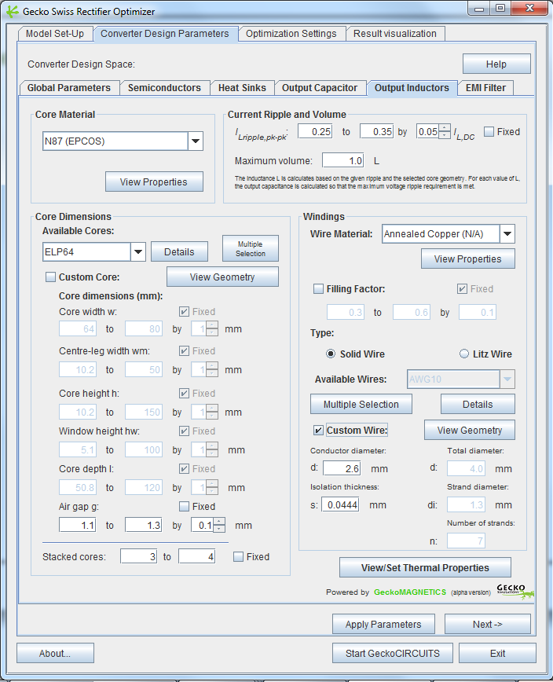
Specifying the Design Space – Output Inductors
► The most different parameters to set are for the output inductor design
► Here you can select a core material –
several are offered – this choice is a
fixed parameter
► The main parameter for inductor design is the current ripple – this can be specified as a range, and in turn determines the required inductance L
► A maximum allowed volume must also be specified

Slide 11
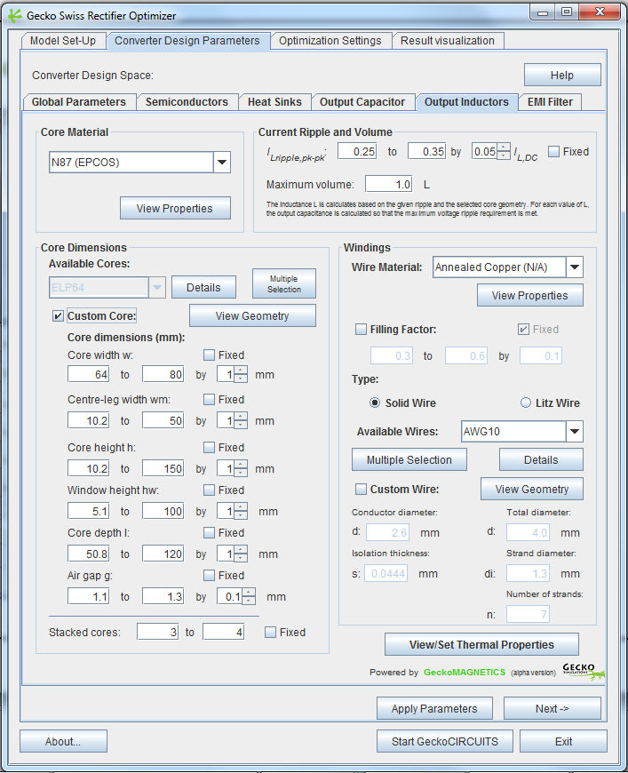
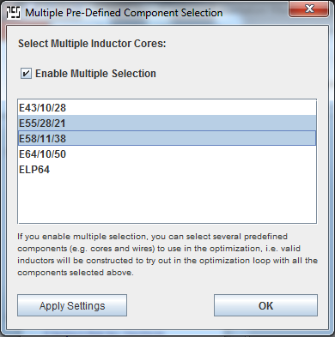
Specifying the Design Space – Output Inductors
► Cores: Only EE-Cores with
three air gaps are available
► You can select a predefined core from
the drop-down list, or define a custom
core by defining a value range for
each core dimension parameter
► Besides setting ranges for a custom EE-Core geometry, you can also do a multiple selection of predefined cores, so that the program tries out all of them
► Whether using predefined cores or a custom core, you must define the air
gap range and the number of stacked
cores (also variable)

Slide 12
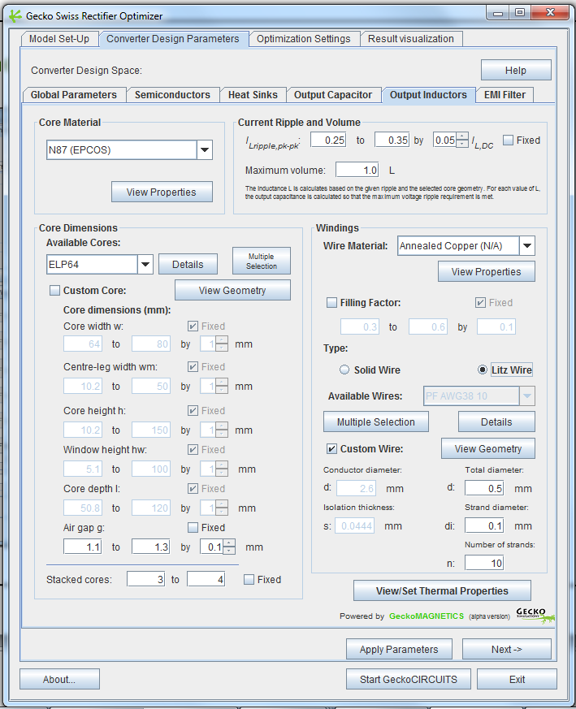
Specifying the Design Space – Output Inductors
► Windings: you can select solid round
or litz wire (but not both at the same time)
► One fixed winding material (several predefined available)
► Like with cores, you can select one or
multiple pre-defined windings
► However, if you choose a custom wire, the parameters are fixed – no range can be defined, and only that single wire is used during the entire optimization process

Slide 13
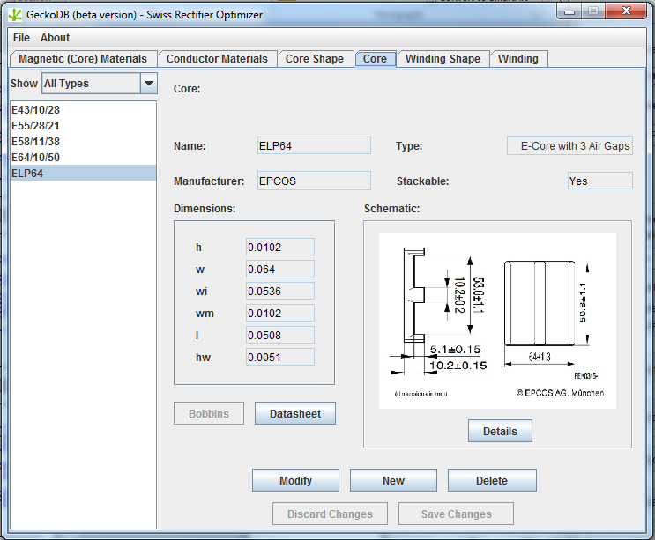
Specifying the Design Space – Output Inductors
► Whenever you click on a “View Geometry” or “View Properties”
button, the magnetic component
database - GeckoDB - opens up
► Here you can define your own core and
wire sizes and core materials – any
changes or additions to make are
saved to disk and are available next
time you start the program

Slide 14
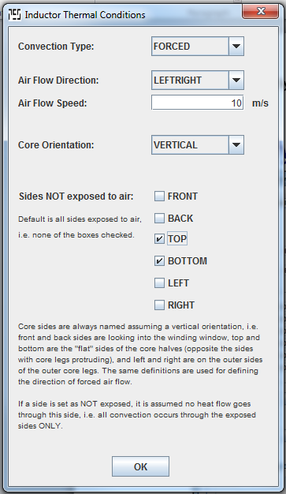
Specifying the Design Space – Output Inductors
► The thermal properties are set in a separate window by clicking on the lower-right button
► You can select the type of convection (natural or forced – and if forced, at which air speed and in which direction of airflow), the orientation of the core with respect to gravity, and which of the sides are exposed to air flow
► Thermal model is only stationary (resistances, no capacitances)
► Sides not exposed to air are assumed to transfer no heat
► Volume or losses of the fan blowing if forced convection is selected are not taken into account at this point

Slide 15
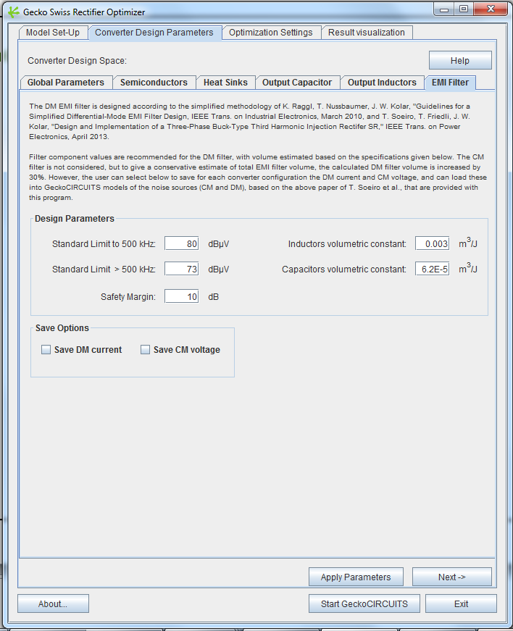
Specifying the Design Space – EMI Filter
► For the EMI filter, you can specify the limits of the standard being used, the safety margin for the attenuation, and the volumetric constants of the inductors and capacitors that are to be used for the filter
► After a converter is optimized at a certain
switching frequency, from simulation data of
the differential mode current the required
attenuation is calculated
► From this attenuation, a two-stage LC input DM EMI filter is calculated, with the volume calculated based on the volumetric
constants
► CM filter is not calculated; volume of DM filter is increased by 30% to approximate the effect of the CM filter on total volume
► DM filter LC values (1st and 2nd stage) are
given in the Output Window and in the output
file at the end of the optimization

Slide 16
Specifying the Design Space – EMI Filter
► To perform a detailed optimization of the
EMI filter for a particular efficiency optimized
converter design, including all losses and the
CM filter design, select the options to save
the DM current and CM voltage
► Then load these saved waveforms into the
Swiss Rectifier CM and DM noise models
supplied with this program and load them
into the Gecko Three-Phase EMI Filter
Optimizer

Slide 17
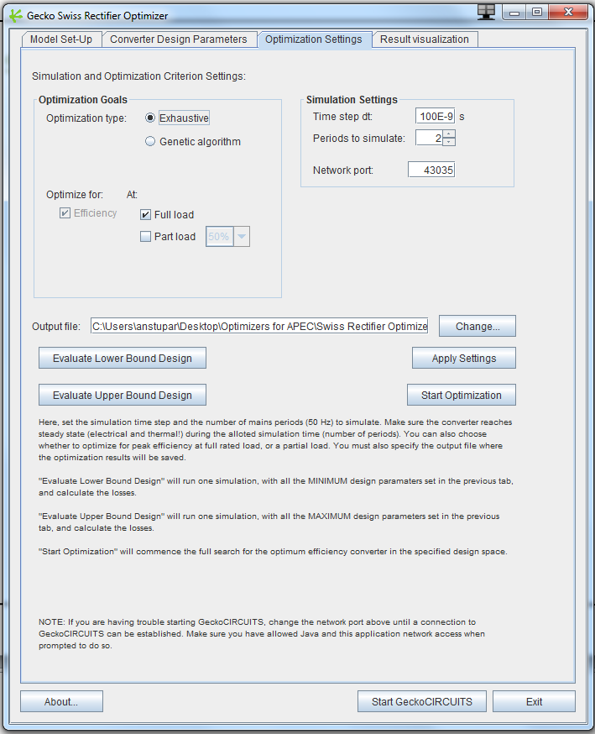
Optimization Settings
► Here you must specify:
The output file to which the optimization results will be written
Simulation settings: the time-step and the number of periods to simulate (make sure the circuit is in steady-state in the last simulated period)
Whether to optimize for full or partial output load
Optimization algorithm: exhaustive (brute-force) or genetic
The usage of the genetic algorithm is recommended for large design spaces

Slide 18
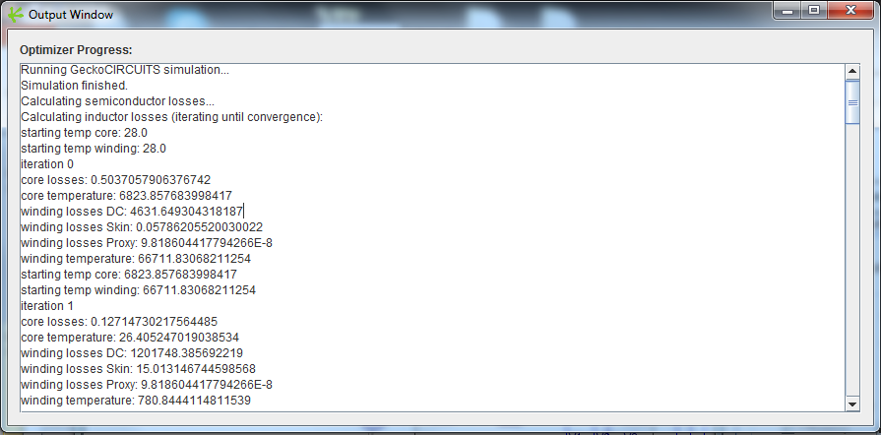
Optimization Settings
► “Evaluate Upper/Lower Bound Design” runs one simulation, and gives the breakdowns of the losses and volume – the upper bound takes all the maximum defined values of the variable parameters, and the lower bound all the minimum defined values of those parameters
► “Start Optimization” will start the full
optimization and open the Output Window
in which you can monitor the Optimizer’s
progress

Slide 19
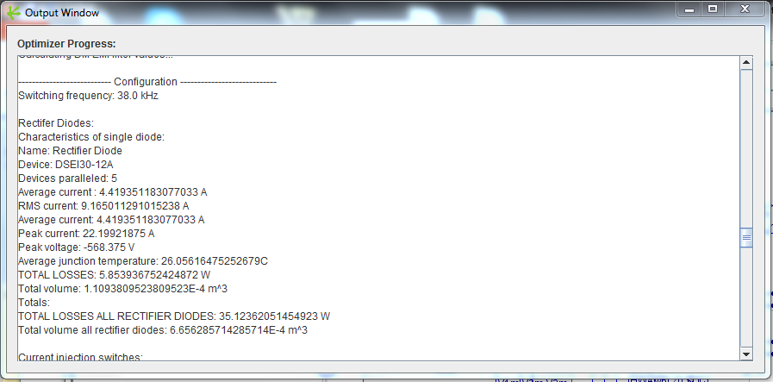
Optimization Results
► At the end, for each switching frequency, the
maximum efficiency design is specified in the
Output Window
► Given are all the component values, which
components to use and how many (how
many diodes and switches to place in
parallel, how many cores of which size, turns
of which wire, etc).
► The same information is written to the output
file you have previously specified

Slide 20
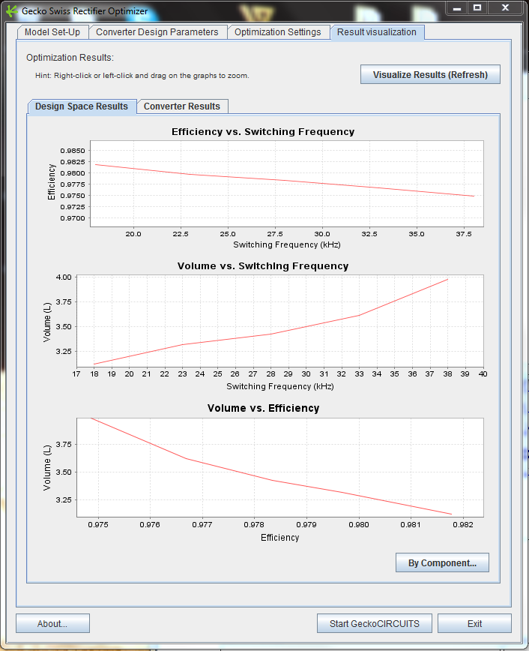
Visualization of Results – Design Space
► When the optimization finishes, click
“Visualize Results (Refresh)” in the Result
visualization tab to see plots and graphs of
the resulting designs
► The “Design Space” visualization gives the key characteristics of the efficiency- optimized converters over the switching frequency range
► Clicking “By Component” …

Slide 21
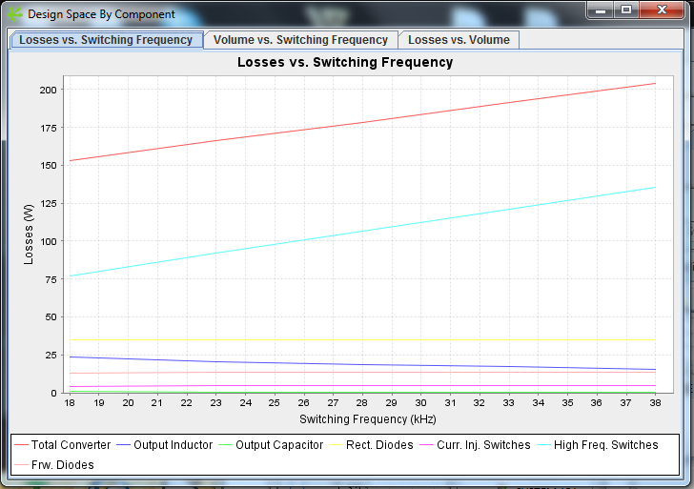
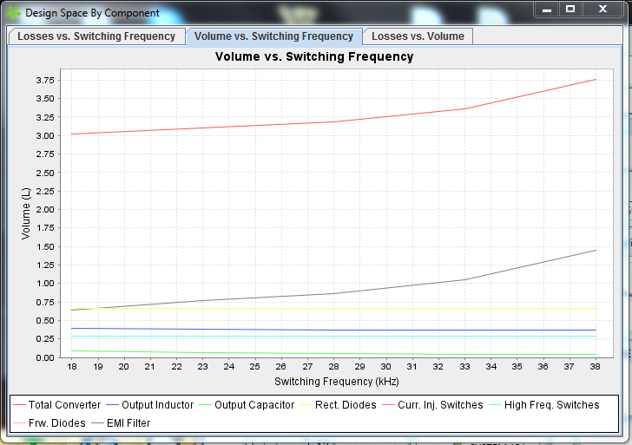
Visualization of Results – Design Space
… will show the same plots, but broken down by component type, so you can see how the design of e.g. the inductor moves over frequency

Slide 22

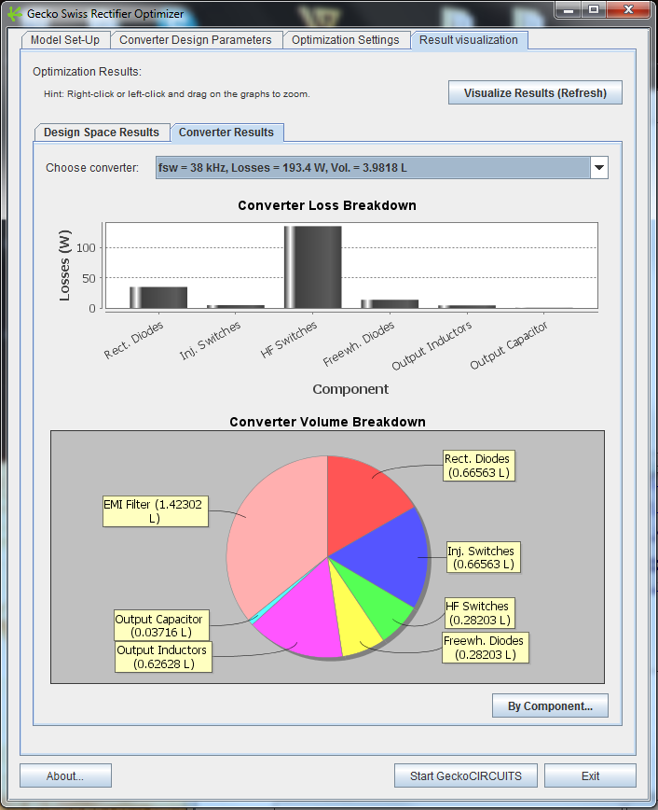
Visualization of Results – Converter Results
► The “Converter Results” visualization gives loss and volume breakdown by component for the optimum-efficiency converter at each frequency

Slide 23
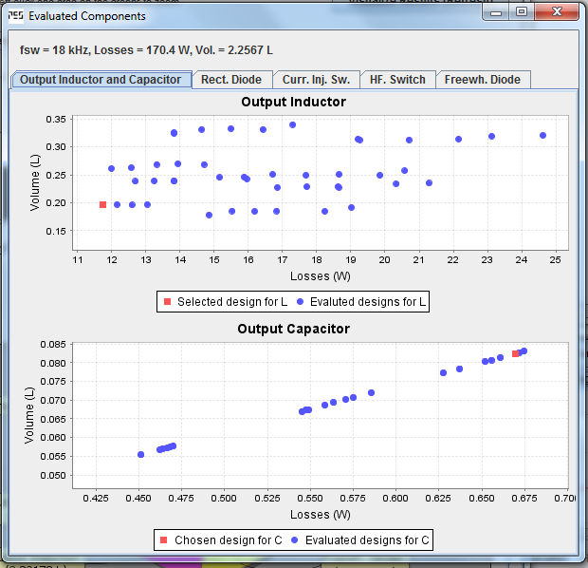
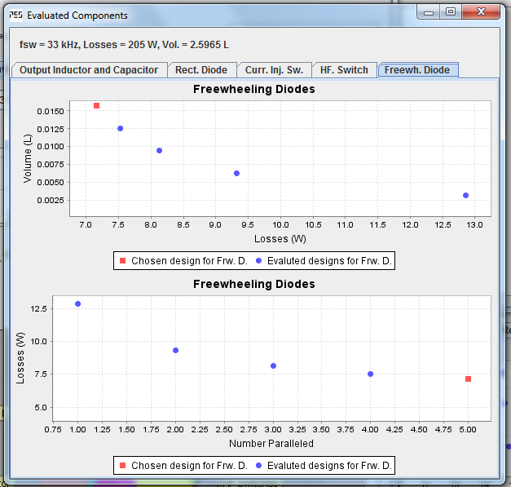
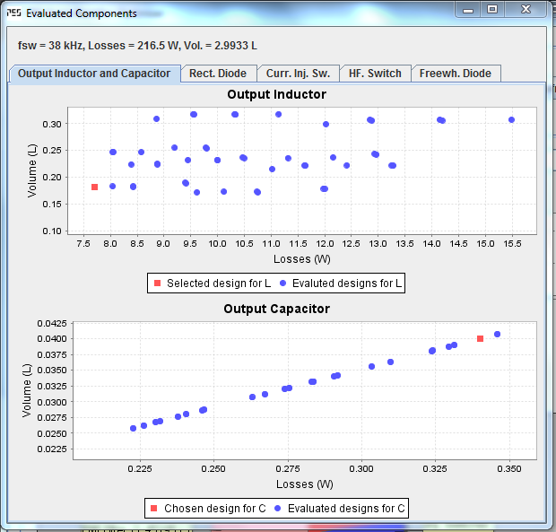
Visualization of Results – Converter Results
► Clicking “By Component” gives, for that switching frequency, all the designs evaluated for a particular component (e.g. all inductors simulated) in a loss vs. volume plot, and shows also the selected (optimum) design

Slide 24
Gecko-Simulations AG
Physikstrasse 3, 8092 Zurich,
Switzerland
contact@gecko-simulations.com

