Slide 1
Workflow Coordination with Security Features
Brandon Lange - B00688070
Sarah Redmond - B00636646
Yaser Alkayale – B00

Slide 2
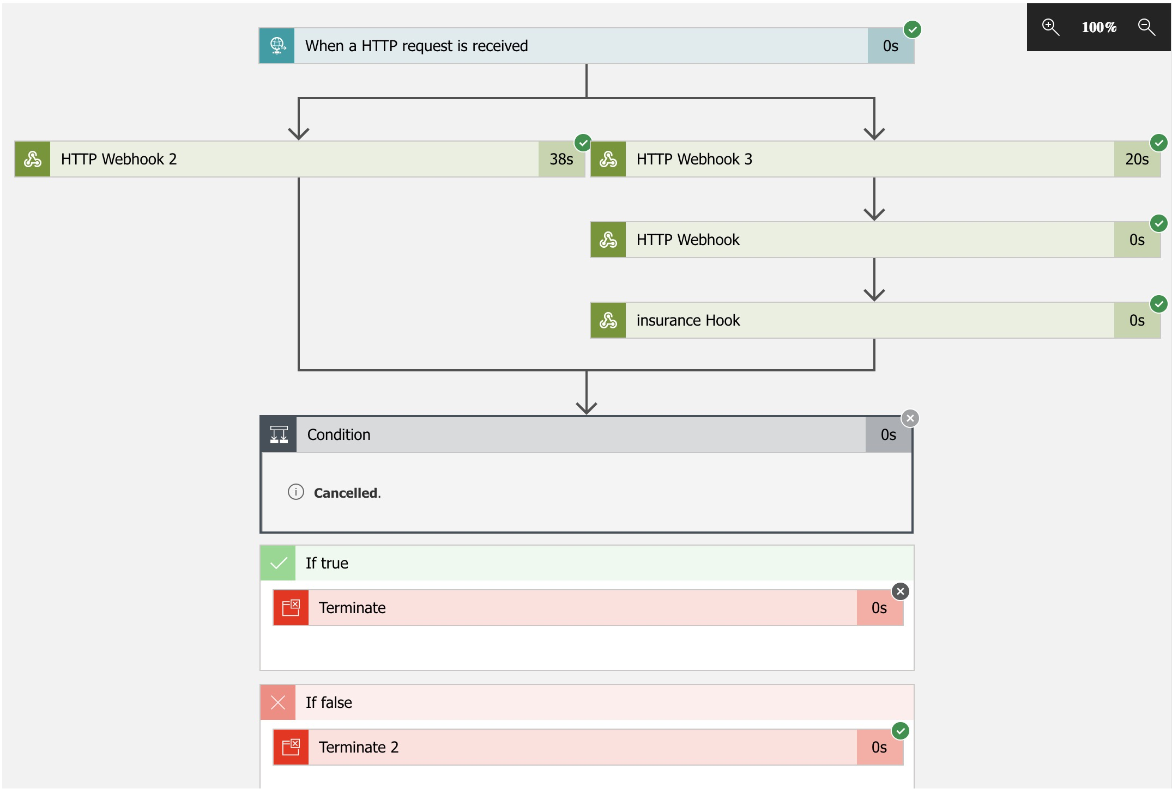

Slide 3
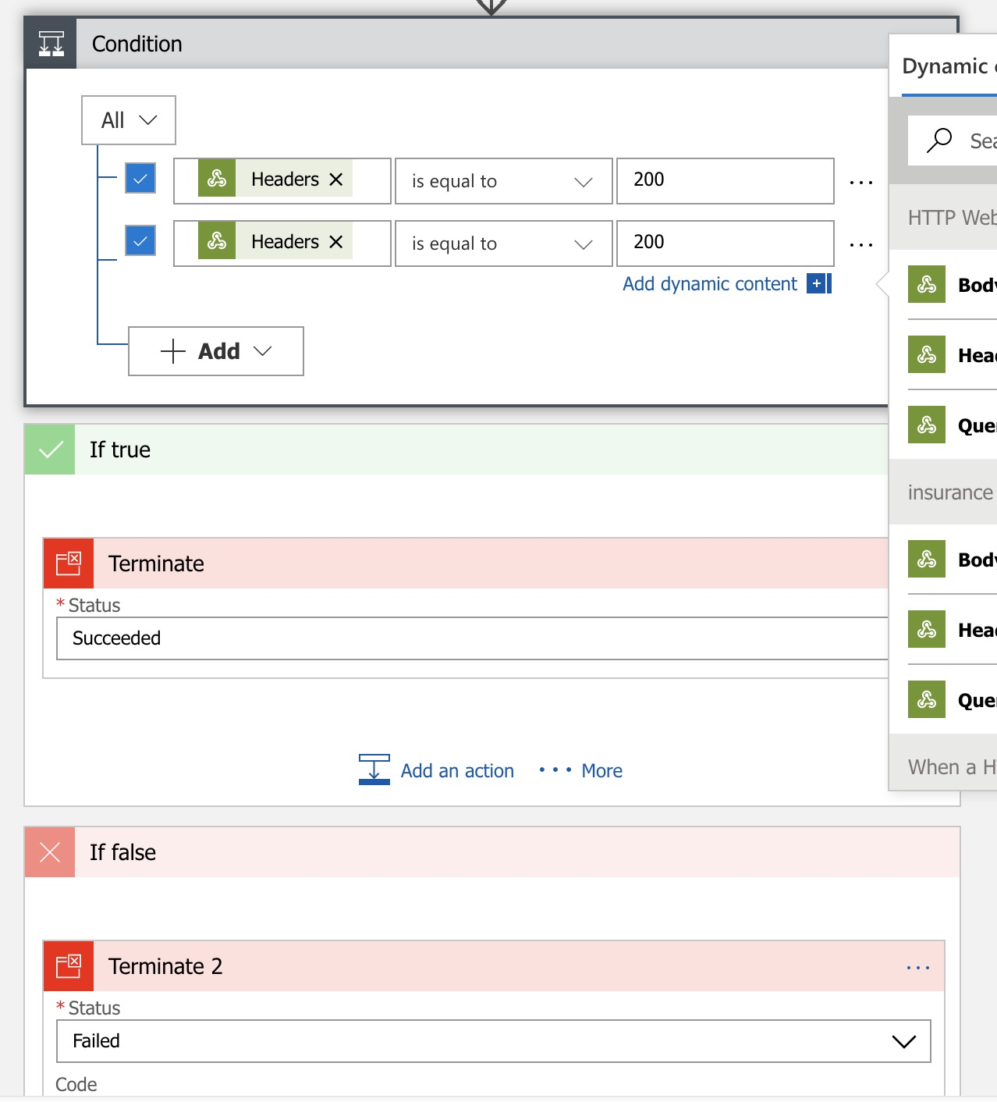

Slide 4
