Slide 1
How to avoid turning your data lake into a data swamp
Leonardo Trevizo Herrera
July 25th, 2025.

Slide 2
Lightning Talk #2 Delta Lake → Databricks

Slide 3
Agenda
The challenges of traditional data lakes ………………………. 4
What is Delta Lake? ……………………………………………………. 5
How Delta Lake improves architecture ………………………… 6
Key features: Merge, time travel, schema enforcement … 7
Working together with Unity Catalog ………………………….. 10
Wrap-up and takeaways……………………………………………… 11

Slide 4
The reality of raw data lakes
What problems data lakes have?
No transactions or consistency guarantees
Difficult to update or delete data safely
Schema evolution is manual and error-prone
No easy way to track versions or recover from mistakes

Slide 5



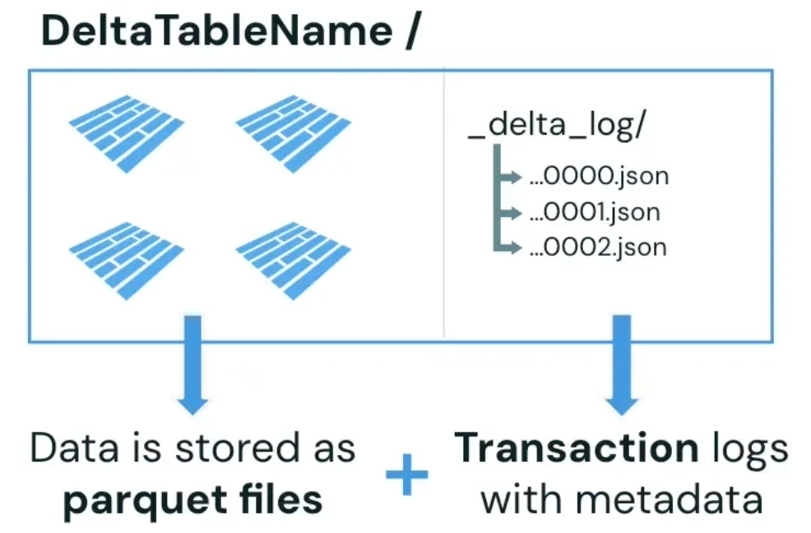

What is Delta Lake
What can I achieve?
A storage layer that adds transactions, versioning, schema enforcement, and performance optimizations to your existing data lake.
Transactions
Versioning
Schema Enforcement
Performance Optimization

Slide 6
What is Delta Lake
Where does Delta Lake sit?
Main Idea | Characteristics | Example
Structured storage for analysis | High performance Strong ACID Expensive Schema-on-write | Snowflake Amazon Redshift
Raw data storage at scale | Limited transactions Lacks governance Low cost Schema-on-read | Amazon S3 Azure Data Lake
Storage layer on top of Data Lake. Enhances cloud storage with reliable reads & writes. | Versioning Schema enforcement ACID transactions | Databricks Delta Lake
Reinforce Data Lake architecture with Data Warehouse characteristics via Delta Lakes | Strong ACID Versioning control Less expensive Raw data storage | Databricks Lakehouse Platform
Data Warehouse
Data Lake
Delta Lake
Data Lakehouse

Slide 7
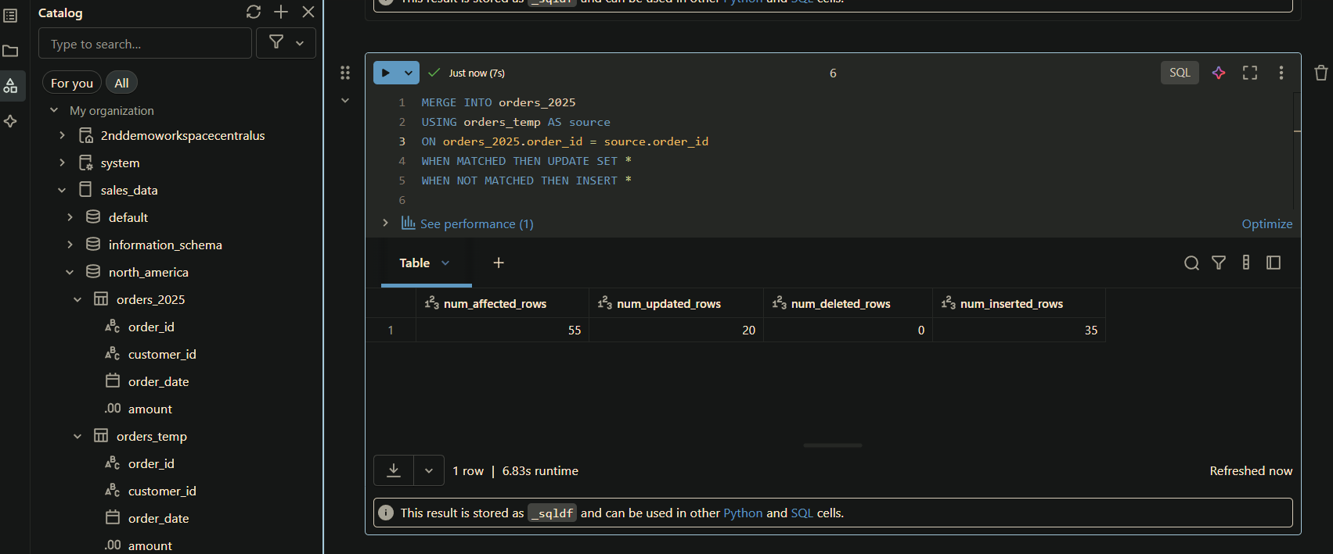
How a data engineer uses Delta Lake features
First, we add some new information

Slide 8
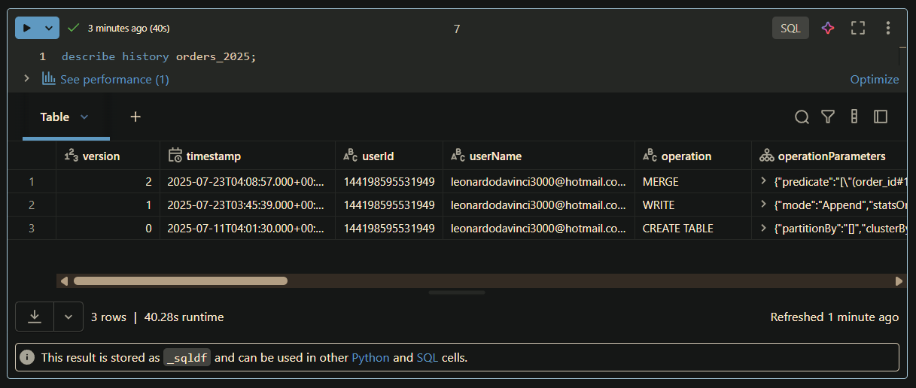
How a data engineer uses Delta Lake features
Then we have the describe commands

Slide 9
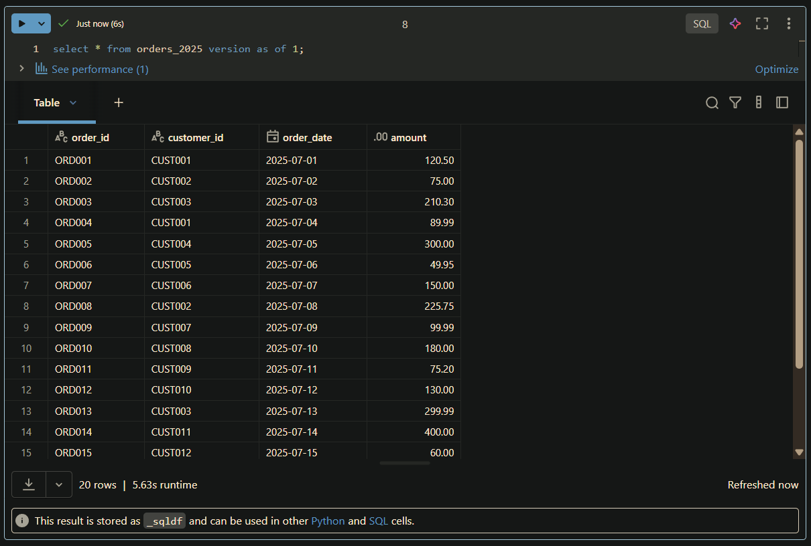
How a data engineer uses Delta Lake features
Then we have the versioning

Slide 10
Real benefits for data engineers
Why it matters? What can It do for us?
Reliable tables for downstream consumers
No more costly “overwrite” jobs
Auditable, reproducible datasets
Easier collaboration across teams

Slide 11









