Slide 1
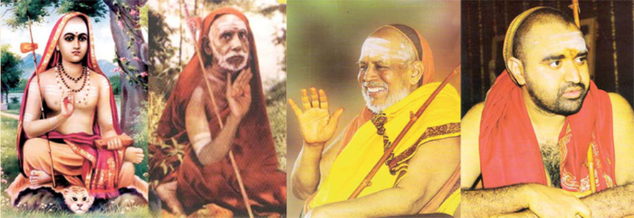
THE NORTH ARCOT DISTRICT
Global Network for North Arcot District, India

