Slide 1

SCHOLAR ZONE
- Dream to Reality

Slide 2

Current System :
Visit Different Websites.
Apply in each and every website.
Wait to know whether you will get one or not.

Slide 3

Proposed System :
One Place for all types of scholarships.
One time registration and application.
Get the prediction immediately.

Slide 4
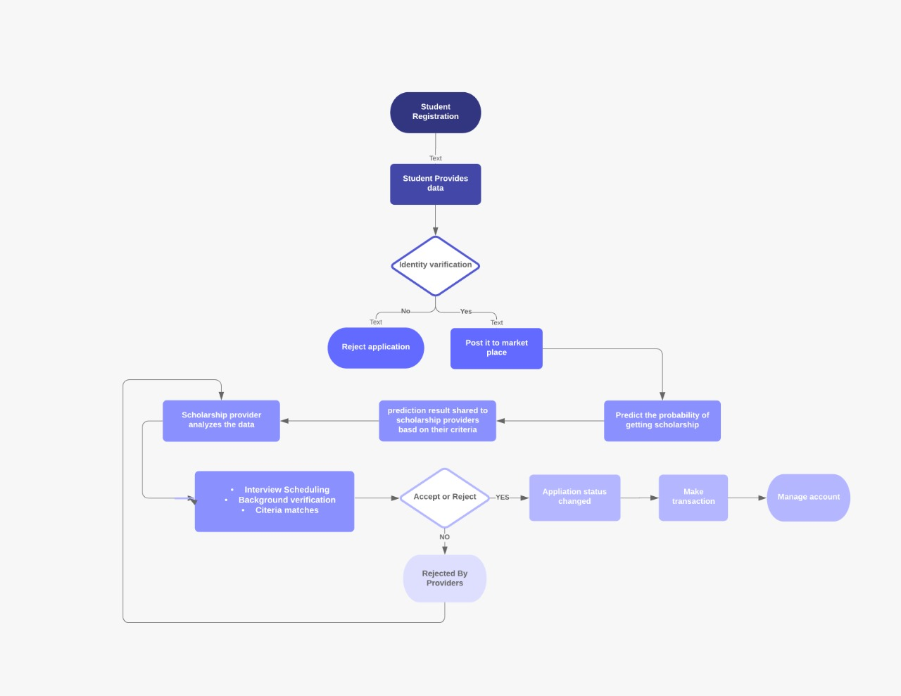
How it Works?

Slide 5

Any Questions?

