Slide 1
Password Locker
Your passwords , our Security

Slide 2
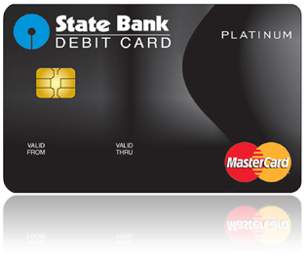








Have Many Accounts ? How to remember the passwords?

Slide 3
Here Is the Solution ?
Account 1
Account 2
Account 3
Account 4
Account n
ADD
EDIT
Password Locker
Passwords
DELETE
SHOW
UPLOAD

Slide 4
Functions of this App :
1) ADD record
2) Show record
2) Delete record
3) Edit Record
4) Upload Record

Slide 5
Adding new record
In this app we can add new records with service name ,user name , password.
Ex :
Service Name : Amazon.com
Username : arunkenjila111@gmail.com
Password : ************
So here service name acts as primary key , which is unique for each records .
If you have multiple gmail accounts then you can use service name as gmail1 or gmail2 etc.

Slide 6
Show records
Using this app user can see all his inserted records.
We can also search for record using its service name and see its username and passwords.

Slide 7
Editing Exist Record
This app also provides user to modify the contents of inserted records
You can modify username or passwords as per your need
But you cant modify service name , because it is primary key

Slide 8
Deleting exist Record
Sometimes we delete our accounts in real time or may be our account get deactivated .
So in this time if we don’t have any use from these account we can delete here by single click.

Slide 9
Upload Records
Our app provides the uploading records facility with google drive.
For this user must have google drive account.
This will actually convert all the records into text file and upload it to google drive with date and time.
So your password will be safe in your google drive account.

Slide 10
Conclusion :
Writing passwords in notepad or notebook and saving them it’s not so handy.
So this app reduces the paper work as well as laptop work.
Very easy to maintain all the passwords.
Nowadays everyone having multiple accounts , this app targets people almost every age.
Uploading passwords to google drive provides more security.

