Slide 1
Requirements Verification and Validation
Module 4

Slide 2
Agenda
Verification & Validation Overview
Integration Techniques

Slide 3
V&V Applicability
V&V is typically applied to
Requirements
Entities that result from the requirements (component, sub-system, system)

Slide 4
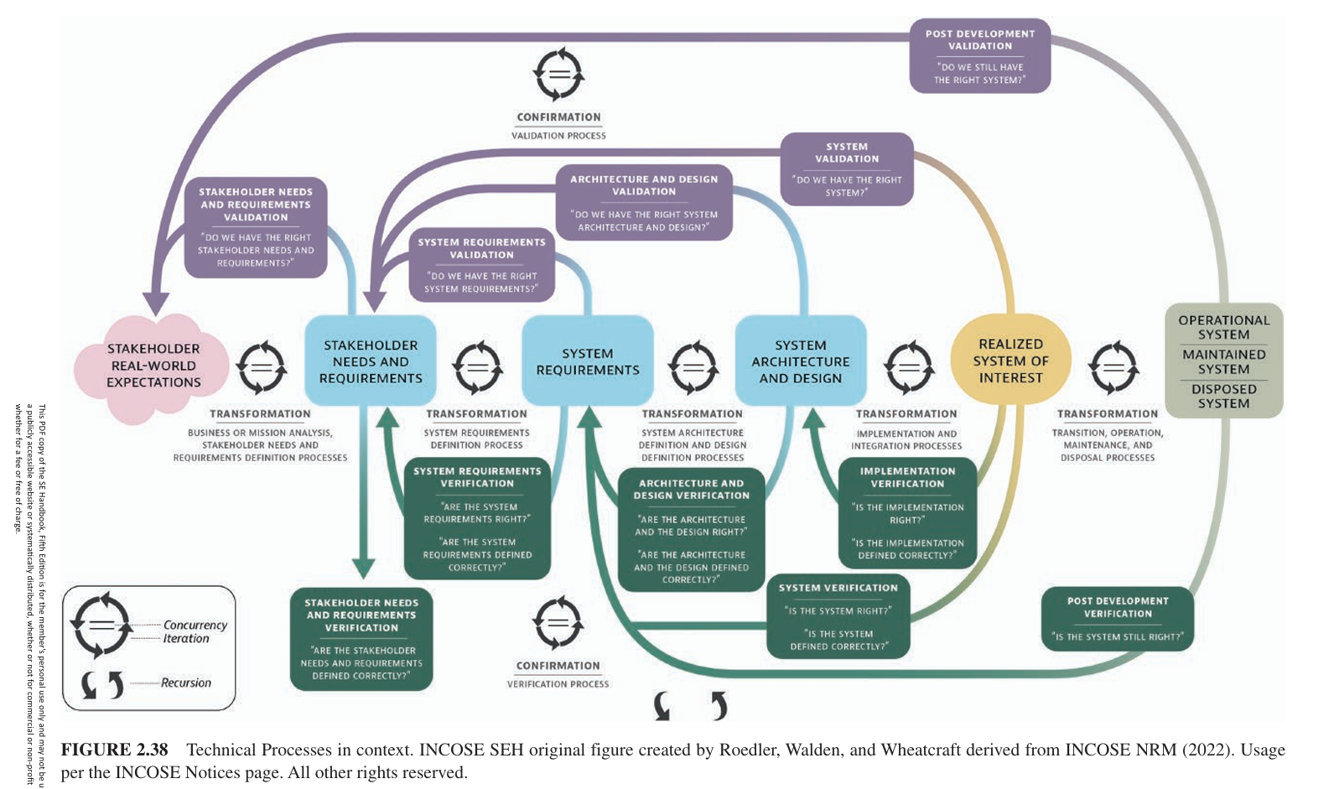

Slide 5
V&V of Requirements
Verification of Requirement
Involves verifying that the statements and sets of statements have the characteristics of well-formed requirements statements resulting from following requirements writing rules
Validation of Requirement
Determines whether the requirement statement clearly communicates the intent of the need or parent requirement from which it was derived or transformed

Slide 6
V&V of the Entity
Verification of the Entity
Results in collected evidence that can be used to prove that the entity is being/has been “formed” in the right way as defined by the set of system requirements with the required level of confidence
Validation of the Entity
Results in collected evidence to be used for the acceptance, certification, and qualification of the SOI that proves the right “entity” is being/has been “formed” as defined by the set of stakeholder requirement with the required level of confidence

Slide 7
System Integration

Slide 8
System Integration
System integration consists of a process that “iteratively combines implemented system elements to form complete or partial system configurations in order to build a product or service. It is used recursively for successive levels of the system hierarchy.” (ISO/IEC 15288)
https://www.sebokwiki.org/wiki/System_Integration

Slide 9
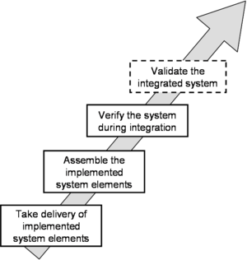
Boundary of Integration Activities
SEBOK wiki

Slide 10
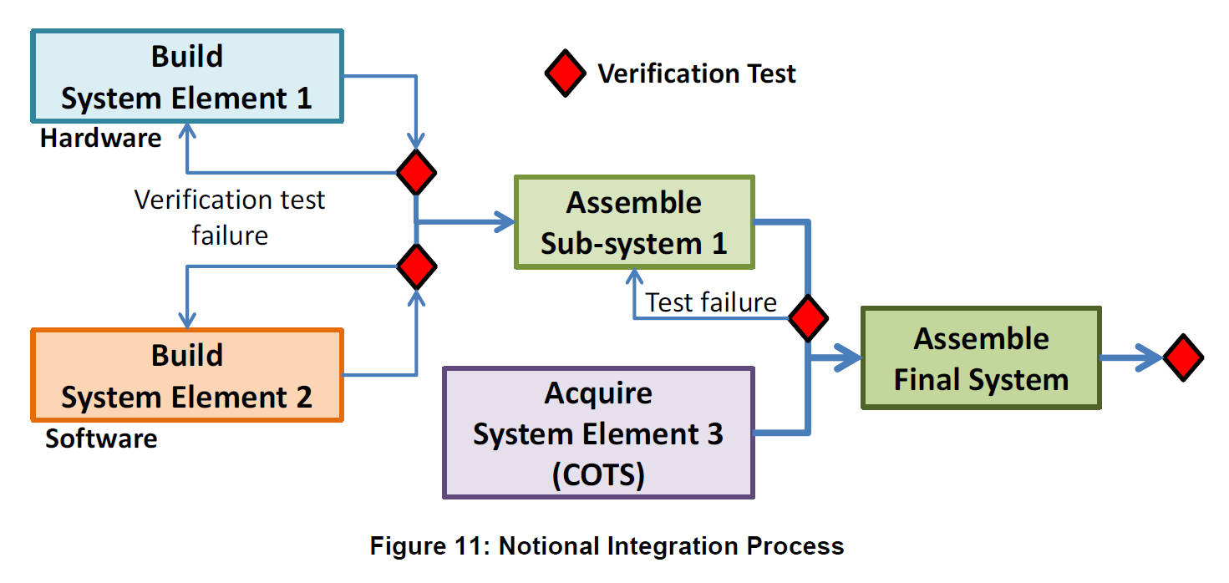
Integration Process
Source: FAA SE Manual

Slide 11
Integration Strategies
Integration Technique | Description
Global Integration | Also known as big-bang integration; all the delivered implemented elements are assembled in only one step.This technique is simple and does not require simulating the implemented elements not being available at that time. Difficult to detect and localize faults; interface faults are detected late. Should be reserved for simple systems, with few interactions and few implemented elements without technological risks.
Integration "with the Stream" | The delivered implemented elements are assembled as they become available. Allows starting the integration quickly. Complex to implement because of the necessity to simulate the implemented elements not yet available. Impossible to control the end-to-end "functional chains"; consequently, global tests are postponed very late in the schedule. Should be reserved for well-known and controlled systems without technological risks.
Incremental Integration | In a predefined order, either one or a very few implemented elements are added to an already integrated increment of implemented elements. Fast localization of faults: a new fault is usually localized in lately integrated implemented elements or dependent of a faulty interface. Require simulators for absent implemented elements. Require many test cases, as each implemented element addition requires the verification of the new configuration and regression testing. Applicable to any type of architecture.

Slide 12
Integration Strategies
Integration Technique | Description
Subsets Integration | Implemented elements are assembled by subsets, and then subsets are assembled together (a subset is an aggregate); could also be called "functional chains integration". Time saving due to parallel integration of subsets; delivery of partial products is possible. Requires less means and fewer test cases than integration by increments. Subsets shall be defined during the design. Applicable to architectures composed of sub-systems.
Top-Down Integration | Implemented elements or aggregates are integrated in their activation or utilization order. Availability of a skeleton and early detection of architectural faults, definition of test cases close to reality, and the re-use of test data sets possible. Many stubs/caps need to be created; difficult to define test cases of the leaf-implemented elements (lowest level). Mainly used in software domain. Start from the implemented element of higher level; implemented elements of lower level are added until leaf-implemented elements.

Slide 13
Integration Strategies
Integration Technique | Description
Bottom-Up Integration | Implemented elements or aggregates are integrated in the opposite order of their activation or utilization. Easy definition of test cases; early detection of faults (usually localized in the leaf-implemented elements); reduce the number of simulators to be used. An aggregate can be a sub-system. Test cases shall be redefined for each step, drivers are difficult to define and realize, implemented elements of lower levels are "over-tested", and does not allow architectural faults to be quickly detected. Mainly used in software domain, but can be used in any kind of system.
Criterion Driven Integration | The most critical implemented elements compared to the selected criterion are first integrated (dependability, complexity, technological innovation, etc.). Criteria are generally related to risks.Allows early and intensive testing of critical implemented elements; early verification of design choices. Test cases and test data sets are difficult to define.

Slide 14
How do these strategies inform/influence activities on Left Side of Vee?
Global integration (big-bang integration)
Integration with the stream (as elements become available)
Incremental integration (in predefined order)
Subset integration (functional chains integration)
Top-down integration
Bottom-up integration
Criterion-driven integration (based on criticality – usually, risk)
Source: SE Handbook

Slide 15
Exercise 4.1
For your BSD,
Choose an Integration strategy for your system of Interest
Identify some requirements that exist because of integration strategy
Classify the levels as System, HW or SW.

Slide 16
Verification and Validation

Slide 17
What’s what?
Validation
Verification
Proving the system requirements have been met
Did we build the system right? (objective)
Designers and developers perspective & participation
Glass Box / White Box approach
Usually initiated/completed first
Determining to what extent the stakeholder requirements have been met
Did we build the right system? (subjective)
Customer or end-user perspective & participation
Black Box approach
Usually initiated/completed next
Notes:
Can you actually do the conops as you envisioned it? Thats validation
In medical / health care the line is thin.

Slide 18

What failed? Verification or Validation?
Notes:
Used for fun discussion only, not to be published.

Slide 19
Verification Methods
Inspection (Examination against reference)
Analysis (Theoretical proof)
Demonstration (Show functionality)
Test (Controlled environment; special equipment)
Analogy / Similarity (Equivalence)
Simulation (Using “models”)
Sampling (Representation)
Verification Methods
are usually the same as
Validation Methods, but with a different purpose
How do these methods inform/influence activities on Left Side of Vee?

Slide 20
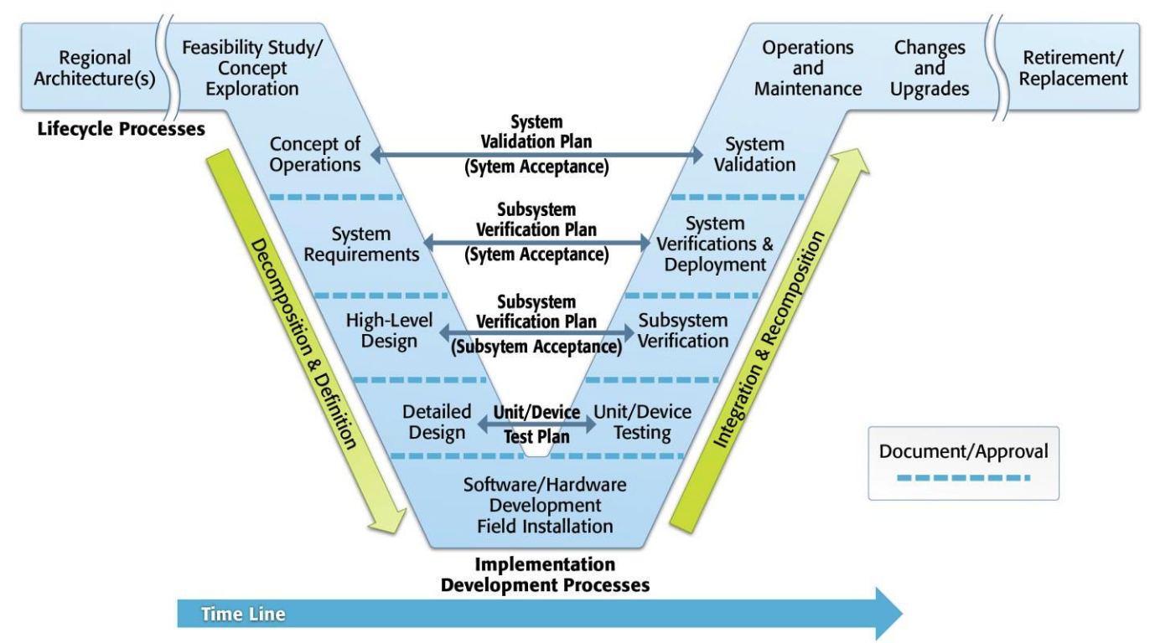
Systems Engineering V
Image source: USDOT

Slide 21
Requirement types and Verification methods
Requirement Types | Requirement type definition | Typical Verification method
Function | What must the system do? | Demonstration Use of system, subsystem, or component operation to show that a requirement can be achieved
Performance | How well must it be done? | Test Use of system, subsystem, or component operation to obtain detailed data to verify performance or to provide sufficient information to verify performance though further analysis
Design Constraint | What design characteristics must be followed or achieved? Typically set by a higher authority for business reasons | Inspection Visual examination
Quality Attributes | How will the users determine the quality of the system, given the other requirements? Usability, maintainability, etc. Specification must include agreement on how it will be measured | Analysis Use of mathematical modeling and analytical techniques to predict the compliance of a design to its requirements based on calculated data or data derived from lower level component or subsystem testing

Slide 22
Exercise 4.2
For your BSD,
Pick a few Software Requirements already identified, and discuss the following:
Item to be Verified
Verification method
Facility / setup (if applicable)
Conducting the Verification (steps to be followed)
Data to be recorded; Analysis to be performed

Slide 23
End of Module

