Slide 1
Building on Ethereum with agents
Shiv Bhonde
BuidlGuidl · @shivbhonde

Slide 2
An agent can scaffold a dapp. Shipping it is still your job.
What that looks like with Scaffold-ETH 2, step by step.

Slide 3
What the agent gets for free
A contract, a deploy script and a frontend in one repo
Typed hooks for every deployed contract
A local chain, a burner wallet and a faucet
A debug page that lists every function it can call

Slide 4
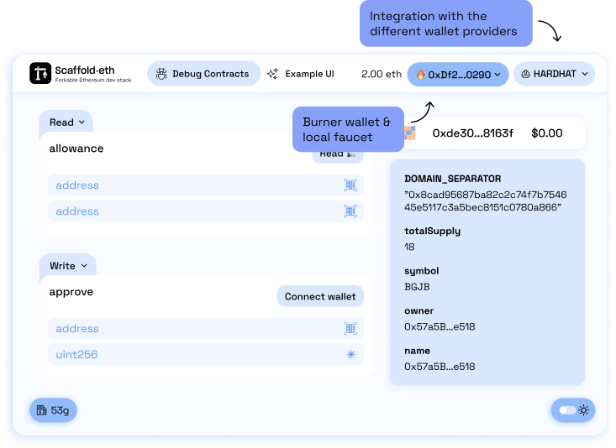
The debug page is the agent's first UI

Slide 5
Three places to start
SpeedRun Ethereum
Scaffold-ETH 2
BuidlGuidl batches
Seven challenges, from a simple NFT to a DEX.
The toolkit for a real dapp, one command away.
Build with a cohort and ship a project together.

Slide 6
Give the agent a contract
Part 2

Slide 7
One command, one repo
terminal
$ npx create-eth@latest
? Your project name: my-dapp
? Solidity framework: hardhat
? Install packages: yes
$ cd my-dapp
$ yarn chain
$ yarn deploy
$ yarn start

Slide 8
“Everything you need to build on Ethereum.”
Scaffold-ETH 2
scaffoldeth.io

Slide 9
From contract to UI in Scaffold-ETH 2
Write the contract
Deploy it
Read and write from React
Solidity, with Hardhat or Foundry
yarn deploy writes deployedContracts.ts
useScaffoldReadContract

Slide 10
Thanks
Shiv Bhonde
@shivbhonde on X and GitHub
buidlguidl.com

Slide 11
Building on Ethereum with agents
Shiv Bhonde, BuidlGuidl
13:15 · Workshop 1

