Slide 1

Presents
Docker

Slide 2
Agenda ( Summarized)

Slide 3
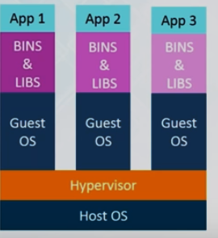
Virtualization
Notes:
Multiple OS on same machine
Easy Maintenance & Recovery
Lower Cost
Disadv : Unstable, Hypervisors not efficient as OS, Long Boot up Time ( 1 minute onwards)
Scaling is costly & tedious ; Resource Utilization n is nit god or anywhere.
A hypervisor is a function which abstracts -- isolates -- operating systems and applications from the underlying computer hardwar

Slide 4
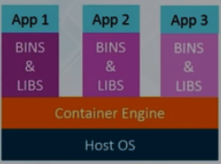
Docker
Notes:
Containers on same host OS Kernel
Better Resource Utilization & boot is fast.
People usex mix, Containerization on top of

Slide 5
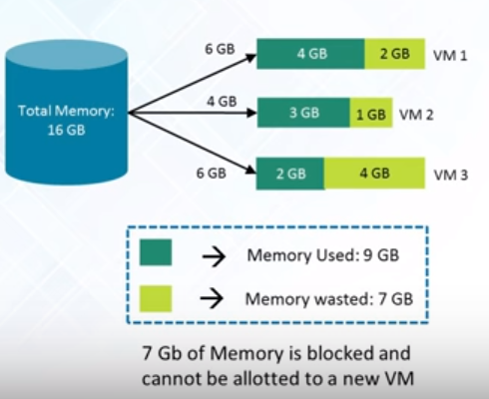
Virtualization – Space Used

Slide 6
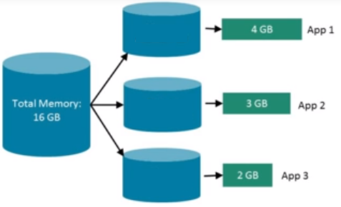
Docker –Space Used

Slide 7
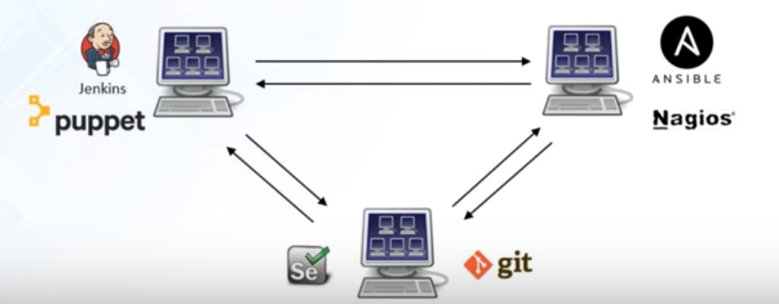
Virtualization - Integration
Notes:
Costly(due to infrastructure requirements) & not scalable

Slide 8
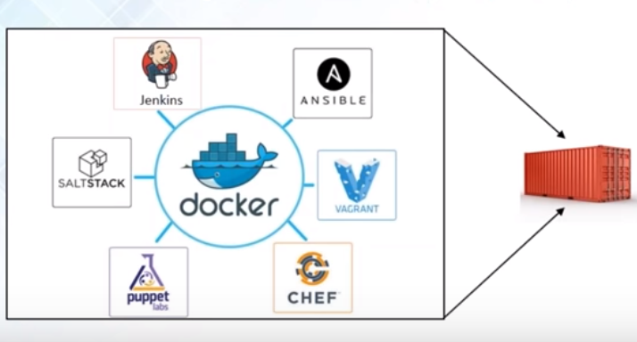
Docker - Integration

Slide 9
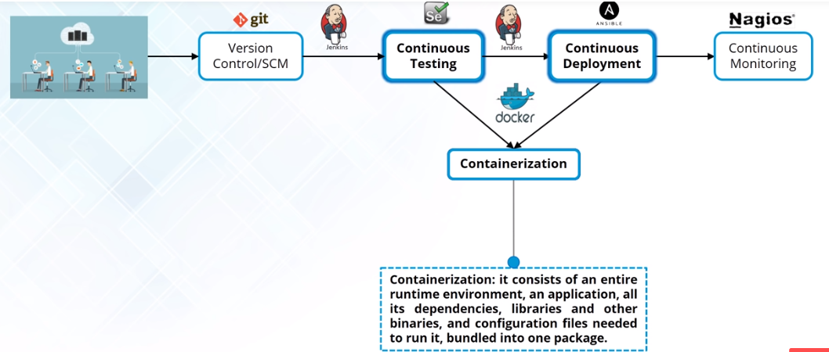
Docker & Devops

Slide 10
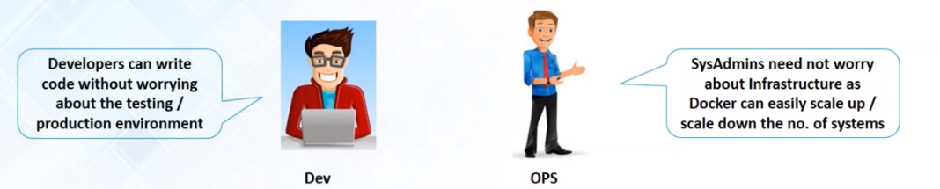
Docker for Everyone

Slide 11
Docker -Introduction
Docker
Open platform for developing, shipping, and running applications
Separation between application & Infrastructure
Manage your Infrastructure as if it is a application
Speed up the Dev to Prod Cycle
Easily clone the environment
Notes:
Run application in isolated environment called a container.
The isolation and security allow you to run many containers simultaneously on a given host.
Containers are lightweight because they don’t need the extra load of a hypervisor, but run directly within the host machine’s kernel.
Hence more multiple containers
Even in host those are virtual machines!
Docker – Containerization platform which packages appln & its dependencies together in form of Containers so app can work & n environment agnostic
Lifecycle Manager of Container:
Develop your application using Docker
Distribute & test application using Docker
Deployment is now Environment agnostic

Slide 12
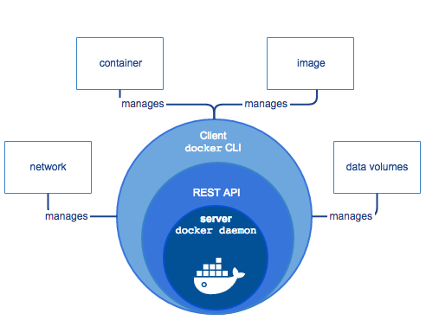
Docker Engine
Notes:
Docker Engine consists of :
Daemon - dockerd
REST Api – Interfaces used by Programs to talk to Daemon & instructing it what to do.
Command line Interface (CLI) – Docker Command
CLI uses Rest API to send commands to daemon through script or direct CLI
Docker manages docker objects – images, containers, networks & Volumes

Slide 13
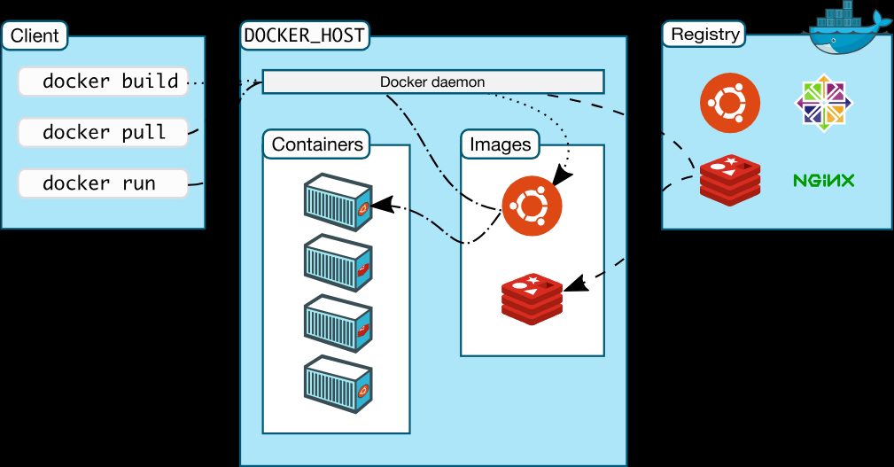
Docker – Architecture
Notes:
Client Server
Docker Client to Docker Daemon
Daemon - building, running, and distributing your Docker containers.
Same System for Docker Client & Daemon or Daemon on Diff Server
Communication between Docker Client & Daemon – Rest API , Unix Socket or network Interface

Slide 14
Docker Architeture
Docker
Docker Daemon
Docker Client
Docker Registries
Notes:
Daemon(dockerd)-> listens for Docker API requests
manages Docker objects such as images, containers, networks, and volumes
communicate with other daemons to manage Docker services
Docket Client(docker) -> You use this to send commands to daemon
Uses Docker API , can communicate to multiple Daemons
Docker Registry - > eg DockerHub , stores Docker images
You can even run your own private registry
Pull for download & Push for checkin

Slide 15
Features of Docker
Fast Delivery of applications
Portable
Lightweight & Fast
Cost Effective
Notes:
Fast Delivery – CI/CD
Ex : Share code with colleagues through docker – push app using Docker and test applications
Fix bugs in Dev , test in Test Envt
Getting fix to Customer is just pushing new Docker Image
local laptop, on physical or virtual machines in a data center, on cloud providers, or in a mixture of environments.
Cost-effective alternative to hypervisor-based virtual machines so that now you can use those resources for something else

Slide 16
Docker – The Technology Inside
Docker Technology
Written in Go
Uses Namespaces to provide isolated workspaces
E.g. PID
Control Groups
UninoFS( Union File Systems)
Container Format
Notes:
Eg of Workspaces : PID, net (network interfaces), ipc ( Interprocess communication), mnt ( file system mount point), uts(isolate kernel & version identifiers
Control Groups - Limit no of resources allocated to Applications
UnionFS – Provide Building Blocks for Containers
namespaces, control groups, and UnionFS to get Container Format

Slide 17
Docker Run – Life Cycle
Docker Run Command Life cycle :
Pull from registry
Creates a new Container
Allocates read-write file system to Container
Connect Container to default network or
Docker Container is started
Executes bin/bash

Slide 18
Why Docker?
Works on my localhost !
Productivity
Team Networking

Slide 19
Features of Docker?
Portable
Scalable
Flexible
Lightweight
Interchangeable
Stackable

Slide 20
Docker for Windows
Docker for Windows installs
Docker Engine
Docker Compose
Docker Machine
Kitematic

Slide 21
Docker
Docker Objects
Images
Containers
Services
Notes:
read-only template with instructions for creating a Docker container.
Often, an image is based on another image, with some additional customization.
For example, you may build an image which is based on the ubuntu image, but installs the Apache web server and your application, as well as the configuration details needed to make your application run.
Create or download from registry.
For creation – create a dockerfile , each statement is a command or instruction , creating a layer in image.
When rebuilding only changed part is rebuilt hence rebuild is also faster
Container – Runnable instance of Image
Scale containers across multiple daemons, Alllows you to define desired state ( how many service replicas)must be available
Service is load balanced so to docker client it looks like a single application.

Slide 22
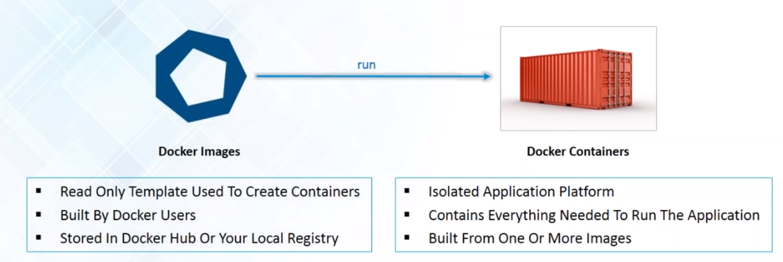
Docker Images & Container

Slide 23
Docker – Getting Started
Correct the Cursor Settings

Slide 24
Hands on
docker ps
docker --version
docker version
docker run hello-world
docker images ls
docker container ls --all

Slide 25
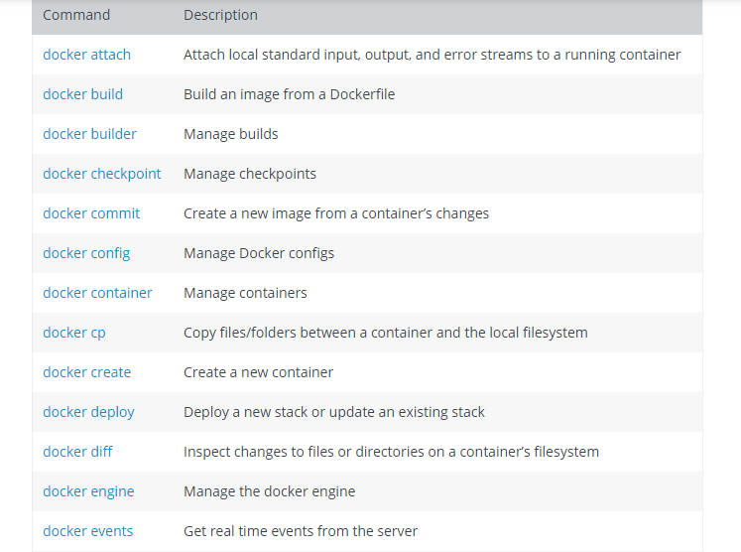
Docker Commands

Slide 26
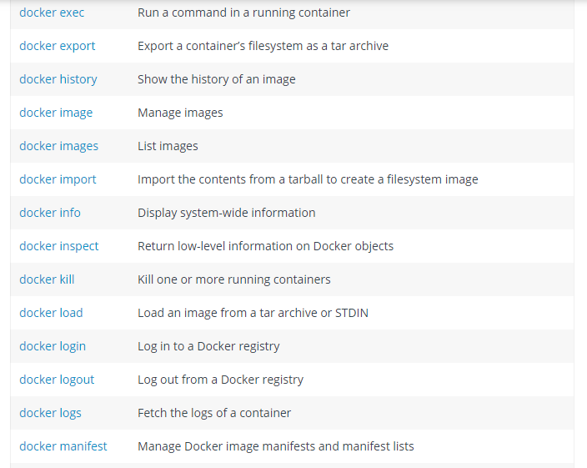

Slide 27
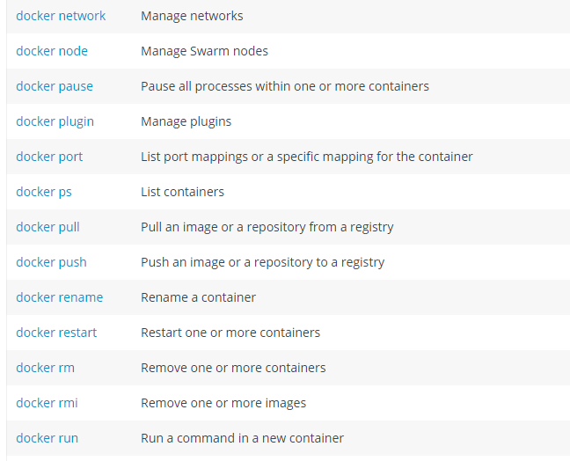
Docker Commands

Slide 28
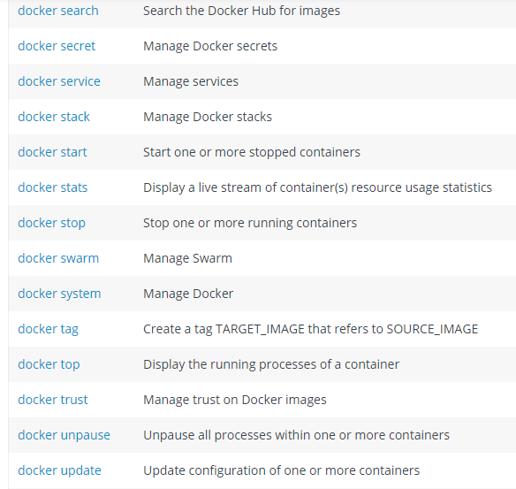
Docker Commands

Slide 29
Dockerfile Commands
The docker build command builds an image from a Dockerfile and a context. The build’s context is the set of files at a specified location PATH or URL. The PATH is a directory on your local file
This example shows a build command that uses the current directory as context:
$ docker build .
Format of Dockerfile
# Comment
INSTRUCTION arguments

Slide 30
Dockerfile -Usage
Usage
docker build -f /path/to/a/Dockerfile .
docker build -t shykes/myapp .
docker build -t shykes/myapp:1.0.2 -t shykes/myapp:latest . (Multiple repositories)

Slide 31
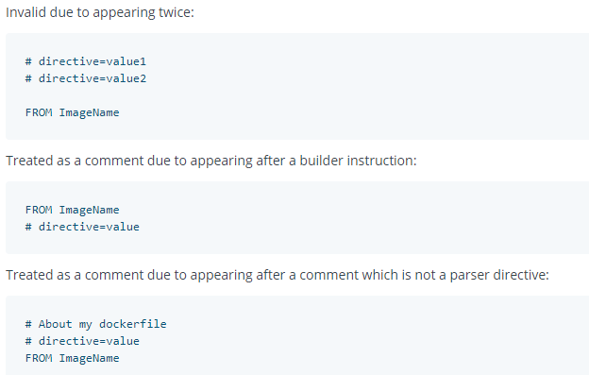
Dockerfile - Parser directives
Format is
# directive=value

Slide 32
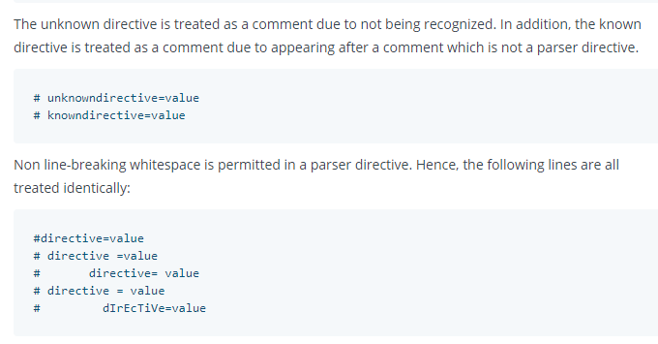
Dockerfile - Parser directives

Slide 33
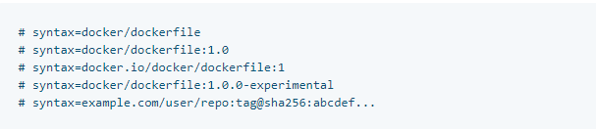
Dockerfile - Parser directives
The escape directive sets the character used to escape characters in a Dockerfile. If not specified, the default escape character is \.
Syntax
escape
The escape directive sets the character used to escape characters in a Dockerfile. If not specified, the default escape character is \.

Slide 34
Dockerfile - Environment Replacement
Environment variables (declared with the ENV statement) can also be used in certain instructions as variables to be interpreted by the Dockerfile. Escapes are also handled for including variable-like syntax into a statement literally.
Environment variables are notated in the Dockerfile either with $variable_name or ${variable_name}

Slide 35
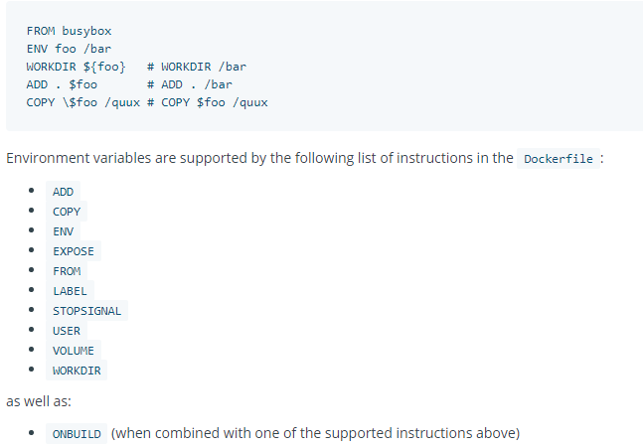
Dockerfile - Environment Replacement

Slide 36
Dockerfile - dockerignore
For Ignoring files or directories
Example :
# comment
*/temp*
*/*/temp*
temp?

Slide 37
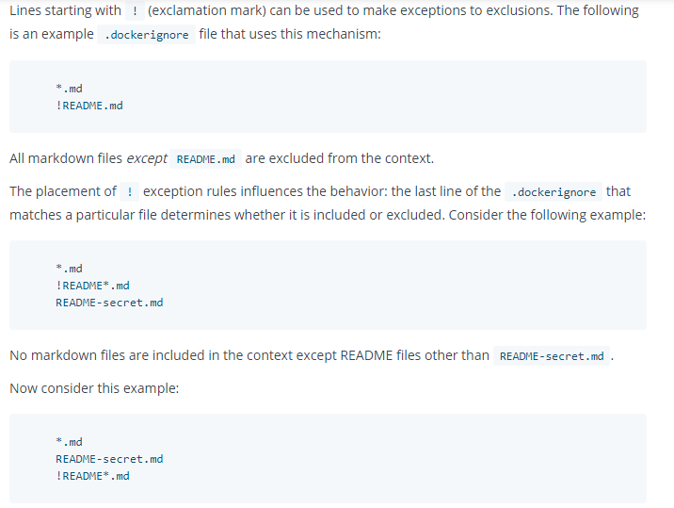
Dockerfile - dockerignore

Slide 38
Dockerfile Commands -FROM
Dockerfile must start with FROM
FROM <image> [AS <name>]
Or
FROM <image>[:<tag>] [AS <name>]
Or
FROM <image>[@<digest>] [AS <name>]
FROM instruction initializes a new build stage and sets the Base Image for subsequent instructions.

Slide 39
Dockerfile - FROM
FROM can appear multiple time
A name can be given to a new build stage by adding AS name to the FROM instruction. The name can be used in subsequent FROM and COPY --from=<name|index> instructions to refer to the image built in this stage.

Slide 40
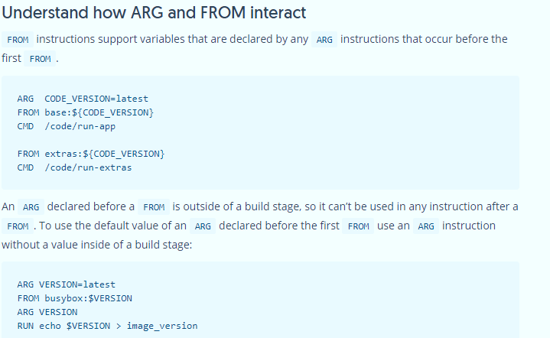

Slide 41
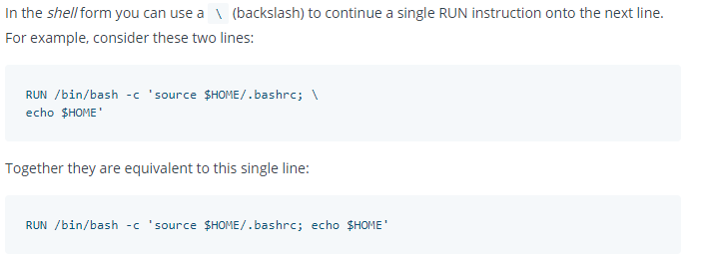
Dockerfile - Run
RUN has 2 forms:
RUN <command> (shell form, the command is run in a shell, which by default is /bin/sh -c on Linux or cmd /S /C on Windows)
RUN ["executable", "param1", "param2"] (exec form)

Slide 42
Dockerfile - CMD
The CMD instruction has three forms:
CMD ["executable","param1","param2"] (exec form, this is the preferred form)
CMD ["param1","param2"] (as default parameters to ENTRYPOINT)
CMD command param1 param2 (shell form)
There can only be one CMD instruction in a Dockerfile. If you list more than one CMD then only the last CMD will take effect.
The main purpose of a CMD is to provide defaults for an executing container. These defaults can include an executable, or they can omit the executable, in which case you must specify an ENTRYPOINT instruction as well.

Slide 43
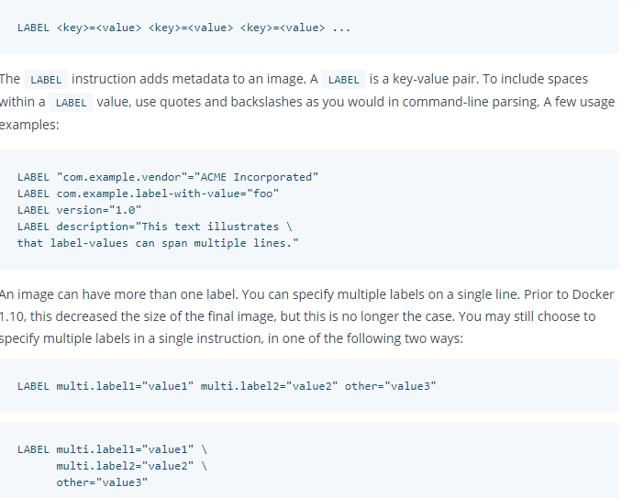
Dockerfile -LABEL

Slide 44
Dockerfile - EXPOSE
EXPOSE <port> [<port>/<protocol>...]
The EXPOSE instruction informs Docker that the container listens on the specified network ports at runtime. You can specify whether the port listens on TCP or UDP, and the default is TCP if the protocol is not specified.
The EXPOSE instruction does not actually publish the port.
Use following in run command to actually execute:
docker run -p 80:80/tcp -p 80:80/udp ...

Slide 45
Dockerfile -ENV
ENV <key> <value>
ENV <key>=<value> ...
The ENV instruction sets the environment variable <key> to the value <value>. This value will be in the environment for all subsequent instructions in the build stage and can be replaced inline in many as well.

Slide 46
Dockerfile - ADD
ADD has two forms:
ADD [--chown=<user>:<group>] <src>... <dest>
ADD [--chown=<user>:<group>] ["<src>",... "<dest>"] (this form is required for paths containing whitespace)
The ADD instruction copies new files, directories or remote file URLs from <src> and adds them to the filesystem of the image at the path <dest>.
Multiple <src> resources may be specified but if they are files or directories, their paths are interpreted as relative to the source of the context of the build.

Slide 47
Dockerfile - COPY
COPY has two forms:
COPY [--chown=<user>:<group>] <src>... <dest>
COPY [--chown=<user>:<group>] ["<src>",... "<dest>"] (this form is required for paths containing whitespace)
Diff wrt ADD
ADD allows <src> to be a URL
If the <src> parameter of ADD is an archive in a recognised compression format, it will be unpacked

Slide 48
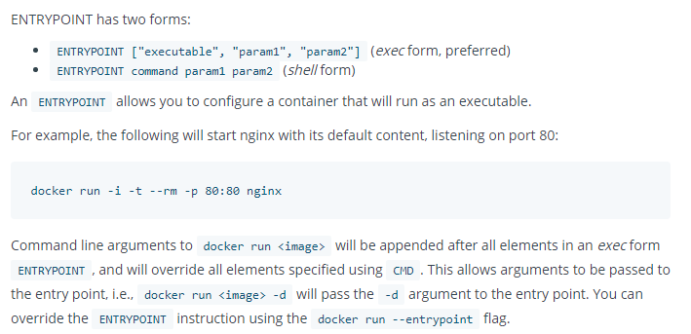
Dockerfile - ENTRYPOINT

Slide 49
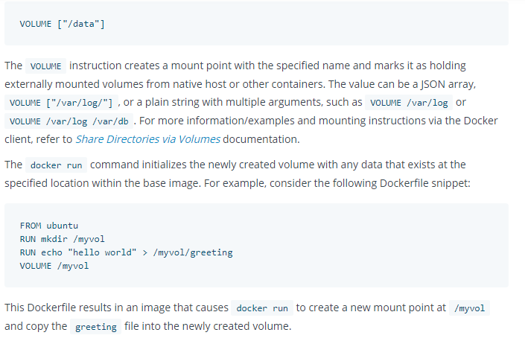
Dockerfile - VOLUMES

Slide 50
Dockerfile - User
USER <user>[:<group>] or
USER <UID>[:<GID>]
The USER instruction sets the user name (or UID) and optionally the user group (or GID) to use when running the image and for any RUN, CMD and ENTRYPOINT instructions that follow it in the Dockerfile.

Slide 51
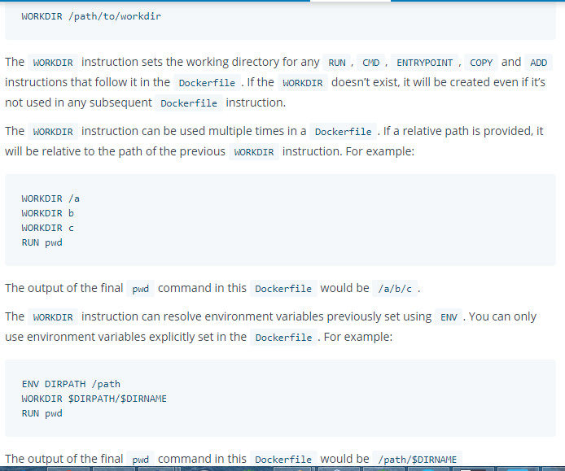
Dockerfile - WORKDIR

Slide 52
Dockerfile - ARG
ARG <name>[=<default value>]
The ARG instruction defines a variable that users can pass at build-time to the builder with the docker build command using the --build-arg <varname>=<value> flag.

Slide 53
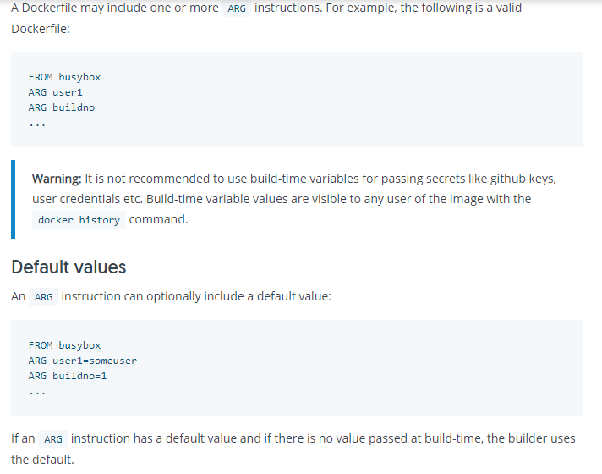
Dockerfile - ARG

Slide 54
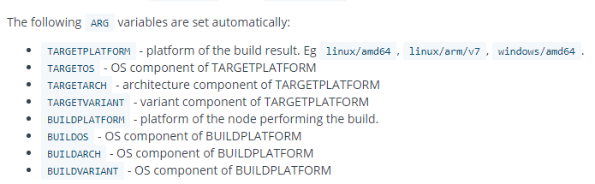
Dockerfile – ARG

Slide 55
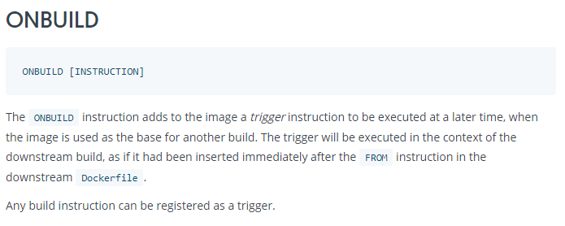
Dockerfile - ONBUILD

Slide 56
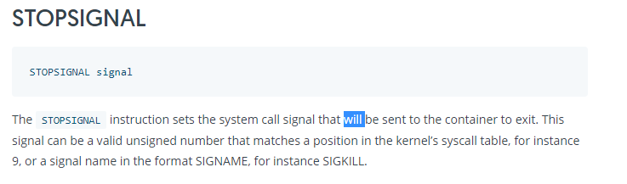
Dockerfile - STOPSIGNAL

Slide 57
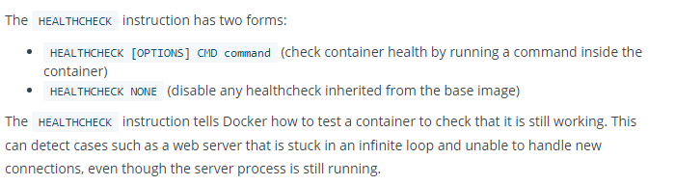
Dockerfile - HEALTHCHECK

Slide 58
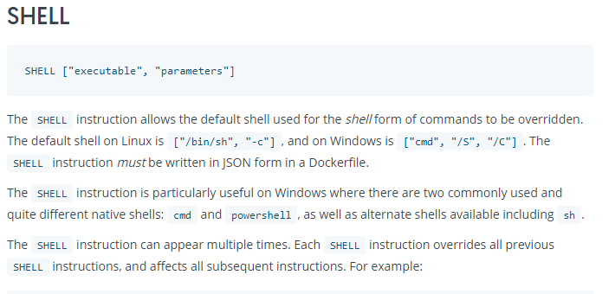
Dockerfile - Shell

Slide 59
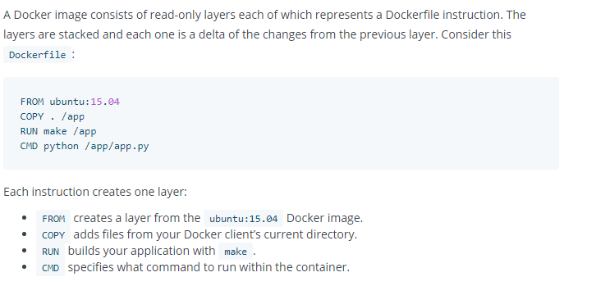
Dockerfile – Best Practices

Slide 60



Dockerfile – Best Practices

Slide 61
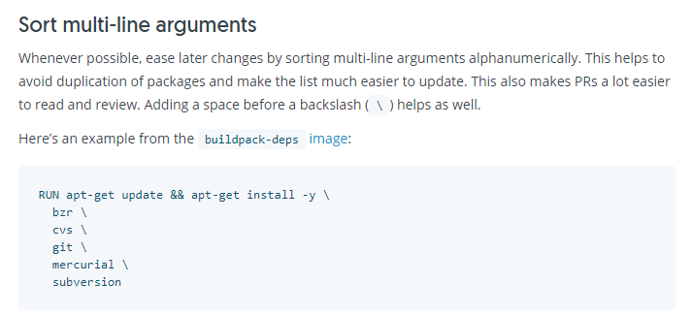
Dockerfile – Best Practices

Slide 62
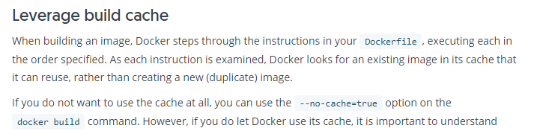
Dockerfile – Best Practices

Slide 63
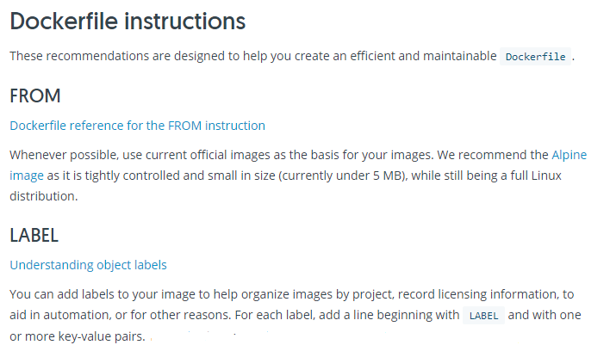
Dockerfile – Best Practices

Slide 64
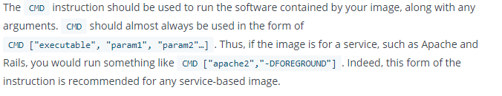
Dockerfile – Best Practices
RUN
Split long or complex RUN statements on multiple lines separated with backslashes to make your Dockerfile more readable, understandable, and maintainable.
CMD

Slide 65
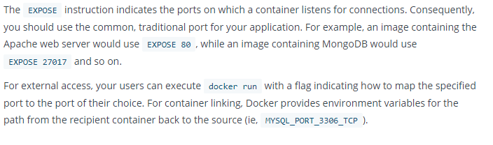
Dockerfile Best Practices - EXPOSE

Slide 66
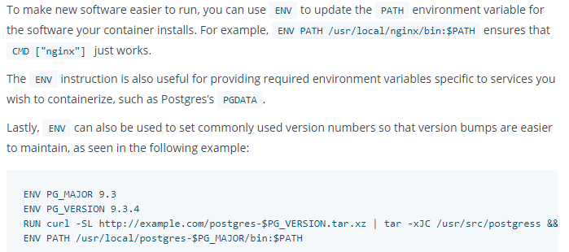
Dockerfile - ENV

Slide 67
Dockerfile & BuildKit
With version 18.09, docker now supports for Buildkit
Detect and skip executing unused build stages
Parallelize building independent build stages
Incrementally transfer only the changed files in your build context between builds
Detect and skip transferring unused files in your build context
Use external Dockerfile implementations with many new features
Avoid side-effects with rest of the API (intermediate images and containers)
Prioritize your build cache for automatic pruning

Slide 68
For any Corporate/Online Training Requirements, you can email me @
milind.technopreneur@gmail.com
Visit my website at
www.technopreneur-milind.com
Subscribe my YouTube Channel
for 6 minutes technical videos

