Slide 1

Presents
MongoDB

Slide 2
Agenda(Summarised)
RDBMS
NOSQL v/s RDBMS
Welcome to NOSQL World
Intro to MongoDB
Ue Cases & Features of MongoDB
Installing MongoDB
MongoDB CRUD operations

Slide 3
Agenda(Summarised)
Using Shell
Mongo in Java !
Indexing
Aggregation
Replication
Sharding
Security
Deployment & Administration

Slide 4
RDBMS – The Good & Bad
Good
Well Documented & mature
SQL Standards defined
Large pool of Developers
ACID
Notes:
Relational databases and related management systems (RDBMS) are more widely known and understood than their NoSQL cousins. Relational databases emerged in the 70s to store data according to a schema that allows data to be displayed as tables with rows and columns. Think of a relational database as a collection of tables, each with a schema that represents the fixed attributes and data types that the items in the table will have. RDBMSs all provide functionality for reading, creating, updating, and deleting data, typically by means of Structured Query Language (SQL) statements.
The tables in a relational database have keys associated with them, which are used to identify specific columns or rows of a table and facilitate faster access to a particular table, row, or column of interest.
Data integrity is of particular concern in relational databases, and RDBMS use a number of constraints to ensure that the data contained in your tables are reliable and accurate.
Oracle, MYSQL, Microsoft SQL, PostgreSQL, DB2

Slide 5
RDBMS – The Good & Bad
Bad
Unstructured or semi structured data
Mapping with real world objects
Migration Difficulties
Scaling
Cost of database
Cost of Administration
Notes:
Relational databases and related management systems (RDBMS) are more widely known and understood than their NoSQL cousins. Relational databases emerged in the 70s to store data according to a schema that allows data to be displayed as tables with rows and columns. Think of a relational database as a collection of tables, each with a schema that represents the fixed attributes and data types that the items in the table will have. RDBMSs all provide functionality for reading, creating, updating, and deleting data, typically by means of Structured Query Language (SQL) statements.
The tables in a relational database have keys associated with them, which are used to identify specific columns or rows of a table and facilitate faster access to a particular table, row, or column of interest.
Data integrity is of particular concern in relational databases, and RDBMS use a number of constraints to ensure that the data contained in your tables are reliable and accurate.
Oracle, MYSQL, Microsoft SQL, PostgreSQL, DB2

Slide 6
The need for NOSQL
Agility & Scaling in RDBMS World
Manual Sharding
Distributed Cache
Notes:
Relational databases were never designed to cope with the scale and agility challenges that face modern applications – and aren't built to take advantage of cheap storage and processing power that's available today through the cloud. Relational database vendors have developed two main technical approaches to address these shortcomings:
Manual Sharding
Tables are broken up into smaller physical tables and spread across multiple servers. Because the database does not provide this ability natively, development teams take on the work of deploying multiple relational databases across a number of machines. Data is stored in each database instance autonomously. Application code is developed to distribute the data, distribute queries, and aggregate the results of data across all of the database instances. Additional code must be developed to handle resource failures, to perform joins across the different databases, for data rebalancing, replication, and other requirements. Furthermore, many benefits of the relational database, such as transactional integrity, are compromised or eliminated when employing manual sharding.
Distributed Cache
A number of products provide a caching tier for database systems. These systems can improve read performance substantially, but they do not improve write performance, and they add complexity to system deployments. If your application is dominated by reads then a distributed cache should probably be considered, but if your application is dominated by writes or if you have a relatively even mix of reads and writes, then a distributed cache may not improve the overall experience of your end users.
NoSQL databases have emerged in response to these challenges and in response to the new opportunities provided by low-cost commodity hardware and cloud-based deployment environments - and natively support the modern application deployment environment, reducing the need for developers to maintain separate caching layers or write and maintain sharding code.

Slide 7

Welcome to NOSQL World

Slide 8
RDBMS v/s NOSQL
RDBMS
Manipulate Data using Query Language , very powerful.
Primary Key to identify unique object or record
Relation based , structure is defined & fixed , rules are defined and followed implicitly. Structure/rules apply to all data of that table
NOSQL
Dynamic Schema , relations are not required or managed at Data Source level
Modelled around Objects rather than relations.
Notes:
RDBMS – Relational Model
NOSQL - data that is modeled in means other than the tabular relations used in relational databases.
Diff types we will see in a while

Slide 9
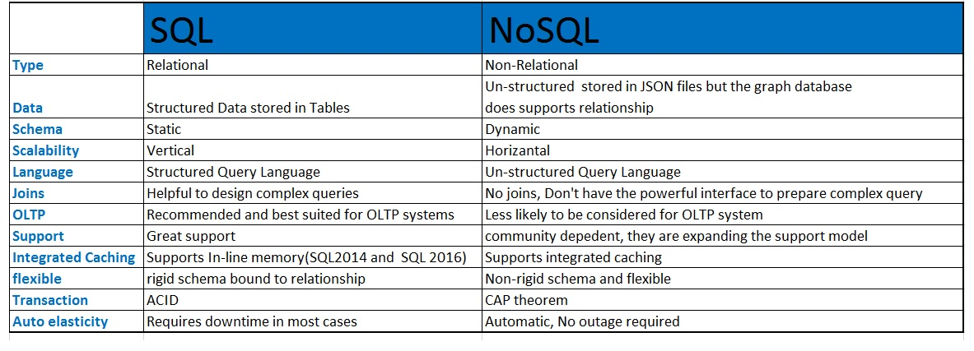
SQL v/s NOSQL
Notes:
Relational databases require that schemas be defined before you can add data. For example, you might want to store data about your customers such as phone numbers, first and last name, address, city and state – a SQL database needs to know this in advance.
This fits poorly with agile development approaches, because each time you complete new features, the schema of your database often needs to change. So if you decide, a few iterations into development, that you'd like to store customers' favorite items in addition to their addresses and phone numbers, you'll need to add that column to the database, and then migrate the entire database to the new schema.
If the database is large, this is a very slow process that involves significant downtime. If you are frequently changing the data your application stores – because you are iterating rapidly – this downtime may also be frequent. There's also no way, using a relational database, to effectively address data that's completely unstructured or unknown in advance.
NoSQL databases are built to allow the insertion of data without a predefined schema. That makes it easy to make significant application changes in real-time, without worrying about service interruptions – which means development is faster, code integration is more reliable, and less database administrator time is needed.
Because of the way they are structured, relational databases usually scale vertically – a single server has to host the entire database to ensure reliability and continuous availability of data. This gets expensive quickly, places limits on scale, and creates a relatively small number of failure points for database infrastructure.
The solution is to scale horizontally, by adding servers instead of concentrating more capacity in a single server. Cloud computing makes this significantly easier, with providers such as Amazon Web Services providing virtually unlimited capacity on demand, and taking care of all the necessary database administration tasks. Developers no longer need to construct complex, expensive platforms to support their applications, and can concentrate on writing application code. In addition, a group of commodity servers can provide the same processing and storage capabilities as a single high-end server for a fraction of the price.
"Sharding" a database across many server instances can be achieved with SQL databases, but usually is accomplished through SANs and other complex arrangements for making hardware act as a single server. NoSQL databases, on the other hand, usually support auto-sharding, meaning that they natively and automatically spread data across an arbitrary number of servers, without requiring the application to even be aware of the composition of the server pool. Data and query load are automatically balanced across servers, and when a server goes down, it can be quickly and transparently replaced with no application disruption.
Most NoSQL databases also support automatic replication, meaning that you get high availability and disaster recovery without involving separate applications to manage these tasks. The storage environment is essentially virtualized from the developer's perspective.
Lastly, many NoSQL database technologies have excellent integrated caching capabilities, keeping frequently-used data in system memory as much as possible. This removes the need for a separate caching layer that must be maintained.

Slide 10
What NOSQL brings in?
Scalability
Cost Savings in Administration
Open Source & lesser server cost
Flexibility - No fixed model or always ready for change
Inbuilt support for Caching
Notes:
Scalability - Adding more Servers or sharding and so on
Cost Savings - automatic repair, easier data distribution, and simpler data models make administration and tuning requirements lesser in NoSQL.
Quickly – NOSQL – dsiadv – No stds defined , GUI tools not available, developers not available etc.

Slide 11
Features of NOSQL
Dynamic schemas
Auto-sharding
Replication
integrated caching
Notes:
Relational databases require that schemas be defined before you can add data. For example, you might want to store data about your customers such as phone numbers, first and last name, address, city and state – a SQL database needs to know this in advance.
This fits poorly with agile development approaches, because each time you complete new features, the schema of your database often needs to change. So if you decide, a few iterations into development, that you'd like to store customers' favorite items in addition to their addresses and phone numbers, you'll need to add that column to the database, and then migrate the entire database to the new schema.
If the database is large, this is a very slow process that involves significant downtime. If you are frequently changing the data your application stores – because you are iterating rapidly – this downtime may also be frequent. There's also no way, using a relational database, to effectively address data that's completely unstructured or unknown in advance.
NoSQL databases are built to allow the insertion of data without a predefined schema. That makes it easy to make significant application changes in real-time, without worrying about service interruptions – which means development is faster, code integration is more reliable, and less database administrator time is needed.
Because of the way they are structured, relational databases usually scale vertically – a single server has to host the entire database to ensure reliability and continuous availability of data. This gets expensive quickly, places limits on scale, and creates a relatively small number of failure points for database infrastructure.
The solution is to scale horizontally, by adding servers instead of concentrating more capacity in a single server. Cloud computing makes this significantly easier, with providers such as Amazon Web Services providing virtually unlimited capacity on demand, and taking care of all the necessary database administration tasks. Developers no longer need to construct complex, expensive platforms to support their applications, and can concentrate on writing application code. In addition, a group of commodity servers can provide the same processing and storage capabilities as a single high-end server for a fraction of the price.
"Sharding" a database across many server instances can be achieved with SQL databases, but usually is accomplished through SANs and other complex arrangements for making hardware act as a single server. NoSQL databases, on the other hand, usually support auto-sharding, meaning that they natively and automatically spread data across an arbitrary number of servers, without requiring the application to even be aware of the composition of the server pool. Data and query load are automatically balanced across servers, and when a server goes down, it can be quickly and transparently replaced with no application disruption.
Most NoSQL databases also support automatic replication, meaning that you get high availability and disaster recovery without involving separate applications to manage these tasks. The storage environment is essentially virtualized from the developer's perspective.
Lastly, many NoSQL database technologies have excellent integrated caching capabilities, keeping frequently-used data in system memory as much as possible. This removes the need for a separate caching layer that must be maintained.

Slide 12
Few NOSQL DBs
Document Oriented ( MongoDB)
Key Value Store ( Amazon s3)
Column based ( Cassandra , Hbase)
Graph based ( Neo4j)
Notes:
Column based – Storage Block contains data from only one column

Slide 13
RDBMS => ACID
ACID
Atomic
Consistent
Isolated
Durable
Notes:
Atomic
All operations in a transaction succeed or every operation is rolled back.
Consistent
On the completion of a transaction, the database is structurally sound.
Isolated
Transactions do not contend with one another. Contentious access to data is moderated by the database so that transactions appear to run sequentially.
Durable
The results of applying a transaction are permanent, even in the presence of failures.

Slide 14
NOSQL => BASE
BASE
Basic Availability
Soft-State
Eventual Consistency
Notes:
Basic Availability
The database appears to work most of the time.
Soft-state
Stores don’t have to be write-consistent, nor do different replicas have to be mutually consistent all the time.
Eventual consistency
Stores exhibit consistency at some later point (e.g., lazily at read time).

Slide 15
CAP Theorem
Consistency
Availability
Partition Tolerance
Notes:
No distributed system is safe from network failures, thus network partitioning generally has to be tolerated. In the presence of a partition, one is then left with two options: consistency or availability. When choosing consistency over availability, the system will return an error or a time-out if particular information cannot be guaranteed to be up to date due to network partitioning. When choosing availability over consistency, the system will always process the query and try to return the most recent available version of the information, even if it cannot guarantee it is up to date due to network partitioning.
P – Only network failure can cause system to react incorrectly , Event if connection between nodes are down , A& C is kept
C - every read would get you the most recent write
A – Every node if not failed executes
Consistency is achieved by updating several nodes before allowing further reads
Availability is achieved by replicating the data across different machines
On systems that allow reads before updating all the nodes, we will get high Availability
On systems that lock all the nodes before allowing reads, we will get Consistency

Slide 16
Introduction to MongoDB
Document Oriented
JSON like documents ( BSON)
No Fixed Structure
Two Documents may have same Id.

Slide 17
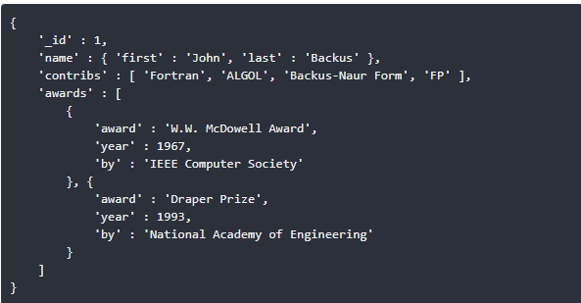
MongoDB Document & JSON/BSON
Notes:
Dynamic Schemas – MongoDB’s dynamic schema provides a simple way to incorporate changes as application requirements change. These changes can be made to the database without affecting existing data or application code and without incurring downtime.
Scalability – MongoDB is designed to be scaled across server clusters. As data volumes grow, organizations can simply add more nodes to their clusters, and MongoDB will balance the data seamlessly and automatically in the background.
Querying – MongoDB supports a full query language and primary and secondary indexing, as well as full text search with Google-like syntax.
Map/Reduce & Aggregation Support – MongoDB’s native map/reduce and aggregation framework provides insights in real-time for applications, going beyond the capabilities of batch analytics technologies like Hadoop and traditional BI tools.
Performance – MongoDB was built to work with commodity hardware and cloud architectures. Data is localized for queries to ensure performance is robust and predictable regardless of deployment size.

Slide 18
Features of MongoDB
Dynamic Schemas
Scalability
Querying
Map/Reduce & Aggregation Support
Performance
Auto-Sharding
Support
Index on any Attribute
Consistency
Notes:
Dynamic Schemas – MongoDB’s dynamic schema provides a simple way to incorporate changes as application requirements change. These changes can be made to the database without affecting existing data or application code and without incurring downtime.
Scalability – MongoDB is designed to be scaled across server clusters. As data volumes grow, organizations can simply add more nodes to their clusters, and MongoDB will balance the data seamlessly and automatically in the background.
Querying – MongoDB supports a full query language and primary and secondary indexing, as well as full text search with Google-like syntax.
Map/Reduce & Aggregation Support – MongoDB’s native map/reduce and aggregation framework provides insights in real-time for applications, going beyond the capabilities of batch analytics technologies like Hadoop and traditional BI tools.
Performance – MongoDB was built to work with commodity hardware and cloud architectures. Data is localized for queries to ensure performance is robust and predictable regardless of deployment size.

Slide 19
Common Use Cases
Content Management and Delivery
Mobile and Social Infrastructure
Customer Data Management
Blogs
Data hub
Notes:
Content Management and Delivery – Manage a diverse product catalog of content in a single data store that allows for quick changes and rapid response times without additional complexity from content retrieval systems.
Mobile and Social Infrastructure – MongoDB provides a high-availability, low-latency, agile, and scalable platform that allows for geospatial capabilities, real-time analytics, and global availability.
Customer Data Management – Utilize rich querying capabilities for real-time analytics on massive user bases with complex data models by using dynamic schemas and auto-sharding for horizontal scaling.

Slide 20
Who uses MongoDB
MetLife
Adobe
Amazon
Ebay
Vmware
SAP
Cisco
Splunk
Expedia
BOSCH
Notes:
Content Management and Delivery – Manage a diverse product catalog of content in a single data store that allows for quick changes and rapid response times without additional complexity from content retrieval systems.
Mobile and Social Infrastructure – MongoDB provides a high-availability, low-latency, agile, and scalable platform that allows for geospatial capabilities, real-time analytics, and global availability.
Customer Data Management – Utilize rich querying capabilities for real-time analytics on massive user bases with complex data models by using dynamic schemas and auto-sharding for horizontal scaling.

Slide 21
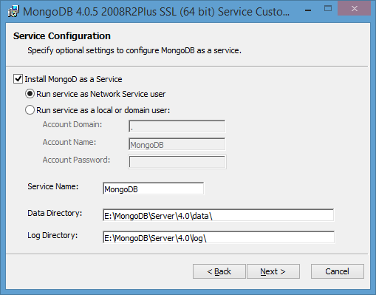
Installing MongoDB
Download from
https://www.mongodb.com/download-center/community?jmp=docs
Notes:
Content Management and Delivery – Manage a diverse product catalog of content in a single data store that allows for quick changes and rapid response times without additional complexity from content retrieval systems.
Mobile and Social Infrastructure – MongoDB provides a high-availability, low-latency, agile, and scalable platform that allows for geospatial capabilities, real-time analytics, and global availability.
Customer Data Management – Utilize rich querying capabilities for real-time analytics on massive user bases with complex data models by using dynamic schemas and auto-sharding for horizontal scaling.

Slide 22
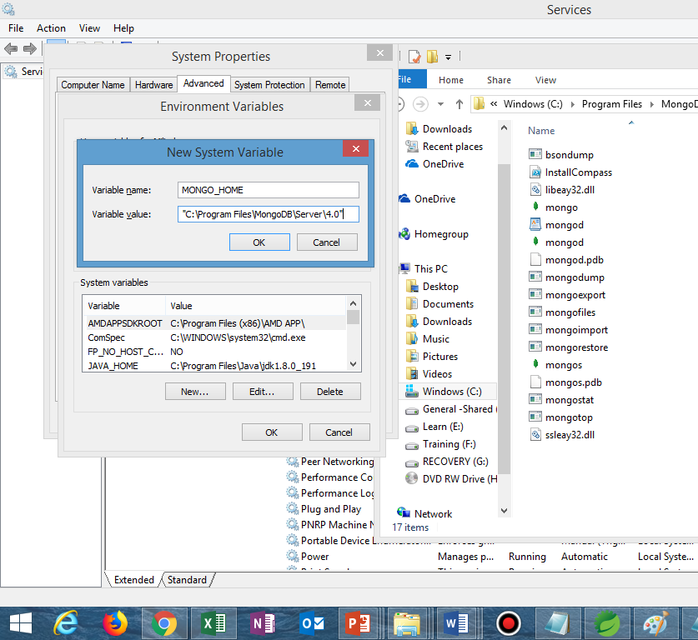

Slide 23
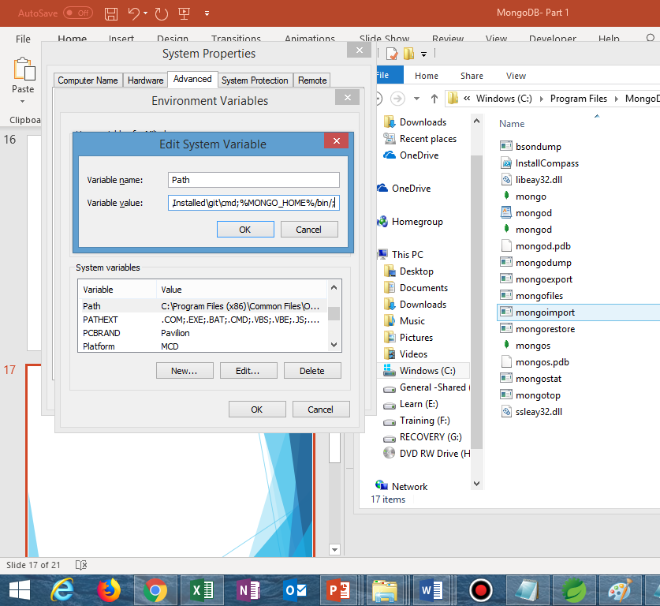

Slide 24
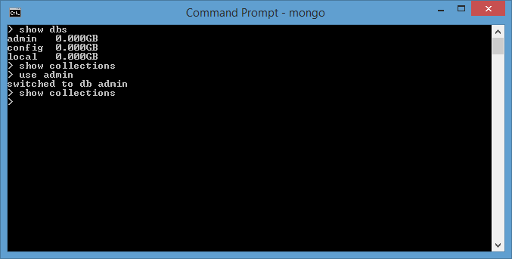
Mongo Shell

Slide 25
MongoDB – Data Model
Pre-requisite : Understand JSON?
Flexible Schema
Collections
Documents
Schema Validation
Embedded Data
References
Atomicity – Single Document & Multi-Document
Notes:
Content Management and Delivery – Manage a diverse product catalog of content in a single data store that allows for quick changes and rapid response times without additional complexity from content retrieval systems.
Mobile and Social Infrastructure – MongoDB provides a high-availability, low-latency, agile, and scalable platform that allows for geospatial capabilities, real-time analytics, and global availability.
Customer Data Management – Utilize rich querying capabilities for real-time analytics on massive user bases with complex data models by using dynamic schemas and auto-sharding for horizontal scaling.

Slide 26

CRUD operations in MongoDB
Notes:
Content Management and Delivery – Manage a diverse product catalog of content in a single data store that allows for quick changes and rapid response times without additional complexity from content retrieval systems.
Mobile and Social Infrastructure – MongoDB provides a high-availability, low-latency, agile, and scalable platform that allows for geospatial capabilities, real-time analytics, and global availability.
Customer Data Management – Utilize rich querying capabilities for real-time analytics on massive user bases with complex data models by using dynamic schemas and auto-sharding for horizontal scaling.

Slide 27
Insert Document
db.inventory.insertOne(
{ item: "canvas", qty: 100, tags: ["cotton"], size: { h: 28, w: 35.5, uom: "cm" } }
)
db.inventory.find( { item: "canvas" } )

Slide 28
Insert Multiple Documents
db.inventory.insertMany([
{ item: "journal", qty: 25, tags: ["blank", "red"], size: { h: 14, w: 21, uom: "cm" } },
{ item: "mat", qty: 85, tags: ["gray"], size: { h: 27.9, w: 35.5, uom: "cm" } },
{ item: "mousepad", qty: 25, tags: ["gel", "blue"], size: { h: 19, w: 22.85, uom: "cm" } }
])
db.inventory.find( {} )

Slide 29

Insert Documents
Hands on Session -Shell
Notes:
mongoimport --db users --collection contacts --file contacts.json

Slide 30
Insert Documents
Hands on Session -Java

Slide 31
Query Documents
Hands on Session -Shell

Slide 32
Query Documents
Hands on Session -Java

Slide 33
Update
db.collection.update(
<query>,
<update>,
{
upsert: <boolean>,
multi: <boolean>,
writeConcern: <document>,
collation: <document>,
arrayFilters: [ <filterdocument1>, ... ]
}
)
Notes:
collation: { locale: <string>, caseLevel: <boolean>, caseFirst: <string>, strength: <int>, numericOrdering: <boolean>, alternate: <string>, maxVariable: <string>, backwards: <boolean> }
Optional. An array of filter documents that determines which array elements to modify for an update operation on an array field.
[ { $or: [ { "x.a": { $gt: 85 } }, { "x.b": { $gt: 80 } } ] } ] [ { $and: [ { "x.a": { $gt: 85 } }, { "x.b": { $gt: 80 } } ] } ] [ { "x.a": { $gt: 85 }, "x.b": { $gt: 80 } } ]

Slide 34
Update Documents
Hands on Session

Slide 35
Delete
db.collection.deleteOne(
<filter>,
{
writeConcern: <document>,
collation: <document>
}
)
db.collection.deleteMany(
<filter>,
{
writeConcern: <document>,
collation: <document>
}
)

Slide 36
Delete
db.collection.remove(
<query>,
<justOne>
)

Slide 37
Delete Documents
Hands on Session

Slide 38
Cursors
Notes:
When the db.collection.find () function is used to search for documents in the collection, the result returns a pointer to the collection of documents returned which is called a cursor.
By default, the cursor will be iterated automatically when the result of the query is returned. But one can also explicitly go through the items returned in the cursor one by one. If you see the below example, if we have 3 documents in our collection, the cursor object will point to the first document and then iterate through all of the documents of the collection.

Slide 39
BulkWrite

Slide 40
MongoDB CRUD- Few Things
Atomicity
Read Concern
Write Concerns
Concurrency Control
Use Indexing
Expected Current Value
Notes:
Atomicity : Default for Single Document
Multi-Document supported from version 4.0
Read & Write Concern : Local , Majority & Snapshot (Multi-Document Transaction)
Concurrency Control :
Concurrency control allows multiple applications to run concurrently without causing data inconsistency or conflicts.
One approach is to create a unique index on a field that can only have unique values. This prevents insertions or updates from creating duplicate data. Create a unique index on multiple fields to force uniqueness on that combination of field values. For examples of use cases, see update() and Unique Index and findAndModify() and Unique Index.
Another approach is to specify the expected current value of a field in the query predicate for the write operations.

Slide 41
Indexing
Types
Default
Single Field
Compound
MultiKey Index for Arrays
Text Index
Hashed Base Index
Geospatial Index
Notes:
Introduction to Indexing
Typically, Indexes are data structures that can store collection’s data set in a form that is easy to traverse. Queries are efficiently executed with the help of indexes in MongoDB.
Indexes help MongoDB find documents that match the query criteria without performing a collection scan. If a query has an appropriate index, MongoDB uses the index and limits the number of documents it examines.
Indexes store field values in the order of the value.The order in which the index entries are made support operations, such as equality matches and range-based queries. MongoDB sorts and returns the results by using the sequential order of the indexes.
The indexes of MongoDB are similar to the indexes in any other databases.MongoDB defines the indexes at the collection level for use in any field or subfield.
Order becomes important in compound

Slide 42
Index Prefixes
Index = >{ "item": 1, “available”:1, "soldQty“:1}
Index Prefixes => { “item”:1}
{“item”:1,”available”:1}
Efficient Search on :
item
item & available
item & soldQty?

Slide 43
Indexes
Hands on Session
Notes:
Default _id Index
In sharded clusters, if you do not use the _id field as the shard key, then your application must ensure the uniqueness of the values in the _id field to prevent errors. This is most-often done by using a standard auto-generated ObjectId.

Slide 44
Aggregation
Hands on Session
Notes:
The aggregation pipeline can operate on a sharded collection.
Work in stages , first match then group.
Match & Sort works if Indexing is done

Slide 45

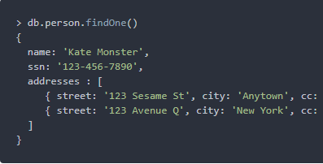
MongoDB Database Design
Embedding

Slide 46
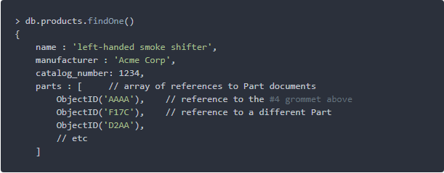
MongoDB Design - References

Slide 47
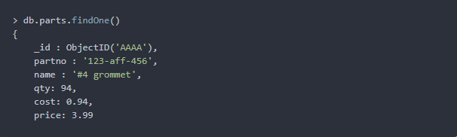
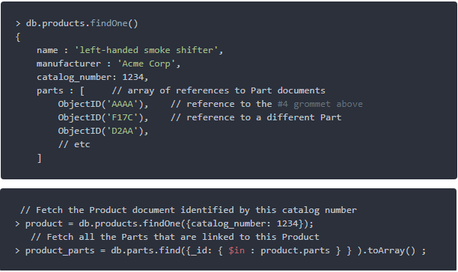
MongoDB Design - References

Slide 48
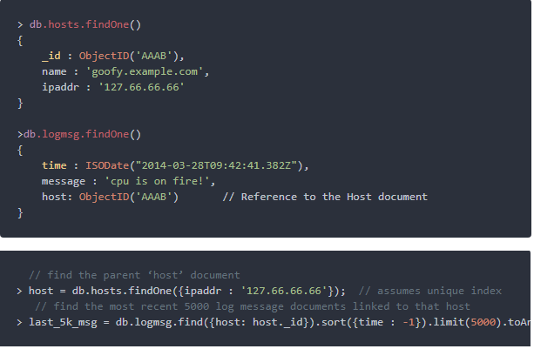
MongoDB Design - References

Slide 49
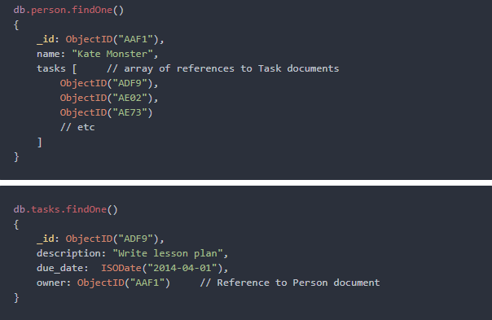
MongoDB Design – Two way References

Slide 50
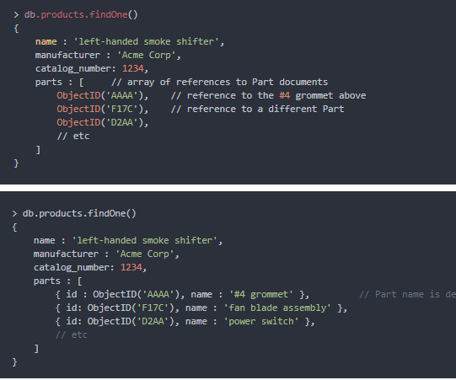
MongoDB Design – Denormalize where Necessary

Slide 51
MongoDB – Design Tips
Favor Embedding
More than Hundred Documents on Many time, go referencing
Application level joins aren’t Scary if you index properly and use Projections
Read/Write ratio versus Normalization & DeNormalization
More Read -> DeNormalized
More Write -> Normalized
Identify your application Data Access Patterns.
Structure Data according to match ways of queries & Updates
Notes:
Rules of Thumb: Your Guide Through the Rainbow
Here are some “rules of thumb” to guide you through these indenumberable (but not infinite) choices
One: favor embedding unless there is a compelling reason not to
Two: needing to access an object on its own is a compelling reason not to embed it
Three: Arrays should not grow without bound. If there are more than a couple of hundred documents on the “many” side, don’t embed them; if there are more than a few thousand documents on the “many” side, don’t use an array of ObjectID references. High-cardinality arrays are a compelling reason not to embed.
Four: Don’t be afraid of application-level joins: if you index correctly and use the projection specifier (as shown in part 2) then application-level joins are barely more expensive than server-side joins in a relational database.
Five: Consider the write/read ratio when denormalizing. A field that will mostly be read and only seldom updated is a good candidate for denormalization: if you denormalize a field that is updated frequently then the extra work of finding and updating all the instances is likely to overwhelm the savings that you get from denormalizing.
Six: As always with MongoDB, how you model your data depends – entirely – on your particular application’s data access patterns. You want to structure your data to match the ways that your application queries and updates it.

Slide 52
MongoDB & Security

Slide 53
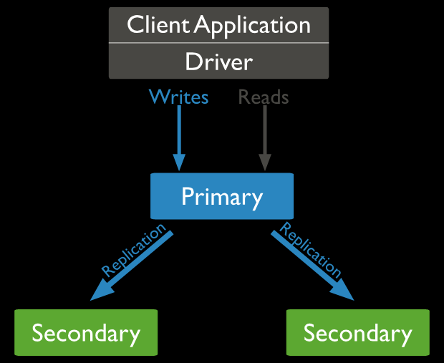
Replication in MongoDB

Slide 54
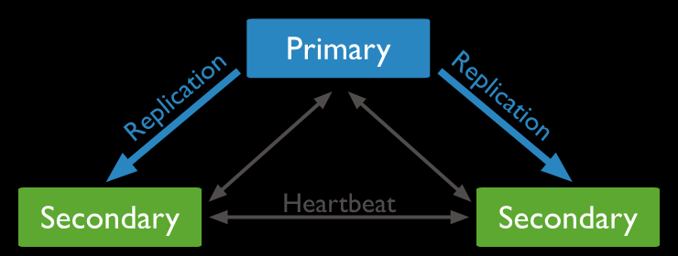
Replication in MongoDB

Slide 55
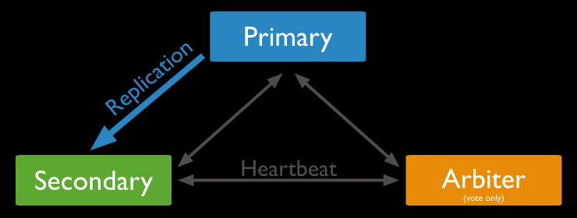
Replication in MongoDB

Slide 56
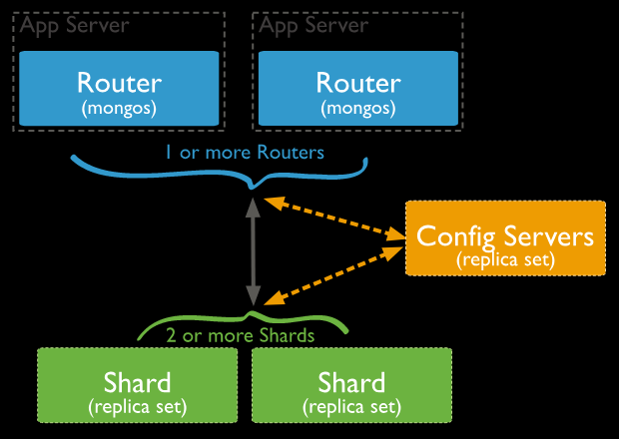
Sharding in MongoDB

Slide 57
Sharding in MongoDB

Slide 58
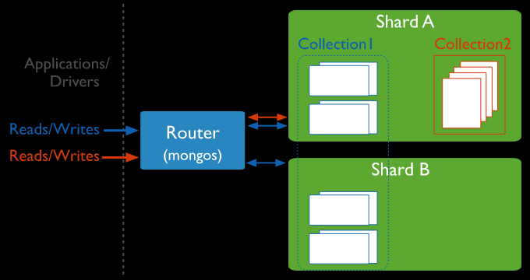
Sharding in MongoDB

Slide 59
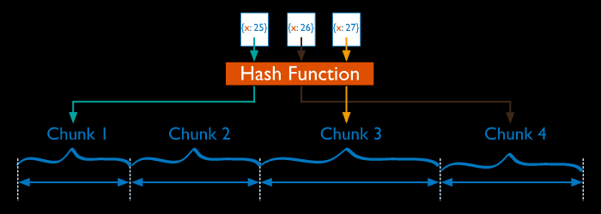
Sharding in MongoDB
Notes:
Hashed Sharding

Slide 60
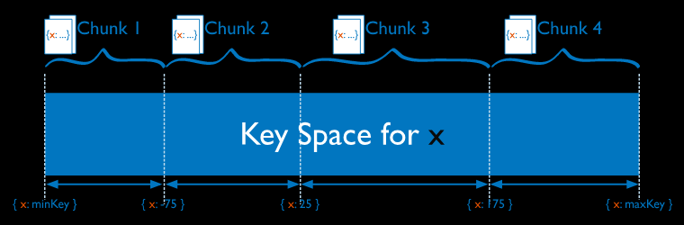
Sharding in MongoDB
Notes:
Range Sharding

Slide 61
MongoDB – Sharding & Chunking

Slide 62
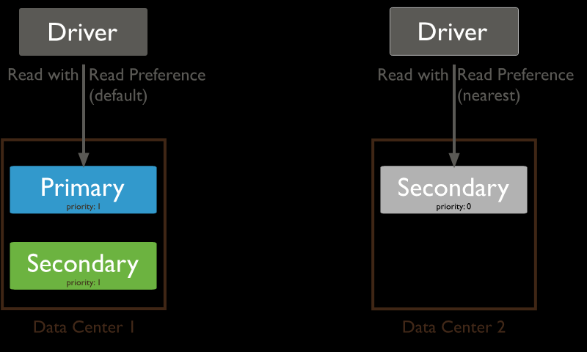
MongoDB – Distributed Queries -Read

Slide 63
MongoDB – Distributed Queries

Slide 64
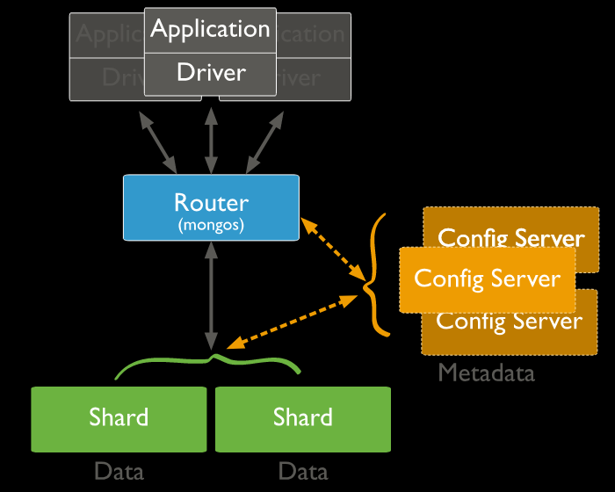
MongoDB – Distributed Queries

Slide 65
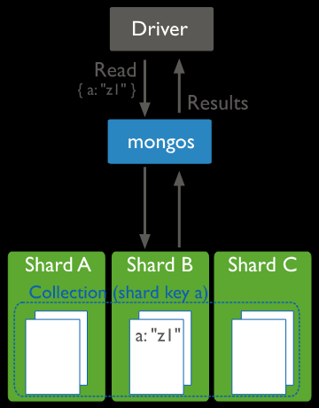
MongoDB – Distributed Queries
Notes:
With ShardKey

Slide 66
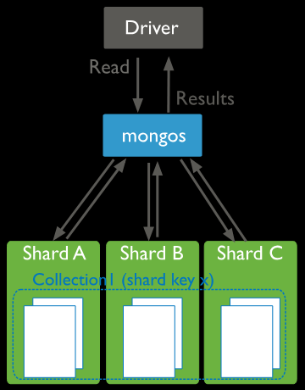
MongoDB – Distributed Queries
Notes:
Without ShardKey

Slide 67
MongoDB – Write Operations

Slide 68
MongoDB – Write Operations

Slide 69
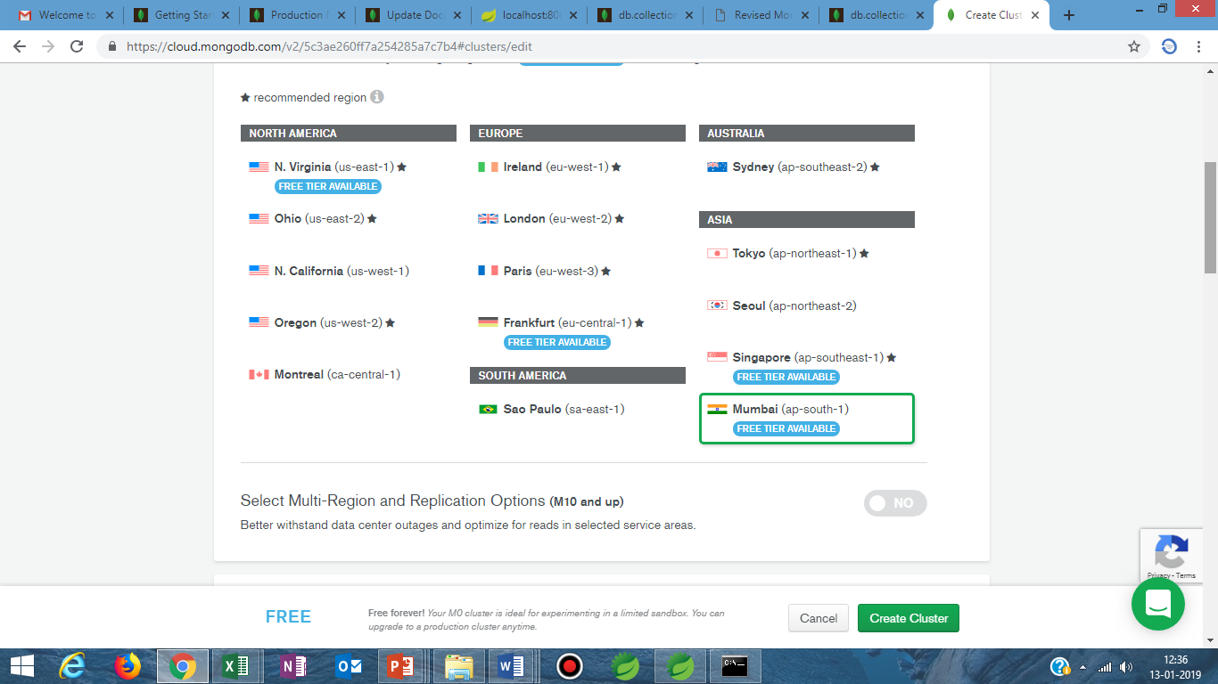
MongoDB & Cloud

Slide 70
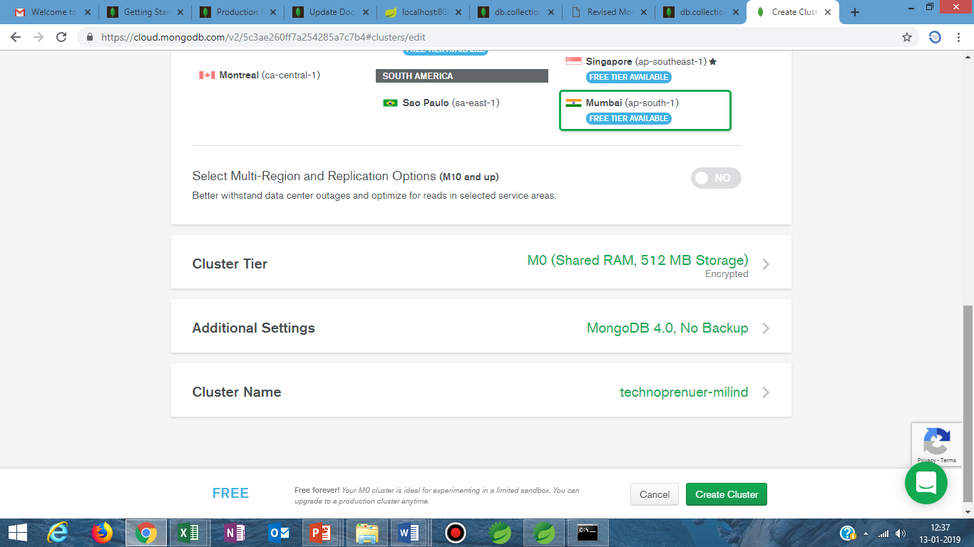
MongoDB & Cloud

Slide 71
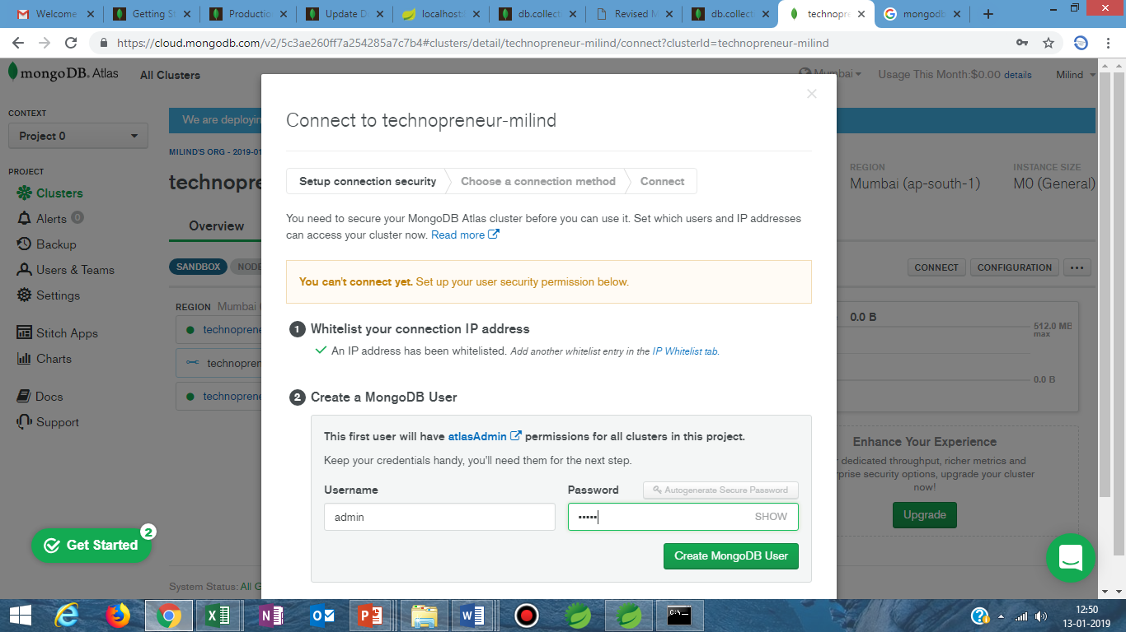
MongoDB & Cloud

Slide 72
MongoDB Atlas

Slide 73
MongoDB Compass

Slide 74
ReturnKey
https://docs.mongodb.com/manual/reference/operator/meta/returnKey/

Slide 75
MongoDB Regex
https://docs.mongodb.com/manual/reference/operator/query/regex/

Slide 76
MongoDB Cursor
https://docs.mongodb.com/manual/reference/method/cursor.limit/
Limit, Skip , Sort
DB Commands
Advance Query Options

Slide 77
MongoDB Application Design -.Normalisation Vs DeNormalization
https://www.mongodb.com/blog/post/6-rules-of-thumb-for-mongodb-schema-design-part-3
https://www.damiencosset.com/mongodb-normalization-vs-denormalization/
https://dev.to/damcosset/mongodb-normalization-vs-denormalization/comments
http://makble.com/normalization-and-denormalization-with-mongodb
https://keon.io/mongodb-schema-design/
https://facility9.com/2011/01/three-mistakes-i-made-with-mongodb/

Slide 78
Examples of Data Representation

Slide 79
Optimization of Data Manipulation

Slide 80
When NOT to use MongoDB

Slide 82
For any Corporate/Individual Training Requirements, you can email me @
milind.technopreneur@gmail.com
Visit my website at
www.technopreneur-milind.com
Subscribe my YouTube Channel
<Technology> 6 minutes Series
for more such technical videos

