Slide 1
Shell Bootcamp 2024 4 Reflections for Week #2
Mahendra Kumar
Date : 06-Sept-2024

Slide 2

About Me
Dedication for improvement is what makes you perfect.

Slide 3

My learnings from this week!

Slide 4

Learning 1 | My takeaways
Key Learnings
Software testing is a process aimed at discovering bugs or defects in a software system during its development.
This helps in identifying deviations from the specified requirements and minimizes the associated risks.
By pinpointing these defects, it aids developers in creating software that is free from errors.

Slide 5
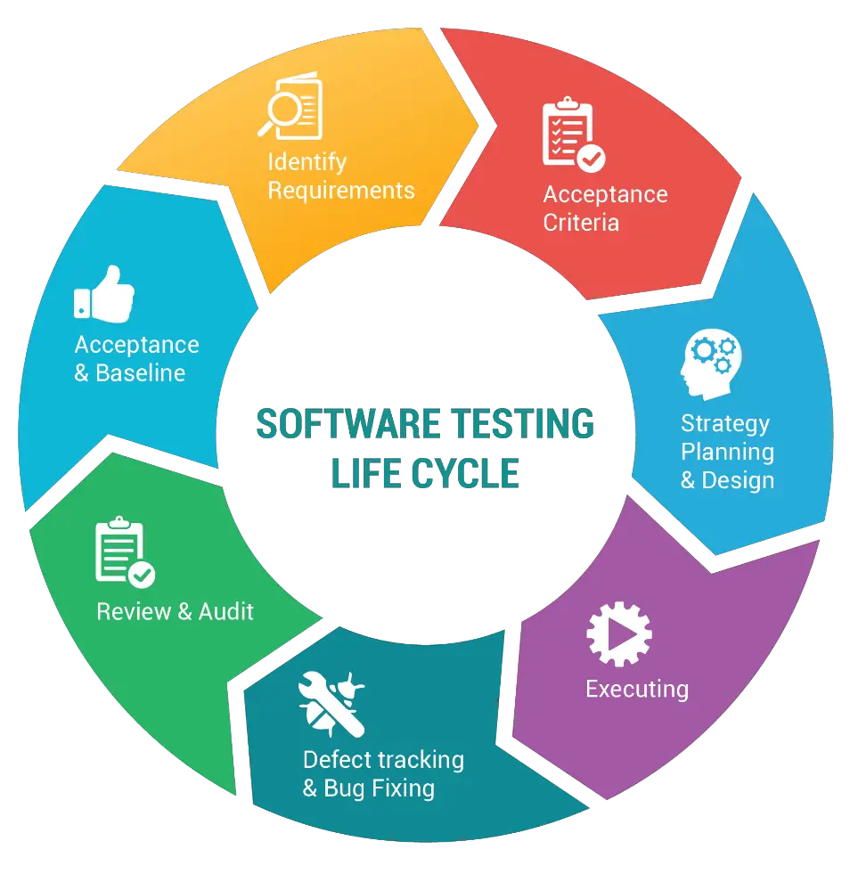
Learning 2 | My takeaways
The STLC specifies the different phases in the software testing process.
Generally, software testing begins with the requirements phase.
It concludes with the deployment phase.

Slide 6
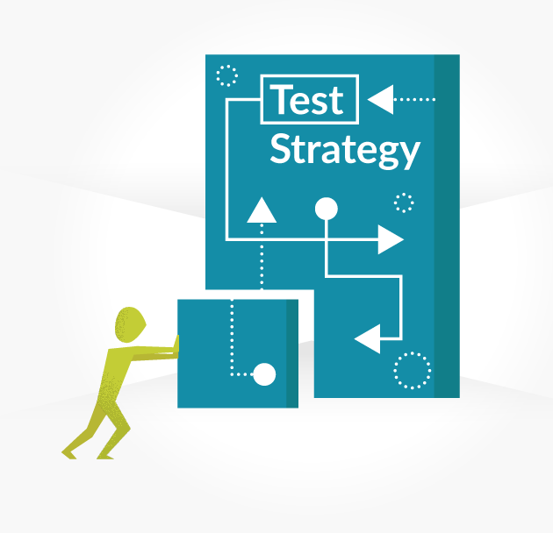
Learning 3 | My takeaways
A brief outline on achieving testing objectives efficiently within a limited timeframe using optimal resources.
Set up the framework for testing the system.
Analyse the requirements.

Slide 7

Learning 4 | My takeaways
Test Plan
A document outlining the objectives, scope of testing, approach, schedule, and roles and responsibilities.
Develops the test plan deliverable according to established standards.
Estimates the test effort required.
Defines roles and responsibilities.

Slide 8

Relevance of learnings for my organization

Slide 9

Learning 1 | Relevance for Shell
How I feel Shell implements this learning
Shell ensures effective software testing by incorporating testing early in the development process, utilizing automated tools, and keeping robust defect-tracking systems. This strategy allows for the quick identification and resolution of defects, minimizes risks, and aids in creating defect-free software.

Slide 10
Learning 2 | Relevance for Shell
How I feel Shell implements this learning
Shell applies the Software Testing Life Cycle (STLC) by integrating testing into every phase, starting from the requirements phase and continuing through to the deployment phase. This systematic approach guarantees comprehensive software validation at each stage, facilitating the early identification and correction of defects.

Slide 11
Learning 3 | Relevance for Shell
How I feel Shell implements this learning
Shell's Test Strategy involves creating a clear plan to meet testing objectives efficiently within time and resource limits. This includes analysing requirements, defining the testing scope, and selecting the necessary tools and techniques. A well-defined strategy ensures focused, prioritized testing aligned with business goals.

Slide 12
Learning 4 | Relevance for Shell
How I feel Shell implements this learning:
Shell can implement a Test Plan by developing a comprehensive document that details the objectives, scope, testing approach, schedule, and roles and responsibilities. This document acts as a blueprint, guiding the testing process to align with project standards. It includes test effort estimation, resource allocation, and clearly defines responsibilities, ensuring a structured and efficient testing process that meets timelines and quality goals.

Slide 13

Challenges in implementing learning

Slide 14

Challenge faced while implementing Learning 1
Challenges faced while implementing:
Unclear Requirements: Lack of clear or complete specifications complicates thorough testing.
Time Limitations: Tight deadlines restrict comprehensive testing, increasing the risk of undetected defects.
Environment/Tool Challenges: Difficulties in setting up testing environments and selecting appropriate tools.

Slide 15
Challenge faced while implementing Learning 2
Challenges faced while implementing:
Challenges in implementing the Software Testing Life Cycle (STLC):
Changing Requirements: Incomplete or evolving requirements complicate effective test planning and execution.
Resource Constraints: Limited time and resources hinder thorough testing.
Team Integration: Poor collaboration between testing and development teams leads to miscommunication and delays.

Slide 16
Challenge faced while implementing Learning 3
Challenges faced while implementing:
Resource Allocation: Effectively distributing limited resources to meet testing goals is challenging and requires meticulous planning and prioritization.
Time Constraints: Conducting comprehensive testing within a restricted timeframe can be tough, potentially resulting in overlooked defects or incomplete test coverage.
Requirement Analysis: Precisely interpreting and converting requirements into a test strategy is complex and crucial for the success of the testing framework.

Slide 17
Challenge faced while implementing Learning 4
Challenges faced while implementing:
Scope Definition: Clearly outlining the scope and objectives can be difficult, potentially causing misalignment with project goals.
Resource Allocation: Estimating the required test effort and assigning suitable roles can be challenging, impacting the effectiveness of the plan.
Standard Compliance: Ensuring the test plan adheres to all standard requirements can be intricate and time-consuming.

Slide 18

Action Plan

Slide 19
My Action Plan for this Week
Actions
Timeline
Status
Learning more about Azure DevOps and creating the Agile projects in it.
Taking part in Changemakers event.
Learning Industry level practices and methodology in DevOps.
Exploring DevSecOps.
1 Week
Ongoing

Slide 20

Learning is also Fun!

Slide 21

Learning is also Fun!
My learning was fun this week because of the following reasons:
Fun Projects
Assessments and Quiz
Fun games and activity
Collaboration and bonding

Slide 22

Summary
Software Testing: Integrate testing early and continuously throughout development to identify defects, reduce risks, and support defect-free software creation.
Software Testing Life Cycle (STLC): Follow a structured approach from the requirements phase to deployment, ensuring thorough validation at each stage.
Test Strategy: Develop a clear and efficient plan to meet testing objectives by analyzing requirements, optimizing resource use, and establishing a framework.
Test Plan: Create a comprehensive document detailing objectives, scope, approach, schedule, and roles to guide testing efforts, estimate resources, and ensure adherence to standards.

Slide 23
Thank You

