Slide 1
Shell Bootcamp 2024 Reflections for Week 3
Mahendra Kumar
Date : 18-Sep-2024

Slide 2

About Me
Dedication for improvement is what makes you perfect.

Slide 3

My learnings from this week!

Slide 4
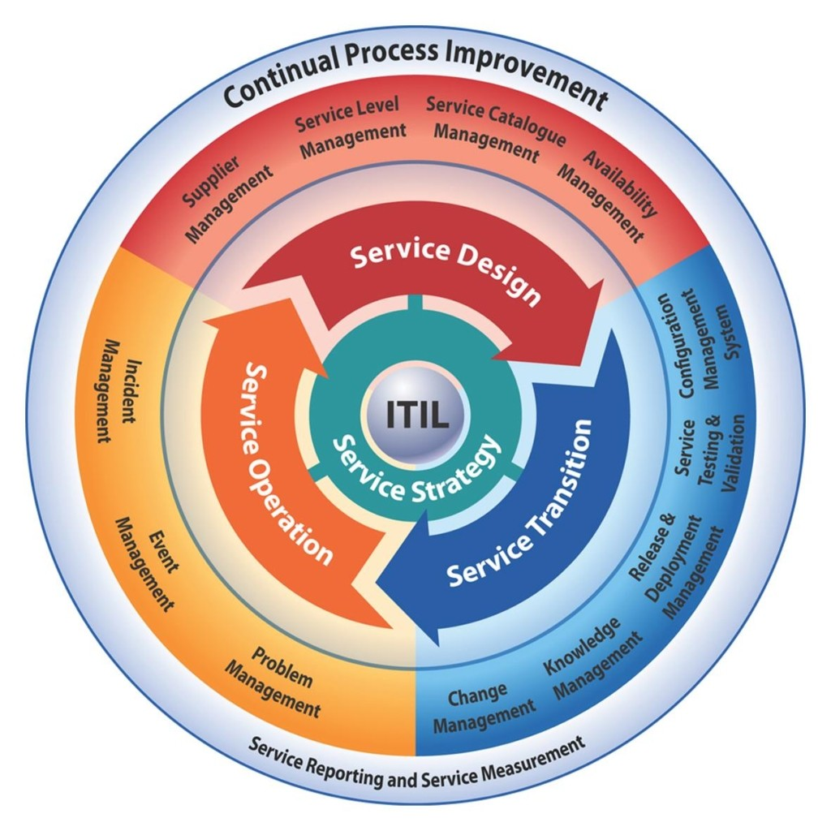
Learning 1 | My takeaways
ITIL
ITIL is a set of practices for IT service management (ITSM) that focuses on aligning IT services with the needs of the business. Purpose: Improve efficiency, achieve predictable service levels, and enhance customer satisfaction.
ITIL Framework
Service Strategy
Service Design
Service Transition
Service Operation
Continual Service Improvement

Slide 5
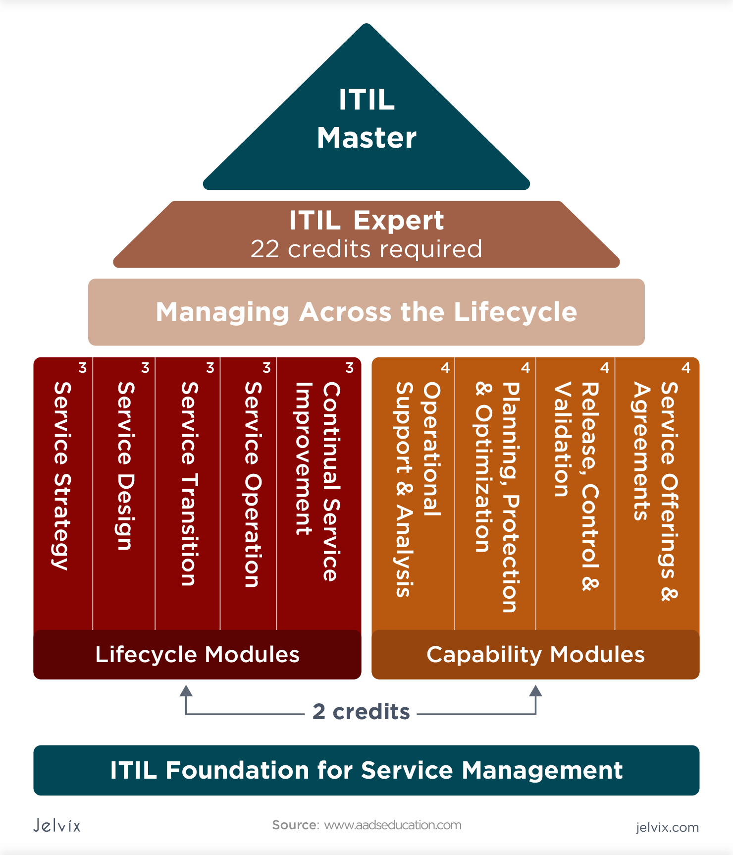
Learning 1 | My takeaways
Key Concepts and Terminology
Service Lifecycle: The stages through which IT services pass, from conception to retirement.
Processes: Structured sets of activities designed to achieve specific objectives.
Roles: Defined responsibilities within ITIL processes.
Key Concepts and Terminology
Improved Service
Delivery Cost Efficiency
Customer Satisfaction Risk Management

Slide 6
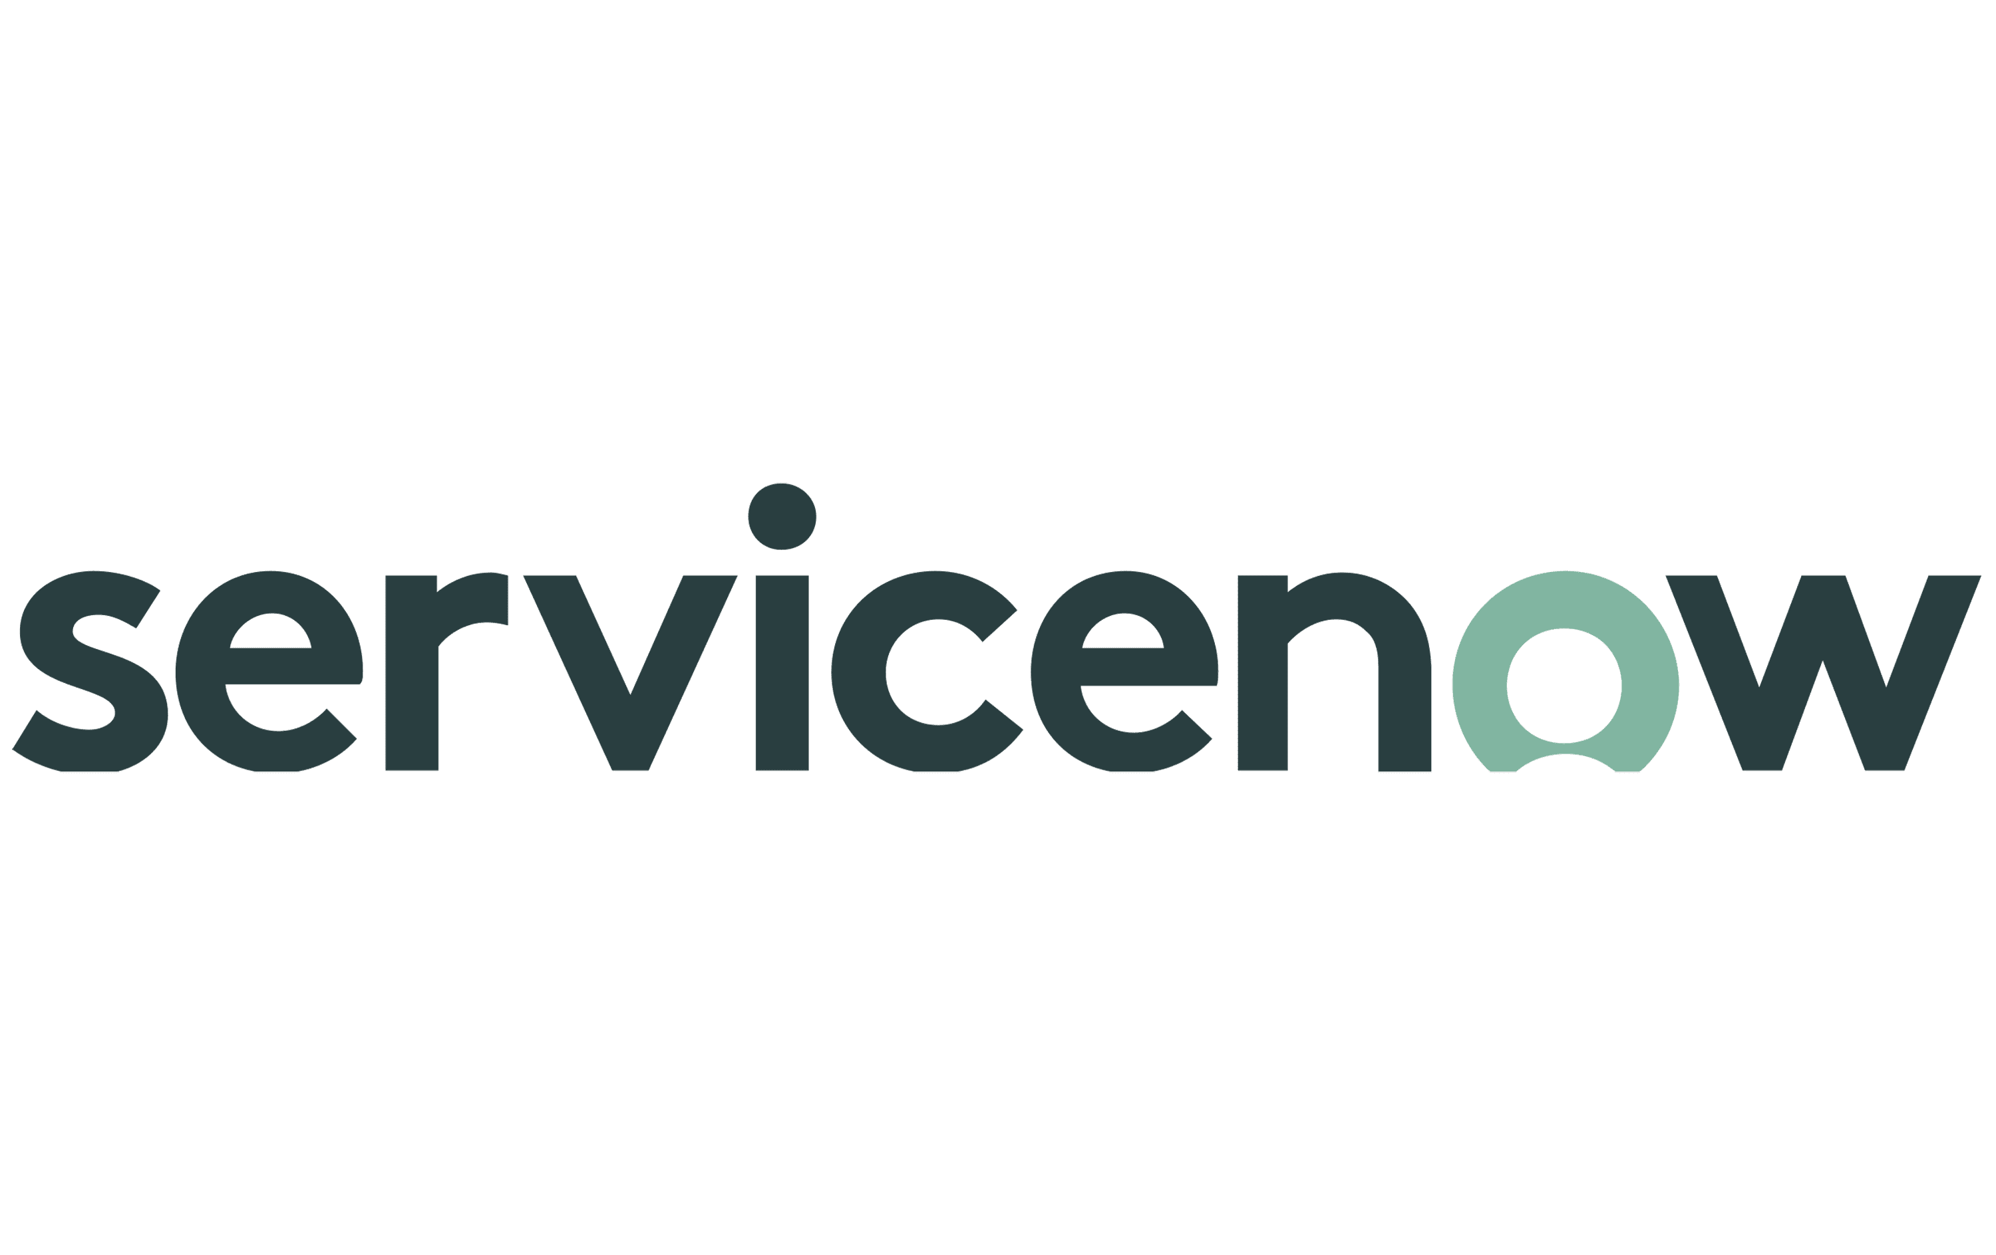
Learning 2 | My takeaways
ServiceNow
Cloud-based platform for IT service management and business process automation.
Core Components:
ITSM
ITOM
ITBM
SecOps
CSM.
Key Concepts:
Incident Management, Change Management, Service Catalog, and Workflows.

Slide 7
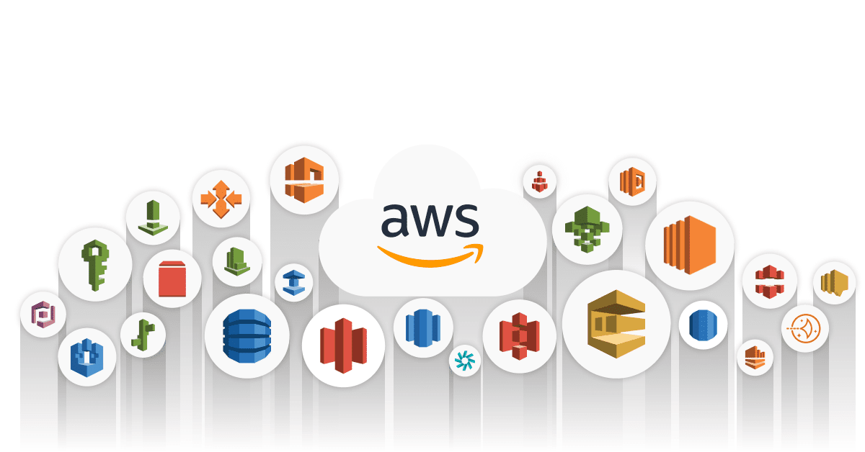
Learning 3 | My takeaways
AWS
Leading cloud services platform offering a wide range of services.
Core Service
Compute
Storage
Database
Networking
Key concepts of AWS
Scalability, Security, Cost Management, and Global Reach

Slide 8
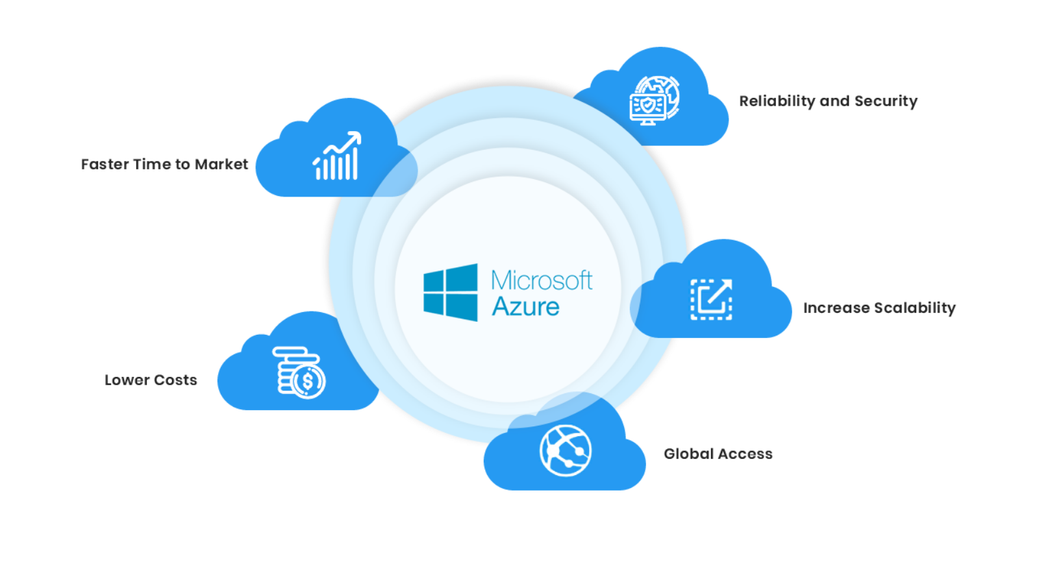
Learning 3 | My takeaways
AZURE
Microsoft’s cloud computing platform offering a wide range of services.
Core Service
Compute
Storage
Database
Networking
Key concepts of AWS
Scalability, Security, Cost Management, and Global Reach

Slide 9
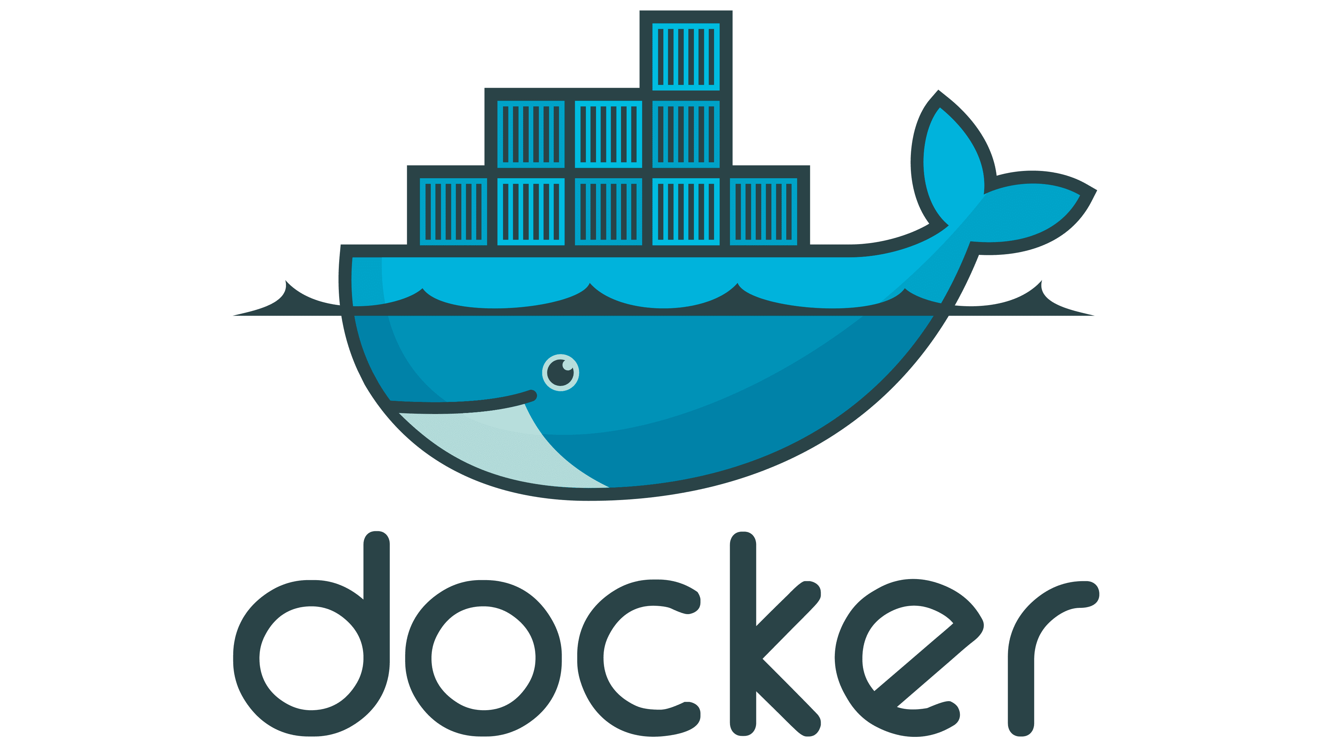
Learning 4 | My takeaways
Docker
Platform for developing, shipping, and running applications in containers.
Core Concepts:
Containers
Images
Docekrfile
Dockerhub
Dockercompose
Key Features: Portability, Efficiency, Scalability, and Isolation

Slide 10
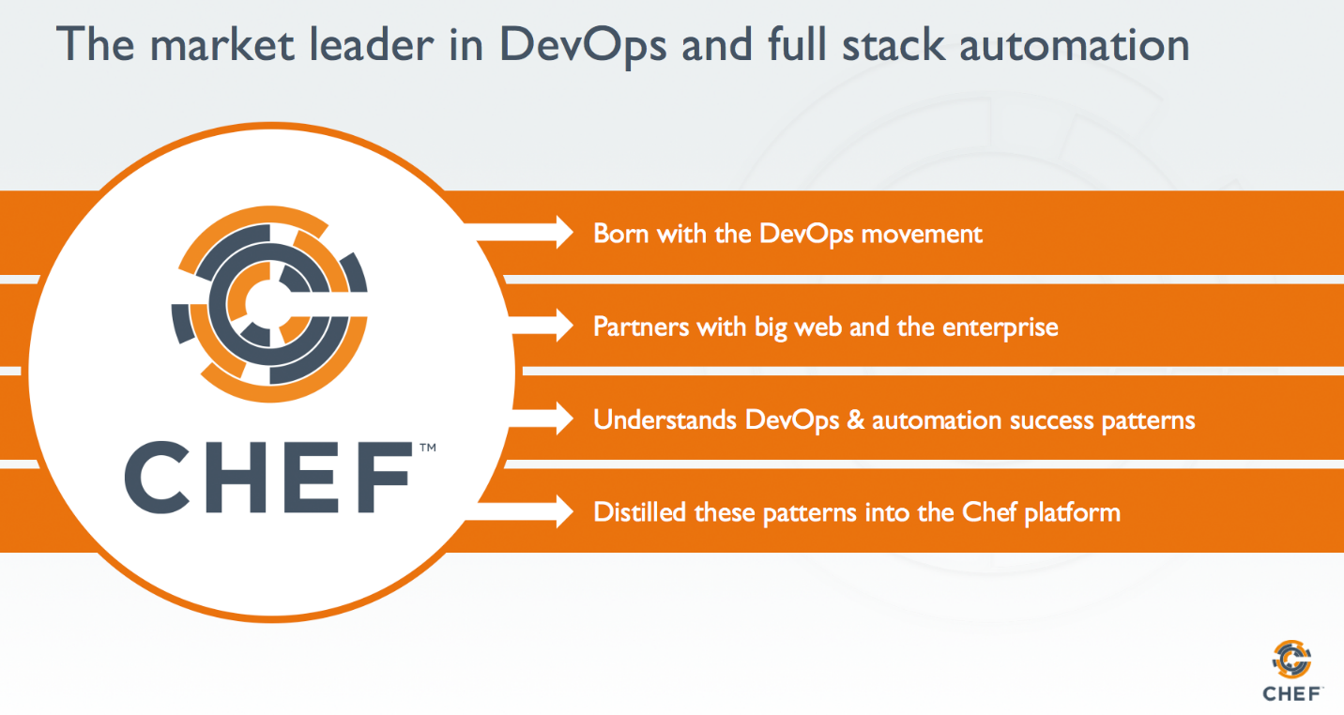
Learning 5 | My takeaways
Chef
Configuration management tool for automating infrastructure.
Core Concepts:
Recipes: Code that defines how to configure a system.
Cookbooks: Collections of recipes and related files.
Chef Server: Central repository for managing configurations.
Nodes: Machines managed by Chef.
Key Features: Automation, Consistency, Scalability, and Compliance

Slide 11

Relevance of learnings for my organization

Slide 12

Learning 1 | Relevance for Shell
ITIL skills can benefit Shell by:
Operational Efficiency: Standardized Processes and Incident Management.
Business Alignment: Service Strategy and Service Design.
Risk Management: Change Management Problem Management.
Continuous Improvement: Service Improvement and Performance Metrics.
Compliance and Security: Regulatory Compliance and Security Management.

Slide 13
Learning 2 | Relevance for Shell
ServiceNow Actions skills can benefit Shell by:
Operational Efficiency: Automated Workflows and Incident Management.
Business Alignment: Service Catalog and ITBM.
Risk Management: Change Management and Problem Management.
Continuous Improvement: Performance Analytics and Service Improvement.
Compliance and Security: Regulatory Compliance and Security Operations.

Slide 14
Learning 3 | Relevance for Shell
AWS skills can benefit Shell by:
Operational Efficiency: Elastic Compute and Automated Backups.
Business Alignment: Data Lakes and IoT Services.
Risk Management: Disaster Recovery and Security Compliance.
Continuous Improvement: Machine Learning and Cost Management.
Global Reach: Global Infrastructure and Edge Computing.

Slide 15
Learning 4 | Relevance for Shell
Azure skills can benefit Shell by:
Operational Efficiency: Virtual Machines and Azure Automation.
Business Alignment: Azure Synapse and IoT Hub.
Risk Management: Backup and Site Recovery and Security Center.
Continuous Improvement: AI and Machine Learning and Cost Management.
Global Reach: Global Data Centers and Edge Computing.

Slide 16
Learning 5 | Relevance for Shell
Docker skills can benefit Shell by:
Operational Efficiency: Containerization and Resource Efficiency.
Business Alignment: Microservices and CI/CD Pipelines.
Risk Management: Isolation and Rollback.
Continuous Improvement: Scalability and Automation.
Flexibility: Multi-Cloud Support and Portability.

Slide 17

Challenges in implementing learning

Slide 18

Challenge faced while implementing Learning 1
Challenge faced while implementing:
Understanding complex terminologies and frameworks.
Aligning ITIL processes with existing business practices.
Resistance to change from staff. High initial implementation costs.
Continuous training and certification requirements.
Measuring the ROI of ITIL implementation.

Slide 19
Challenge faced while implementing Learning 2
Challenge faced while implementing:
Customizing the platform to fit specific business needs.
Integrating ServiceNow with existing systems.
Managing data migration to the new platform.
Ensuring user adoption and training.
Handling performance issues with large-scale deployments.
Keeping up with frequent updates and new features.

Slide 20
Challenge faced while implementing Learning 3
Challenge faced while implementing:
Navigating the vast array of services and features.
Managing costs and avoiding unexpected charges.
Ensuring data security and compliance. Migrating existing applications to the cloud.
Handling scalability and performance optimization.
Understanding and implementing best practices for architecture.

Slide 21
Challenge faced while implementing Learning 4
Challenge faced while implementing:
Integrating Azure services with on-premises systems.
Managing and optimizing cloud costs.
Ensuring data security and regulatory compliance.
Migrating legacy applications to Azure.
Handling scalability and performance issues.
Keeping up with frequent updates and new services.

Slide 22
Challenge faced while implementing Learning 5
Challenge faced while implementing:
Learning containerization concepts and Docker commands.
Managing container orchestration with tools like Kubernetes.
Ensuring security and isolation of containers.
Handling persistent storage for containers.
Debugging and troubleshooting containerized applications.
Optimizing container performance and resource usage.

Slide 23

Action Plan

Slide 24
My Action Plan for this Week
Actions
Timeline
Status
Joining my Team and getting into business
Learning more about devops and data pipelining
Making more friends and collaborate with new people
1 Week
Ongoing

Slide 25

Learning is also Fun!

Slide 26
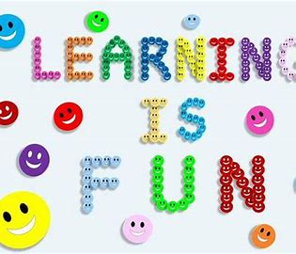
Learning is also Fun!
My learning was fun this week because of following reasons:
Teamwork
Fighting with problems
In class presentations
Assessment
Games
Networking

Slide 27

Summary
Quick summary
This week, I faced several challenges across various technologies. With ITIL, I struggled to understand complex terminologies and align processes with business practices. ServiceNow presented difficulties in customization, integration, and user adoption. AWS required navigating a vast array of services, managing costs, and ensuring data security. Azure posed challenges in integrating with on-premises systems, managing cloud costs, and ensuring compliance. Docker involved learning containerization concepts, managing orchestration, and ensuring security. Despite these challenges, I gained valuable insights into improving service delivery, streamlining workflows, optimizing costs, and enhancing scalability and security across these platforms.

Slide 28
Thank You

