Slide 1

Literature Review & Seminar
Sabyasachi Ghosal

Slide 2
Research Journey & Goals
Aug-Dec 2024
Jan – May 2025
Jan 2026 onwards
Jun – Dec 2025
I am here
Continuation of Research
…
Comprehensive exam
Research Gap identification
Making a prototype
State of the Art Seminar
Publishing a paper (if possible)
Spoken Query in Conversation
Multimodal Communication
Edge Based Solutions (Small / Micro LLMs)
Speaker Verification
Speech LLM
Edge Based Solutions
Multilingual RAG

Slide 3
Literature Review (12th Feb 2025)
Modeling Spoken Information Queries for Virtual Assistants
(SIGIR ’23, July 23–27, 2023, Taipei, Taiwan)
A SURVEY ON SPEECH LARGE LANGUAGE MODELS
(arXiv , Oct 2024)
Recent Advances in Speech Language Models: A Survey
(arXiv, Oct 2024)

Slide 4
1a. A survey on Speech Language Models
Direct Speech to text and speech to speech generation
Eliminates the need for separate ASR & TTS modules
Discrete Sequence – Discrete tokens, Sequence to Sequence Task
Continuous Sequence – Continuous representation (waveform/embeddings), Richer context (no tokenization), Multimodal interaction (speech, text & vision), Multilingual
Enables end to end spoken language understanding, dialogue & reasoning,
Expands LLM into Multimodal learning, real time conversation and audio generation
Separate Acoustic & Language Model for ASR & TTS
Traditional Speech processing pipelines like HMM-GMM, RNN-based models
Introduction of Transformer in Speech processing
Integration of Self – Supervised approach for speech representations
Models like wav2vec2.0, HuBERT bridge the gap between audio and text

Slide 5
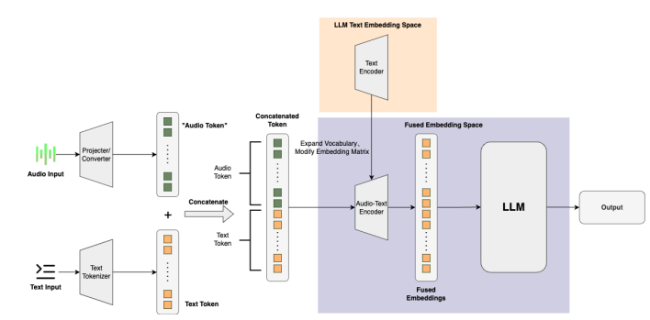
1b. A survey on Speech Language Models
Model Paradigm of Speech LLMs
S2T (Encoder – Decoder)
ST2T (Audio Encoder + Text Encoder - Decoder)
ST2ST (Audio Encoder + Text Encoder – Text Decoder + Vocoder)
Multimodal Information Fusion
Direct Projection, Token Mapping, Combination of Audio & Text Space
Training Strategies
Pretraining
Supervised Fine Tuning
RL - Usage of Reinforcement Learning in LLMs – Proximal Policy Optimizations, Direct Policy Optimizations – Rewards in model training
Performance of Speech Tasks – ASR (WER), Translation(BLEU Score)
Discussion about Pengi & SALMONN success in Multitasking & Cross-tasking abilities
LLM Dormancy
Lack of Speech Specific Adaptions – problems because of tokenization
Poor Generalisation in Noisy conditions – Diverse acoustic conditions

Slide 6
1c. A survey on Speech Language Models
Identified Research Gaps
Lack of Unified Speech-Text Representation: Continuous Embeddings & Discrete Tokens, but no unified way yet to represent speech & text seamlessly to bridge gap between written and spoken language (alignment)
Limited Multilingual and Low-Resource Language Support
End-to-End Speech Reasoning and Understanding : reasoning and long-context understanding, need for LLMs that can perform spoken question answering, summarization and dialog generation
Efficiency and Deployment Challenges

Slide 7
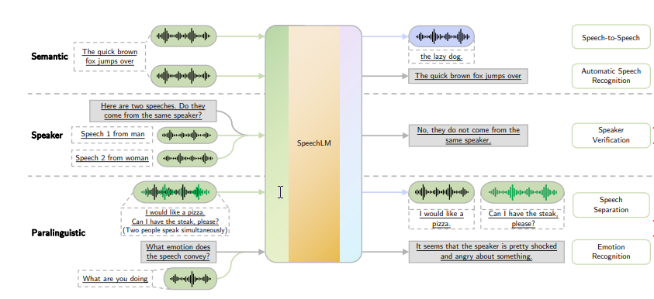
2a. Recent Advances in Speech Language Models
ASR + LLM + TTS
ASR + LLM + TTS
ASR + LLM + TTS

Slide 8


2b. Recent Advances in Speech Language Models
Design Pattern /Components of Speech LLM
Speech Tokenizer
Language Model
Token to Speech Synthesizer (Vocoder)
Semantic Understanding Objective – Waveforms to tokens
Acoustic Generation Objective – Waveforms to Acoustic Features
Mixed Objective – Semantic Understanding + Acoustic Generation
GAN-based Vocoder
GAN-based Neural Audio Codec
Pure Signal Processing Vocoder
Autoregressive Vocoder
Flow based Vocoder
VAE-based Vocoder
Diffusion based Vocoder
Decoder only
Transformer
Taxonomy of Speech Language Models
Architecture choice summary of components of Speech LLM

Slide 9
2c. Recent Advances in Speech Language Models
Modelling of features – Discrete & Continuous Features
Training Stages – Speech Tokenizer, Language Model, Vocoder
Speech Generation Paradigm – Realtime Interaction (User Interruption, Simultaneous Response), Silence Mode (When to join? When to stay silent ?)
Semantic Related - Spoken Dialogue, Speech Translation, ASR, Keyword Spotting, Text to Speech Synthesis, Intent Classification, Slot Filling, Query by Example Spoken Term Detection
Speaker Related Applications – Speaker Identification, Verification, Diarization, Voice Conditioned Speech Generation
Paralinguistic – Emotion Recognition, Speech Separation, (Isolation + Text), Paralinguistics-Enhanced Generation (Style, Pace, Singing etc)
Training Recipes
Speech LLM Applications
Understanding Different Component Choices
End to End Training – Gradients to be back propagated from vocoder to tokenizer input
Real Time Speech Generation – Delays, Soln – Speech LM generating audio samples in waveform – Gemini
Safety Risks – Privacy Concerns, Toxicity etc
Performance on Rare Languages
Research Gaps

Slide 10

3. Modeling Spoken Information Queries for Virtual Assistants
Highlights
Information retrieval from Speech driven VA
Problems & Challenges with respect to Modeling Spoken information Queries
How knowledge graphs and external data sources to remove undesirable bias in the ASR training and help in recognition of entity- rich queries
Query templatization and Entity Popularity.
“play The Look” by “Saby” => play $SONG by $ARTIST
Using Knowledge Graph (KG) relations during ASR decoding. For decoding,
“play can you moon by Saby”
“play Canyon Moon by Saby”
KG
Artist: “Saby”
Song Title: “Canyon Moon”
Notes:
The KG relationship between artist and Song Title as a signal during recognition to boost the factually correct hypothesis (b) is chosen

Slide 11

3. Modeling Spoken Information Queries for Virtual Assistants
Identified Research Gaps
Queries
Context Info
Lang Model
Who is Modi ?
Encyclopedia
Use of Query Domain Classification &
Effective Integration of Contextual signals into E2E-ASR systems
VA
Play a song “The Look”
Media Play
Integration of External LMs in E2E ASR Systems
1. Domain Classification at Runtime to guide ASR decoding
Entity Popularity Adaption Methods (Popularity in Source Application vs VA application (e.g demographics)
2. Using classification of queries at training time
Presence of Domain Gap inspite of using a large pre-trained Transformer LM to improve ASR
Personalization of ASR Query model in E2E ASR systems (e.g user models based on query behavior)
Size NNLM < Size N-Gram LM , Training NNLM on diverse datasets is difficult because of domain mismatch, federated learning

Slide 12
Research interests and Topics
Intelligent Information retrieval from Multi-modal domain(using RAGS)
Multi-modal Information retrieval in low-footprint systems (edge based systems)
Improving information retrieval from spoken queries to improve personalization

Slide 13
Next Steps
- Incorporate feedback from this session
- LLaMA – OMNI : Seamless Speech Interaction with Large Language models (https://arxiv.org/pdf/2409.06666 ) : Speech Interaction with LLMs (Pretrained Speech Encode + Speech Adaptor + LLM + Streaming Speech Decoder)
- Review paper on multimodality Dawei Huang, Chuan Yan, Qing Li, and Xiaojiang Peng, “From large language models to large multimodal models: A literature review,” Applied Sciences, vol. 14, no. 12, 2024.
- Changli Tang, Wenyi Yu, Guangzhi Sun, Xianzhao Chen, Tian Tan, Wei Li, Lu Lu, Zejun Ma, and Chao Zhang, “Salmonn: Towards generic hearing abilities for large language models,” arXiv preprint arXiv:2310.13289, 2023.
- Xiaofei Wang, Manthan Thakker, Zhuo Chen, Naoyuki Kanda, Sefik Emre Eskimez, Sanyuan Chen, Min Tang, Shujie Liu, Jinyu Li, and Takuya Yoshioka, “Speechx: Neural codec language model as a versatile speech transformer,” IEEE/ACM Transactions on Audio, Speech, and Language Processing, 2024.
- Yassir Fathullah, Chunyang Wu, Egor Lakomkin, Junteng Jia, Yuan Shangguan, Ke Li, Jinxi Guo, Wenhan Xiong, Jay Mahadeokar, Ozlem Kalinli, et al., “Prompting large language models with speech recognition abilities,” in ICASSP 2024-2024 IEEE International Conference on Acoustics, Speech and Signal Processing (ICASSP). IEEE, 2024, pp. 13351–13355.
- Soham Deshmukh, Benjamin Elizalde, Rita Singh, and Huaming Wang, “Pengi: An audio language model for audio tasks,” in Advances in Neural Information Processing Systems, A. Oh, T. Naumann, A. Globerson, K. Saenko, M. Hardt, and S. Levine, Eds. 2023, vol. 36, pp. 18090–18108, Curran Associates, Inc.
- Emiru Tsunoo, Hayato Futami, Yosuke Kashiwagi, Siddhant Arora, and Shinji Watanabe, “Decoder-only architecture for speech recognition with ctc prompts and text data augmentation,” 2024.

Slide 14
Questions
Thank You !!!!

