Slide 1

Literature Review & Seminar
Sabyasachi Ghosal

Slide 2
Research Journey & Goals
Aug-Dec 2024
Jan – May 2025
Jan 2026 onwards
Jun – Dec 2025
I am here
Continuation of Research
…
Comprehensive exam
Research Gap identification
Making a prototype
State of the Art Seminar
Publishing a paper (if possible)
Spoken Query in Conversation
Multimodal Communication
Edge Based Solutions (Small / Micro LLMs)
Speaker Verification
Speech LLM
Edge Based Solutions
Multilingual RAG

Slide 3
Research interests and Topics
Intelligent Information retrieval from Multi-modal domain(along with RAGS)
Multi-modal Information retrieval in low-footprint systems (edge based systems)
Improving information retrieval from spoken queries to improve personalization

Slide 4
Feedback from Guide (Prof Deepak KT)
Find a domain to find the gaps (automotive, consumer electronics, home IOT, medical etc.)
Difficult to make thesis on generic topics (on part time)
Combine research Interests on a domain to find the research gaps.

Slide 5
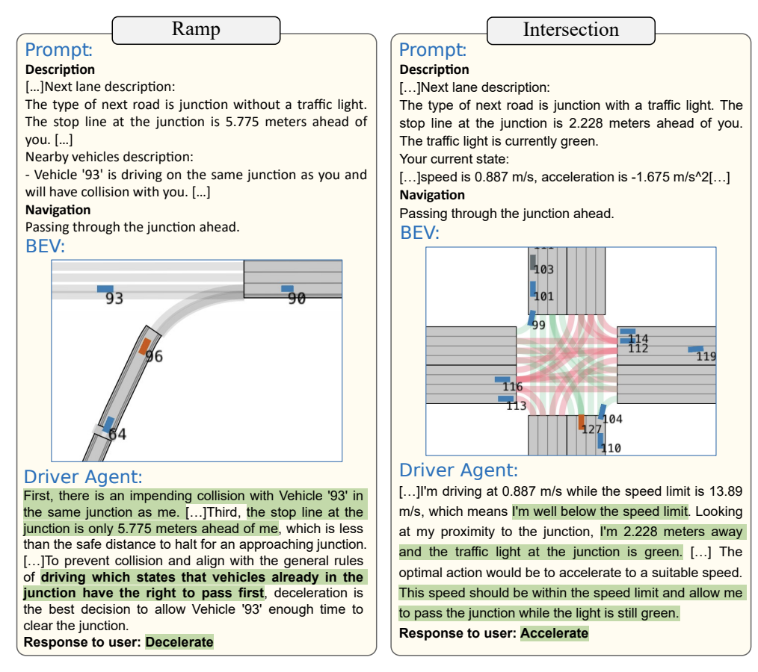
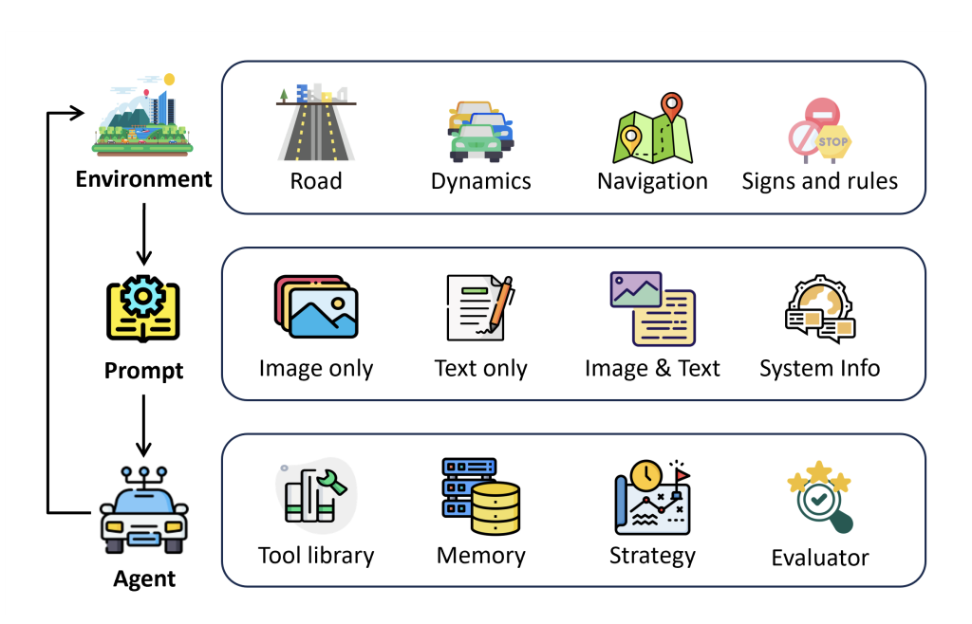
1 a. LimSim++: A Closed-Loop Platform for Deploying Multimodal LLMs in Autonomous Driving
- Open source platform for Multimodal LLM in Autonomous driving
- Closed loop infrastructure supporting continuous learning and generalization
- Prompt Engineering, Model Evaluation, Framework Enhancement
Notes:
Prompt Engineering: Users can create appropriate scenario descriptions and prompt cues for custom scenarios, facilitating the utilization of (M)LLMs for vehicle control.
Model Evaluation: Users can evaluate the performance of various (M)LLM-based models in autonomous driving within scenarios involving intricate interactive processes.
Framework Enhancement: Users can enhance submodules within the closed-loop framework we provide to achieve improved performance

Slide 6
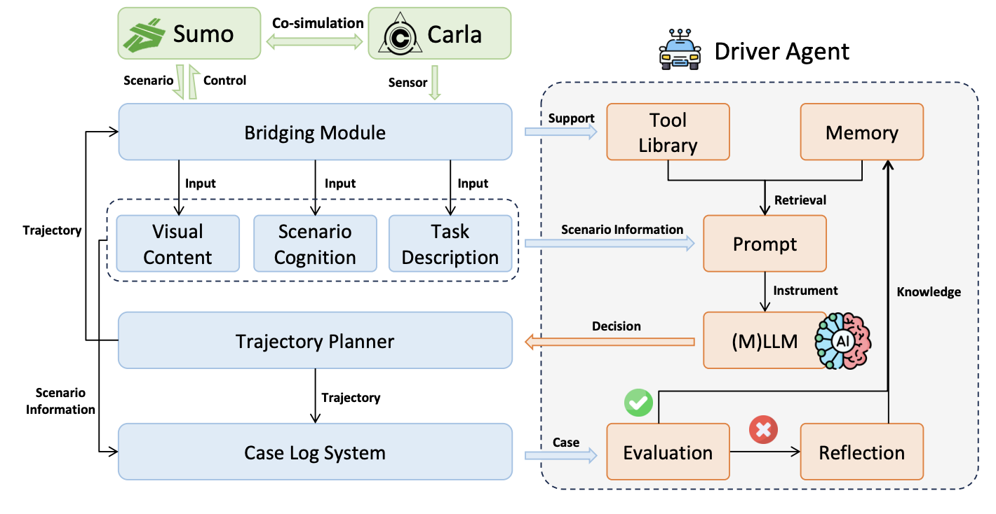
1 a. LimSim++: A Closed-Loop Platform for Deploying Multimodal LLMs in Autonomous Driving
- Well-performing reasoning and decisions are directly added to memory, while those with poor performance are added after reflection.
- Users can freely combine scenario information based on the needs of the driver agent and package it into suitable prompts.
- Zero-shot or few-shot driving approaches
judgments directly based on obtained prompts (specialised MLLMs)
Few-shot (non-specialised MLLMs)
- Performance based on ride-comfort, driving efficiency, driving safety
- GPT 3.5, 4, 4V as MLLMs

Slide 7
1 a. LimSim++: A Closed-Loop Platform for Deploying Multimodal LLMs in Autonomous Driving
Identified Research Gaps
- Due to the different execution periods of various vehicle behaviours, such as lane-changing behaviours having much longer execution periods than acceleration or deceleration behaviours. Evaluating the rationality of current vehicle decisions based on predictions of future scenarios, particularly the motion predictions of surrounding vehicle trajectories, appears to be promising.
- Some constraints in experiments like 80sec for each scenario.
- Real World Validation, This is a simulation platform

Slide 8
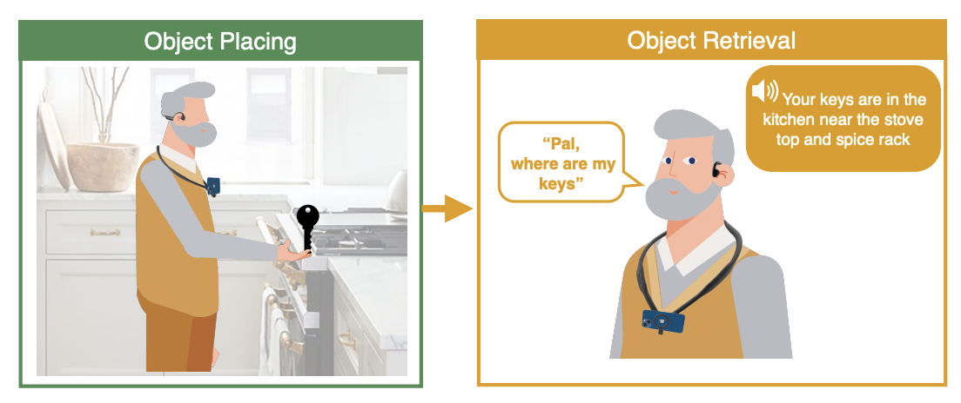
2 a. MemPal: Leveraging Multimodal AI and LLMs for Voice-Activated Object Retrieval in Homes of Older Adults
Multimodal Integration: Visual Data + Voice interface passed into LLMs to generate text diary to be queried.
Additional use cases like context-based proactive safety reminders and recall of past actions.
Qualitative & Quantitative study with 15 older adults with fixed set of objects.
Result - Improved retrieval performance and reduced recall difficulty compared to no aid but similar to visual aid.
MemPal, a wearable memory assistant designed to aid older adults in locating misplaced objects within their homes.
Creates an automated text diary of the user's activities, enabling efficient object retrieval assistance.

Slide 9
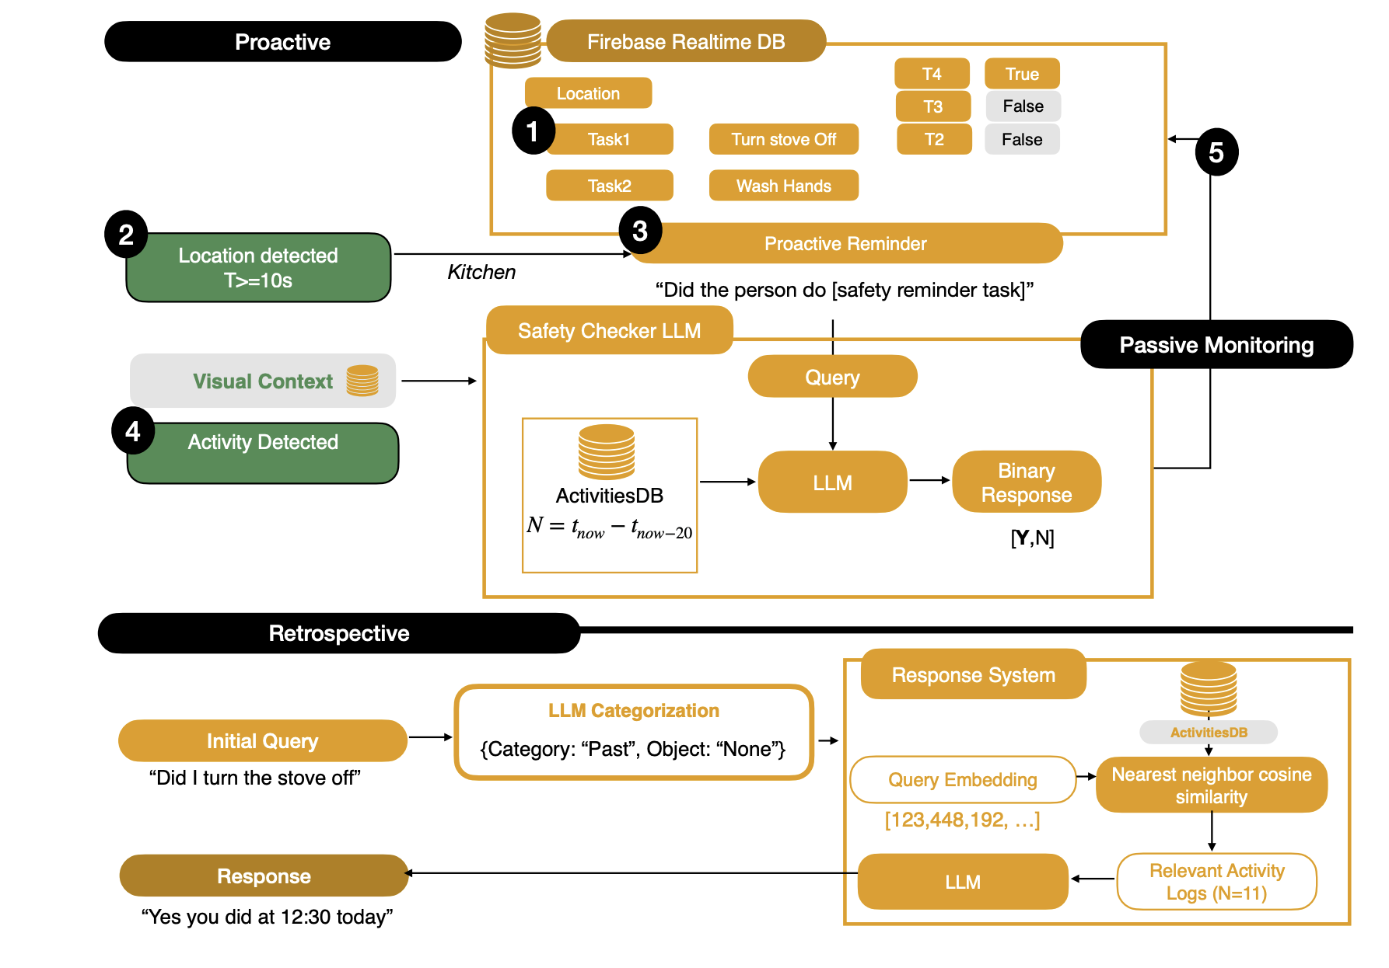
2b. MemPal: Leveraging Multimodal AI and LLMs for Voice-Activated Object Retrieval in Homes of Older Adults
- Safety Reminder Implementation system. Workflow for proactive reminders, retrospective task remembering, passive monitoring.
- Camera preprocessing, visual feature extraction, and LLM query/ processing are designed to be reused for multiple features besides object finding.
- Object Finding & retrieval techniques, Latency, query log fetching techniques

Slide 10
2b. MemPal: Leveraging Multimodal AI and LLMs for Voice-Activated Object Retrieval in Homes of Older Adults
Identified Research Gaps
- Privacy Concerns: Continuous visual monitoring may raise privacy issues among users.
- System Reliability: The accuracy of object recognition and activity logging in diverse home environments needs further validation to ensure consistent performance.
- User Adaptation: Investigating the long-term acceptance and adaptability of older adults to wearable assistive technologies like MemPal is essential for widespread adoption.

Slide 11
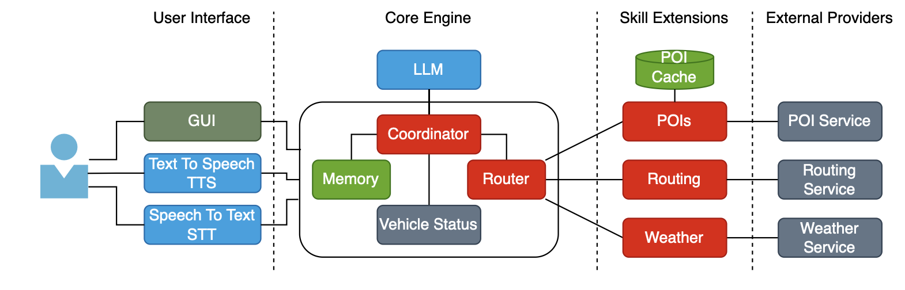
3a. Demo: Towards a Conversational LLM-Based Voice Assistant for Transportation Applications
Problem:
LLMs lack sufficient understanding
of geospatial data
timely information, such as weather and traffic conditions
Solution – KIIT (Knowledge-based Intelligence for Transportation Technologies)
- in-car assistant capable of verbally communicating with the driver, and by utilizing external APIs
- Customizable speech synthesizer, is accessible through a graphical user interface that facilitates experimentation by simulating the change in time, origin, destination, and location of the car.

Slide 12
3a. Demo: Towards a Conversational LLM-Based Voice Assistant for Transportation Applications
Example: Is there a Pizzeria nearby?
the LLM decides that it must call a function to obtain nearby restaurants.
The function is now called with specified arguments and the results (restaurants) are obtained.
They are then placed into the prompt to execute another query, and let the LLM find the correct
answer, i.e. the closest or highest rated Pizzeria.
Identified Research Gaps
- Effective Geospatial Embedding: Still the necessity to reach cloud, any approach which can do the computation at edge.
- Timely Information Accessibility: Ensuring that LLMs can access and process real-time data, such as dynamic traffic updates, remains a challenge.
- User Experience Evaluation: Further research is needed to assess the impact of such assistants on driver distraction and overall user satisfaction.

Slide 13
Questions
Thank You !!!!

