Slide 1
Naive Bayes Classifier and Spam Filtering
Valentini Ivan

Slide 2
The Naive Bayesian Classifier
The Naive Bayesian classifier is based on Bayes' theorem with indipendence assumptions between predictors;
A Naive Bayesian model is easy to build, with no complicated iterative parameter estimation which makes it particularly useful for very large datasets;
Despite its simplicity, the Naive Bayesian classifier often does surprisingly well and is widely used because it often outperforms more sophisticated classification methods.

Slide 3
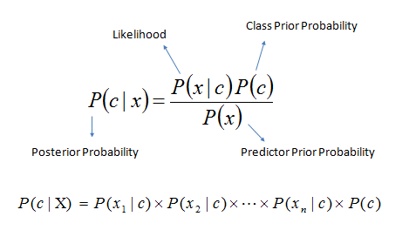
How it works
Bayes theorem provides a way of calculating the posterior probability, P(c|x), from P(c), P(x) and P(x,c).
NB classifier assumes that the effect of the value of a predictor (x) on a given class (C) is independent from the values of the predictors.
This assumption is called class conditional indipendence.
P(c|x) is the posterior probability of a class given a predictor;
P(C) is the prior probability of a class;
P(x|C) is the likelihood, which is the probability of a predictor given a class;
P(x) is the prior probability of a predictor.

Slide 4
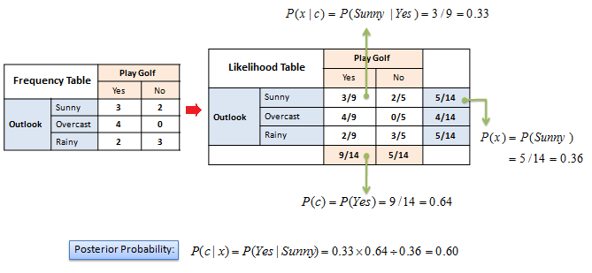
Example
The posterior probability can be calculated by first, constructing a frequency table for each attribute against the target; then, transforming the frequency table to a likelyhood table and finally using the Naive Bayes equation to calculate the posterior probability for each class.
The class with the highest posterior probability is the outcome of the prediction.

Slide 5
Project
The idea is to implement a simple email spam filter using the Naive Bayes classifier.
The project type is Algorithmic.
Matlab was used to develop the project.
The dataset used is a preprocessed subset of the Ling-Spam Dataset; the complete raw data can be downloaded from: http://www.aueb.gr/users/ion/data/lingspam_public.tar.gz
All the preprocessed mails used in the experiment are included in the files of the project.

Slide 6
Data Description
The dataset is split into two subsets: a 700 email subset for training and a 260-email subset for testing. Each of the training and testing subsets contain 50% spam messages and 50% nonspam messages. Additionally, the emails have been preprocessed in the following ways:
1. Stop word removal: Certain words like "and," "the," and "of," are very common in all English sentences and are not very meaningful in deciding spam/nonspam status, so these words have been removed from the emails.
2. Lemmatization: Words that have the same meaning but different endings have been adjusted so that they all have the same form. For example, "include", "includes," and "included," would all be represented as "include." All words in the email body have also been converted to lower case.
3. Removal of non-words: Numbers and punctuation have both been removed. All white spaces (tabs, newlines, spaces) have all been trimmed to a single space character.
All these mails are divided within 4 folders in the project root named "nonspam-test", "nonspam-train", "spam-test", "spam-train"; a backup of the dataset is inside the folder named "dataset complete".

Slide 7
Script files
The project contains 5 matlab scripts.
The execution sequence for the scripts is:
1) dictionary.m - this script creates a dictionary with all the words in the mails within the 4 folders we discussed before, showing the user how many mails are being analyzed. At the start of the script the variable "numTokens" determines how many words will be used to calculate the features in the next step.
2) features_train.m - this script calculates the features for all the mails in the training set, the computation needs a lot of time to be completed (whole training set of 700 mails takes around 6 minutes); the result is a matrix which contains the features for any mail in the training set and an array containing their class. A feature in the matrix is represented by: a numeric identifier for the mail, an index for a word contained in both the mail and the dictionary, the occurencies of that word in the mail.
3) features_test.m - same as before but on the test set.
4) train.m - this script calculates all the prior probabilities for any word to be present in spam or nonspam mail using the features calculated in the step number 2.
5) test.m - this script predict a class for any mail in the test set using the features calculated in the step 3. It then confronts the results with the labels to count how many mistakes were made and calculate the error over the whole test set.

Slide 8
Execution Parameters
The only variable editable in the scripts is "numTokens" in the "Dictionary.m" script. Now set to 2500. A smaller number reduces the probability to classify correctly a mail (2500 -> 6 err., 500 -> 11 err.).
All the other paramaters are automatically calculated based on the number of files contained in the folders "nonspam-test", "nonspam-train", "spam-test" and "spam-train".
Right now the training set contains 150 spam and 150 nonspam mails in order to make the computation time shorter. A smaller number of mails in the training set reduces the probability to classify correctly a mail (300 -> 6 err., 100 -> 8 err.).
Copy the 4 folders from the backup folder in the root of the project to test the whole dataset.

