Slide 2
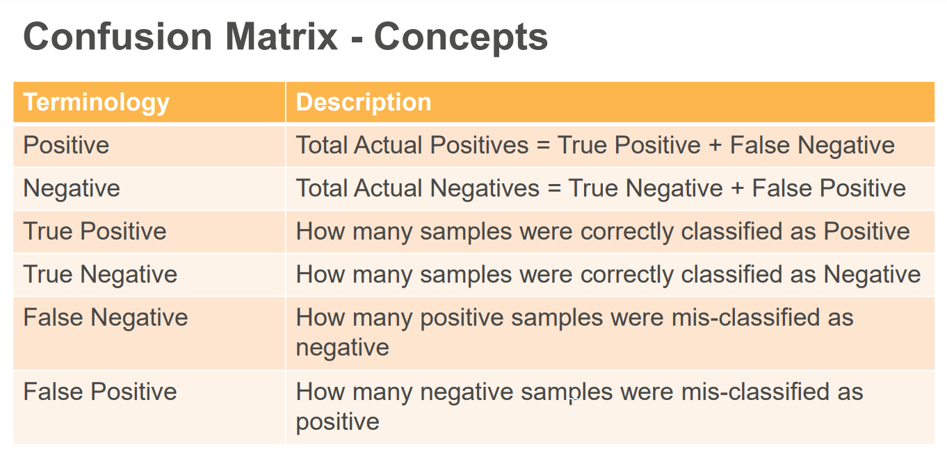
Confucion Matrix

Slide 3
Process Layer
https://www.tensorflow.org/guide/keras/preprocessing_layers

