Slide 1


Your Digital Footprint
Staying safe online, and protecting your future
Notes:
⚡ WAYGROUND: add a POLL question after this slide.
Question: "How many hours a day do you spend online?"
Options: Less than 2 · 2–4 · 4–6 · More than 6
Why: a no-wrong-answer warm-up. Everyone takes part and you get a quick read of the room.

Slide 2

What is a Digital Footprint?
The trail of information you leave online. It lasts longer than you think.
Everything you post, like, share and comment on
Photos and tags other people post of you
Data collected by apps and websites as you browse
Notes:
⚡ WAYGROUND: add a MULTIPLE CHOICE question after this slide.
Question: "You delete a post an hour after sharing it. Is it gone from your digital footprint?"
Options: Yes, deleted means gone · No, it may already be screenshotted, shared or saved (correct) · Only if nobody liked it · Yes, after 24 hours
Why: instant check for understanding, and it tackles a common misconception.

Slide 3

Active vs Passive Footprint
Active: you choose to share it
Passive: collected without you noticing
1
Posting a photo or video
📍
Your location from apps
2
Commenting on a post
🍪
Cookies tracking your browsing
3
Filling in an online form
🔎
Your search history
4
Liking or sharing content
5
🏷️
Tags in friends' photos
Writing a review
Notes:
⚡ WAYGROUND: add a CATEGORISE (sort) question after this slide.
Question: "Sort these into ACTIVE or PASSIVE footprint."
Items: Posting a TikTok (active) · Leaving a Google review (active) · Signing up for a giveaway (active) · An app tracking your location (passive) · Cookies on a shopping site (passive) · Your IP address being logged (passive)
Why: learners apply the idea instead of just recalling it. Results show which items cause confusion.

Slide 4
Who Might Look You Up?
01
Employers
04
Landlords
02
Universities
05
Scammers
03
Apprenticeships
06
Future you
Notes:
⚡ WAYGROUND: add a OPEN-ENDED question after this slide.
Question: "An employer searches your name tomorrow. What would you want them to find, and what would you NOT want them to find?"
Why: gives every learner a voice, including quieter ones. Show answers anonymously on screen to start a discussion.

Slide 5
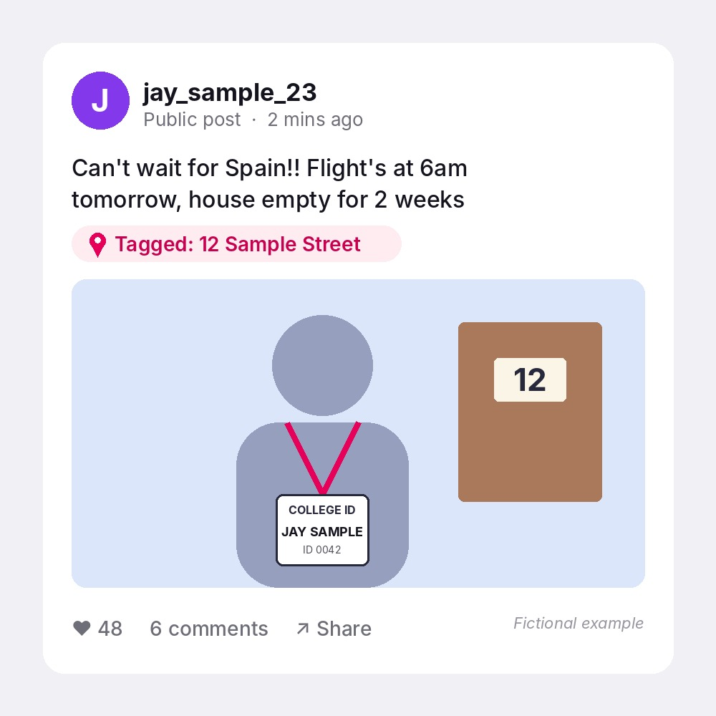
Spot it
2 minutes
What does this post give away?
Look closely at the words, the tag and the photo.
How many risks can you find?
Notes:
⚡ WAYGROUND: add a HOTSPOT question after this slide.
Question: "Click on the part of the post that tells a burglar the house will be empty." Upload the post image from this slide into the Hotspot question.
Correct area: the caption "house empty for 2 weeks".
Run it again or follow up with: the location tag (home address), the door number in the photo, the full name on the college ID, and the "Public" setting.
Why: visual and hands-on, which suits learners with lower reading confidence. The post is fictional.

Slide 6

Protect Your Footprint
Check your privacy settings
🔒
Your footprint, your future
Small habits now protect your reputation and your safety later.
Quick check
When did you last search your own name online?
Three random words + 2SV
🔑
Turn off location tagging
📍
Notes:
⚡ WAYGROUND: add a FILL IN THE BLANK question after this slide.
Question: "The National Cyber Security Centre recommends a password made of ___ random words."
Answer: three (also accept 3)
Why: quick recall check with no options to guess from.

Slide 7
THINK Before You Post
Five questions to ask before you hit "share"
True: is it accurate?
Helpful: does it help anyone?
Inspiring: would you be proud of it?
Necessary: does it need saying?
Kind: could it hurt someone?
If the answer to any of these is "no", think again before posting.
Notes:
⚡ WAYGROUND: add a MATCH question after this slide.
Question: "Match each letter of THINK to its word."
Pairs: T = True · H = Helpful · I = Inspiring · N = Necessary · K = Kind
Why: low-stakes memory check that works well as a quick fire round.

Slide 8
Regret a Post? What To Do
Act quickly, but don't panic
Most things can be limited if you act fast.
Steps to take:
1. Delete the post from your account
2. Ask friends to remove shares or tags
3. Check and tighten your privacy settings
4. Search your name to see what still shows
5. Talk to someone you trust if it is worrying you
Notes:
⚡ WAYGROUND: add a REORDER question after this slide.
Question: "Put these steps in the right order." (Wayground shuffles them for learners.)
Correct order: Delete the post · Ask friends to remove shares or tags · Tighten privacy settings · Search your name · Talk to someone you trust
Why: checks understanding of a process, not just facts.

Slide 9
Get Help
Something worrying you online? Tell someone.
Your tutor or any member of staff you trust
The college Designated Safeguarding Lead (DSL)
CEOP, if someone online is making you feel unsafe
Notes:
⚡ WAYGROUND: add a MULTIPLE CHOICE (or Poll) question after this slide.
Question: "Who in college should you tell if something online is worrying you?"
Options: Nobody, just block them · Any member of staff you trust, or the DSL (correct) · Only your friends · Post about it online
Why: makes sure every learner leaves knowing where to go for help.
Swap in your college's own DSL name or contact details on the slide.

Slide 10
Your footprint, your future
One thing you'll change today?
Notes:
⚡ WAYGROUND: add a DRAW (exit ticket) question after this slide.
Question: "Draw or write one thing you will change about your online profile this week."
Why: creative exit ticket. Drawing gives learners who struggle with writing another way to respond.

