Slide 1
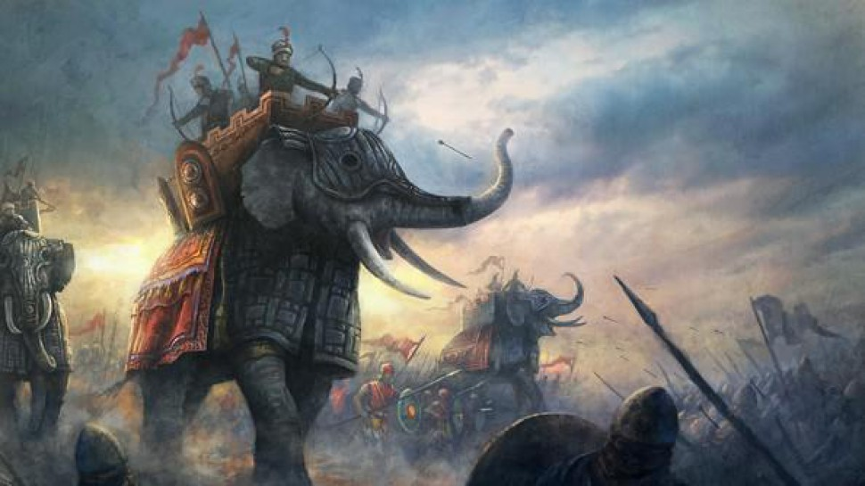
Đại việt Empires
2018
2TT – Two ‘T’ Team

Slide 2
Overall
A
Category : Tower defense
Story : The story of the war against northern enemies during 4000 years ago.
Different and Specific :
First tower defense about Vietnam history
During story you can collect hero and using them for battles with your strategy.
Heroes are famous warrior of Vietnam’s history such as: An Dương Vương, 2 bà Trưng, Lê Lợi …
Enemies are famous warrior of Chinese.
Heroes and enemies have their specific skill ( example : An Dương Vương’s skill is “ Nỏ thần “ …) , skill name is funny.
Enemy can attack hero.
Game play:
As most tower defense game, kill enemy, pass battle, collect gold to upgrade hero’s level.
Collect diamond to buy hero and unlock skills

Slide 3
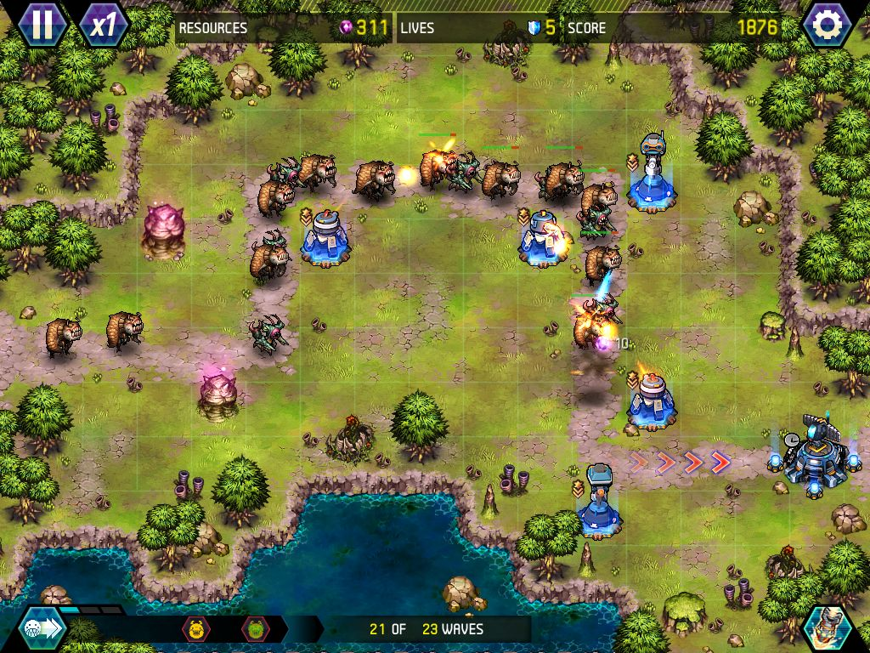
Art Style
Simplicity is first
Character style : http://ngocrongonline.com/
Heroes stand on a place and can not move
Skill affect in a limit arena.
Plz comment your ideas for this path.

Slide 4
UI
Screens in game
Splash screen
Main screen
Map screen
Battle screen

Slide 5
Splash Screen
Target : Make impression for player, and they will remember it to recognize us.
Contain : Logo ,Slogan and some animation, sound
Time exists : 1.5s
Some thing like right picture =>
Do bigger things

Slide 6
Main Scene
Assets info (gold, diamond ..)
Maybe this is the most different of game.
Start with a hero who repression for player
Can create name, select one type character.
List hero to unlock with gold or diamond
Unlocked heroes and locked heroes.
List idle task to get gold
Like a idle game, resource can get automatic by some task
Gold in battle is enough for update but not enough for buy hero. (Need time for clear my idea ☺)
List
Idle task
To collect gold
List hero
Some button such as map, event ..

Slide 7
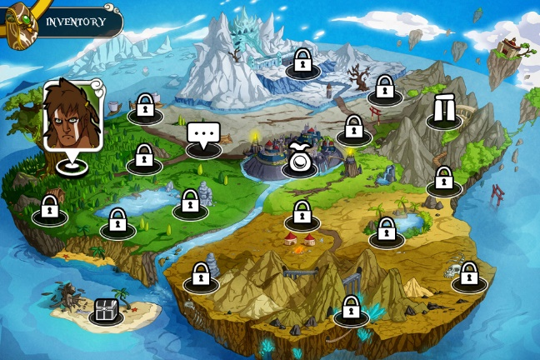
Map Scene
Refer to time stone of Vietnam’s history.
Divided into stages
End of stages is a famous match
Information about hero will can unlock and enemy will attack

Slide 8
Battle Scene
Position to place warrior
Match information
Game play like another tower defense game. Enemies attack in some waves.
Player have some warrior items which always unlock such as swordsman and archers.
List heroes of player (The heroes are collected or bought by player)
In the big battle, appear hero of enemies. They have power and skill.
Not only warrior attack enemies, enemies can attack warrior.
Gold is collected when kill enemy and pass match
List warrior can buy to join battle

