Slide 1

Signal Processing Project
Team Members:
Abhishek Sharma (2022102004)
Abhinav S (2022102037)
Himanshu Yadav (2022102010)
Team Name: Mixed Signals

Slide 2
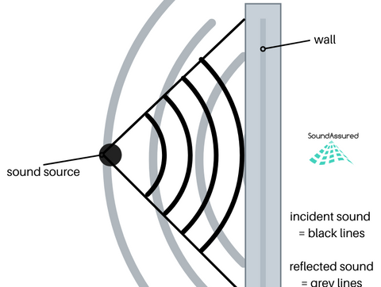
Part 1 – ECHO CREATION

Slide 3
ECHO
The reflection of sound waves from rigid surfaces such as walls, cliffs etc. causes echo in sound
Which creates sound which can be heard even after the original sound from source has died out.
This is due to delay in echoes due to reflection phenomenon. Since sound is a wave and is not
100% reflected from any surface, the echo we hear is attenuated to a certain extent thus making
It sound different from original signal.
When echo is reflected by multiple surfaces, multiple echoes can be heard of the same signal.
However, on each reflection the signal is further attenuated and thus echoes are lost after some time.

Slide 4
ECHO CREATION USING FILTERS
For any signal echo can be created by attenuating the original signal and then adding it with a specific delay
To the signal which will thus have same properties as the echo in a natural setting however for making sure of
Multiple echoes, the signal can be attenuated further and then delayed before adding it to above signal
to make it sound more natural.
The above function can be done by a simple filter consisting of some impulses whose height can be chosen
Based on the level of attenuation which are spaced as per the required delay between echoes. Applying this
Filter on given input thus gives the required echo effects.

Slide 5
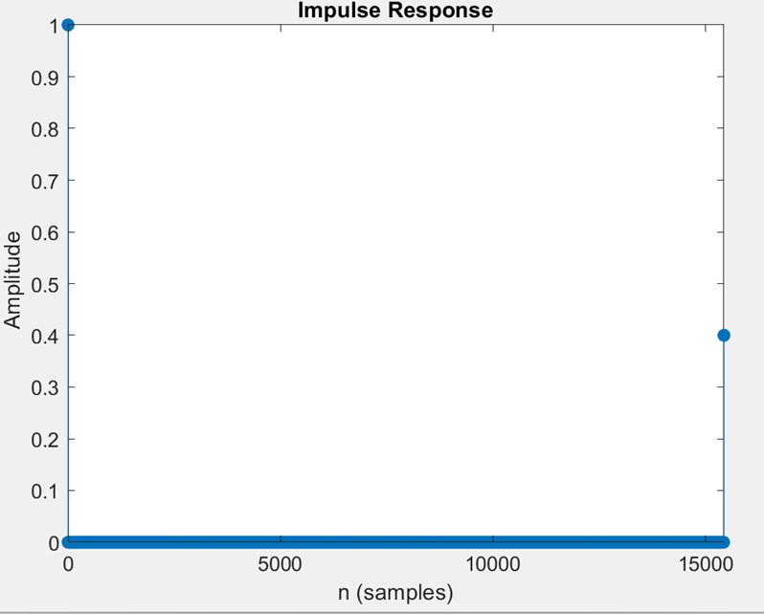
Now, for finding the desired filter for this purpose, attenuation is taken from user, which is the value of impulse at a fixed
Delay specified by user again.(Delay = Delay Time(in seconds)*Fs)

Slide 6
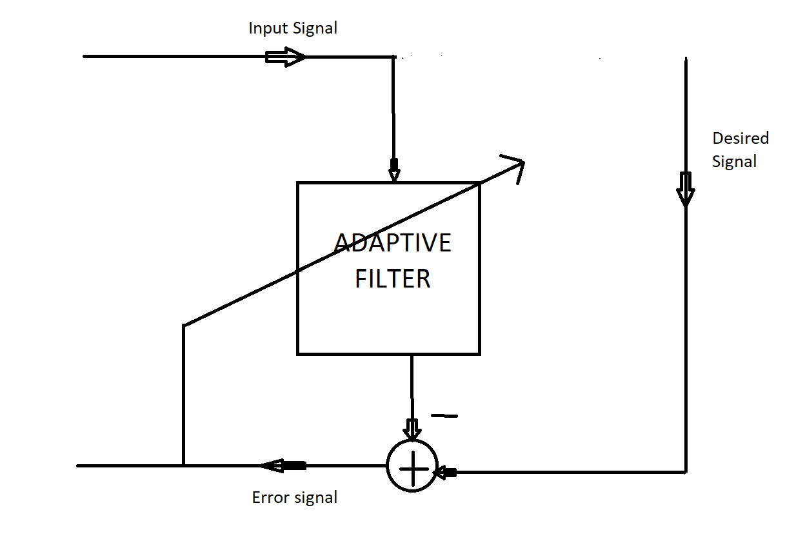
PART 2 – CANCEL THE ECHO

Slide 7
ECHO CANCELLATION
For this task, we are given the original signal and an input signal out of which echo is to be cancelled
Based on some signal processing technique such that the output resembles original signal as much as
Possible. The algorithm used for this part is Least mean square ADAPTIVE FILTERING where a filter is
Made for echo cancellation based on the least mean square error between the original signal and
Output signal at every instant and based on this value the next filter value is determined.

Slide 8
FILTER IMPLEMENTATION
We have an input signal x(n) which has echo. d(n) is the desired signal . w(n) is the filter coefficients of the
Adaptive filter. We wish to adapt the filter such that output y(n) of the adaptive filter resembles the desired
signal d(n) as much as possible
For this , as we move through signal by taking windows of length equal to that of the order of the
adaptive filter ,x’(n) which is the time delayed-input at time n , the filter coefficients are updated at each iteration.
This is updated such that mean square error of e(n)=d(n)-y(n) is minimized.
The LMS algorithm is applied by using this formula for calculating the coefficients of filter
w(n+1)=w(n)+2µe(n)x’(n)
Here, e(n) is the error signal,
w(n) is the value of filter Tap weights corresponding to current iteration and w(n+1) is the value of filter Tap
weights of the next iteration,
x’(n) is the time-delayed signal at time n
µ is a constant

Slide 9
Parameters in Adaptive Filtering
µ(step size):If it is small,the convergence towards the optimum filter is more stable but it will be slow and
might take too many iterations to converge.If it is large,convergence is faster or adaptation is faster but might lead
to divergence if environment is unstable.
2.Filter order:The Filter order selected depends on the input.If the input doesn’t have rapid fluctuations,then a lower
filter order might be sufficient.Otherwise,a higher filter order is needed.Another factor that impacts it is the
computational complexity that out system can handle.

Slide 10
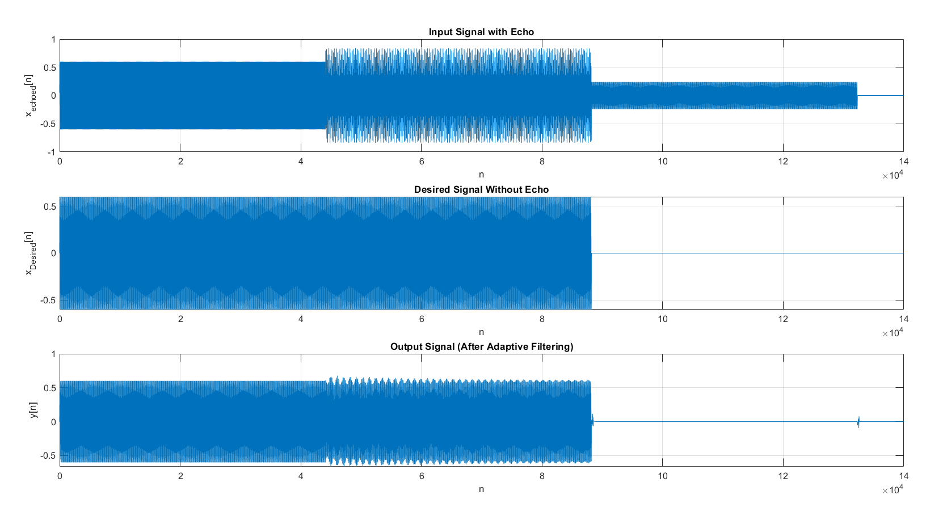

Slide 11
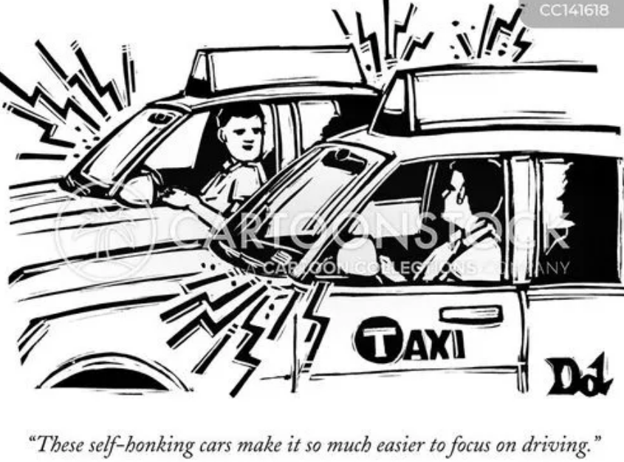
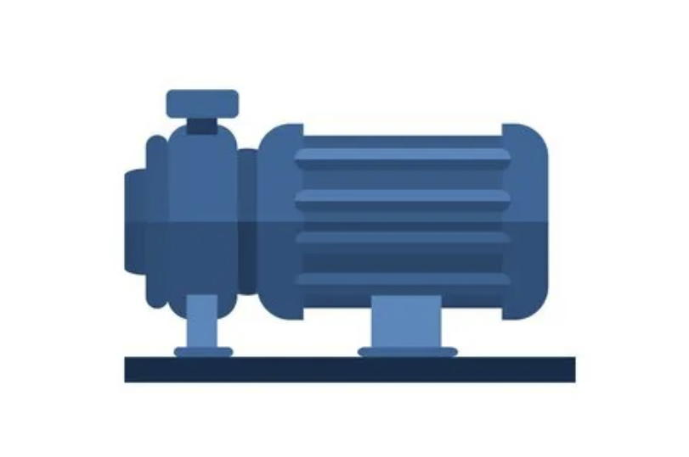
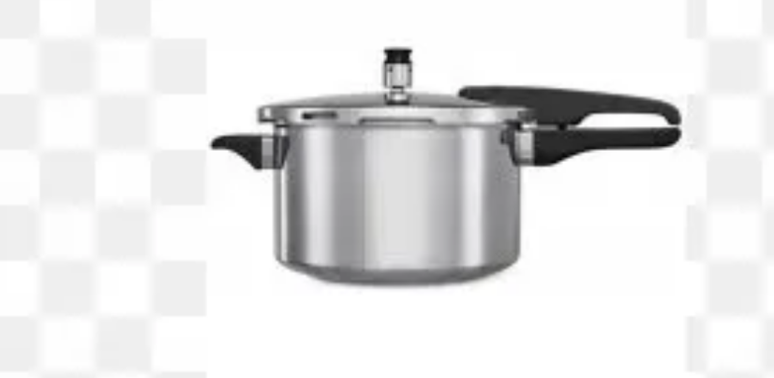
PART 3 – WHAT IS THIS NOISE?

Slide 12
NOISE CLASSIFICATION
In this task, we are given an audio signal, and we are required to classify the noise present in signal as one of the
Following types:
Pressure Cooker
City Traffic
Ceiling Fan
Water Pump
For classifying noise, we have used MEL Spectrogram which gives us a frequency vs time relation and thus we
Concentrate on the noisy part(higher frequencies) and based on characteristics of above noise types, it is
Classified on one of them.

Slide 13
SHORT TIME FOURIER TRANSFORM(STFT)
When we compute DFT of a discrete time signal x[n],we can find the frequency components in the signal. We can find
the what frequency components are dominant but not when .So, we don’t have information about the temporal
Characteristics of the data.
In STFT, we divide the signal into small segments of some specific window length for which the audio remains stationary
and compute its DFT locally. For speech, this is taken around 20-30ms. The DFT can be computed using computationally
efficient algorithm like FFT.
This is done by taking frames throughout the signal considering some jump size typically half of the window size.
The overlap between frames allows us to keep track of the characteristics of the signal.

Slide 14


Parameters in STFT
STFT provides us with information of frequency components of the signal at each frame of the signal
The various parameters to be chosen for doing STFT are:
1.Frequency bins: The number of frequency bins refers to the number of frequency components needed
To get an idea of the magnitude of each frequency. The signal is assumed to be real. So, the magnitude response
will be symmetric.
$$N_{frequencybins}=\frac{windowsize}{2}+1$$
2.Frames:Number of frames depends on the number of the samples in the signal as well as window size.
$$frames=\frac{samples−framesize}{hopsize}+1$$

Slide 15

Windowing
Before computing DFT, windowing is done in order to make the signal narrow towards the ends of the frame
So, finally STFT can be calculated as:
$$S\left(m,k\right)=\sum_{n=0}^{N−1}{x\left(n+mH\right).w\left(n\right).e^{−\frac{i2πkn}{N}}}$$
where x is the input signal. m is the frame number, H is the hop size, N is the window size
and w(n) is the windowing function.
Typical windows used for this purpose are Hanning or Hamming window.

Slide 16
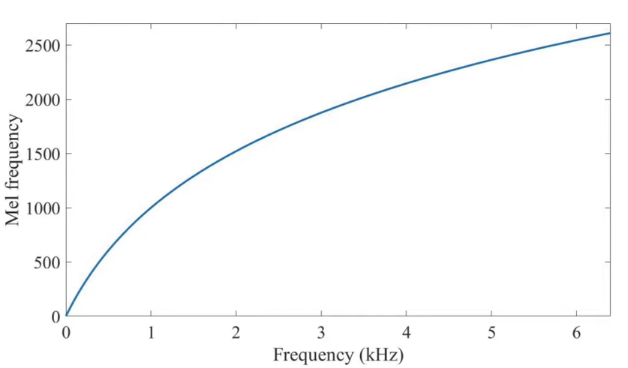
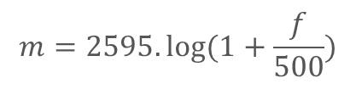
MEL SCALE
Frequencies are not perceptible to human ear in Hz scale. We can differentiate between 300Hz and 310Hz but
we can’t differentiate between 2000 and 2010Hz which have the same absolute difference between them.
So, for this we convert the frequencies in Hz to a scale where we can differentiate between the frequencies
by listening the same absolute difference of two frequencies.
This is called MEL scale.
The conversion between the two can be performed by:
$$f=100.({10}^{\frac{m}{2595}}−1)$$
$$m=2595.log⁡(1+\frac{f}{500})$$
where m is frequency in Mel and f frequency is Hz.

Slide 17
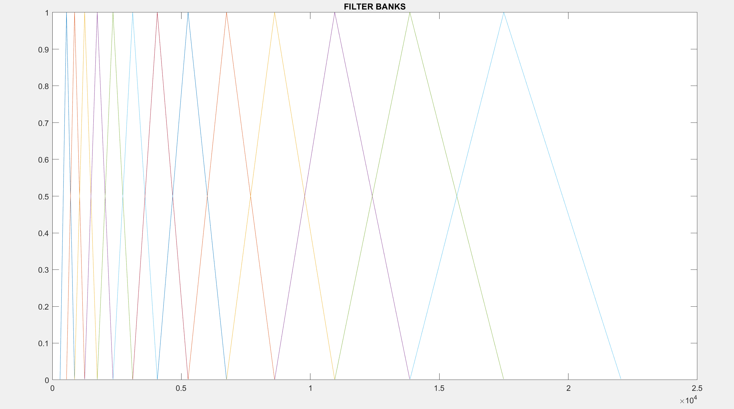
FILTER BANKS
While designing MEL filter banks, we have to choose the number of frequency bins we will be using. Suppose we choose K bins. Then, K equally spaced frequencies is taken in the MEL scale between the low(300Hz) and High(Sampling Frequency/2) is taken.
Then it is converted to Hz and then filter banks are constructed between them as shown in the diagram.
The Power spectrum of the signal is passed through the Mel filter bank to get the MEL bands.
In the Project ,the MEL bands of the signal has been compared to classify the noises by careful inspection.

Slide 18
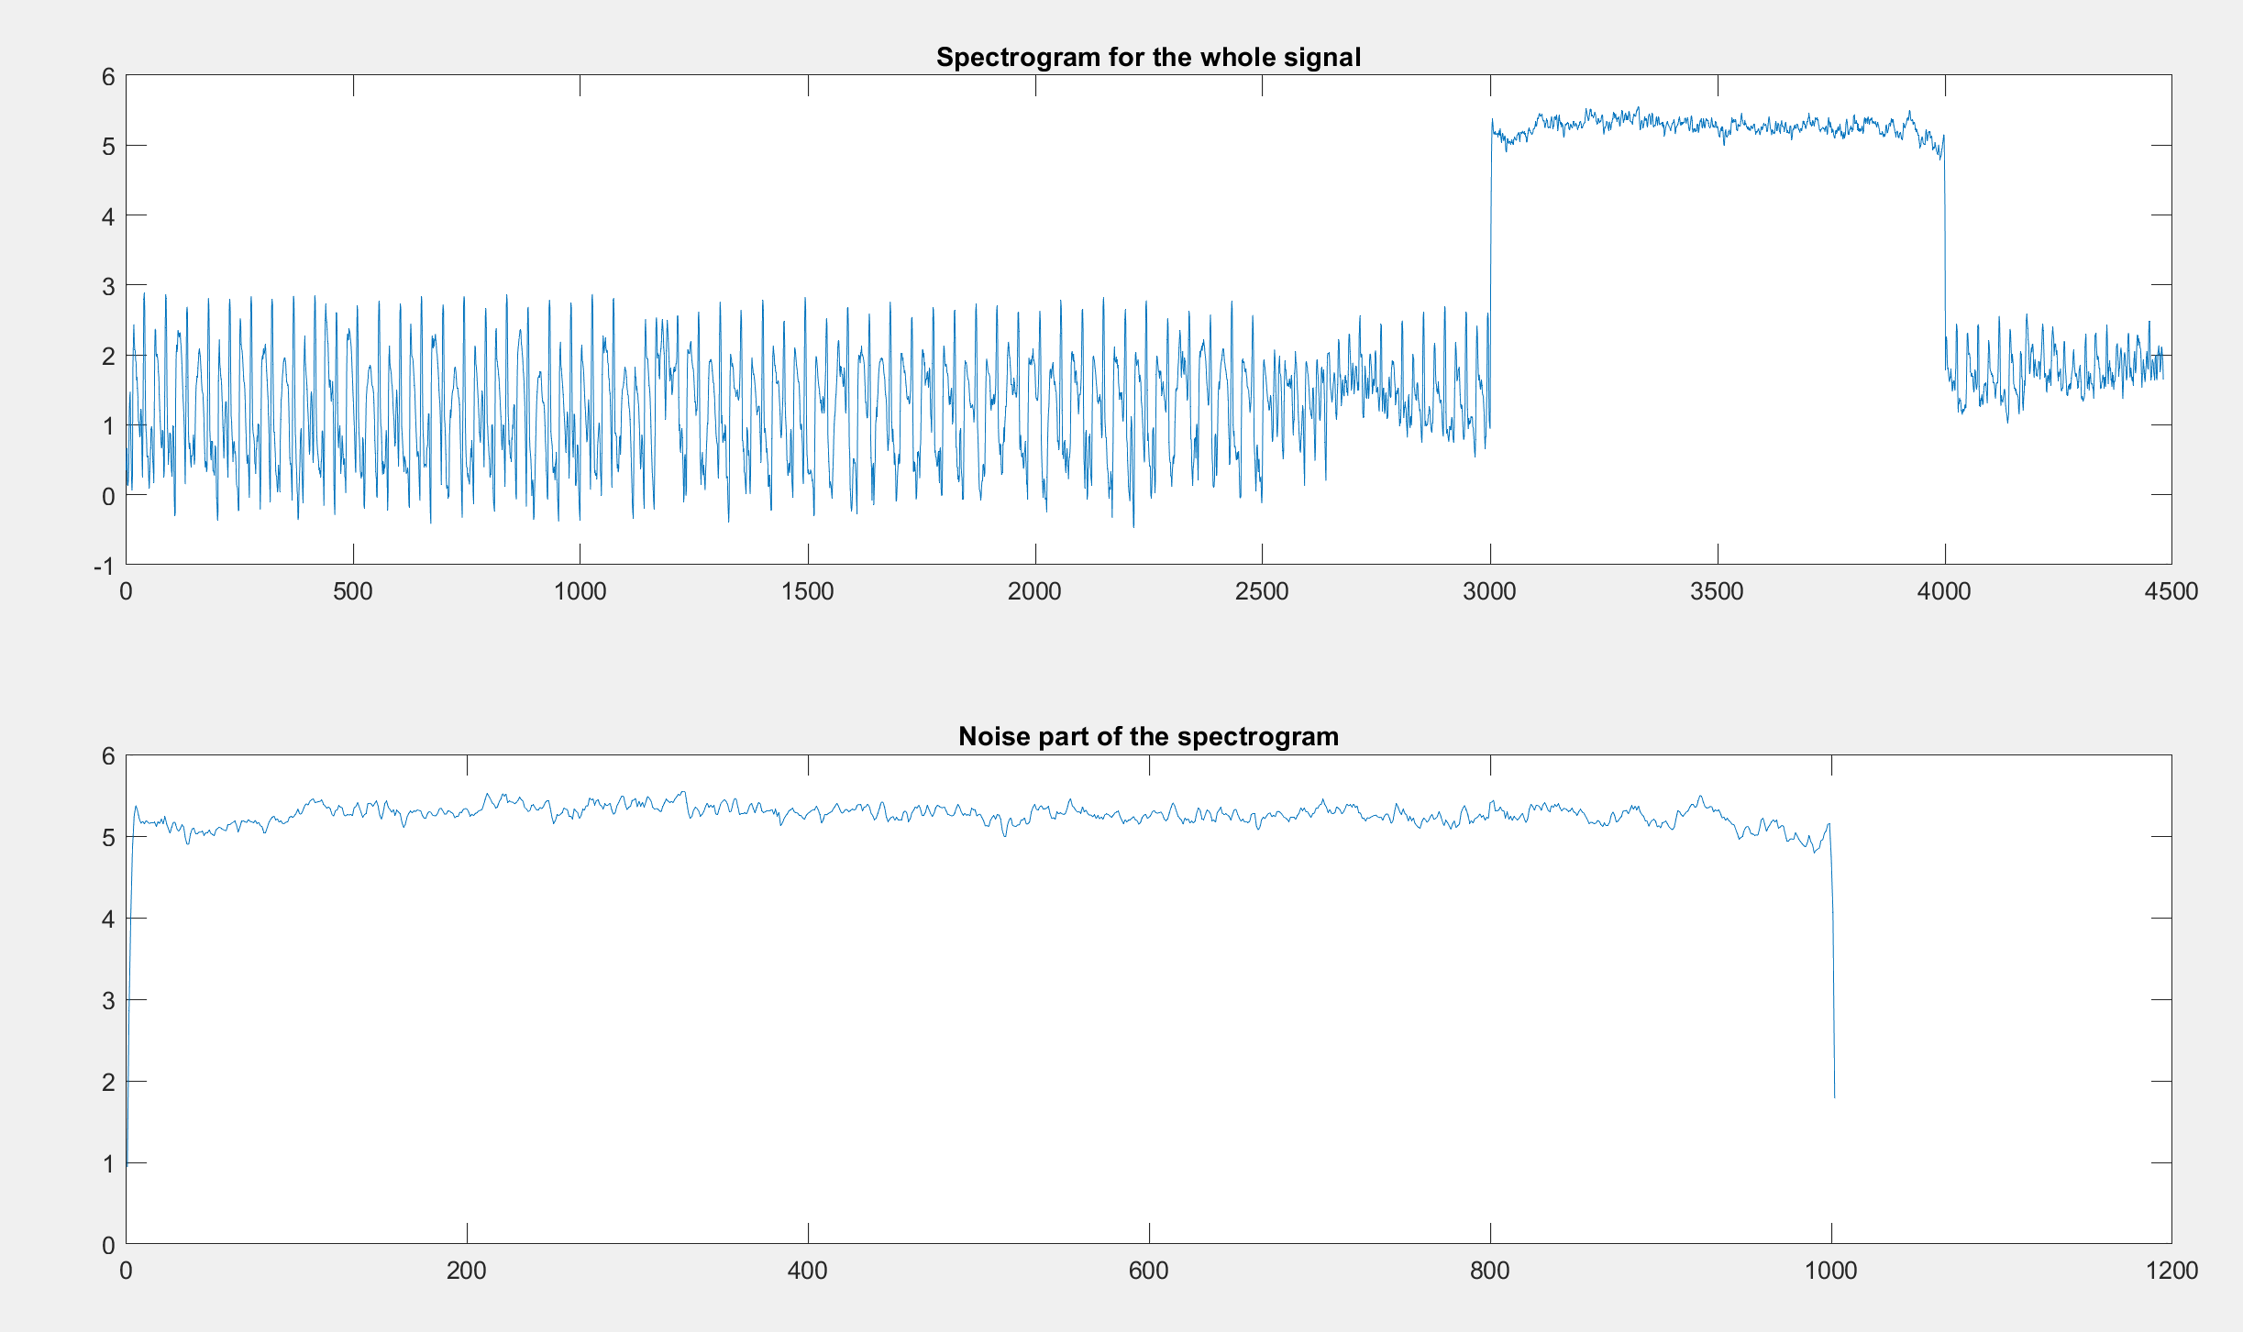
Pressure Cooker

Slide 19
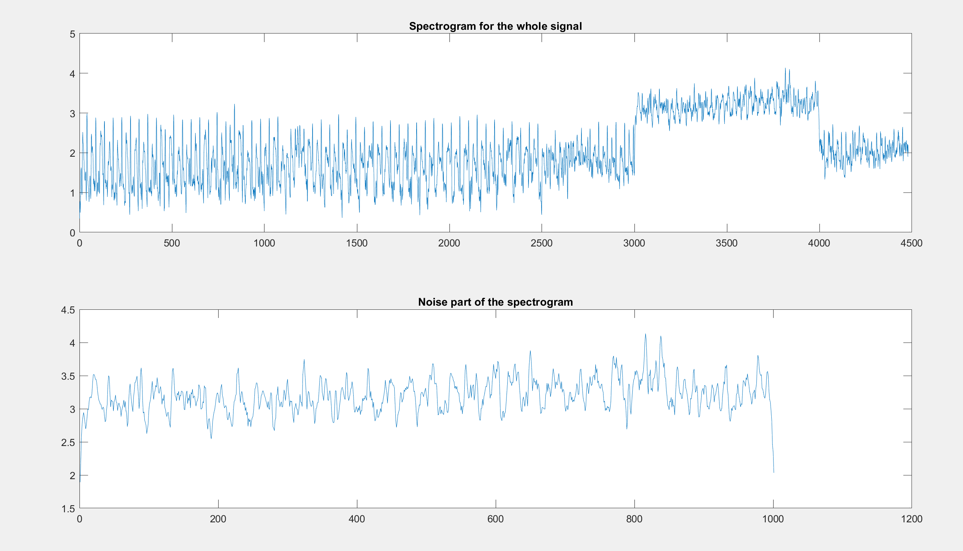
Ceiling Fan

Slide 20
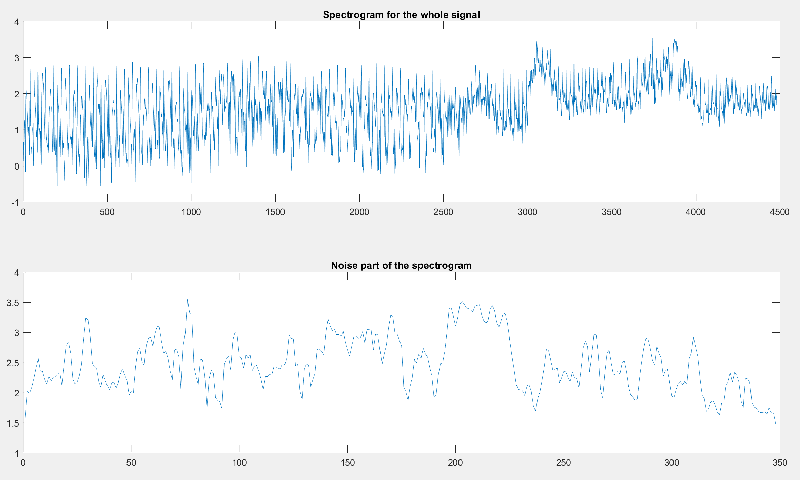
City Traffic

Slide 21
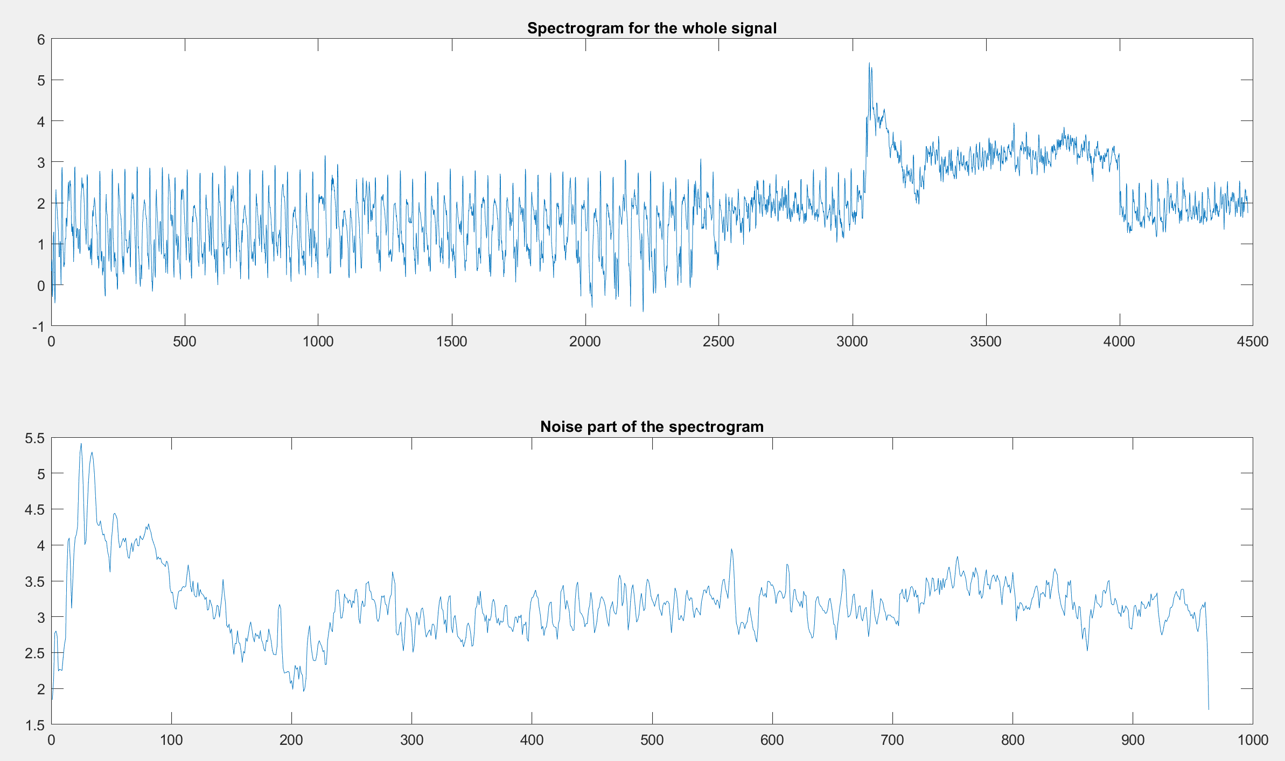
Water Pump

Slide 22

CLASSIFICATION PARAMETERS:
$e_{rms} from maxima of noise$.
$Variance(σ^{2}) of the noise$.
Maxima of the noise.
PRESSURE COOKER:
Since the noise in case of pressure cooker lies in a very small frequency range the rms error from maxima
and Variance of the noise will have very small values compared to the rest.
WATER PUMP: Since the maxima is at a very high frequency level from the general noise range in case of water pump,
rms error from maxima is very high.
CITY TRAFFIC:
For the traffic noise, there are horn noises after some delays and thus the noise level varies a lot hence
The variance will be higher in comparison to ceiling fan.
CEILING FAN: Since, ceiling fan noise is again restricted to a smaller frequency range than in case of city traffic noise,
Thus, the variance will be lower.

