Slide 1
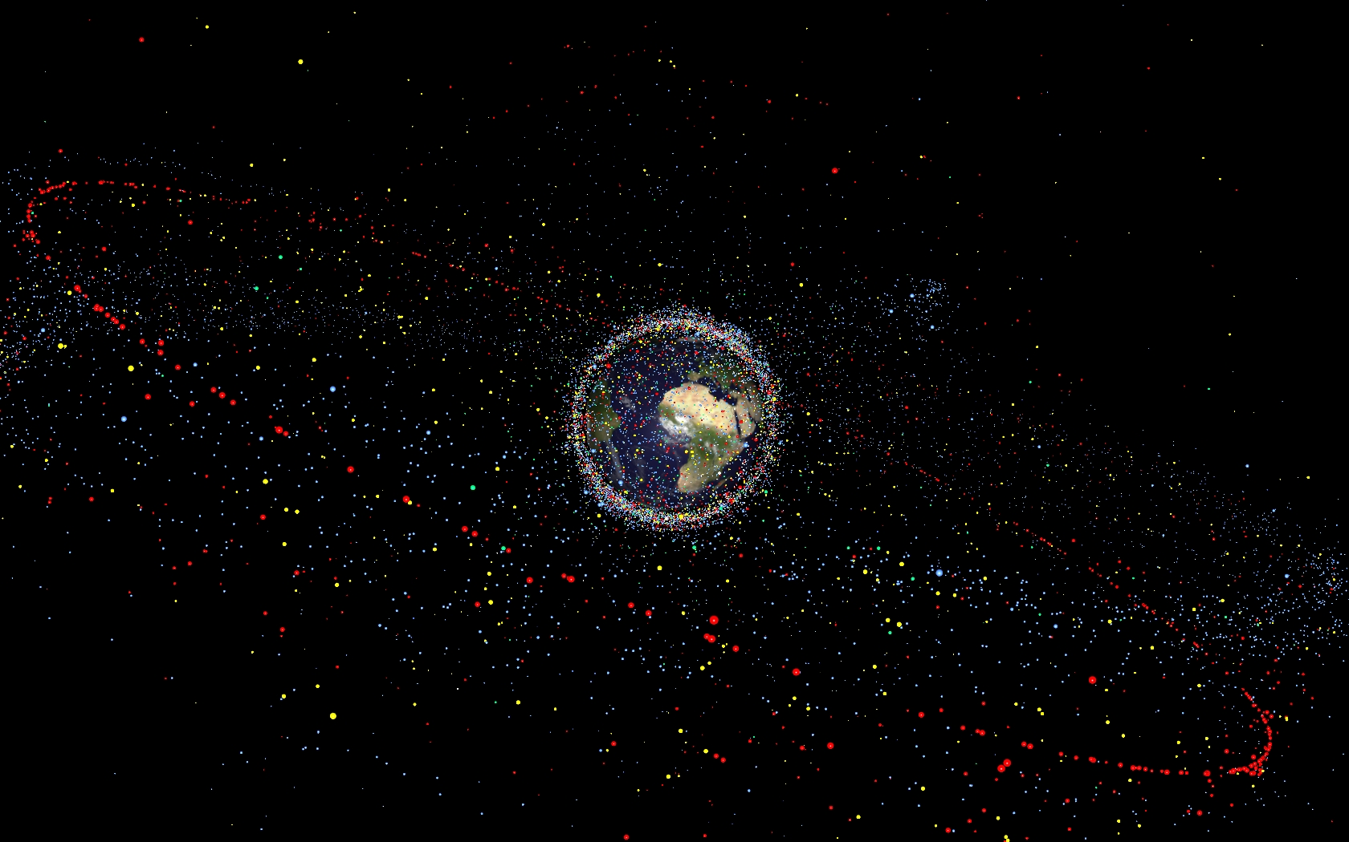
Floaters: Space Junk Tracker
Orbital debris is any human-made object in orbit about the Earth that no longer serves a useful function. Such debris includes nonfunctional spacecraft, abandoned launch vehicle stages, mission-related debris, and fragmentation debris.

Slide 2
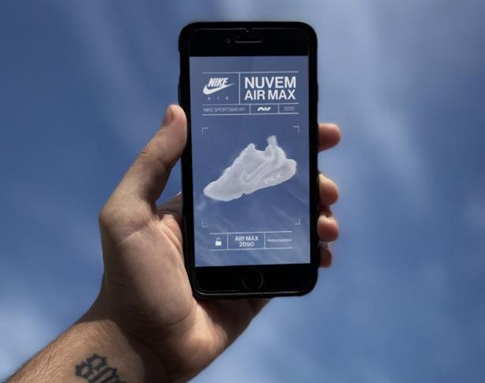

With Floater Track it in Real-Time
Floater utilizes list of data encoding of orbital elements of an Earth-orbiting object for a given point in time to embed position of space debris on the real time frame.
It shows the position of different debris right around where you pointing the camera to be.

