Slide 1
CMPE 283 Large Scale Statistics and Analysis
Ameya Patil
Harishwar Reddy
Manjunath Shivanna
Rohan Pednekar
Shriyansh Jain

Slide 2
Goal
Large scale statistics gathering and analysis tool in scalable virtualized environments

Slide 3
Focus - Monitoring vHosts’ and Virtual Machines’ Performance.
Experiment with the virtualized environment by managing , monitoring and testing virtual machines.
Collecting Logs from the various Virtual machines and analyzing them.
Visualize data using tools like Highcharts and display it accordingly.

Slide 4
Capturing VM Statistics.
Shell script captures VM statistics continuously.
It provides metrics such as
CPU | 5 MHz
Memory | 23 Percent
Disk | 124 Kbps
Network | 140 Kbps
No. Of Threads | 293

Slide 5


VM Statistics Log File Processing
The Statistics collected are written into a log file and this log file is fed into Logstash.
Logstash keeps altering this log file for updates from bash file.
Logstash pushes the log automatically into MongoDB continuously.

Slide 6
Main Components
Supervisor
Info Collector
Analysis
Visualization Application.

Slide 7
TOOLS & TECHNOLOGY
Collection
-InfoCollectors (java application/shell script)
Parsers in java
Visualization Tools
-High Charts
-Logstash
MongoDB
MySQL

Slide 8
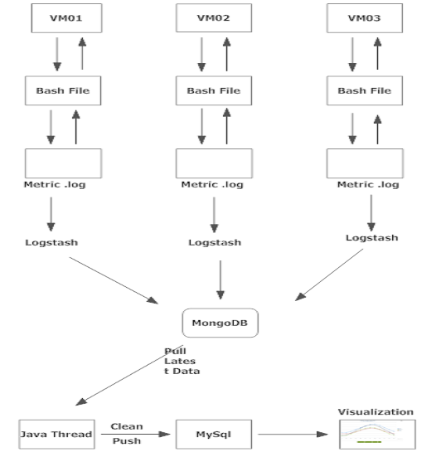
Architecture

Slide 9
Execution Flow of the Program.
MOngoDB is a noSQL Database for storing logs and Metrics.
MongoDB is installed on one VM which is centralized and it collects statistics of every VM continuously.
The Bash script collects the data and pushes it into the MongoDB table. From here the data is loaded into the MySQL DB every 5 seconds.
Hourly slices of the statistical data is collected and so is daily rollup of the data done.
These slices of data is used to visualize it using the highcharts tool.

Slide 10
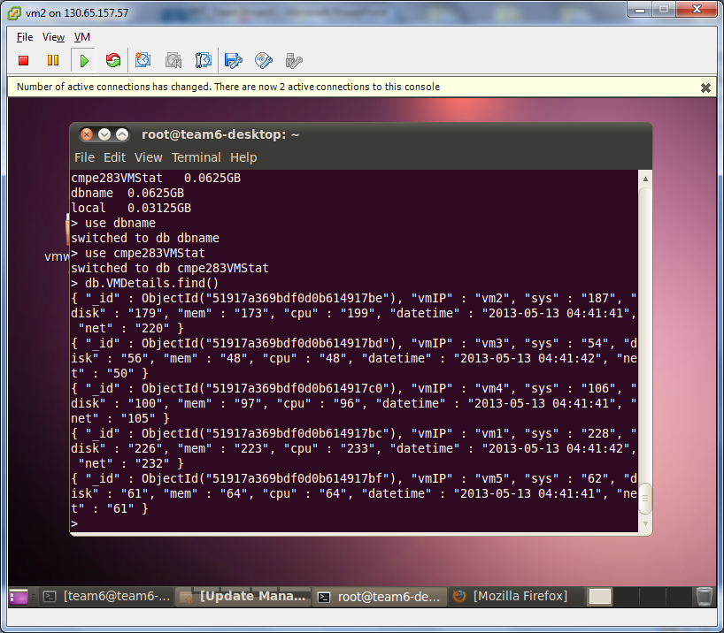

Slide 11

Graphs
Line Charts provided by HighCharts are used for depicting the statistics of VM at certain time intervals.
The line chart is represented by a series of datapoints connected with a straight line and are most often used to visualize data that changes over time
Statistics like CPU , Network , Memory , Disk usage and number of threads are displayed.

Slide 12
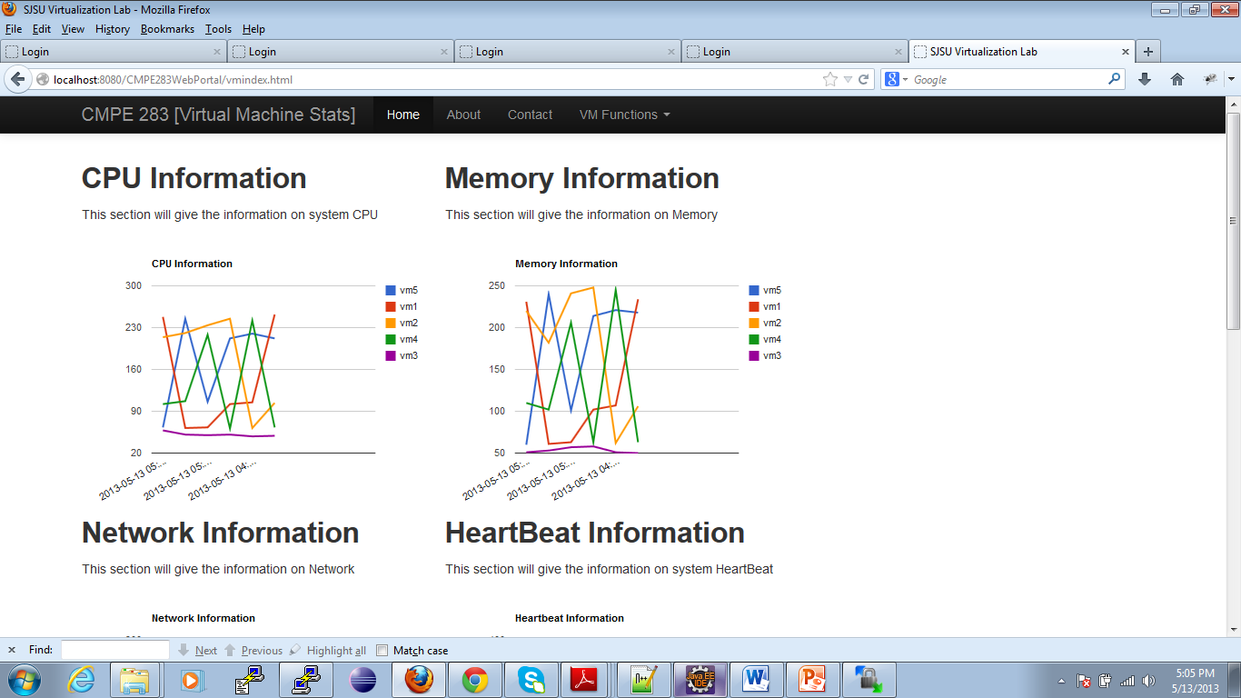
Charts for VMs – CPU & Memory Usage

Slide 13
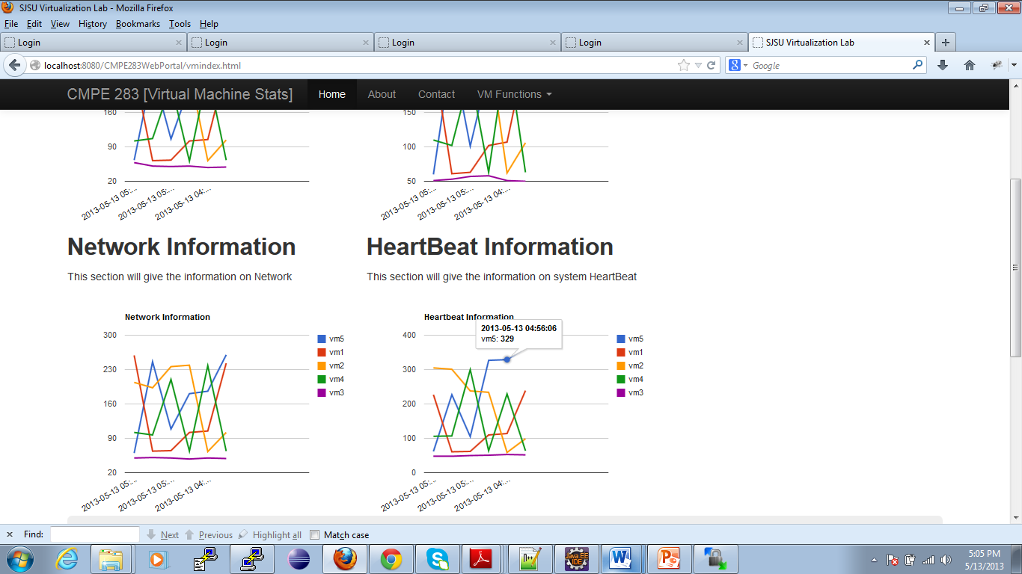
Charts for VMs – Network & System Heartbeat Usage

Slide 14
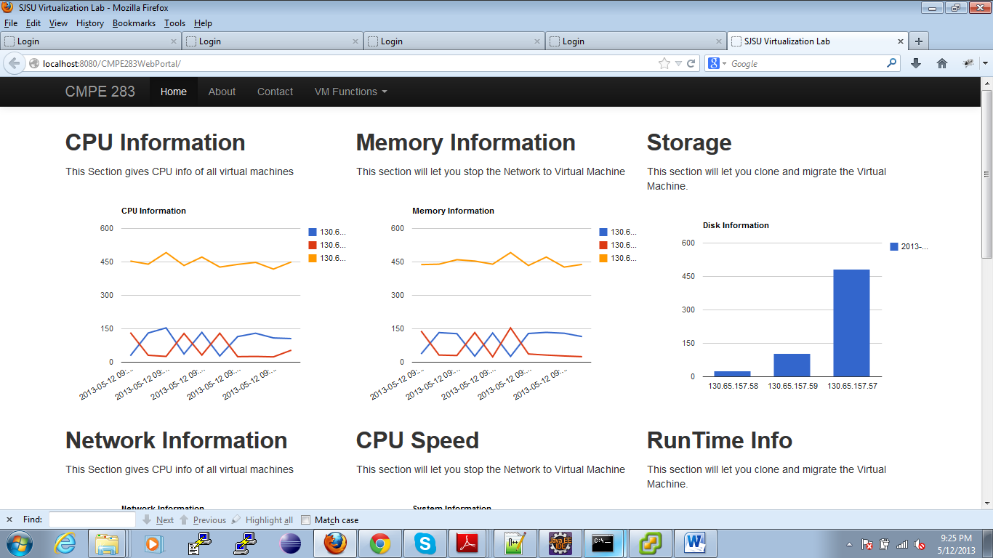
Charts for VHosts – Network & System HeartBeat Usage

Slide 15
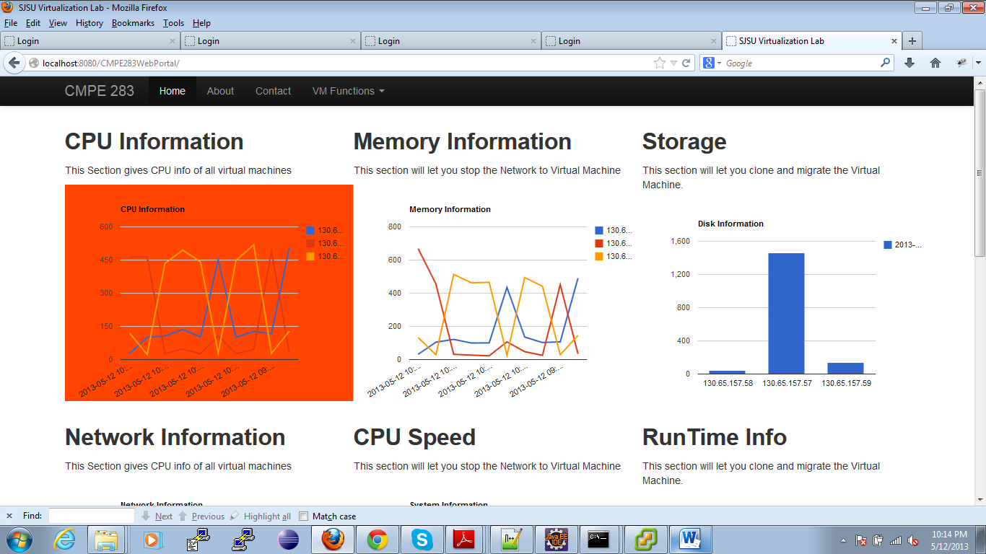
When the CPU usage increases above 450 its background becomes Red

Slide 16
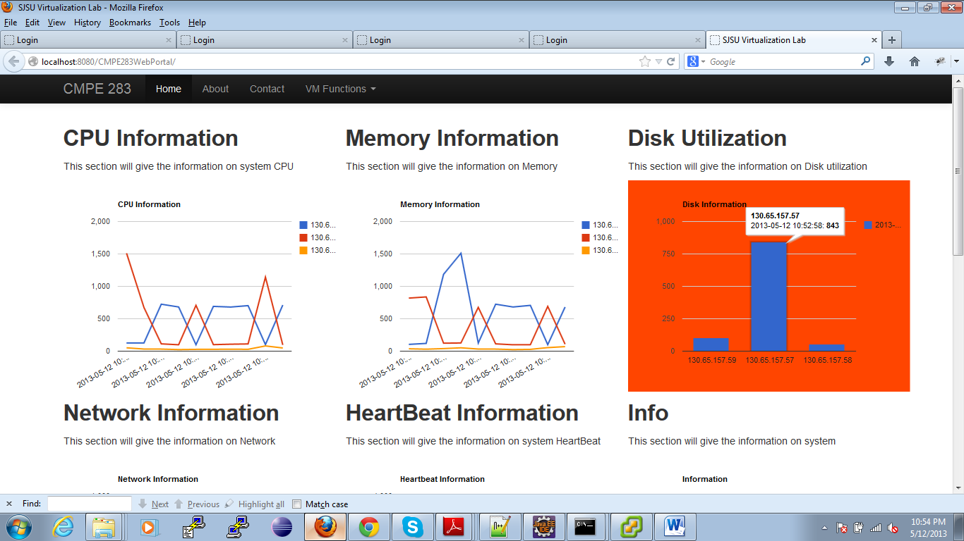
When the Disk usage increases above 750 its background becomes Red

Slide 17
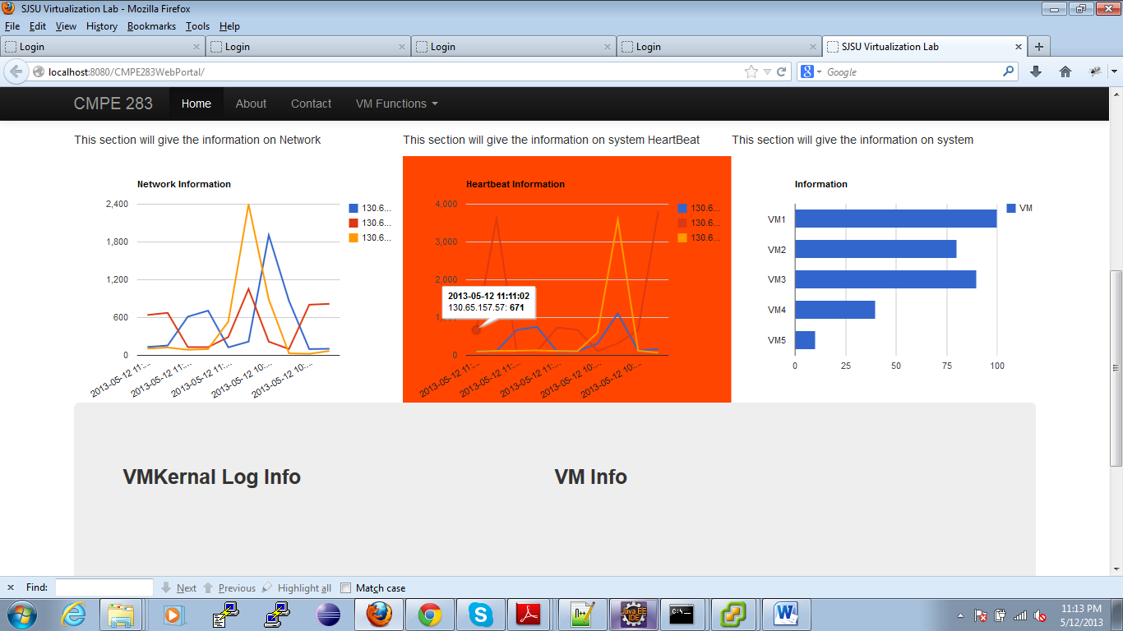
When the HeartBeat rate increases above 600 its background becomes Red

Slide 18
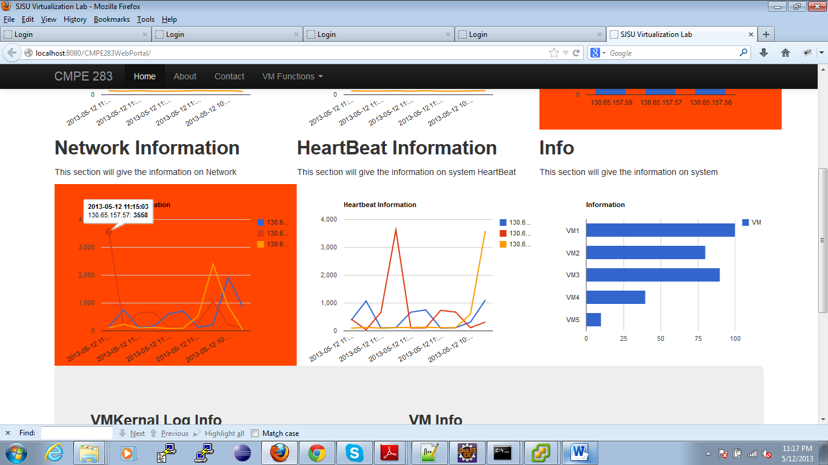
When the Network usage increases above 750 its background becomes Red

Slide 19
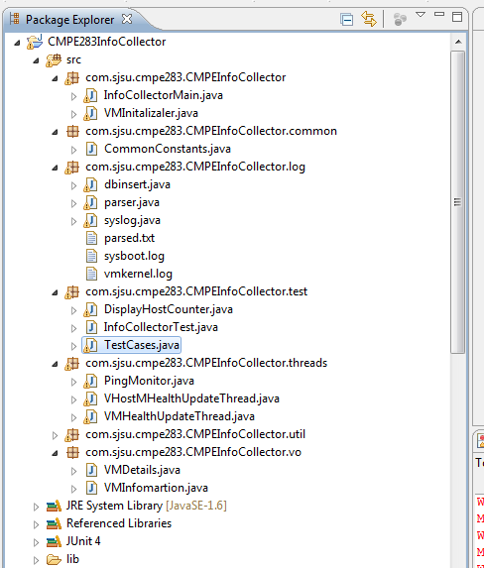
InfoCollector

Slide 20
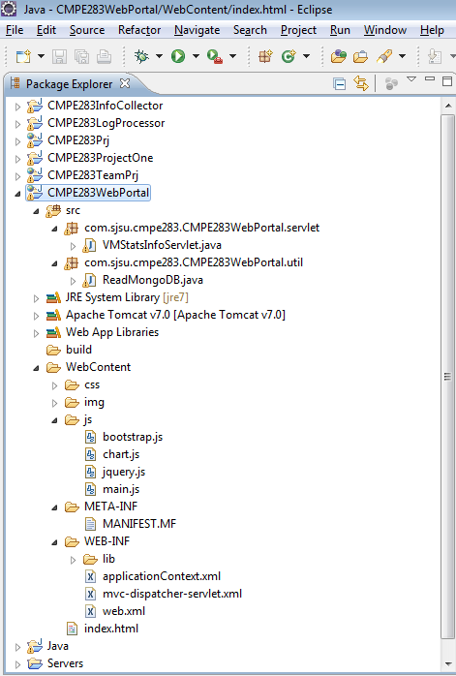

Slide 21
Test Cases
Test Case for
Connectivity to vHost and vCenter
VM is alive or not.
Examine the health of the VMs.
System Stress testing using JMeter

Slide 22
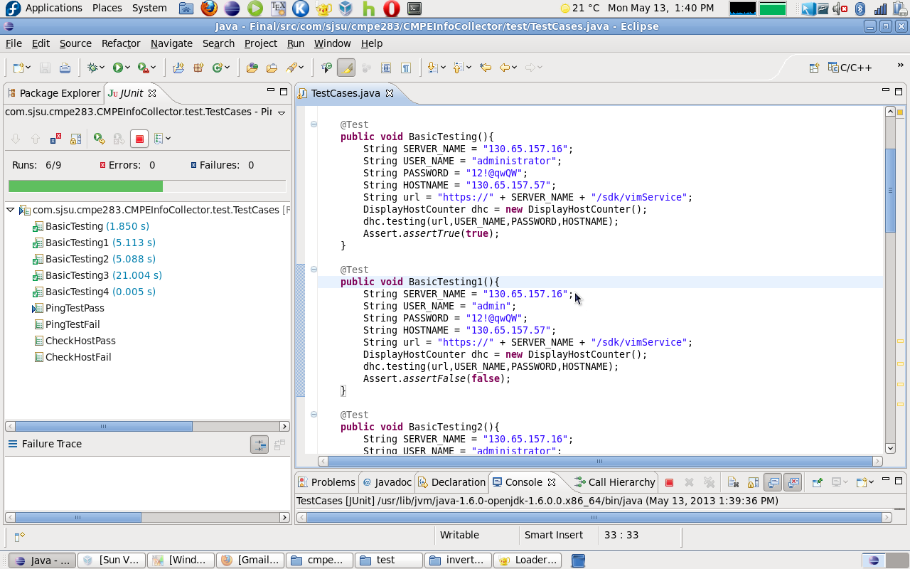

Slide 23
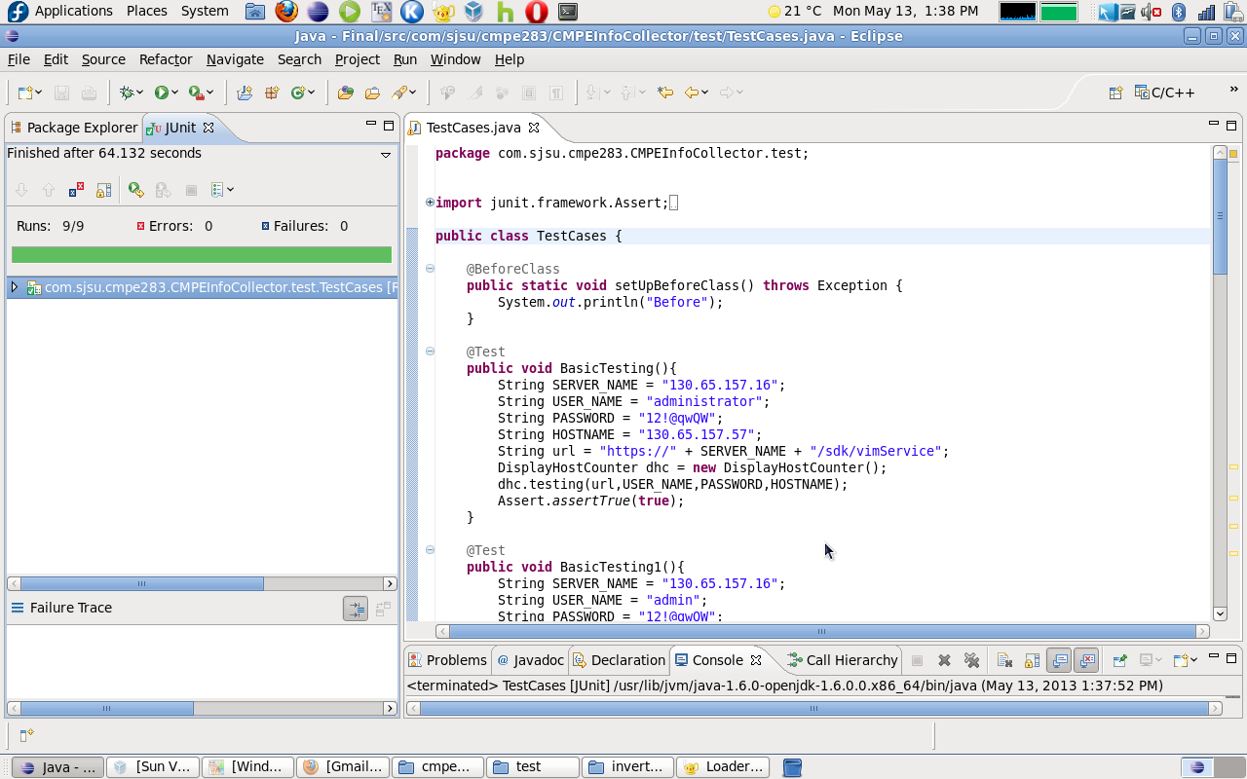

Slide 24
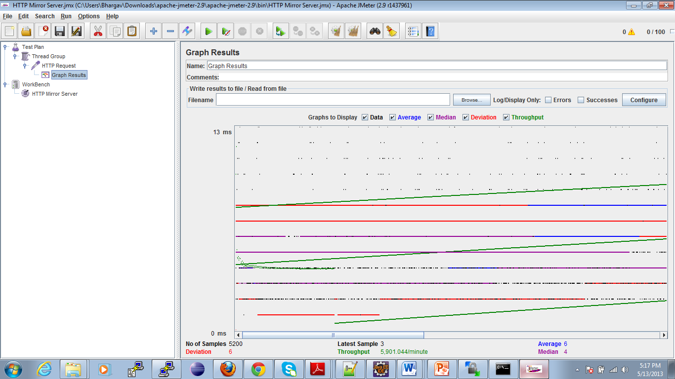
JMeter Graph

Slide 25
Challenges
Dual Core Hosts was unable to Handle many threads for data collection.
Choosing key metrics from wide range available performance metrics

Slide 26
Solution
Load was distributed between two machines to handle data collection.
Identified CPU, memory, network, disk and system heartbeat as key metrics.

Slide 27
CONCLUSION
The Hourly and Daily rollups metrics of the Vhosts and VM’s provide a way to constantly perform performance monitoring and based on the threshold values, load-balancing can be implemented to improve the performance.
The graphical visualization provides an easy UI for centralized monitoring and maintenance.

Slide 28
References
http://www.vmware.com/pdf/esx_lun_security.pdf
http://logstash.net/docs/1.2.2/
http://www.mongodb.com/presentations/real-time-integration-between-mongodb-and-sql-databases
http://www.highcharts.com/docs/working-with-data

Slide 29
Thank You

