Slide 1
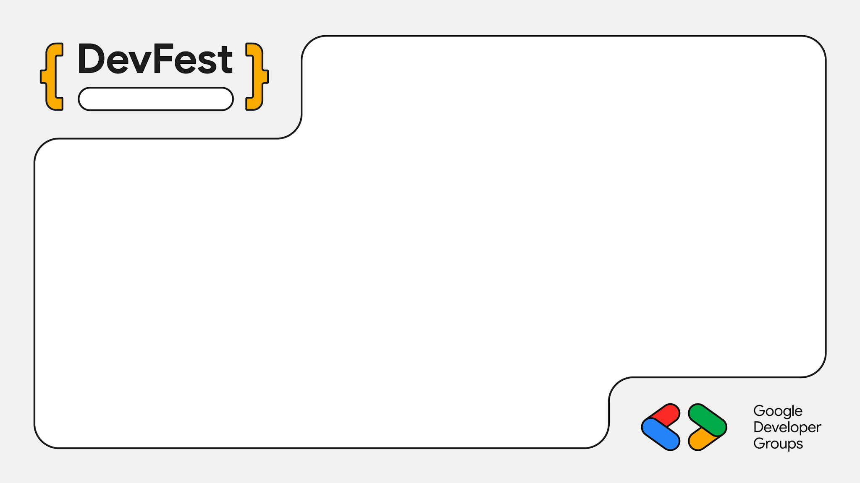
Hands-on workshop
Spec Driven Development with the Elephant - Goldfish Model
Pat Bentley
Google ADK · 90 minutes
Notes:
Welcome. Everyone should have run check_setup.py already. Say the promise of the day: nobody writes code until the design passes a gate. Tech desk is at the back for anyone whose preflight failed.

Slide 2
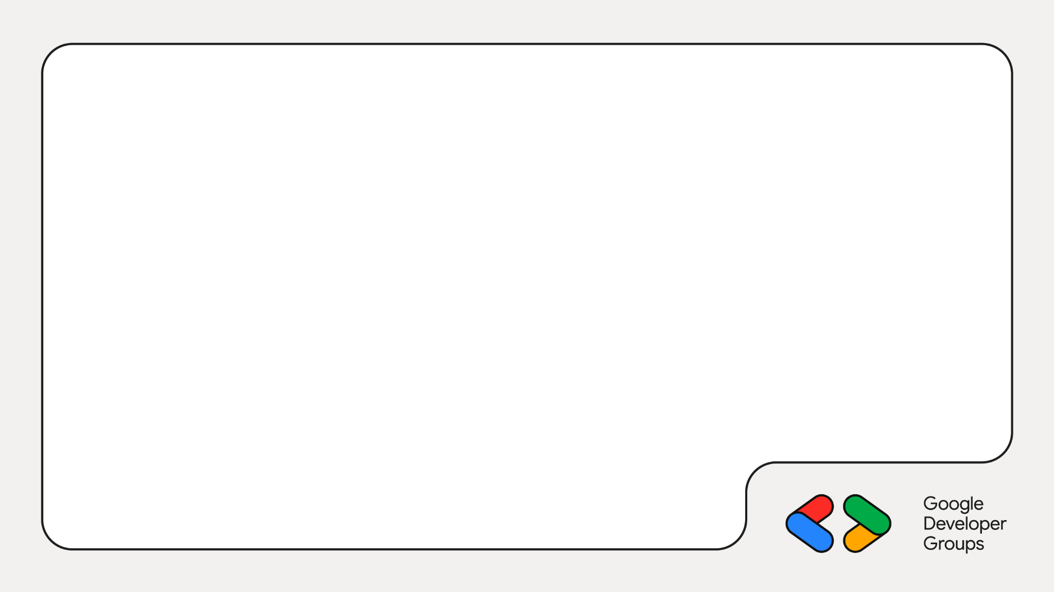

Before we start · scan me
Follow along on your phone
Setup steps with copy-ready commands
All five lab prompts
The agenda and every hard stop
Fixes for the common errors
techpeerpat.github.io/devfest-sdd-workshop-site
Notes:
Leave this up while people arrive. The QR code opens the one-page workshop guide: setup commands, lab prompts, agenda and troubleshooting, all copy-ready. Point out the System and Agent toggles near the top of the setup section.

Slide 3
Before we start · about 10 min
Setup 1 of 4: Get the kit
Install Python 3.11+ and git
Clone the workshop repo
Make a venv, pip install (adds Google ADK)
Add your free Gemini key (next slide)
TERMINAL
git clone https://github.com/techpeerPat/2026-DevFest-SDD-Workshop.git triage-workshop
cd triage-workshop
python3 -m venv .venv
source .venv/bin/activate
pip install -r requirements.txt
cp .env.example .env
Free Gemini key: aistudio.google.com. Windows: activate with .venv\Scripts\Activate.ps1
Notes:
Leave this slide up while people arrive. The repo is public and has no answer key; the answer key is on a separate branch. The Gemini key is free from aistudio.google.com: Get API key, paste it into .env. Windows users use PowerShell. Anyone without git or Python goes to the tech desk.

Slide 4
Before we start · about 10 min
Setup 2 of 4: Free Gemini API key
Open aistudio.google.com and sign in with a personal Google account
Click Get API key in the sidebar
Create API key, then Create key in new project
Copy the key (it starts with AIza)
Paste it into .env after GOOGLE_API_KEY=
.ENV FILE
GOOGLE_API_KEY=AIza...your-key
GOOGLE_GENAI_USE_VERTEXAI=FALSE
WORKSHOP_MODEL=gemini-3.5-flash-lite
Keep the key private
Never commit or share it. .env is already gitignored.
No credit card. Limits apply per project: aistudio.google.com/rate-limit
Notes:
Walk through it live on the projector. Use a personal Google account; work or school accounts can be restricted. First visit asks to accept terms and confirm region. Screens change, so if a button is named differently look for API keys. The key is free and needs no card. Free-tier limits are per Google project, not per key, so extra keys in the same project add nothing. Anyone blocked goes to the tech desk, which holds spare keys.

Slide 5
Before we start · about 10 min
Setup 3 of 4: Agent and skills
Install the Antigravity CLI (or use Claude Code)
Run agy once and sign in with Google
Download the skills with the kit's installer
Start agy here and type /ele
TERMINAL
curl -fsSL https://antigravity.google/cli/install.sh | bash
agy --version
python install_skills.py
# Claude Code instead of agy:
python install_skills.py --agent claude
Windows PowerShell
irm https://antigravity.google/cli/install.ps1 | iex
Skills repo: github.com/techpeerPat/elephant-goldfish-skills. Installs into this project only: .agents/skills/ (agy) or .claude/skills/ (Claude).
Notes:
Open a NEW terminal after installing agy so it is on the PATH. First run opens a browser for Google sign-in. install_skills.py downloads the elephant-goldfish-skills repo, copies the seven skill folders into .agents/skills/ inside the project, and works on macOS, Linux and Windows, and only touches the project folder, never global config. Participants using Claude Code add --agent claude, which installs into .claude/skills/ instead; pick one agent and stay on it. Success test: start agy from the project folder, type /ele and see /elephant-grow and /elephant-teach. If not, agy was started from the wrong folder.

Slide 6
Before we start · about 10 min
Setup 4 of 4: Run the preflight
Run python check_setup.py
Every line must say [ ok ]
Fix any [FAIL] with the hint shown
Still red? Go to the tech desk
EXPECTED (ABBREVIATED)
[ ok ] Python 3.12
[ ok ] google-adk
[ ok ] agy on PATH
[ ok ] 7 skills installed
[ ok ] GOOGLE_API_KEY is set
[ ok ] Gemini call works
All set.
The Gemini check uses one free request. Skip it with --no-model.
Notes:
Everyone should see All set. before the workshop starts. Common fails: venv not activated (google-adk or adk missing), agy installed but terminal not reopened, wrong or missing key, and a 429 from free-tier quota. The skills line failing means install_skills.py was not run from the project folder.

Slide 7
What you leave with
01
A gated design doc
A written spec that a stranger could build from, checked before any code exists.
02
A running agent team
A router and three specialists in Google ADK, served from localhost with a visible trace.
03
A loop you can reuse
Grow, teach, gate, implement, review. Seven skills, five of them hands-on today.
Nothing is deployed. Everything runs on your machine.
Notes:
Set expectations: this is a discipline workshop that happens to produce an ADK app. Be clear that model calls still go to the free Gemini API over the internet; the agents, tools, data and UI are local.

Slide 8
Chatting your way to code fails quietly
THE USUAL LOOP
Describe the idea in chat
Agent writes code
Find a surprise
Patch, patch, patch
Decisions get made by accident, inside code nobody asked for.
THE SPEC-FIRST LOOP
Decide, with no code allowed
Write the decisions down
Gate them with a cold reader
Build exactly that, then attack it
Surprises show up in a document, where they cost one edit.
Notes:
Keep this to two minutes. The point: when the document is wrong you edit a paragraph; when code is wrong you edit a system. Ask who has been bitten by an agent that quietly widened scope.

Slide 9
Why we work this way
Spec-driven development in one idea
The written spec is the contract. Code is what you build from it.
In this workshop
docs/DESIGN.md is the spec.
Five sections: Problem, Technical Plan, Alternatives, Detailed Implementation, Evaluation Criteria.
Wrong result? Fix the spec, then rebuild.
Decide first: write down what, why and how you will know it works
Build only what the spec says: no extras, no silent changes
Review the code against the spec: does it match?
Notes:
Keep this to two minutes. Spec-driven development means the written document is the source of truth, not the chat. You decide before you build, the agent builds only what the document says, and reviews check the code against the document. In this workshop the spec is docs/DESIGN.md. When something is wrong, you decide whether the document or the code was wrong, fix the document if needed, and rebuild.

Slide 10
The model behind the skills
The Elephant and the Goldfish
Elephant: never forgets
Holds the whole conversation
Explores options and challenges you
Writes it all into one design doc
/elephant-grow, /elephant-teach
Goldfish: remembers nothing
Sees only the written document
Finds what the page forgot to say
Says Ready or Not ready
/goldfish-understand, -critic, -ready
If a goldfish can build it right from the page, the page is good enough.
Then /implement-design and /adversary-review work from the page, not the chat.
Notes:
The metaphor: the Elephant never forgets, so it holds the whole conversation and does the thinking and writing (grow and teach). The Goldfish remembers nothing, so it only sees what is written down (understand, critic, ready). That is why steps 3 to 5 need a fresh session. If the Goldfish can understand it and say Ready, a stranger, or a coding agent, can build it correctly. Implementation and code review then also work from the document.

Slide 11
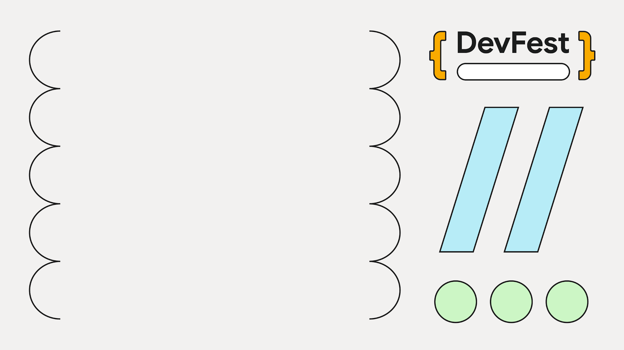
Hands-on workshop
Spec first. Then agents. No code until the design passes the gate.
Notes:
The rule for the whole session. If anyone starts writing code before the gate, point back to this slide.

Slide 12
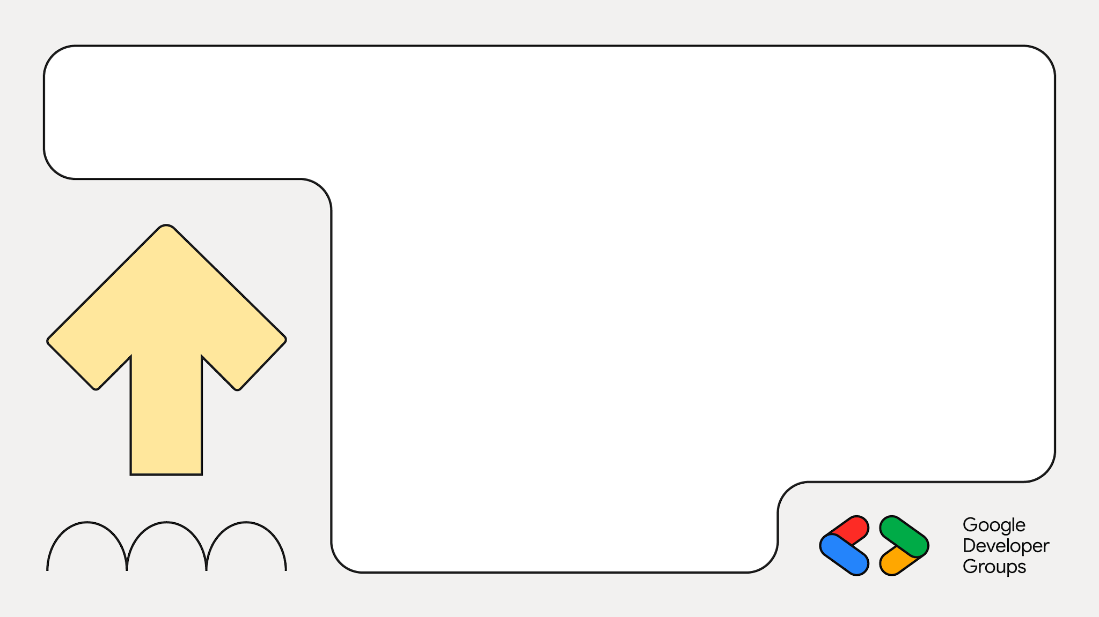
01
The plan
Seven skills, the agenda and the system we build

Slide 13
Seven skills, one loop
Step | Command | What it does | Today
1 | /elephant-grow | No-code design discussion | Hands-on
2 | /elephant-teach | Writes the design document | Hands-on
3 | /goldfish-understand | Zero-context cold read | Demo
4 | /goldfish-critic | Hostile architecture review | Demo
5 | /goldfish-ready | Ready or not ready, before code | Hands-on
6 | /implement-design | Builds only what the doc says | Hands-on
7 | /adversary-review | Hostile code review | Hands-on
Steps 3 to 5 only work in a fresh session: the reader must not remember your conversation.
Notes:
Walk the table once. Emphasise the fresh-context rule: the goldfish skills are named for a reader with no memory. If a review in the same session passes, it proves nothing. Steps 3 and 4 are shown on the projector; participants run only step 5 in Lab 3 to protect their free-tier quota.

Slide 14
The next 90 minutes
Clock | Segment | Tool
0:00 | Welcome and why spec-first | none
0:08 | ADK in 10 minutes (demo) | adk web
0:18 | Lab 1: design, no code | /elephant-grow
0:33 | Lab 2: write the design doc | /elephant-teach
0:43 | Lab 3: readiness gate, fresh session | /goldfish-ready
0:53 | Lab 4: build it and run it | /implement-design
1:18 | Lab 5: hostile review | /adversary-review
1:28 | Wrap and homework | none
Notes:
Point out that every lab has a hard stop and a checkpoint file. Put a visible countdown on a second screen. Leave this slide up or printed.

Slide 15
What we build: a support triage team
triage_router
Customer message in. Routes only, never answers.
billing_agent
lookup_customer, check_invoice
technical_agent
search_kb
escalation_agent
create_ticket
customers.json · kb.json
tickets.jsonl
Notes:
Walk top to bottom. The router's description-driven routing is the interesting ADK part: each specialist's description is the routing rule. technical_agent can hand off to escalation_agent when nothing matches. Everything on this slide runs on localhost; no network calls from tools.

Slide 16
ADK in five ideas
An agent is a name, a model and an instruction
A tool is a plain Python function
sub_agents turns agents into a team
The package must expose root_agent
adk web serves a chat UI and a trace
root_agent = Agent(
name="triage_router",
model="gemini-3.5-flash-lite",
instruction="Do not answer.",
sub_agents=[billing_agent,
technical_agent,
escalation_agent],
)
Run adk web from the folder that contains support_triage/, then open localhost:8000.
Notes:
Ten-minute demo. Open the reference solution in an editor and run it. Stress that a tool's docstring is what the model reads, and each sub-agent's description is its routing rule. Show the trace panel; participants will rely on it in Lab 4. The model name is read from the WORKSHOP_MODEL environment variable in the kit; confirm the current free-tier model before the event.

Slide 17
02
Five timed labs
From a blank folder to a reviewed, running app

Slide 18
0:18 · 15 min · /elephant-grow
Lab 1: Design with no code
Settle five things
PROMPT
/elephant-grow I want a local-only support triage system in Google ADK. A triage_router agent uses sub_agents to send each message to billing, technical or escalation. The package is support_triage/ and exposes root_agent, so adk web runs it. Ask at most 5 questions at a time and challenge my assumptions.
Which messages go where
Tool inputs, outputs, errors
Severity rules for tickets
What is out of scope
Three messages, three routes
Hard stop 0:33. The skill refuses to write code. That is the feature.
Notes:
The full prompt is in the lab guide; this is the short form. Circulate. If anyone is writing code, stop them. Remind people the five bullets are what they carry into Lab 2. Anyone unfinished at 0:33 moves on with what they have.

Slide 19
0:33 · 10 min · /elephant-teach
Lab 2: Write the design doc
Five required sections
PROMPT
/elephant-teach Write the design document to docs/DESIGN.md from our discussion. List every file, including support_triage/agent.py with a Google ADK root_agent and sub_agents.
Problem
Technical Plan
Alternatives
Detailed Implementation
Evaluation Criteria
Check it yourself
Is root_agent with sub_agents named? Is every criterion checkable?
Open Questions is optional.
Hard stop 0:43. Stuck? Copy checkpoints/DESIGN.md to docs/DESIGN.md.
Notes:
Stay in the same session as Lab 1 so the skill has the discussion to draw from. Commit the file afterwards. Highlight the quality bar: Detailed Implementation enumerates every file, and Evaluation Criteria are checkable, not adjectives.

Slide 20
0:43 · 10 min · /goldfish-ready
Lab 3: The readiness gate
Use a fresh context
PROMPT
/goldfish-ready docs/DESIGN.md
Open a new terminal tab
Start a fresh agy session
Run the gate on your doc
If Not ready, fix the doc once
Verdict: Ready or Not ready
Every gap it lists is a bug you would have found an hour into coding.
Up front: the facilitator demos /goldfish-understand and /goldfish-critic live.
Notes:
Run the five-minute demo first on a volunteer's document: goldfish-understand (what it understood, what is missing), then goldfish-critic (findings grouped by severity). Participants run only goldfish-ready to save quota. Do not let anyone use /clear in the old session; a new session is the point.

Slide 21
0:53 · 25 min · /implement-design
Lab 4: Build it and run it
Run /implement-design docs/DESIGN.md
Run the offline tests, no key needed
Start adk web from the project root
Send three messages, a few seconds apart
Open the trace for each
Message | Expected route
I was charged twice, my email is maya@example.com | billing_agent, overcharge of 29
My app crashes when I launch it | technical_agent, crash article
Your whole service is down and we lost data | escalation_agent, ticket id
Wrong output? Fix the document first, then re-run. Do not patch in chat. Hard stop 1:18.
Notes:
This is the longest lab. The spec-driven rule is the lesson: decide whether the document or the code was wrong. If the document, edit it and re-run implement-design. Common snags: adk web started from inside support_triage (no agents listed), 429 from messaging too fast, wrong model name (404). Anyone not running at 1:18 pairs with a neighbour.

Slide 22
1:18 · 10 min · /adversary-review
Lab 5: Hostile review
In a fresh session
PROMPT
/adversary-review support_triage/ tests/
Run the review on your code and tests
Fix the two worst findings
Log the rest under Open Questions
Numbered findings, then a verdict
It ends APPROVED or blocked. You will not reach APPROVED in ten minutes. That is fine.
Working code is not the same as reviewed code.
Notes:
Ask two or three people to read their top finding aloud. Note which findings the design doc could have prevented, and which only a code review finds. That contrast is the takeaway of the day.

Slide 23
03
Safety nets and wrap-up
Checkpoints, homework and what comes next

Slide 24
Behind? Use the checkpoint.
At | Not done | Do this
0:33 | Design talk | Go to Lab 2 with your five bullets
0:43 | No design doc | Copy checkpoints/DESIGN.md to docs/
0:53 | No Ready verdict | Carry on; we discuss the gate on screen
1:18 | App not running | Pair with a neighbour whose app runs
Out of free-tier quota? Same rule: take the checkpoint and keep moving.
Notes:
Nobody waits for stragglers. If someone runs out of Antigravity quota, they use the checkpoint file for that lab and follow along on screen. The reference solution is in the starter kit as an answer key for after the session.

Slide 25
Homework
Run /goldfish-understand and /goldfish-critic on your own doc
Add a fourth specialist using all seven steps
Compare your code with the reference solution
Notes:
Point to the starter kit repo for the reference solution (the answer-key branch) and to the skills repo on GitHub (techpeerPat/elephant-goldfish-skills) for the installation steps and the design document specification.

Slide 26
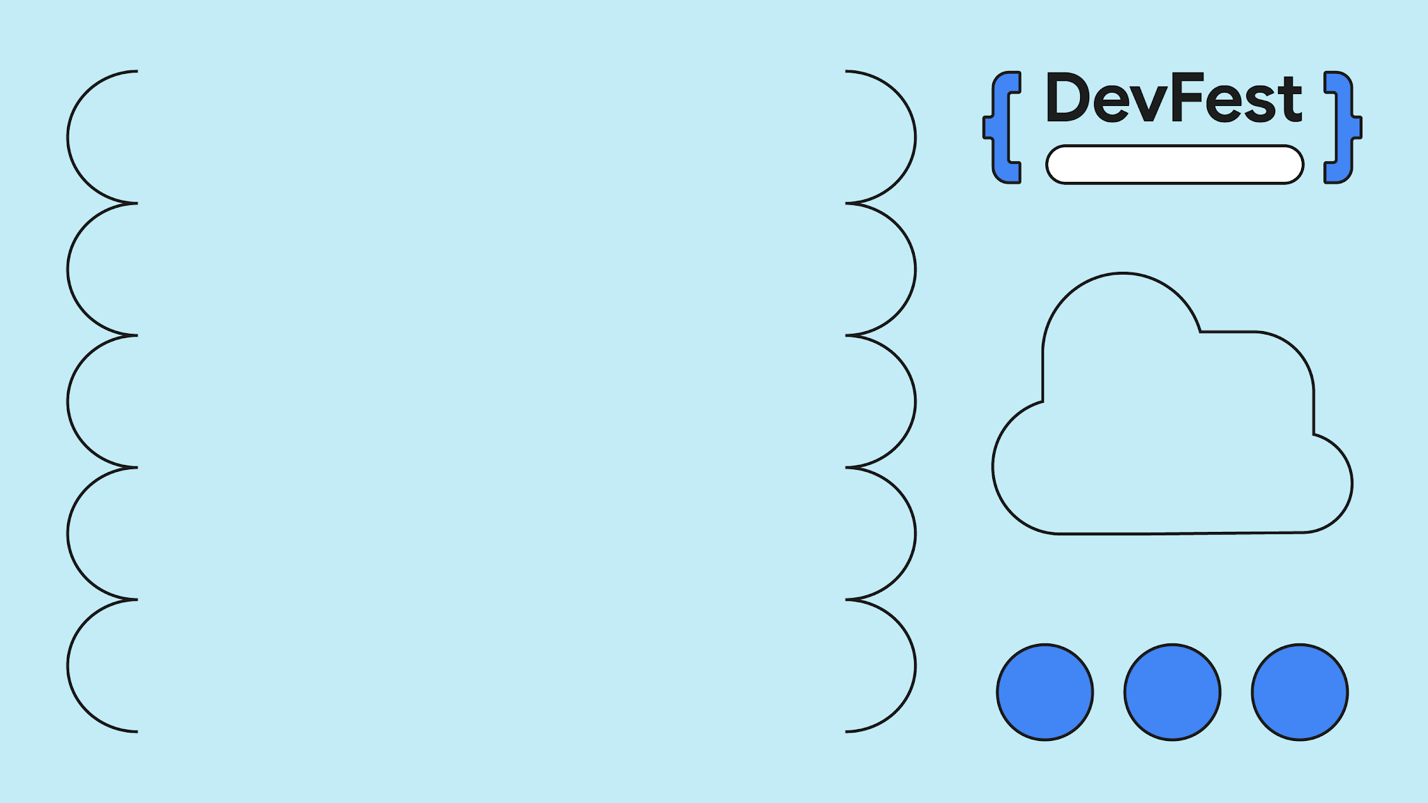
Hands-on workshop
What did the document catch that the code never would have?
Notes:
Take answers from two people, then move to the homework.

