Slide 1

API Security Fundamentals OWASP API Security Top 10
Presenter name
Notes:
Hi everyone, Aadhar and I are here today to talk about API security. APIs are the hidden engines that power many of the applications and services we use every day. Imagine them as the quiet cooks in a bustling restaurant, preparing delicious meals but unseen by the customers. Unfortunately, just like a security breach in a kitchen can have a big impact, insecure APIs can be exploited by attackers.

Slide 2
Agenda
Introduction - Why API Security?
Real-World API Breaches
OWASP API Security Top 10

Slide 3
Why API Security
Term | Description | Example
Security Vulnerability | Weakness in a system | A bug in software code that allows unauthorized access.
API Vulnerability | Weakness in an API | Weak authentication in an API allows unauthorized access to data.
Data Breach | Unauthorized access to sensitive information | Hackers steal customer credit card details from a company's database.
Security Breach | Unauthorized access to a system | Hackers gain access to a company network and install malware.
Notes:
Hi everyone, Aadhar and I are here today to talk about API security. APIs are the hidden engines that power many of the applications and services we use every day. Imagine them as the quiet cooks in a bustling restaurant, preparing delicious meals but unseen by the customers. Unfortunately, just like a security breach in a kitchen can have a big impact, insecure APIs can be exploited by attackers.
APIs are like the hidden engines: Just like the cooks in a restaurant kitchen prepare food but are unseen by the customers, APIs work behind the scenes to power many applications and services we use.
Security breach impact: A security breach in a kitchen, like contaminated food, can have a big impact on the restaurant's customers. Similarly, a security breach in an API can have a big impact on the application or service that relies on it.
Here's an alternative analogy you can use instead:
Imagine APIs as the bridges connecting different parts of a city. They allow smooth flow of information between applications. However, a weak or compromised bridge can lead to traffic jams, accidents, and chaos. In the same way, insecure APIs can disrupt the functionality of applications and expose sensitive data.

Slide 4
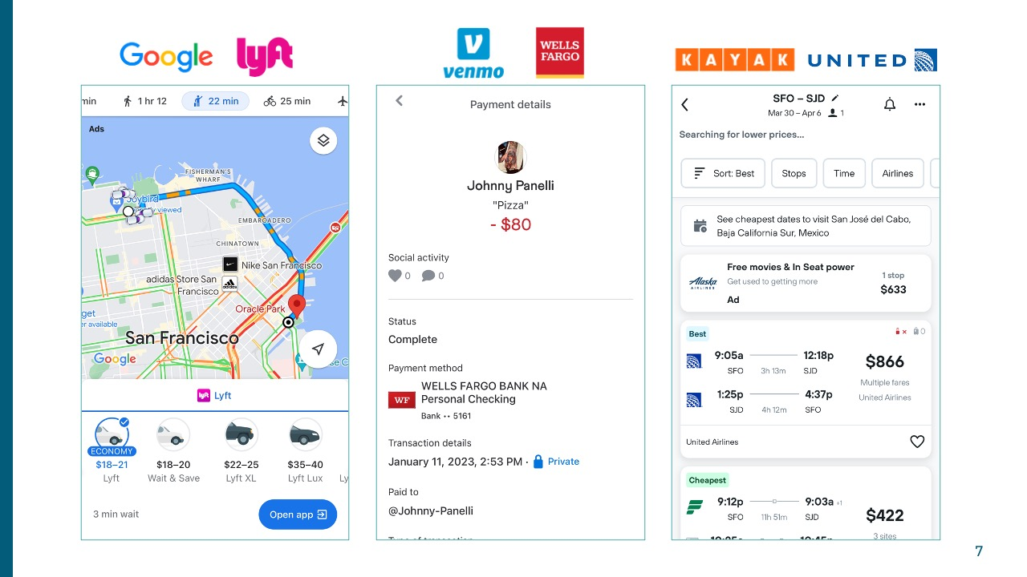
Why API Security
APIs are everywhere
Notes:
According to Akamai, 83% of internet traffic now comprises API calls. That’s right, for every 100 internet requests, a staggering 83 of them are directed towards APIs. This number has been on a steady rise and shows no signs of slowing down.

Slide 5
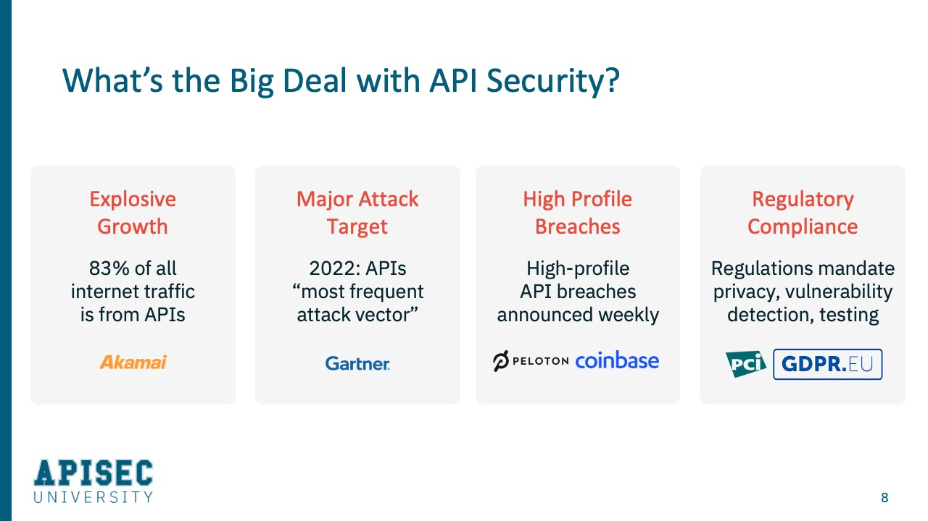
Why API Security

Slide 6
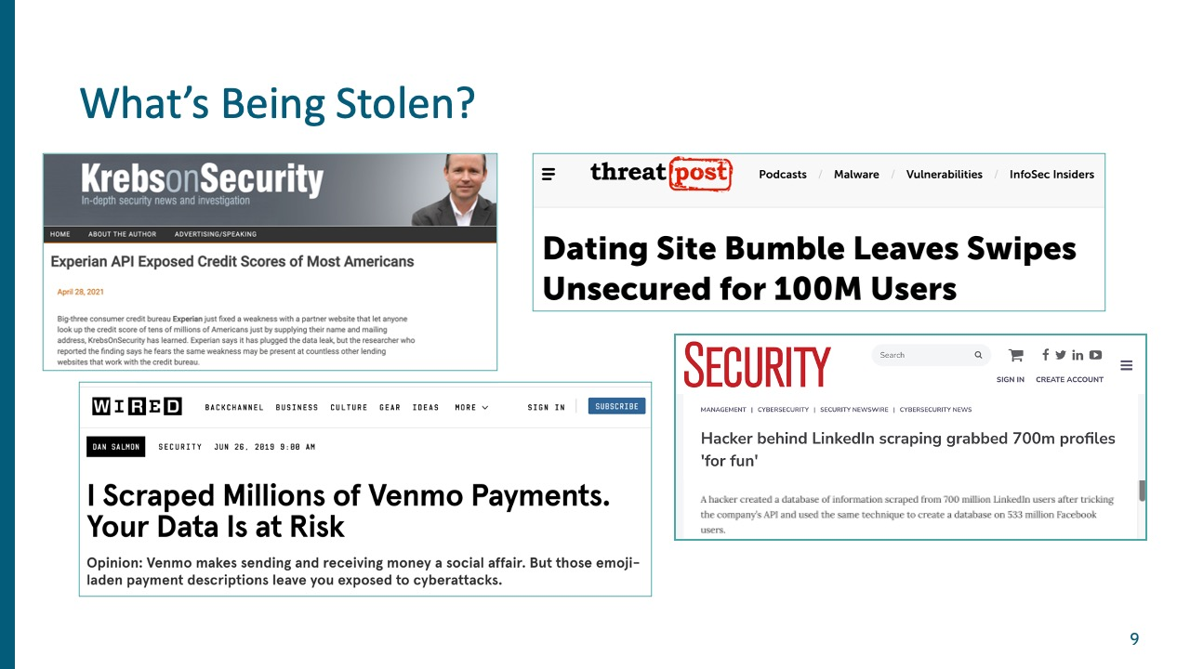
Why API Security
Notes:
And let's look at what kind of things are being stolen. This is really just tip of the iceberg. With APIs is you don't lose 10, 20, a hundred or a thousand records. You lose millions. In the case of Experian, the ability to look up the credit records of any any individual in the United States. The Bumble app, a hundred million users exposed through a leaky API. Everyone on LinkedIn had their information harvested through an API. Venmo had 200 million transactions in full detail harvested through a vulnerable API. Transactions, fraudulent transactions executed through API. You could see why this is such a ripe target for hackers.

Slide 7
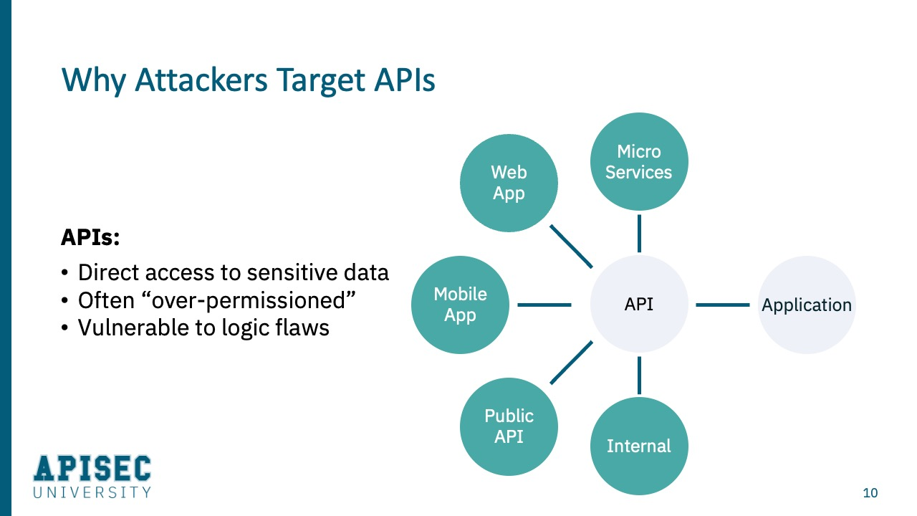
Why API Security

Slide 8
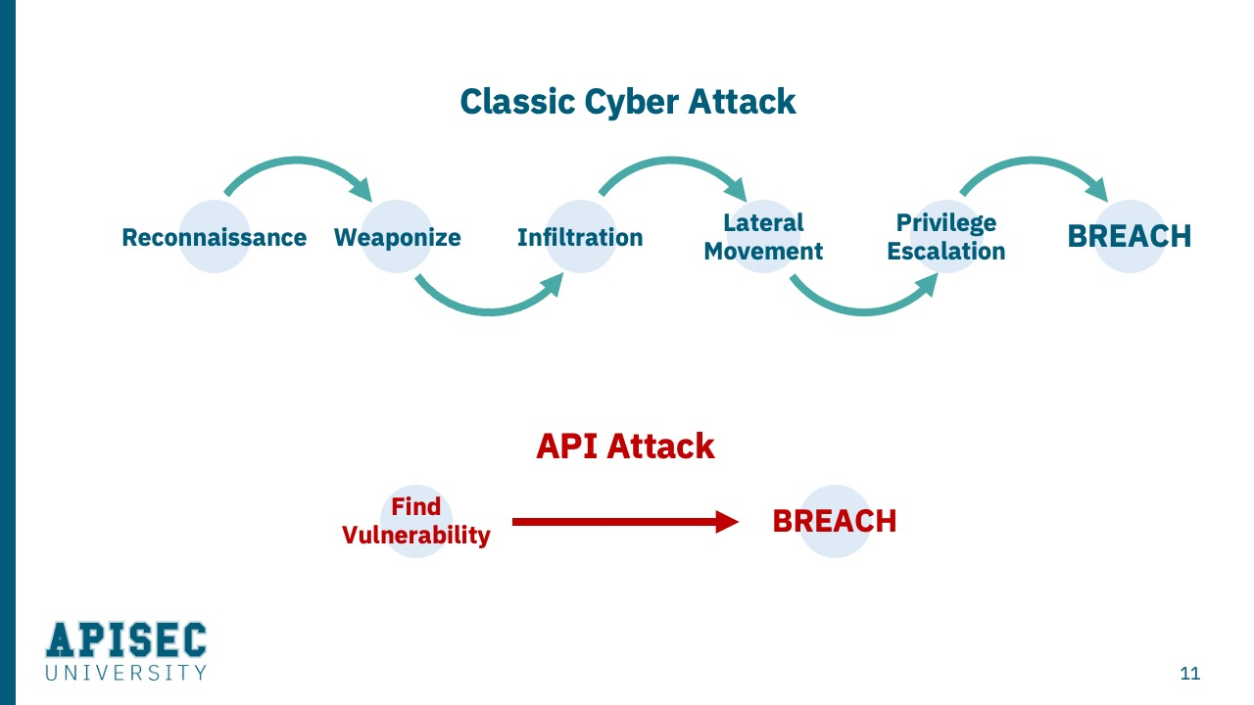
Why API Security

Slide 9
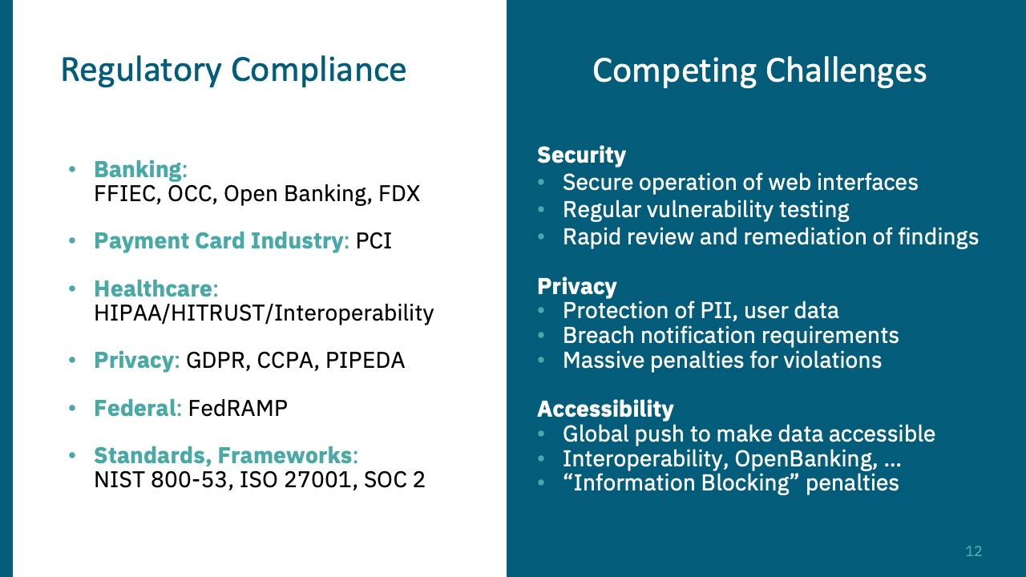
Why API Security
Notes:
There are regulatory requirements to protect this information, and there are very significant penalties when PII gets breached and harvested. The largest I've seen is something on the order of $700 million fine. I think GDPR has up to 4% of top line revenue penalties. So there's a need here to protect the information

Slide 10
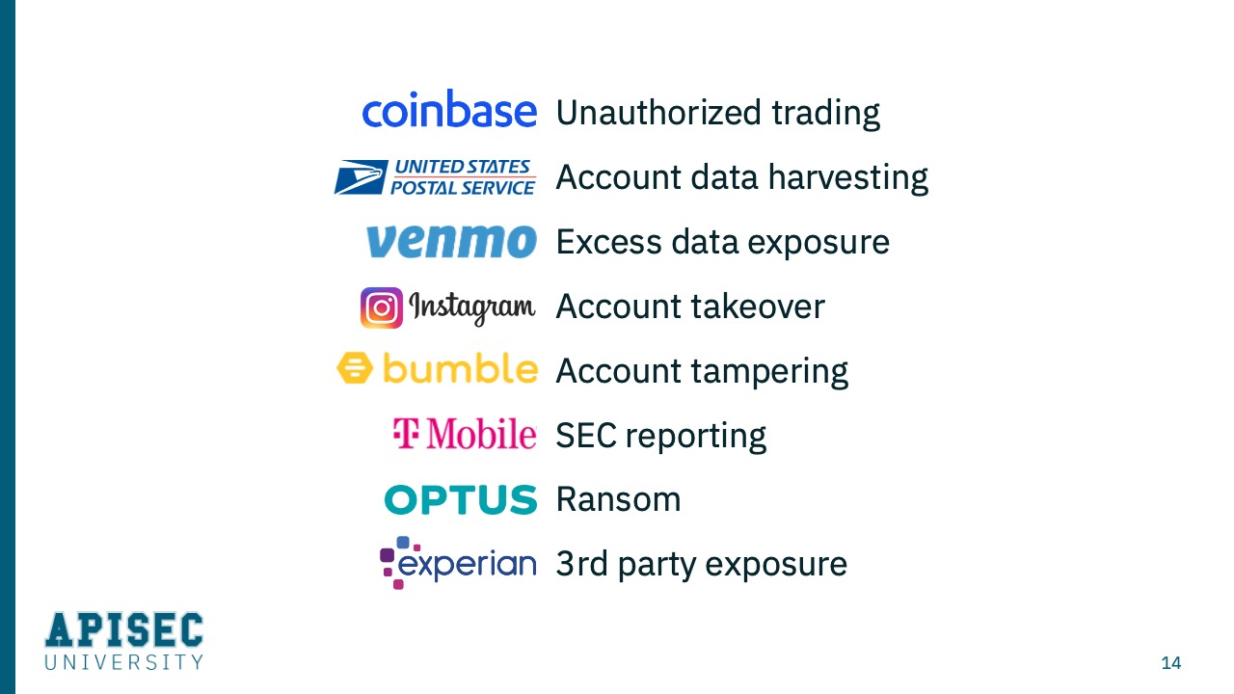
Overview of Real-World Breaches
Notes:
We'll go through many examples. I want to be clear that this is not finger pointing. Each of these companies employed the correct technologies for securing their networks, their infrastructure, and their applications. But it just goes to show how clever attacks can be in finding vulnerabilities and weaknesses in APIs. You'll see many different examples here - such as Coinbase, where there was unauthorized trading possible through a vulnerable API. Or at Instagram where you could take over any user's account through an API attack. As well as examples like T-Mobile, where the exposure was not only the loss of data, but the need to report the incident to a Federal regulator. Or in the case of Optus, where the impact was a ransom demand.
So there's really a lot of different ways that API attacks can achieve their intended goals.

Slide 11
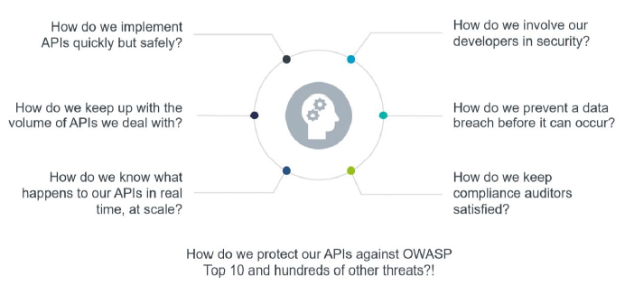
Overview of Real-World Breaches
Notes:
We'll go through many examples. I want to be clear that this is not finger pointing. Each of these companies employed the correct technologies for securing their networks, their infrastructure, and their applications. But it just goes to show how clever attacks can be in finding vulnerabilities and weaknesses in APIs. You'll see many different examples here - such as Coinbase, where there was unauthorized trading possible through a vulnerable API. Or at Instagram where you could take over any user's account through an API attack. As well as examples like T-Mobile, where the exposure was not only the loss of data, but the need to report the incident to a Federal regulator. Or in the case of Optus, where the impact was a ransom demand.
So there's really a lot of different ways that API attacks can achieve their intended goals.

Slide 12
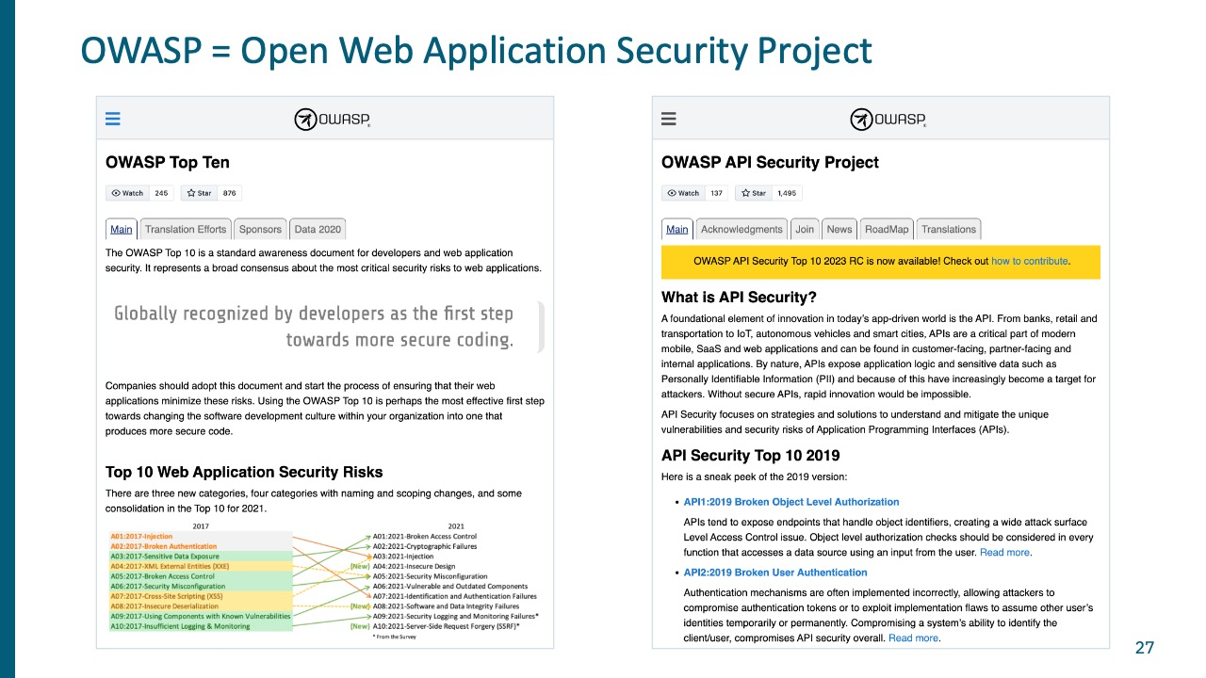
OWASP Top 10 Background
Notes:
There are two different OWASP Top 10s. So just make sure you're aware of which one you're talking about.
The classic OWASP Top 10, here on the left, is for web applications. And this has become the standard for developers and security teams to understand the types of risks that exist with their web applications.
In 2019 the OWASP group determined that with the adoption of APIs, there was a need for an API-specific Top 10 - and that's what you see on the right. The API Security Top 10 was first issued in 2019. There's some overlap with the Web App Top 10, but a whole lot of new unique requirements for the API Top 10. In 2023, a new edition of the OWASP API Top 10 was released. And that's what I'll talk about here in the coming slides.

Slide 13
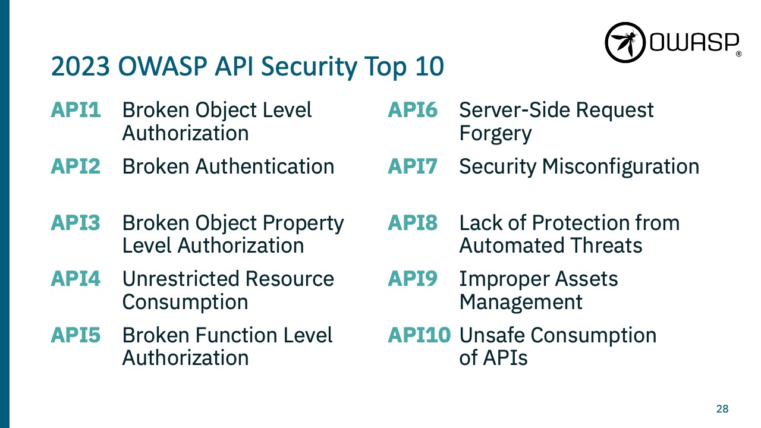
2023 OWASP API Security Top 10
Notes:
There are regulatory requirements to protect this information, and there are very significant penalties when PII gets breached and harvested. The largest I've seen is something on the order of $700 million fine. I think GDPR has up to 4% of top line revenue penalties. So there's a need here to protect the information

Slide 14
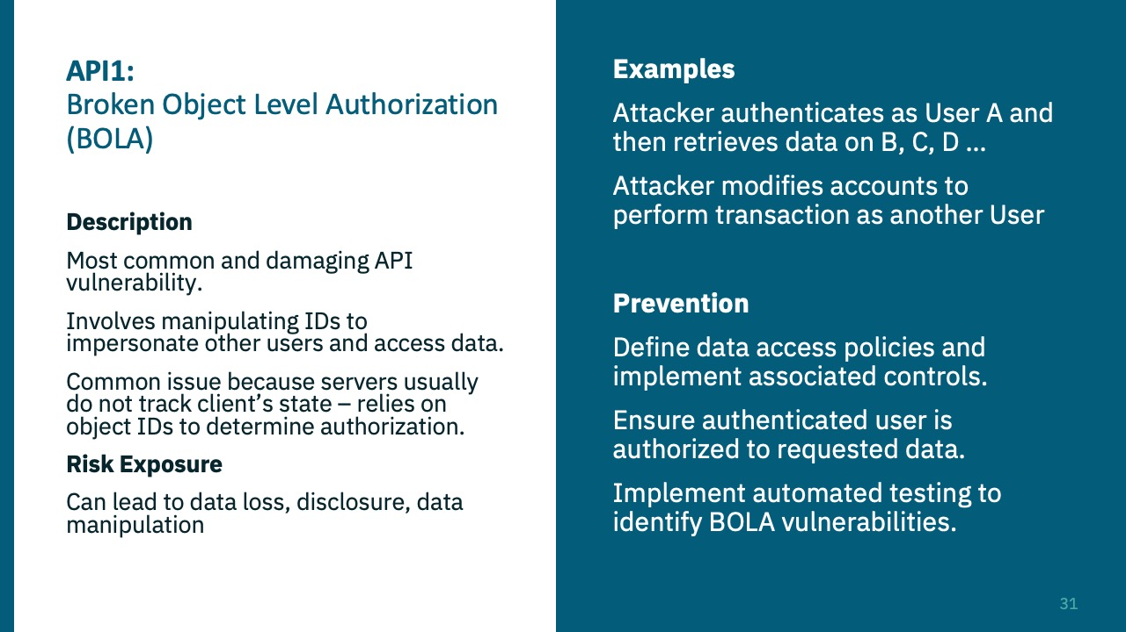
API1:2023 Broken Object Level Authorization
Notes:
There are regulatory requirements to protect this information, and there are very significant penalties when PII gets breached and harvested. The largest I've seen is something on the order of $700 million fine. I think GDPR has up to 4% of top line revenue penalties. So there's a need here to protect the information

Slide 15
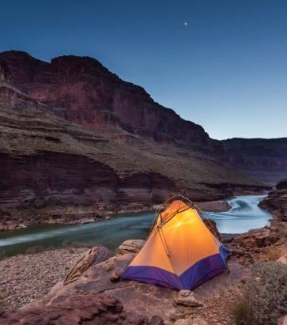



Summary

Slide 16


Thank you
Presenter name
Email address
Website

