Slide 1
OOP Object-Oritented Programming
What
Why
How

Slide 2
What and Why?
We now know and understand the use of methods but …
Although we’ve taken the pressure off the main method our data / program / methods are still not secure
We can use classes and objects to hide away and protect data we don’t want others to see or access
We can also use classes and objects to greatly reduce redundancy as we will see
What?
Multiple files working together as one
Only one of these files contains a main method
Secure/Private programs

Slide 3
Why?
Why?
Safe / Secure / Private
More efficient
Cleaner
Eliminates redundancies
Data Hiding
Why Make 100 of something when we can create 1 object and re-use it?

Slide 4

Example:
Let’s say we want to create this cat in python, well we will need some variables such as:
String catName = “Mittens”;
String catBreed = “Bengal”;
String catColor = “Oranage”
int catAge = 2;
boolean isTrained = false;

Slide 5

Oh look, another cat! Time to make some more variables for this one
String catName2 = “cookie”;
String catBreed2 = “maine coon”;
String catColor2 = “oranage”
int catAge2 = 2;
boolean isTrained2 = true;

Slide 6

Oh look, yet another cat! Time to make yet some more variables for this one
String catName3 = “Ally”;
String catBreed3 = “Cornish rex”;
String catColor3 = “White/Gray”
int catAge3 = 4;
boolean isTrained3 = true;

Slide 7


Slide 8
Did you notice something the last slide?
All of our cats have a few (many) things in common …
They all have:
A name
A breed
A color
A age
Trained or Not

Slide 9
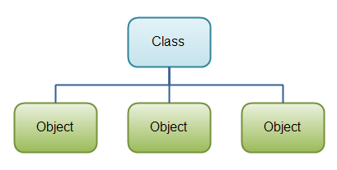
That Means our program would require 5 of the same variable for each dog, imagine if we wanted a 4th, 5th, 6th, 1,000^{th!}
Creating a “cat object” using a separate class
In a separate file we will create what I will refer to as a “shell” for our dog.
We know every one of our cats has a:
Name
Breed
Color
Age
Trained or Not
Our “shell” or client class will contain place holders for all of these variables, each time we want to create a new cat we’ll just create a new one based on this shell, thus we are creating a new object.

Slide 10
Create Client/Demo classes

Slide 11
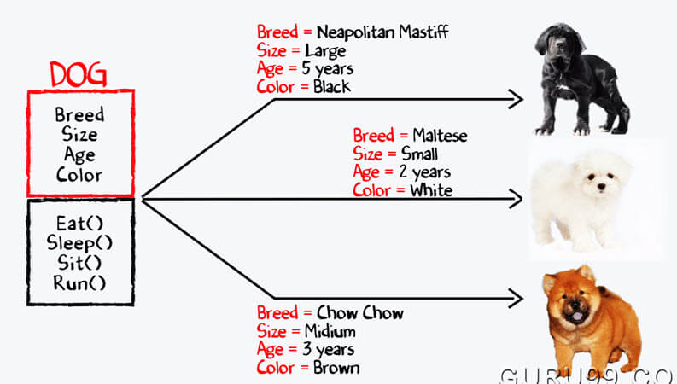
DogClient (The shell for a cat object)
DogDemo (Making use of the DogClient shell)

Slide 12
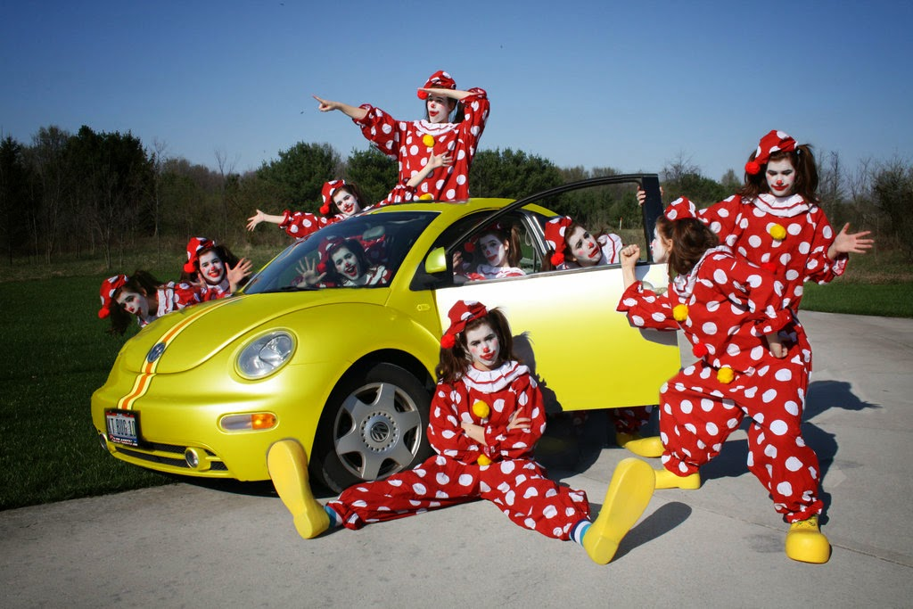
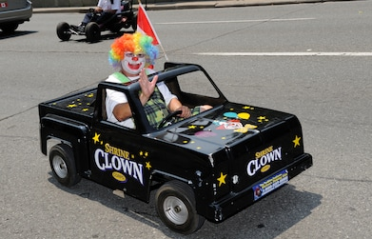
Overloading VS. Overriding

Slide 13
Constructor
Constructor is a type of subroutine in object-oriented programming. Constructor is used to assigning value to data members when an object is created inside a class. The __init__() function is used as a constructor in python almost every time we create an object. In polymorphism, we use this __init__() function almost everywhere.

Slide 14
Inheritance
What & Why
Object-oriented programming allows you to define new classes from existing classes – This is called Inheritance
Inheritance is an important and powerful feature for reusing software
Again, eliminating redundancy!
Superclasses and Subclasses (Parent & Child)
Superclasses and Subclasses
You can use a class to model objects of the same (or similar) type
Different classes may have some common properties / behaviors but also some may differ … (See below)
You can define a more specialized class to inherit the properties and methods from a general class

Slide 15
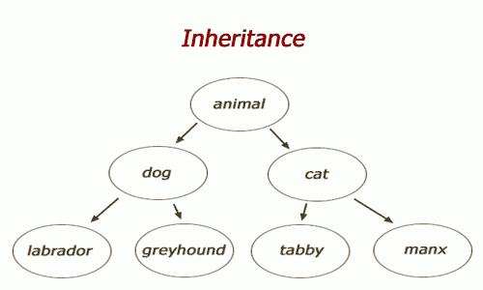
Python Inheritance Inheritance allows us to define a class that inherits all the methods and properties from another class. Parent class is the class being inherited from, also called base class. Child class is the class that inherits from another class, also called derived class.

Slide 16
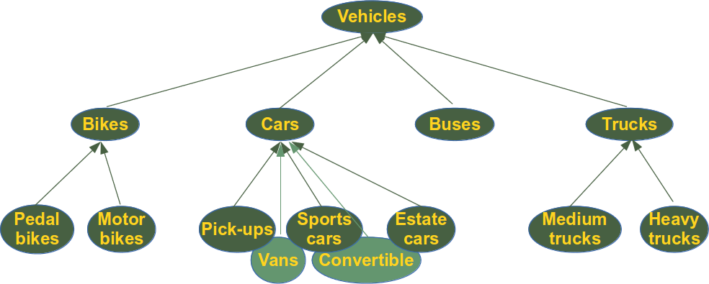

Slide 17
Create a class named Employee,with firstname and lastname properties and a fullname method:
class Employee: def __init__(self, fname, lname): self.firstname = fname self.lastname = lname def fullname(self): print(self.firstname, self.lastname) #Use the Employee class to create an object, and then execute the fullname method: x = Person(“Kevin", “Long") x.fullname()
Your turn to try:

Slide 18
Create a child class names Company, which will inherit the properties and methods from the Employee class
Class Company(Employee):
pass
#use the pass keyword when you do not want to add any other properties or methods to the classes
***Now the Company class has the same properties and methods as the Employee class

Slide 19
Use the Company class to create an object, and then execute the fullname method:
O1 = Company(“Kevin”,”Long”)
O2 = Company(“Katherine”,”Long”)
O1.fullname()
O2.fullname()
Your turn to try:

Slide 20
Add the _init_() Function #The _init_() function is called automatically every time the class is being used to create a new object
Add the _ init_() function to the Company class:
Class Company(Employee):
def _init_(self, fname,lname)
*****when you add _init_()function ,the child class will no longer inherit the parent’s _init_() function
# add properties etc.
*****The child’s _init_() function overrides the inheritance of the parent’s _init_function

Slide 21
Add a call to the parent’s _init_() function:
Class Company(Employee):
def _init_(self, fname, lname):
Employee.init_(self, fname, lname)
Now we have successfully added the __init__() function, and kept the inheritance of the parent class, nd we are ready to add functionality in the __init__() function.

Slide 22
class Company(Employee): def _init_(self, fname, lname): super()._init_(fname, lname) ##By using the super() function, you do not have to use the name of the parent element, It’ll automatically inherit the methods and properties from its parent
Use the super() Function
# python has a super() function that will make the child class inherit all the method and properties from its parent:

Slide 23
Add Properties Add a property called year_employed to the Company class:
Class Company(Employee):
def _init_(self, fname, lname):
super()._init_(fname, lname)
self.year_employed= 2020

Slide 24
Add a year parameter and pass the correct year when creating objects:
Class Company(Employee):
def_init_(self, fname, lname, year):
super()._init_(fname, lname)
self.year_employed = year
O = Company(“Kevin”, “Long”, 2020)
## The year 2020 should be a variable and passed into the Company class when creating company objects. To do so, add another parameter in the _init_() function.

Slide 25
Add methods Add a method greeting to the Company class:
class Company(Employee):
def _init_(self, fname, lname, year):
super()._init_(fname, lname)
self.year_employed = year
def greeting(self):
print(“Welcome”, self.firstname, self.lastname, “to the company of”, self.year_employed)

Slide 26
Polymorphism
What is Polymorphism?
Polymorphism is taken from the Greek words Poly (many) and morphism (forms). It means that the same function name can be used for different types. This makes programming more intuitive and easier.
In Python, we have different ways to define polymorphism. So let’s move ahead and see how polymorphism works in Python.

Slide 27
There are some functions in Python which are compatible to run with multiple data types.
Such as the len() function. It can run with many data types in Python. Let's look at some example use cases of the function.
print(len(“Polymorphism”))
print(len([“Python”, “Java”, “C++”]))
print(len({“Name”: “John”, “Address”: “Poland”}))

Slide 28
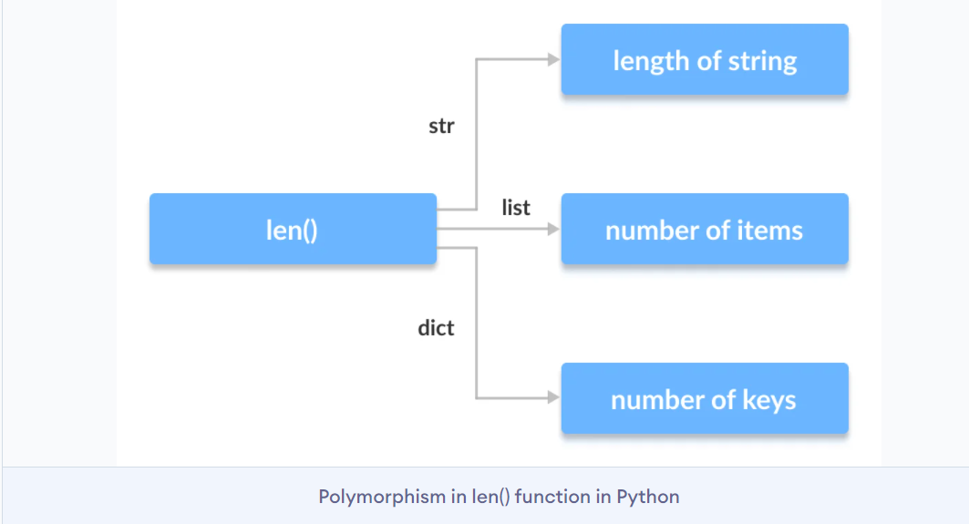

Slide 29
Polymorphism with Classes and Objects
Python can use different types of classes, in the same way, using Polymorphism. To serve this purpose, one can create a loop that iterates through a tuple of objects. Post which, one can call the methods without having a look at the type of class to which the object belong to.
Example:
Animal.py
Country.py
Vegie_fruit.py
Cat_dog.py

Slide 30
Implementing Polymorphism in Python with Inheritance
We will be defining functions in the derived class that has the same name as the functions in the base class. Here, we re-implement the functions in the derived class. The phenomenon of re-implementing a function in the derived class is known as Method Overriding.
Example:
Animal2.py
Bird.py
Shape.py

Slide 31
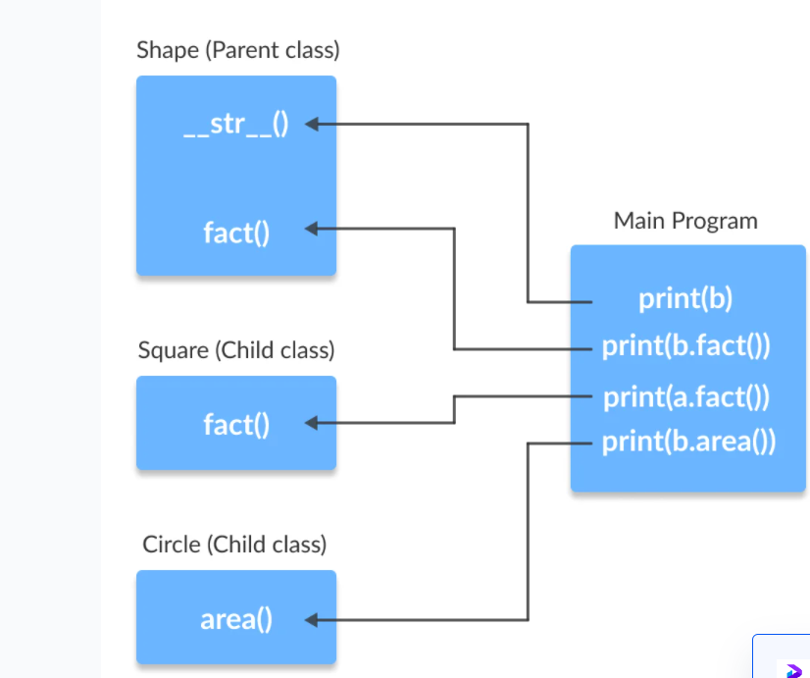

Slide 32
Exception/ try except
What?
Remember, the 3 types of errors from our first class?
We’ve seen many of them by now.
(Syntax, Runtime, Logical)
Exceptions are runtime errors.
Why?
Exception handling enables a program to deal with runtime errors and continue its normal execution.

Slide 33
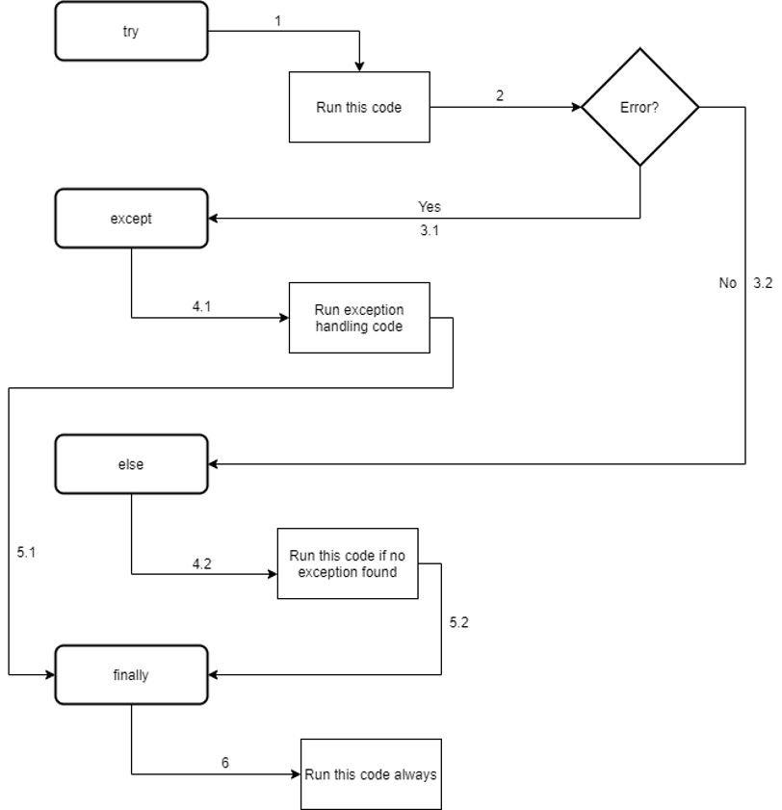

Slide 34
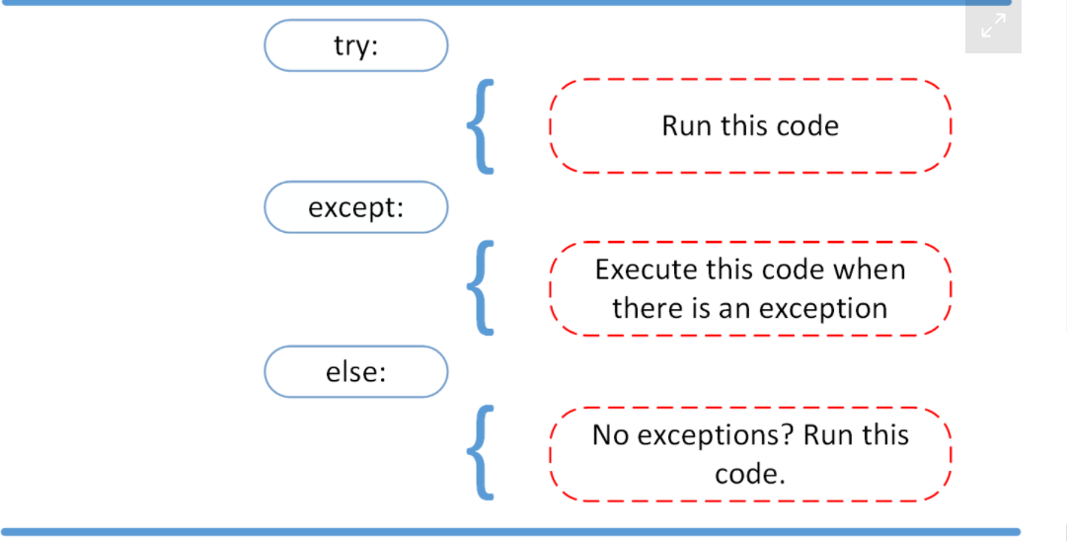

Slide 35
Examples: try_exception1-7

Slide 36
scope
A variable is only available from inside the region it is created. This is called scope.
Not all variables can be accessed from anywhere in a program. The part of a program where a variable is accessible is called its scope. There are four major types of variable scope and is the basis for the LEGB rule. LEGB stands for Local -> Enclosing -> Global -> Built-in.

Slide 37
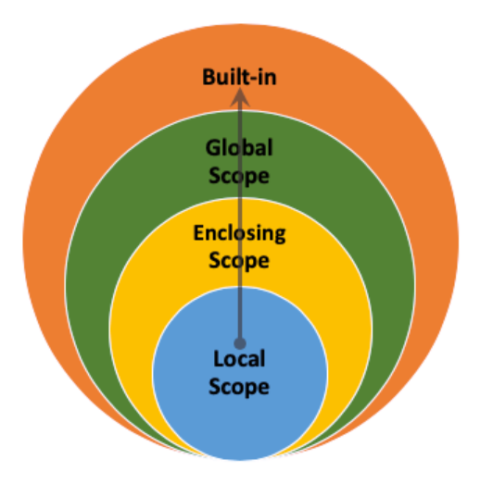
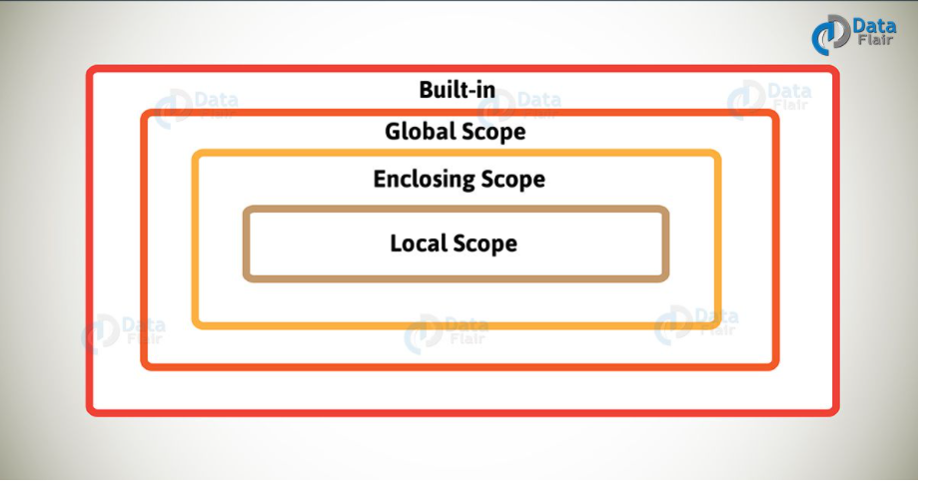
Scope

Slide 38
Local Scope
Whenever you define a variable within a function, its scope lies ONLY within the function. It is accessible from the point at which it is defined until the end of the function and exists for as long as the function is executing .Which means its value cannot be changed or even accessed from outside the function.
Example:

Slide 39
Global Scope
This is perhaps the easiest scope to understand. Whenever a variable is defined outside any function, it becomes a global variable, and its scope is anywhere within the program. Which means it can be used by any function.

Slide 40
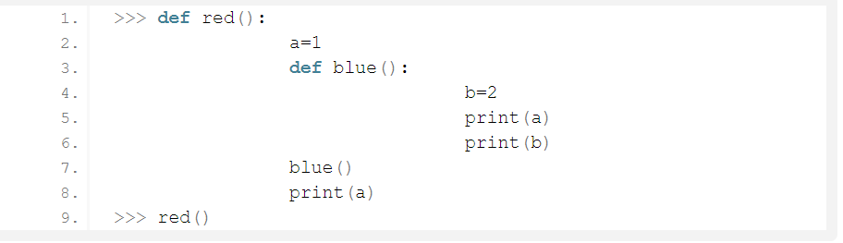
Enclosing Scope
A python variable scope that isn’t global or local is nonlocal. This is also called the enclosing scope.
In this code, ‘b’ has local scope in Python function ‘blue’, and ‘a’ has nonlocal scope in ‘blue’.

Slide 41
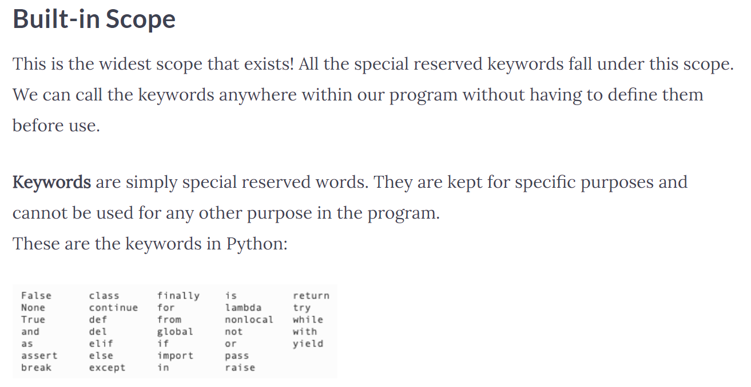

Slide 42
Examples&Exercise

