Slide 1
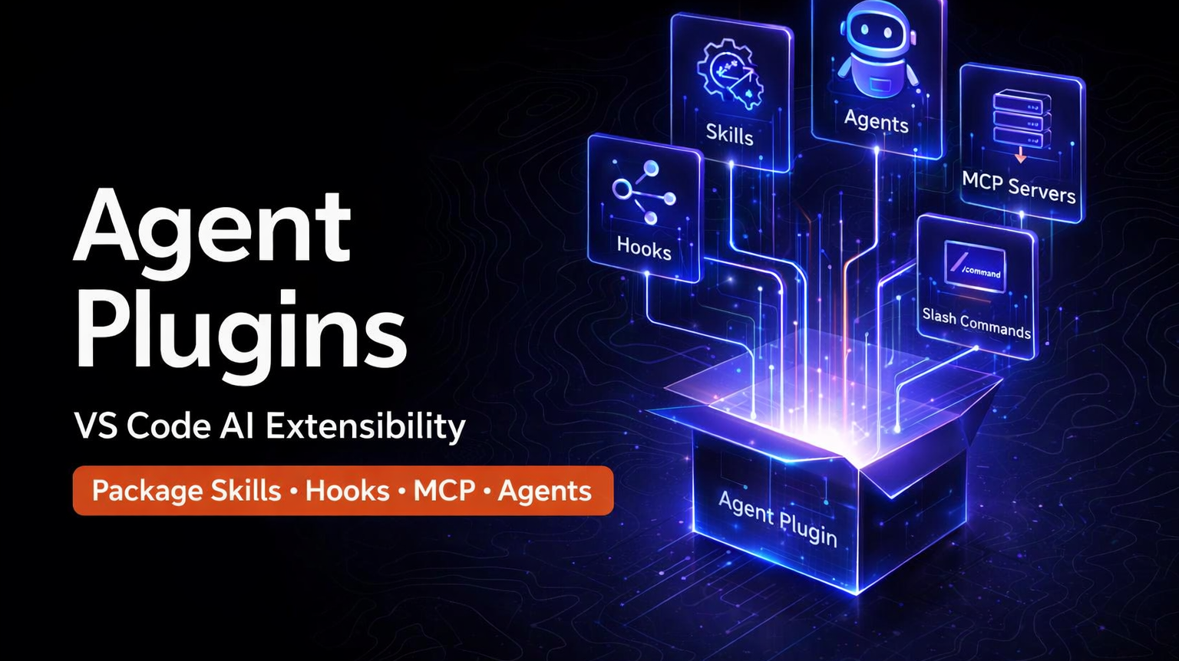

Slide 2
What Plugins Provide
A single plugin can bundle any combination of these customization types
/
Slash Commands
📁 Example Plugin
Additional commands invokable with / in chat
my-testing-plugin/
⚡
Agent Skills
├─ plugin.json
On-demand instructions, scripts, and resources for specific tasks
├─ skills/
├─ test-runner/
🤖
Custom Agents
├─ SKILL.md
├─ run-tests.sh
Specialized personas with tailored tool configurations
├─ agents/
Hooks
├─ test-reviewer.agent.md
🔗
├─ hooks/
Shell commands executed at agent lifecycle points
├─ hooks.json
├─ scripts/
🔌
MCP Servers
├─ validate-tests.sh
External tool integrations and data sources
├─ .mcp.json
Agent Plugins in VS Code — GitHub Copilot

Slide 3
Plugin Architecture
How plugin components integrate into VS Code and GitHub Copilot chat
🏪 Plugin Marketplaces
github/copilot-plugins
github/awesome-copilot
Custom org marketplace
Local plugins
▼
📦 Plugin Package
plugin.json
Metadata & Config
skills/
SKILL.md + scripts
agents/
.agent.md files
hooks/
hooks.json + scripts
.mcp.json
MCP server defs
▼
💻 VS Code Integration
Chat Commands
Configure Skills
Agent Selection
Hook Events
MCP Tool List
Agent Plugins in VS Code — GitHub Copilot

Slide 4
Discover, Install & Manage
🔍 Discovery & Installation
⚙️ Management
Browse Marketplace
Enable / Disable
Search @agentPlugins in Extensions sidebar
Toggle globally or per-workspace from Extensions view
Install from Source
Uninstall
Cmd Palette → Chat: Install Plugin From Source + Git URL
Right-click in Agent Plugins - Installed view
Local Plugins
Auto-Update
Register via chat.pluginLocations in settings.json
Updates checked every 24h when extensions.autoUpdate is on
Workspace Recommendations
View Installed
Teams can recommend via enabledPlugins setting
Agent Plugins - Installed view shows all active plugins
Custom Marketplaces
npm/PyPI Plugins
Add org repos via chat.plugins.marketplaces
Manual update via Update button — no auto-update
📋 Marketplace Configuration (settings.json)
"chat.plugins.marketplaces": [ "anthropics/claude-code" ]
"chat.pluginLocations": { "/path/to/my-plugin": true }
"chat.plugins.enabled": true
Agent Plugins in VS Code — GitHub Copilot

