Slide 1
Chicago Crime Dataset 2024
Data Mining Final Project
Preprocessing · Data Integration · Cluster Analysis · Classification
Sama Gannurdinov
Data Mining · April 2026
github.com/samagannurdinov

Slide 2
Project Overview
What was added since the Midterm
Midterm (completed)
Final (new progress)
• Data Cleaning — 99.4% records retained
• Attribute Subset Selection — 7 columns removed
• PCA — 84.21% variance in 2 components
• Min-Max & Z-Score Normalization
• Equal-Width Binning (time periods)
• Concept Hierarchy (77 areas → 4 sectors)
• Binary Discretization (indoor / outdoor)
• Basic K-Means Clustering (Lat / Long only)
• Interactive D3.js Dashboard
• Data Integration — 2020 Census demographics merged for all 77 community areas
• Per-capita crime rates computed by neighborhood
• Enhanced Clustering — Elbow Method validates K=10
• 4-feature K-Means (location + time + environment)
• Cluster profiling — arrest rate & avg hour per cluster
• Classification Model — Random Forest (arrest prediction)
• 84.3% accuracy · ROC-AUC 0.8154
• Feature Importance analysis
• 8-section Final PDF Report with 10 charts
Sama Gannurdinov | Data Mining Final Project | April 2026

Slide 3
Dataset Overview
City of Chicago Open Data Portal — 2024
259,032
257,547
99.4%
Raw Records
After Cleaning
Retention Rate
22
28
77
Original Features
Engineered Cols
Community Areas
Top 5 Crime Types (2024)
Theft alone accounts for nearly 1 in 4 reported incidents across the city.
Crime Type
Count
%
Theft
60,298
23.4%
Battery
45,953
17.8%
Criminal Damage
28,449
11.0%
Assault
23,380
9.1%
Motor Vehicle Theft
21,642
8.4%
Sama Gannurdinov | Data Mining Final Project | April 2026

Slide 4
Data Preprocessing Pipeline
9 techniques applied before any modeling
Data Cleaning
Attribute Selection
PCA
Dropped 1,486 rows with missing coordinates; filled Location Description gaps
Removed 7 irrelevant ID columns (IUCR, FBI Code, Case Number…)
4 spatial features → 2 principal components retaining 84.21% variance
Min-Max Normalization
Z-Score Normalization
Feature Engineering
Lat / Long scaled to [0,1] — required for K-Means distance calculation
District / Ward standardized — required for PCA (mean=0, std=1)
Extracted Hour, Month, Day_of_Week from raw timestamp
Equal-Width Binning
Concept Hierarchy
Binary Discretization
24 hour values → 4 time periods: Late Night / Morning / Afternoon / Evening
77 Community Areas → 4 City Sectors (North Side, Central/West, South, Far South)
Dozens of location types → Is_Outdoor flag (1 = outdoor, 0 = indoor)
Sama Gannurdinov | Data Mining Final Project | April 2026

Slide 5
Data Reduction — PCA
Compressing 4 correlated spatial features into 2 components
Why PCA?
• District vs Ward correlation: r = 0.653 — they carry overlapping information
• PC1 captures: 69.75% of variance (north-south city axis)
• PC2 captures: 14.46% of variance (east-west spread)
• Total retained: 84.21% of spatial information in just 2 dimensions
• Pre-processing: Z-Score normalization applied before PCA to equalize feature scales
Result: 50% dimensionality reduction (4 → 2) with minimal information loss.
Sama Gannurdinov | Data Mining Final Project | April 2026

Slide 6
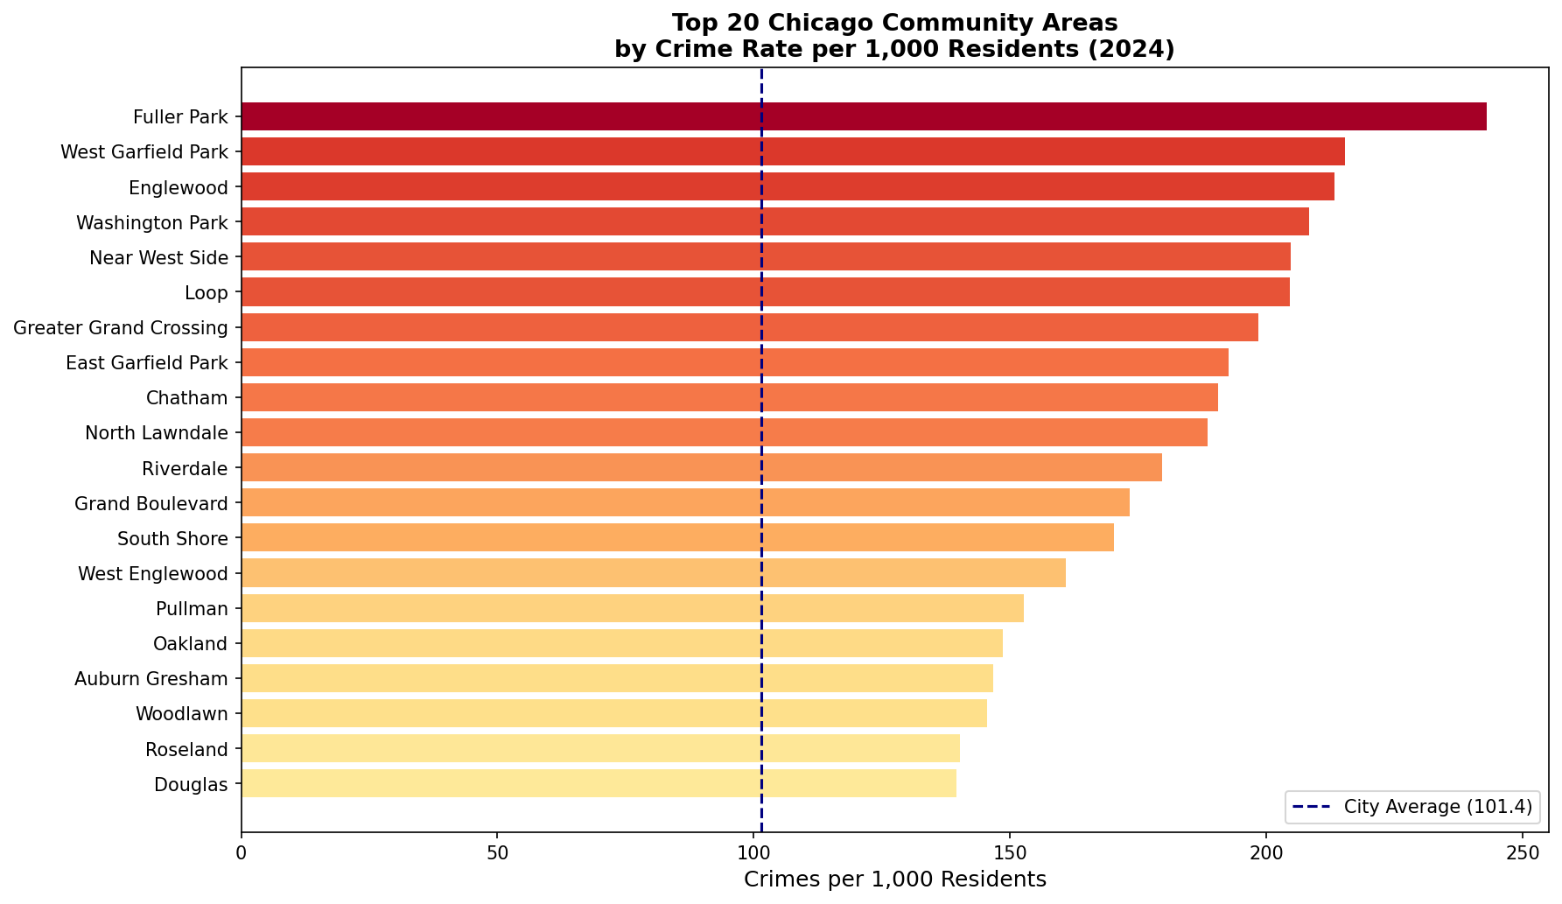
Data Integration
Merging 2020 U.S. Census demographics for all 77 Chicago community areas
Why Integrate?
• Raw crime counts favor large-population areas — unfair comparison
• Per-capita rate reveals the true risk exposure for residents
• Enables evidence-based, equity-aware policy decisions
Key Findings
• Fuller Park: 243 / 1k residents — highest in the city
• Edison Park: 24 / 1k residents — lowest in the city
• 10× gap: between safest and most dangerous areas
• The Loop: High raw count (9,289) but explained by large transient population
Sama Gannurdinov | Data Mining Final Project | April 2026

Slide 7
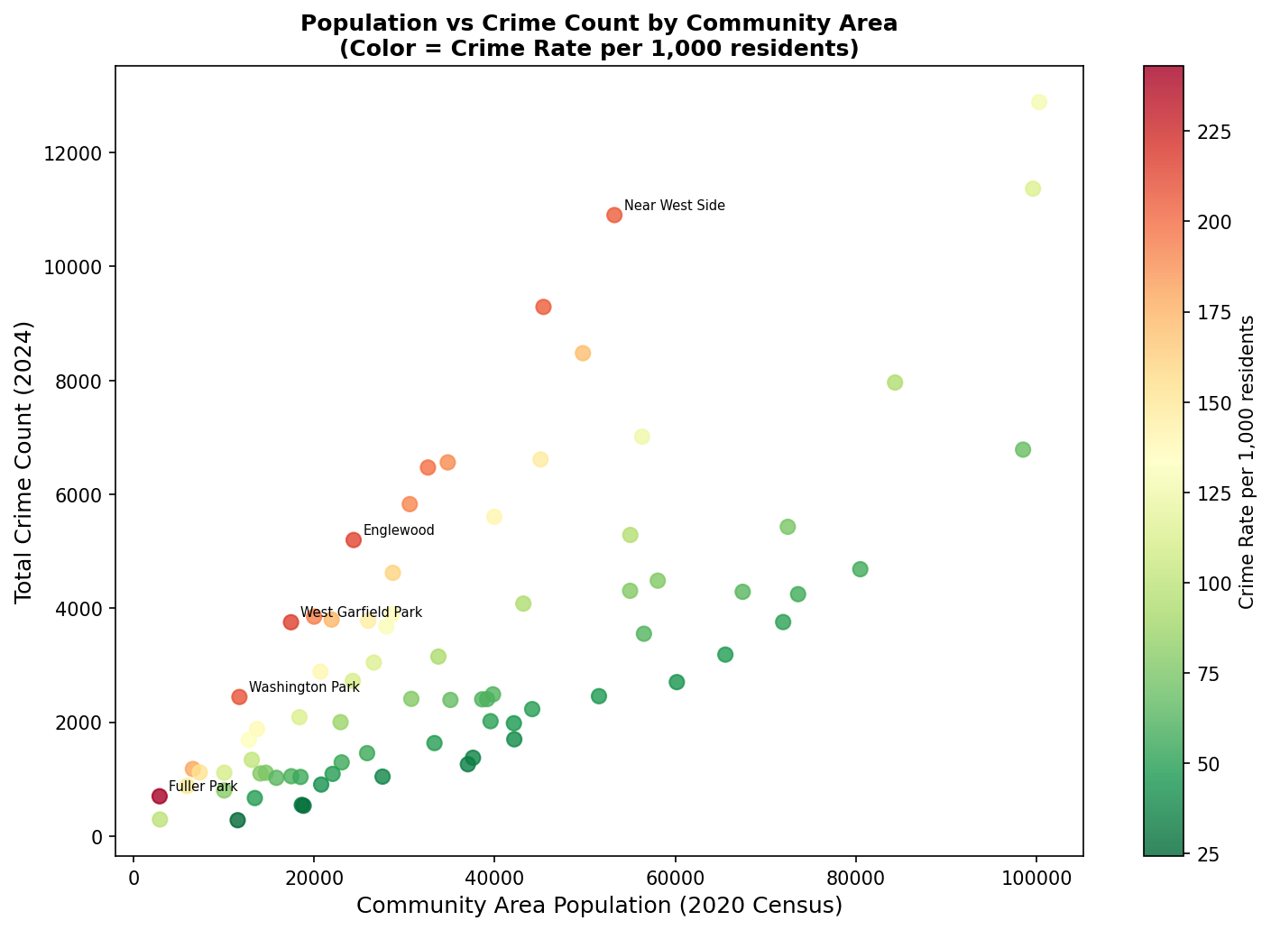
Data Integration — Population vs Crime
Color shows per-capita crime rate — not all busy areas are high-risk
Insight
• Large population does not equal high crime rate
• West Garfield Park & Englewood: small population, extreme per-capita rates
• Austin: largest population (100k) but mid-tier crime rate
• Integration reveals inequality invisible in raw counts
Sama Gannurdinov | Data Mining Final Project | April 2026

Slide 8
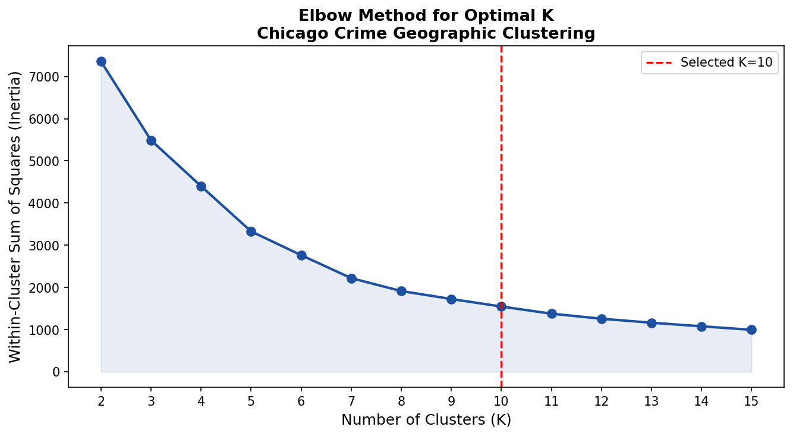
Model 1: Cluster Analysis — Elbow Method
Empirically validating K=10 instead of choosing it arbitrarily
What is the Elbow Method?
• Plot inertia (WCSS) for K = 2 to 15
• Find the 'elbow' where adding more clusters gives diminishing returns
• Inflection occurs near K = 9–10
• K = 10 selected as optimal balance between granularity and efficiency
Improvement vs Midterm
• Midterm: K=10 chosen with no justification
• Final: K=10 validated by Elbow Method inertia analysis
• Features: Added Hour & Is_Outdoor so clusters reflect WHEN and WHERE crimes happen — not just coordinates
Sama Gannurdinov | Data Mining Final Project | April 2026

Slide 9
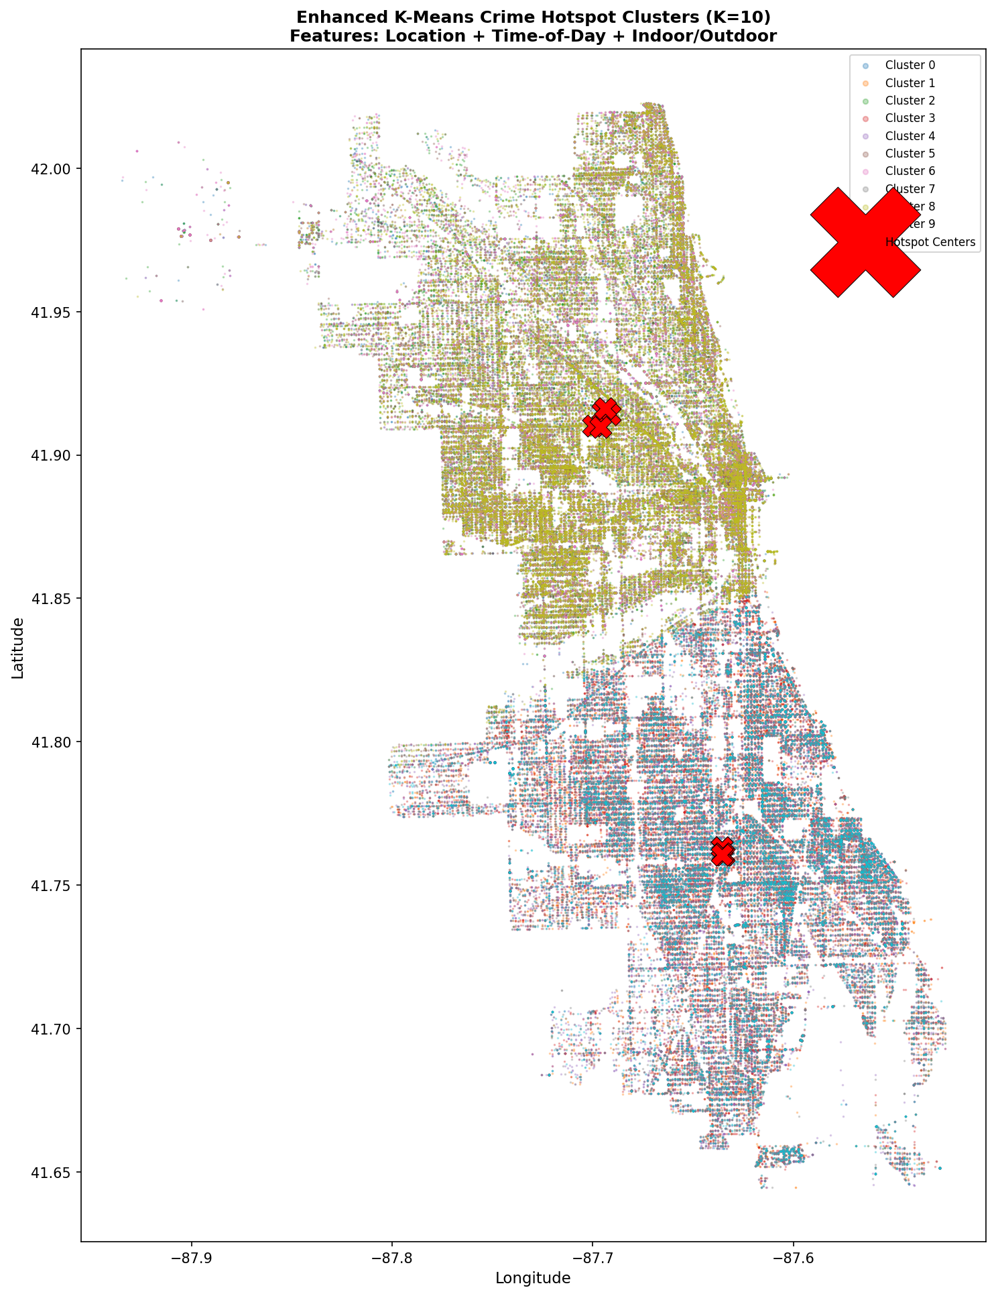
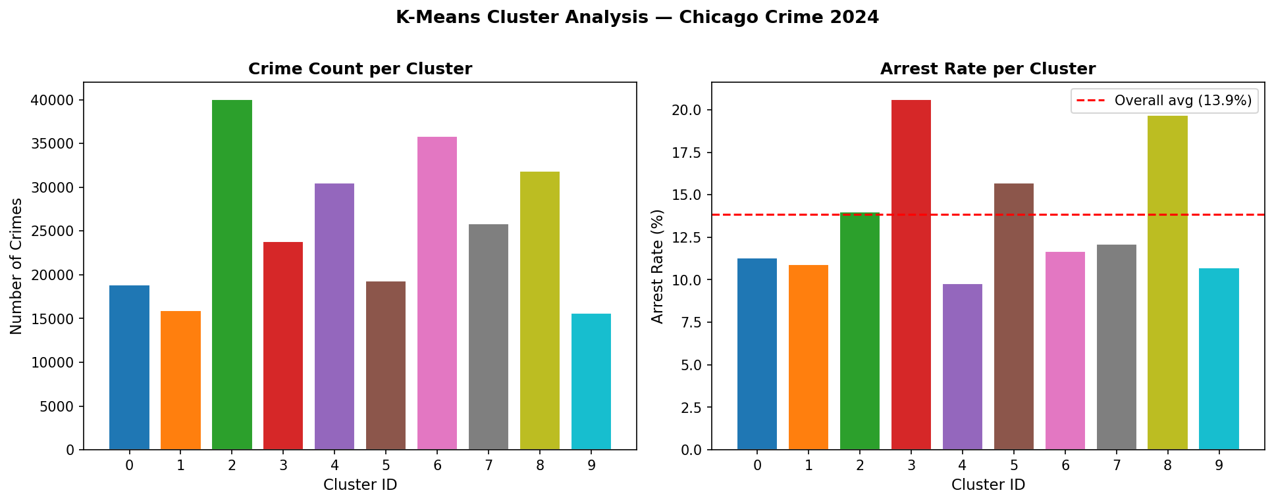
Model 1: Crime Hotspot Clusters (K=10)
Enhanced K-Means — Location + Time-of-Day + Indoor/Outdoor
Outdoor evening clusters (3, 8) have the highest arrest rates: 19–21%
Sama Gannurdinov | Data Mining Final Project | April 2026

Slide 10
Model 2: Random Forest Classification
Predicting whether a crime incident will lead to an arrest
Problem
Configuration
Given the characteristics of a reported crime — type, location, time, district — can we predict whether it will result in an ARREST?
n_estimators
100 trees
max_depth
12
Why Random Forest?
• Handles mixed features natively (numeric, binary, categorical)
• class_weight='balanced' compensates for 6:1 class imbalance
• Feature importance scores reveal what drives arrest outcomes
• More robust than a single Decision Tree — reduces overfitting
class_weight
'balanced'
Train / Test
80% / 20% (stratified)
Target variable
Arrest (0 = no arrest, 1 = arrested)
Features used
12 (hour, month, day, district, ward, beat, domestic, outdoor, time bin, community area, crime type, city sector)
Class imbalance: 85.8% No Arrest vs 14.2% Arrest — balanced weighting is essential
Sama Gannurdinov | Data Mining Final Project | April 2026

Slide 11
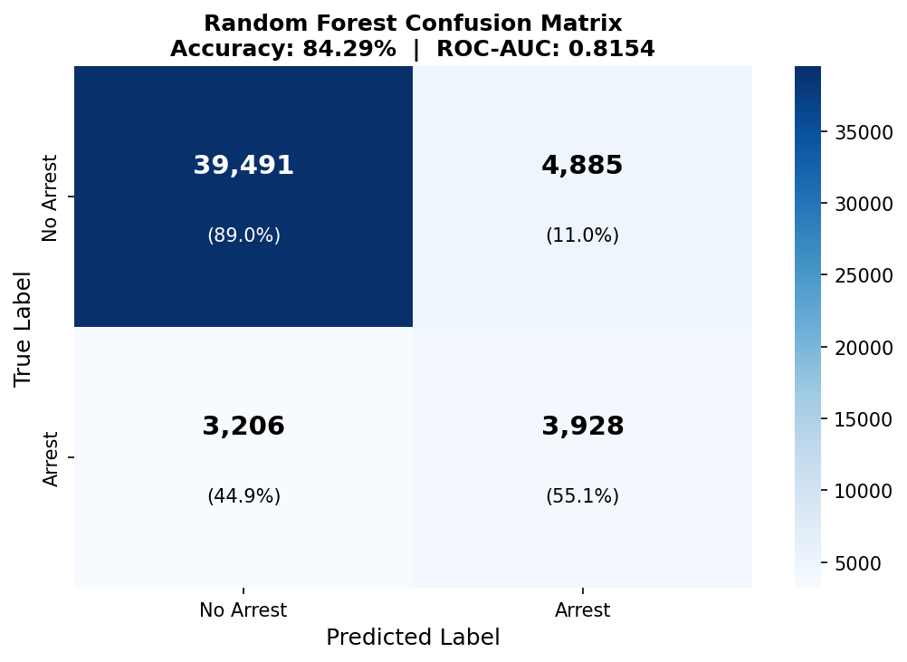
Model 2: Classification Results
Random Forest — Accuracy 84.3% | ROC-AUC 0.8154
Performance Metrics
Overall Accuracy
84.29%
43,434 of 51,510 correct
ROC-AUC Score
0.8154
Strong discrimination power
No Arrest Precision
0.92
92% of predicted no-arrests are correct
Arrest Recall
0.55
55% of actual arrests caught
Arrest F1-Score
0.49
Balanced precision-recall tradeoff
An ROC-AUC of 0.8154 means the model is dramatically better than a random baseline (0.5) at separating arrest from non-arrest cases.
Sama Gannurdinov | Data Mining Final Project | April 2026

Slide 12
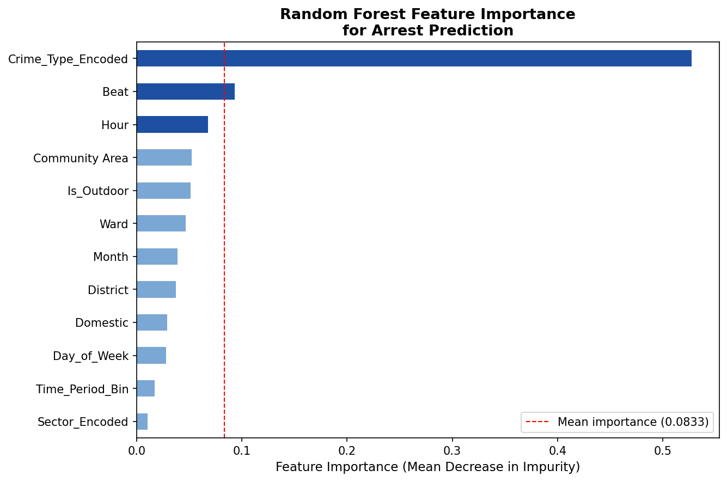
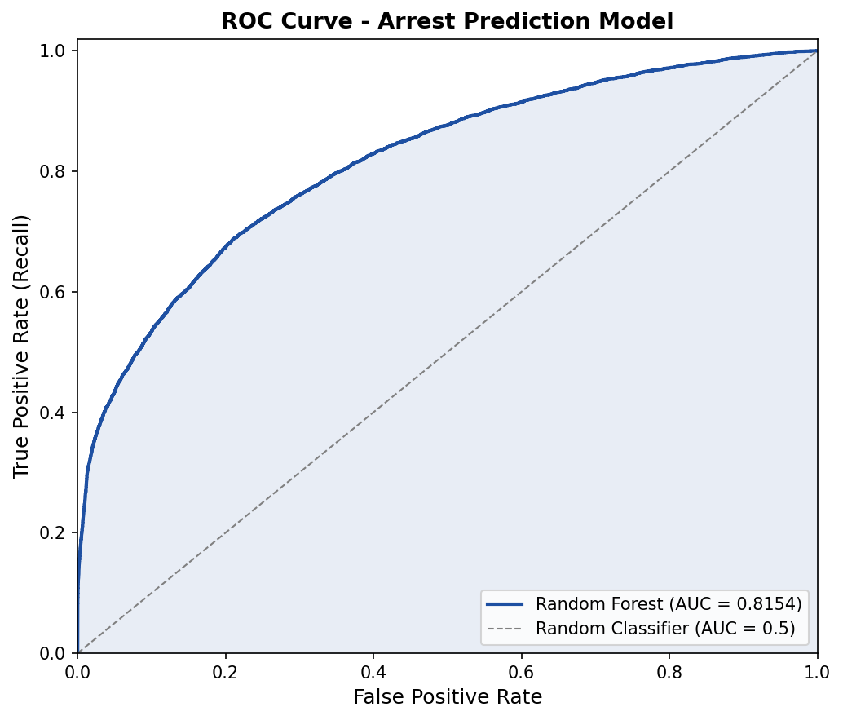
Model 2: What Drives Arrest Outcomes?
Feature Importance & ROC Curve
Crime type is the #1 predictor — what you do determines whether you get arrested, more than where or when.
Sama Gannurdinov | Data Mining Final Project | April 2026

Slide 13
Key Findings & Insights
Data-driven discoveries across all three analyses
Geographic
Temporal
Predictive
• Fuller Park: 243 crimes/1k residents — 10× more than Edison Park (24/1k)
• 10 K-Means clusters reveal distinct hotspot zones across the city
• Central/West sector has the highest raw crime count (94,060 incidents, 36.5%)
• Afternoon (31.2%) + Evening (28.5%) = nearly 60% of all incidents
• Evening outdoor clusters have the highest arrest rates (~20%)
• Late-night indoor crimes (2 AM avg) have the lowest arrest rates (10-11%)
• Crime type is the #1 predictor of arrest — stronger than location or time
• Community Area & Beat are 2nd and 3rd — local enforcement capacity matters
• 84.3% accuracy and AUC=0.8154 with no external data beyond the crime record
Sama Gannurdinov | Data Mining Final Project | April 2026

Slide 14
Limitations & Future Work
Honest assessment and actionable next steps
Current Limitations
Future Improvements
• Class imbalance: Only 13.85% arrests → recall = 0.55 even with balanced weights. SMOTE or cost-sensitive learning could improve minority-class detection.
• Population proxy: Residential Census data underestimates exposure in commercial areas like the Loop (large daytime population not captured).
• Single year: 2024 data only — multi-year analysis needed to detect trends and pre/post-COVID shifts.
• K-Means geometry: Assumes spherical clusters — may not fit Chicago's elongated north-south geography well.
• Frequent Pattern Mining: Apply Apriori to find association rules: e.g., 'Theft + Street + Afternoon' co-occur 3× more than expected.
• DBSCAN clustering: Discovers arbitrary-shape clusters and noise points — better suited to Chicago's irregular geography.
• Weather integration: Merge NOAA daily temperature data to test the warm-weather crime hypothesis.
• Live prediction dashboard: Extend the D3.js dashboard with real-time arrest probability scores from the trained model.
Sama Gannurdinov | Data Mining Final Project | April 2026

Slide 15
Conclusion
99.4%
84.21%
77
records retained after cleaning
variance captured by 2 PCA components
community areas integrated
K=10
84.3%
0.8154
clusters validated by Elbow Method
classification accuracy
ROC-AUC score (arrest prediction)
github.com/samagannurdinov
Data Mining · April 2026 · Sama Gannurdinov
Thank You

