Slide 1


HEART ATTACK PREDICTION AND ANALYSIS
by PROJECT ID:2020CSEPID58
SHIVAM KUMAR(TL) (2002900100142)
MOTKI(2002900100148)
UNDER THE SUPERVISION OF:
MR. SANJEEV KUMAR SIR
DEPARTMENT OF COMPUTER SCIENCE AND ENGINEERING
ABES INSTITUE OF TECHNOLOGY,GHAZIABAD
AFFILIATED TO
DR. APJ ABDUL KALAM TECHNICAL UNIVERSITY
MEMBERS: GUIDED BY:
SHIVAM KUMAR(TL) (2002900100142) MR. SANJEEV KUMAR SIR
SHIVANI SINGH(2002900100148)
OCTOBER,2021

Slide 2
CONTENT
∆ Abstract
∆ Introduction and problem statement
∆Work flow
∆ Proposed solution
∆Conclusion
∆ References

Slide 3
ABSTRACT • Cardiovascular disease is one of the most fatal condition in the present world. • Statistical data display the lethalness of cardiovascular disease by revealing the percentage of death's worldwide cause due to heart attack. • Thus there is an implicit necessity to predict the condition at the earliest.

Slide 4
INTRODUCTION • By utilizing patients medical record a new system is proposed to predict the chances of person contracting heart attack. • Attributes such as age ,blood pressure, thickness of the artery etc. are fed into fuzzy C means algorithm which is used to predict risk of heart attack in a person. • FCM is a clustering algorithm which allows one piece of data to belong to multiple clusters.

Slide 5
PROBLEM STATEMENT • Heart disease or cardiovascular disease remains the primary basis of death worldwide. • An estimate by the World Health Organization, that over 17.9 million deaths occur every year worldwide because of cardiovascular disease. • The efficient and accurate and early medical diagnosis of heart disease plays a crucial role in taking preventive measures to prevent death.

Slide 6
PROPOSED SOLUTION • Machine learning algorithms can analyze huge data from various fields, one such important field is the medical field. It is a substitute to routine prediction modeling approach using a computer to gain an understanding of complex and non-linear interactions among different factors by reducing the errors in predicted and factual outcomes. • Data mining is the process of extracting valuable data and information from huge databases. Various data mining techniques such as regression, clustering, association rule and classification techniques like Naïve Bayes, decision tree , random forest and K-nearest neighbor are used to classify various heart disease attributes in predicting heart disease.

Slide 7
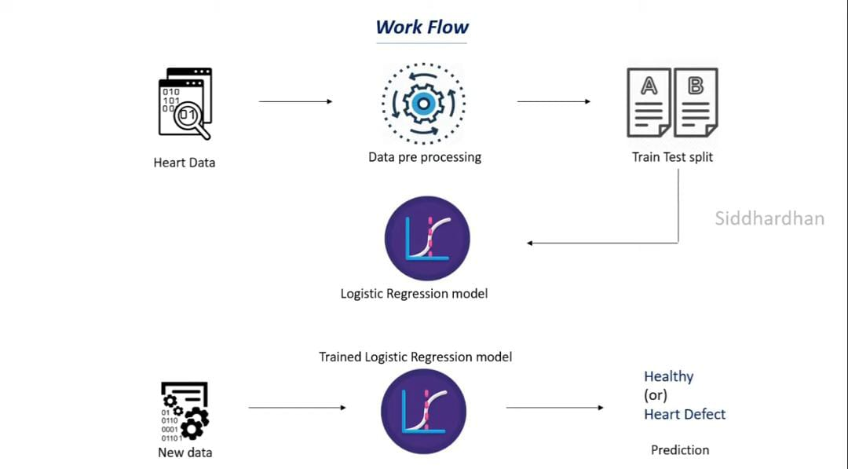
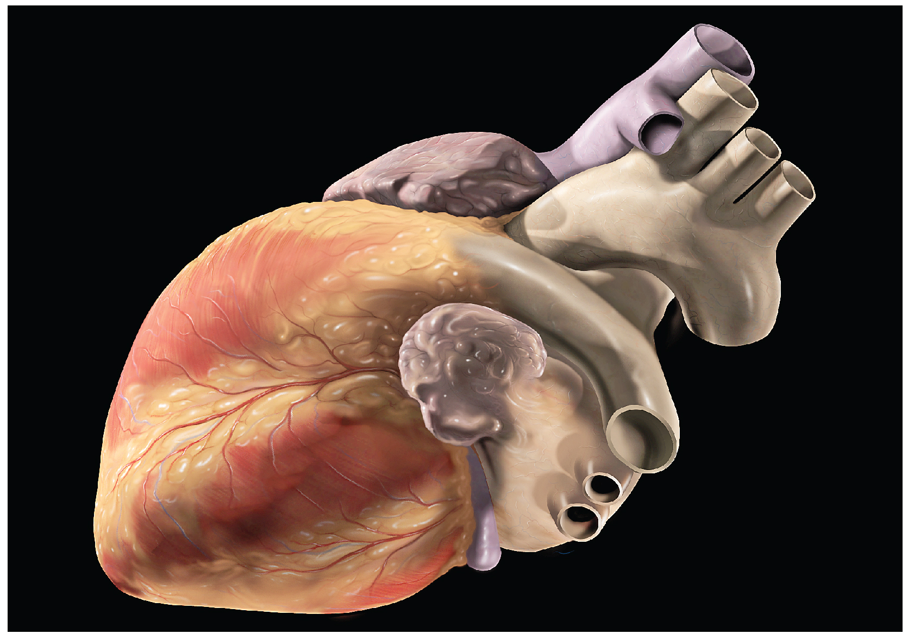

Slide 8
CONCLUSION • The overall aim is to define various data mining techniques useful in effective heart disease prediction. Efficient and accurate prediction with a lesser number of attributes and tests is our goal. • In this study, we will consider only 13 essential attributes. We will apply four data mining classification techniques, K-nearest neighbor, Naive Bayes, decision tree, and random forest. • The data will be pre-processed and then used in the model. K-nearest neighbor, Naïve Bayes, and random forest are the algorithms showing the best results in this model.

Slide 9
REFERENCES 1.Pahwa K, Kumar R. Prediction of heart disease using hybrid technique for selecting features. In: 2017 4th IEEE Uttar Pradesh section international conference on electrical, computer and electronics (UPCON). IEEE. p. 500–504. 2.Pouriyeh S, Vahid S, Sannino G, De Pietro G, Arabnia H, Gutierrez J. A comprehensive investigation and comparison of machine learning techniques in the domain of heart disease. In: 2017 IEEE symposium on computers and communications (ISCC). IEEE. p. 204–207. 3.Devansh Shah, Samir Patel & Santosh Kumar Bharti , Heart Disease Prediction using Machine Learning Techniques.

