Slide 1
Kiva Loans
World Bank Data, Poverty, Gender Influence, and Corruption

Slide 2
The Data and Questions:
Kiva loans are “loans that change lives.”
The vision is a financially inclusive world where all people hold the power to improve their lives.
Kiva works through crowd funding: https://www.kiva.org/about/how
Based on World Bank Data, Poverty Index, and Perceived Corruption, does KIVA succeed in making a more inclusive world.
Hypothesis -

Slide 3
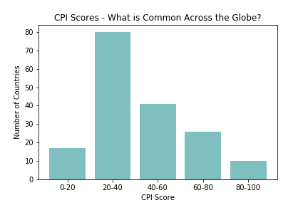
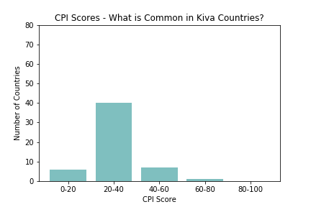
Corruption index & Kiva Loan Countries
Corruption Index worldwide
Corruption index In kiva loan countries
Notes:
2014 data…. 35% of countries with highest corruption, 50% in second to highest corruption, 17% middle of the road, 4% second lowest, 0% least corrupt

Slide 4
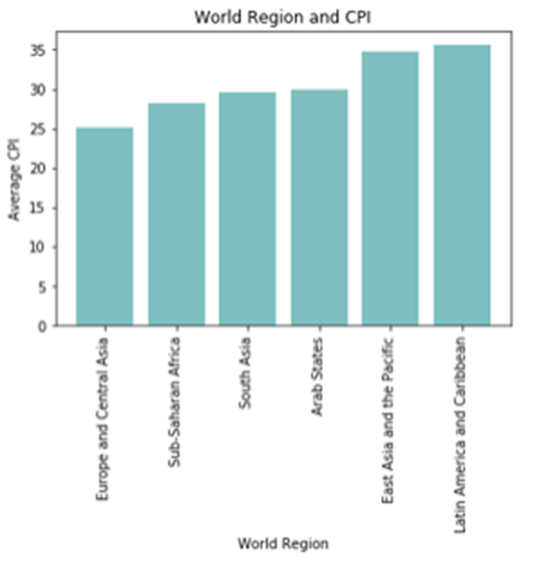

Slide 5
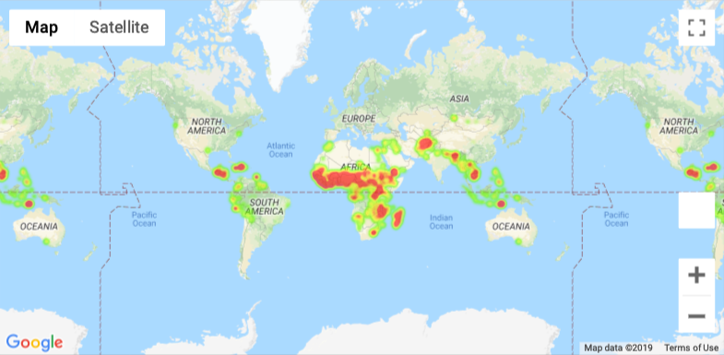
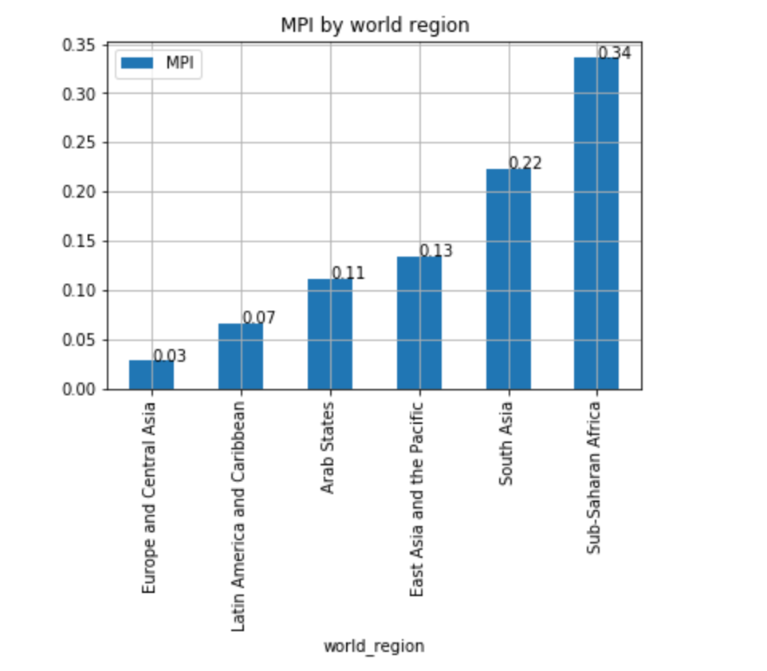
Poverty Index Summary

Slide 6
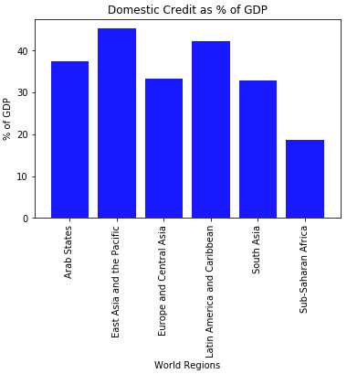
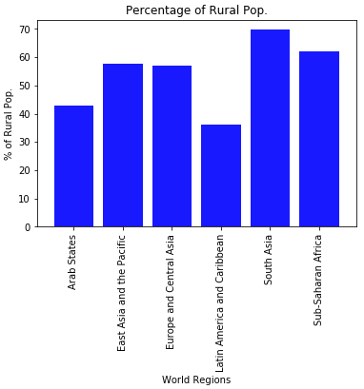
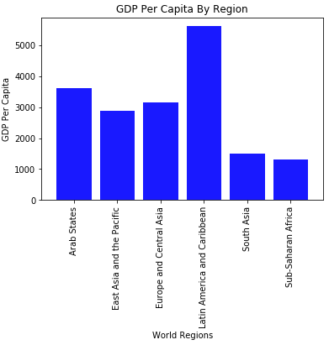

Slide 7
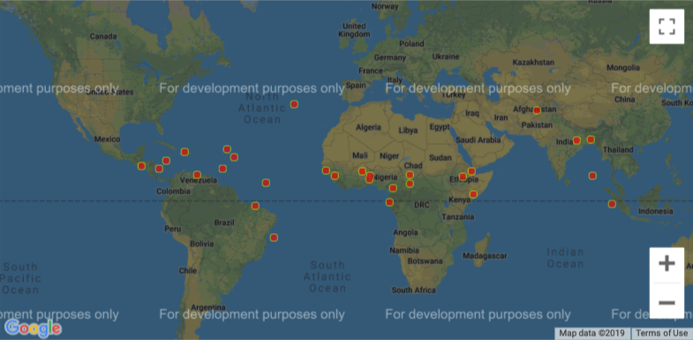
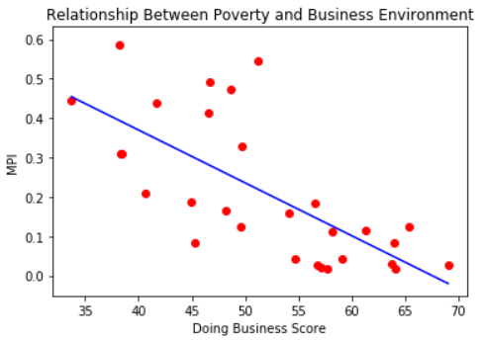
World Bank Data findings
Countries on this map are all those that score the lowest of “Doing Business” metric
Note that the highlighted countries/regions line up with MPI Map
The scatter plot on the right demonstrates the relationship between MPI (poverty levels) and ease of business in countries

Slide 8
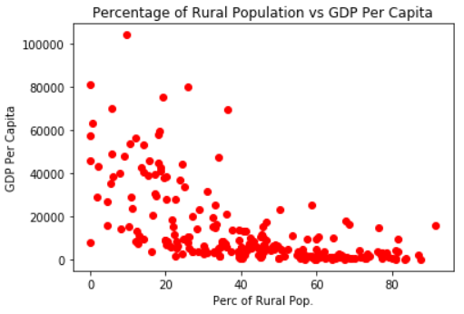
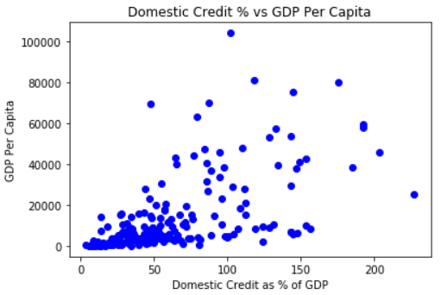
World Bank Data findings .. continued
The first chart demonstrates that generally speaking, the higher the Rural/Urban ratio, the lower the GDP Per Capita
The second chart demonstrates that when more domestic credit it available to the populace, the higher the GDP Per Capita

Slide 9
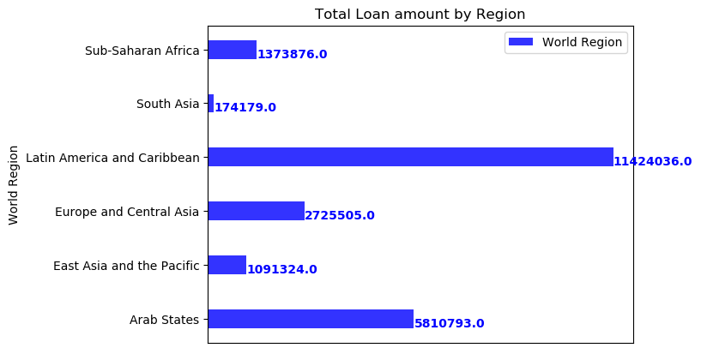
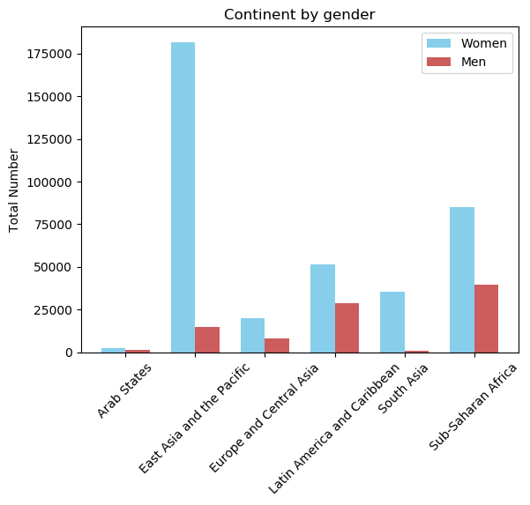
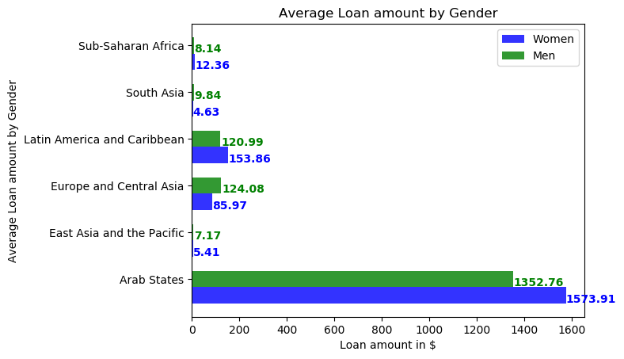

Slide 10
Based on kiva vision – not reaching those most in need of access

Slide 11
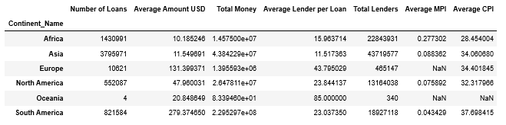
Summary of Kiva Loan Data
Overall Data
By World Region
Thursday – rerun with region instead of continent, format cells?

Slide 12
Add a Slide Title - 4

Slide 13
Add a Slide Title - 5

