Slide 1
Kiva Loans
World Bank Data, Poverty, Gender Influence, and Corruption

Slide 2
The Data and Questions:
Kiva loans are “loans that change lives.”
The vision is a financially inclusive world where all people hold the power to improve their lives.
Kiva works through crowd funding: https://www.kiva.org/about/how
We had some questions about Kiva loan locations and what variables may contribute to the use of Kiva loans in certain locations.
Does a country’s tendency to provide loans to its own citizens affect number of Kiva loans, type of loans, or amount of loans?
Does poverty level affect these variables?
What influence does gender have?
Does the Corruption Perception Index provide any insight into these variables?

Slide 3
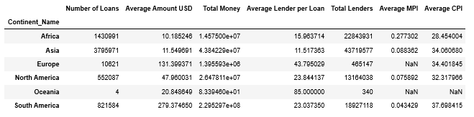
Summary of Kiva Loan Data
Overall Data
By World Region
Thursday – rerun with region instead of continent, format cells?

Slide 4
Poverty Index Summary
First bullet point here
Second bullet point here
Third bullet point here

Slide 5
World Bank Data & findings
Class | Group A | Group B
Class 1
Class 2
Class 3
First bullet point here
Second bullet point here
Third bullet point here

Slide 6
Gender Influences

Slide 7
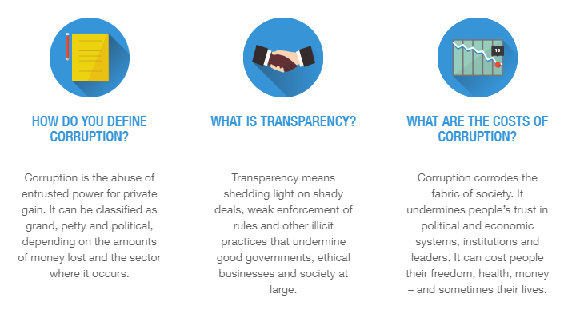
Corruption – Why would this be important?

Slide 8
Corruption Perception Index
The index, which ranks 180 countries and territories by their perceived levels of public sector corruption according to experts and businesspeople, uses a scale of 0 to 100, where 0 is highly corrupt and 100 is very clean.
Started in 1995.
Meant to create visibility and pressure for change where it is needed most.

Slide 9
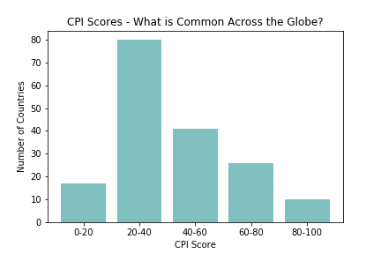
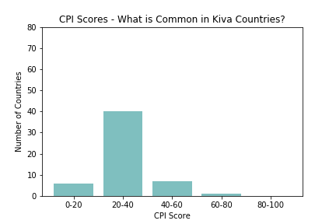
Corruption index & Kiva Loan Countries
Corruption Index worldwide
Corruption index In kiva loan countries
Notes:
2014 data…. 35% of countries with highest corruption, 50% in second to highest corruption, 17% middle of the road, 4% second lowest, 0% least corrupt

Slide 10
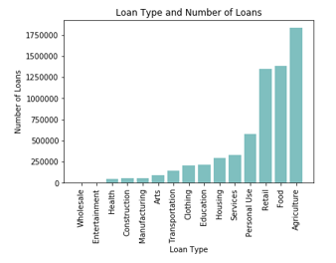
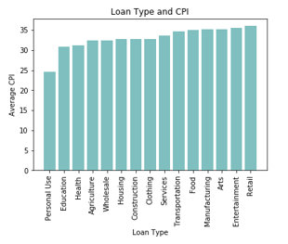
Corruption index & Kiva Loans (continued)
The Corruption Perception Index did not have any marked relationship to the amount of loan, total number of loans distributed in the country, number of lenders/loan, but did seem to have a relationship to loan type:

Slide 12
Add a Slide Title - 4

Slide 13
Add a Slide Title - 5

