Slide 1

NEWS ON DEMAND
Intelligence IN news

Slide 2
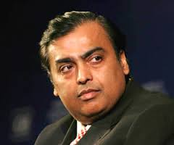
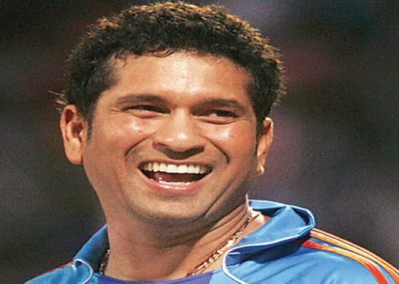
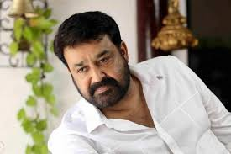
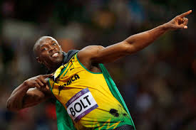
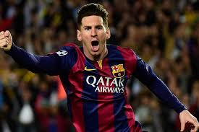
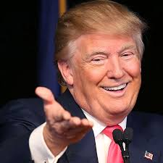
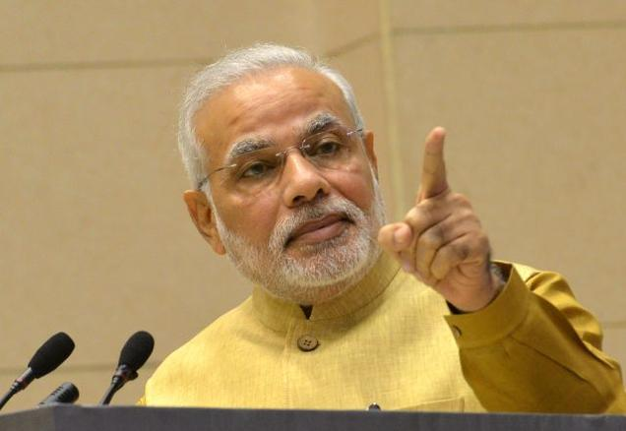
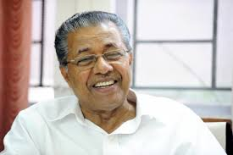

Platform to follow Politicians, Sports men, Bureaucrats, Celebrities ….
NEWS ON DEMAND

Slide 3
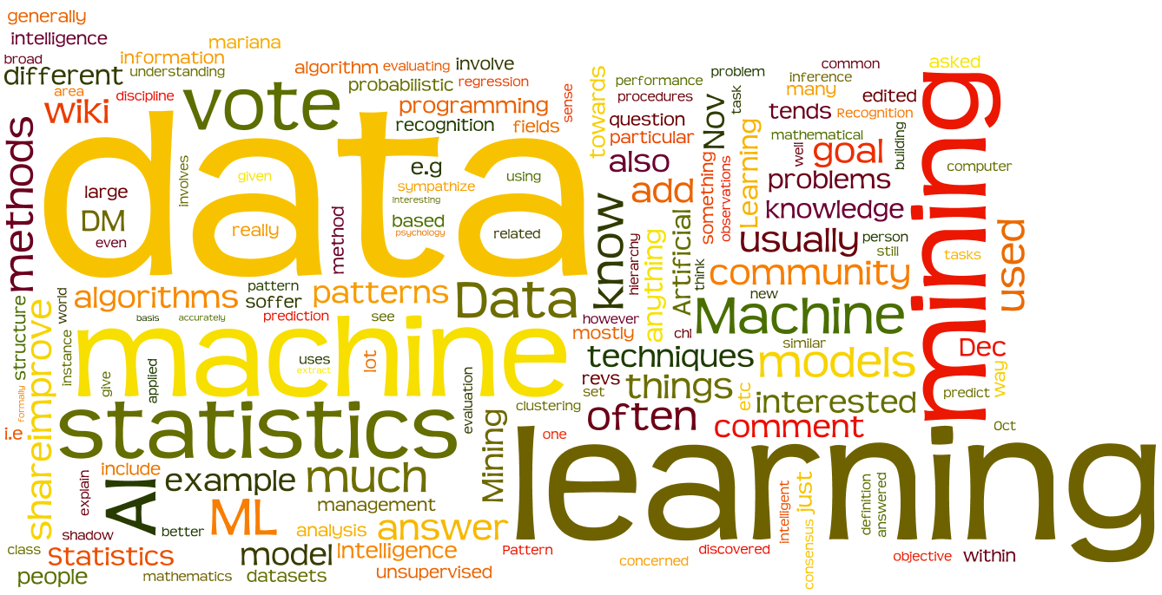
Introducing Artificial Intelligence & Data mining into media
NEWS ON DEMAND

Slide 4

Perfect news based on social media data
Platform to get data from social media
NEWS ON DEMAND

Slide 5

News from wherever you are
Only user INTRESTED stories
NEWS ON DEMAND

Slide 6

Follow news till the end
Reliable, Interesting and Smart
NEWS ON DEMAND

Slide 7

Treasure current stories to next generation
NEWS ON DEMAND

