Slide 1

NEWS ON DEMAND
Intelligence IN news

Slide 2

PRODUCT FEATURES
NEWS ON DEMAND

Slide 3
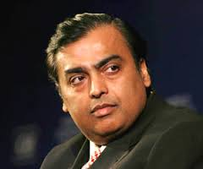


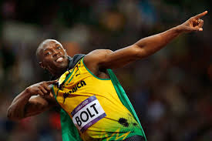


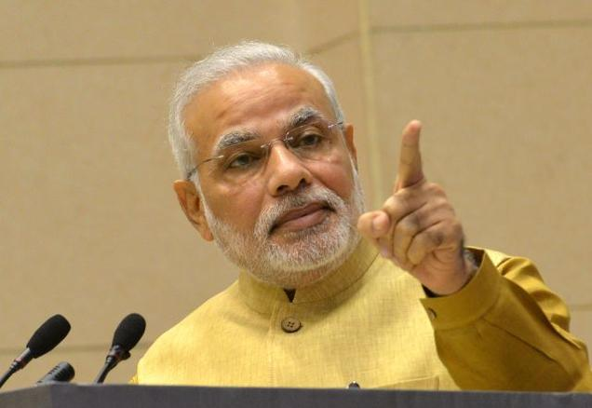

Platform to follow Politicians, Sports men, Bureaucrats, Celebrities ….
NEWS ON DEMAND

Slide 4
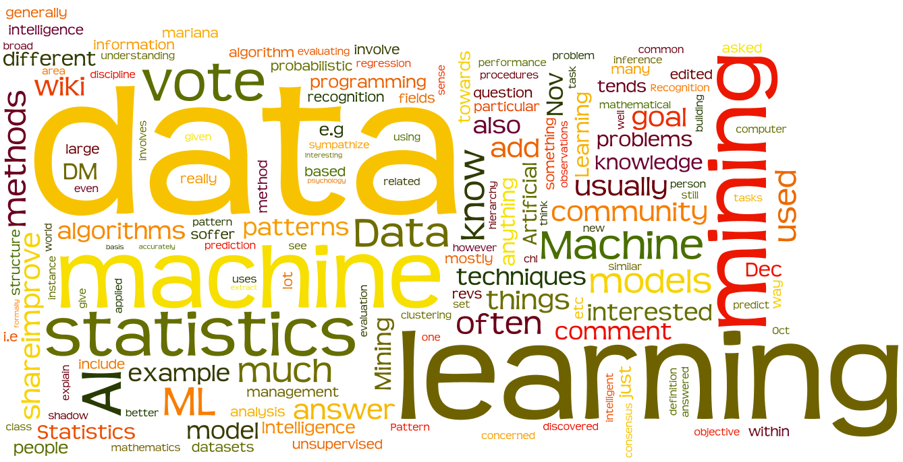
Introducing Artificial Intelligence & Data mining into media
NEWS ON DEMAND

Slide 5

Perfect news based on social media data
NEWS ON DEMAND

Slide 6

News from wherever you are
Only user INTRESTED stories
NEWS ON DEMAND

Slide 7

Follow news till the end
Reliable, Interesting and Smart
NEWS ON DEMAND

Slide 8

Treasure current stories to next generation
NEWS ON DEMAND

Slide 9
ScreENS
NEWS ON DEMAND

Slide 10
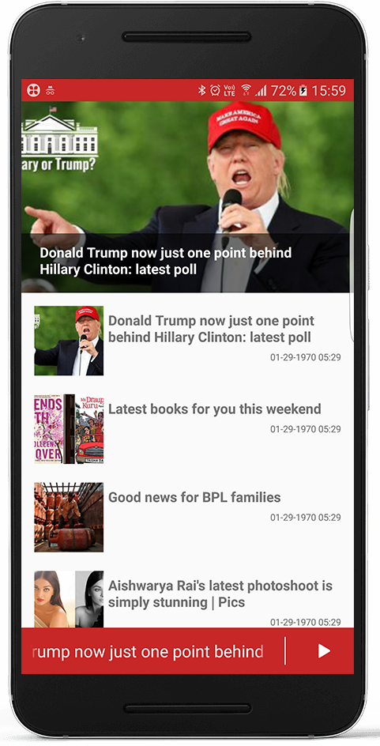
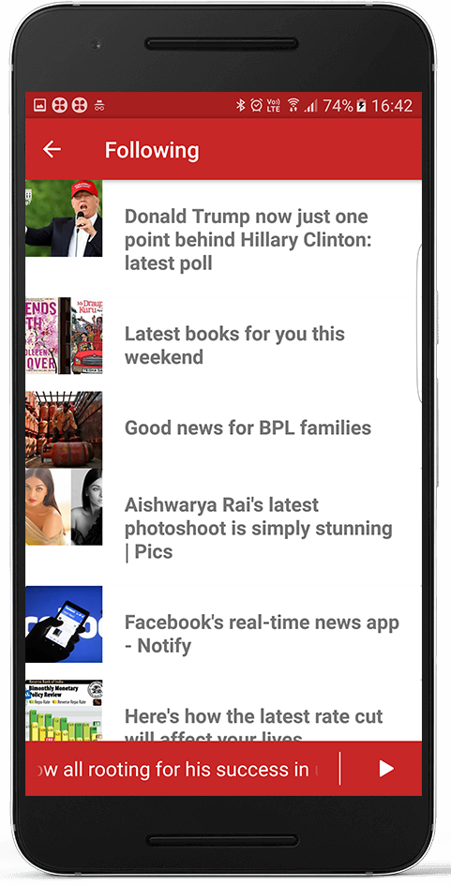
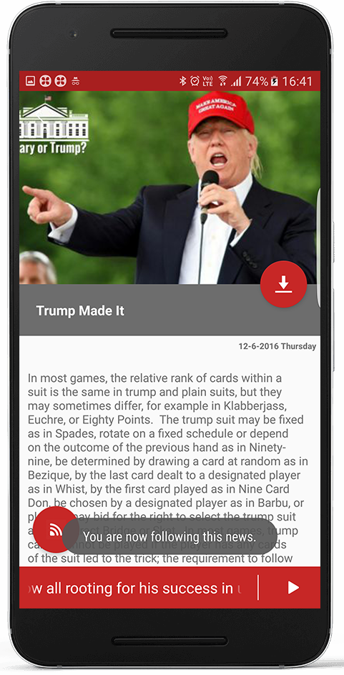
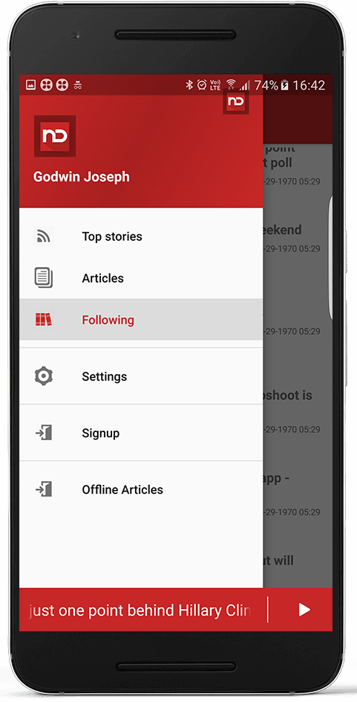
NEWS ON DEMAND

Slide 11
ARCHITECTURE
NEWS ON DEMAND

Slide 12
NEWS ON DEMAND

Slide 13
TECHNOLOGIES
NEWS ON DEMAND

Slide 14
MOBILE APP :
Android- marshmallow
Java 1.8, HttpConnection
Gson
Facebook-SDK
FCM
Google-Play-Services
Gradle Build System
Material Design UI
SQLite
NEWS ON DEMAND

Slide 15
SERVER :
Spring MVC 3.1.1
Hibernate ORM
Quartz 1.6.1
Jursy
Jackson REST Framework 1.9.13
My SQL Database,SL4J Logging
NEWS ON DEMAND

Slide 16
THANK YOU
NEWS ON DEMAND

