Slide 1

Building the bridge between your dream and reality

Slide 2
PROBLEM
IN THE PRESENT SCENARIO, IF A USER HAS MULTIPLE APPS HE HAS TO SWITCH BETWEEN THEM CONSTANTLY.
MOST SYSTEMS DO NOT PROVIDE SEAMLESS INTEGRATION.

Slide 3
SOLUTION
WE PROVIDE MANORAMA WITH A SOLUTION THAT LETS THEM USE THE TRAFFIC IN SOCIAL MEDIA WITH THE HELP OF BOTS.

Slide 4
BOTS?
BOT IS A TYPE OF ARTIFICIAL INTELLIGENCE THAT PERFORMS AN AUTOMATED TASK, SUCH AS SETTING AN ALARM , TELLING YOU THE WEATHER OR SEARCHING ONLINE.
BOTS ARE THE FUTURE AND WILL REPLACE CURRENT APPS.

Slide 5
STATISTICS

Slide 6
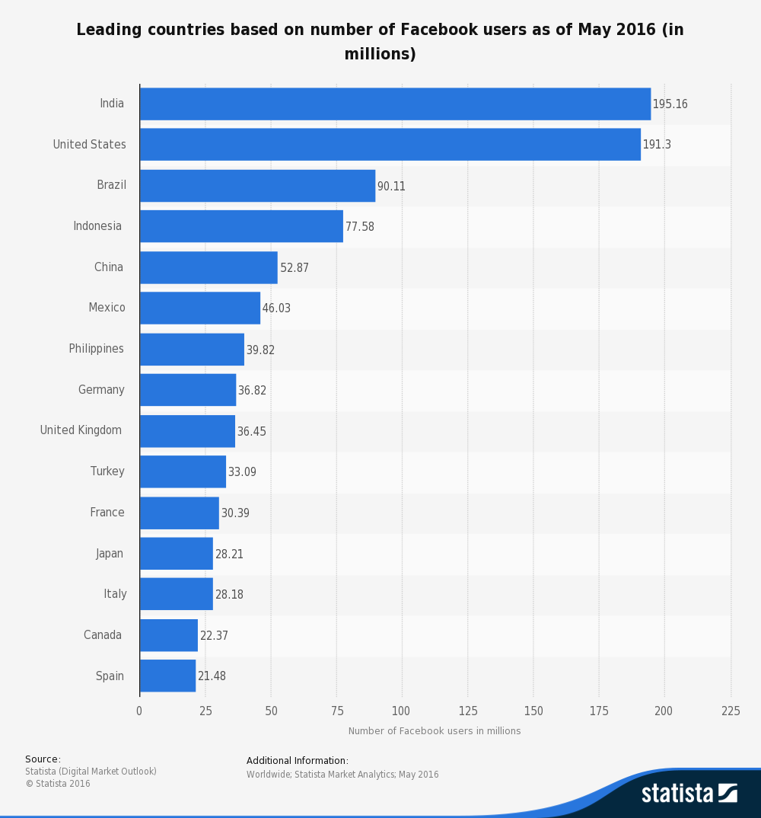

Slide 7
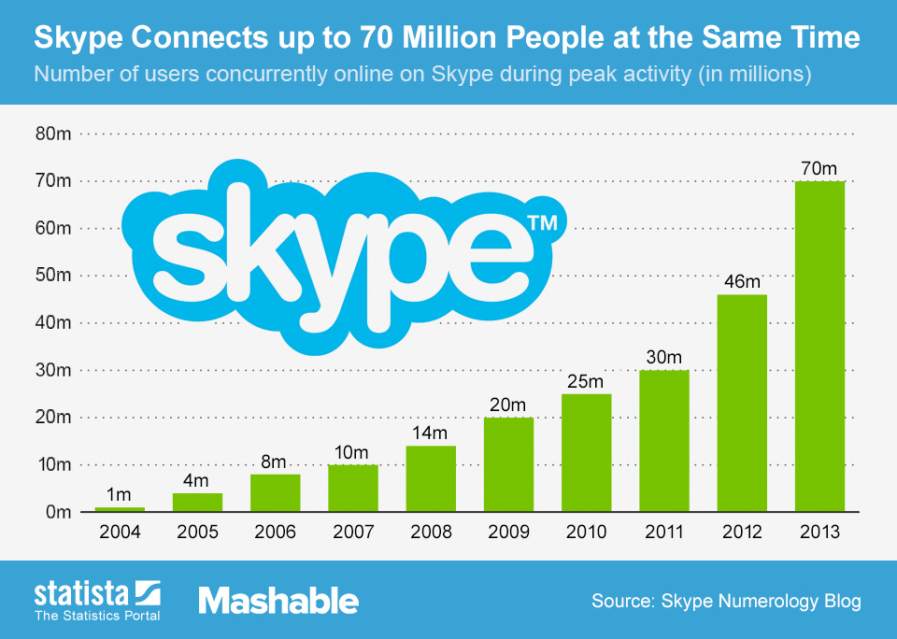

Slide 8
INTRODUCING AVA
AVA IS A CHATBOT THAT CAN BE INTEGRATED WITH VARIOUS SOCIAL MEDIA LIKE FACEBOOK, SLACK , TWILIO ETC.
THE USERS CAN INTERACT WITH AVA TO GET THEIR KIND OF NEWS WITHOUT MOVING OUT OF ONE APP OR A TAB.

Slide 9
COMPARISON
CNN RECENTLY INTRODUCED BOT THAT PROVIDES CONTENT TO THE USER.
AFTER INTRODUCING THE BOT, IT RECEIVED POSITIVE RESPONSE WITH OVER 21.5 MILLION USERS.
THIS PROVES THAT PEOPLE ARE IN NEED OF SEAMLESS INTEGRATION OF MULTIPLE APPS.

Slide 10




TEAM
“Alone we can do so little. Together we can do so much”
Ajo John Mathai
Design
Aravind K P
Engineer
Arun Mathew
Product
Joel Sunny
Market & Research
Goverance

Slide 11
THANK YOU

