Slide 1


Slide 2




Followers Issues
Security Restrictions
Needs Social Media Support
Privacy Conflicts

Slide 3


Features
Connection without any social media account
Chat with Politicians, Film stars etc.
Confirmed Privacy
One time registration
Working as an Additional Feature of News Portal

Slide 4

Process of Celebrity Chat
One time Registration
Find your celebrity
chat

Slide 5

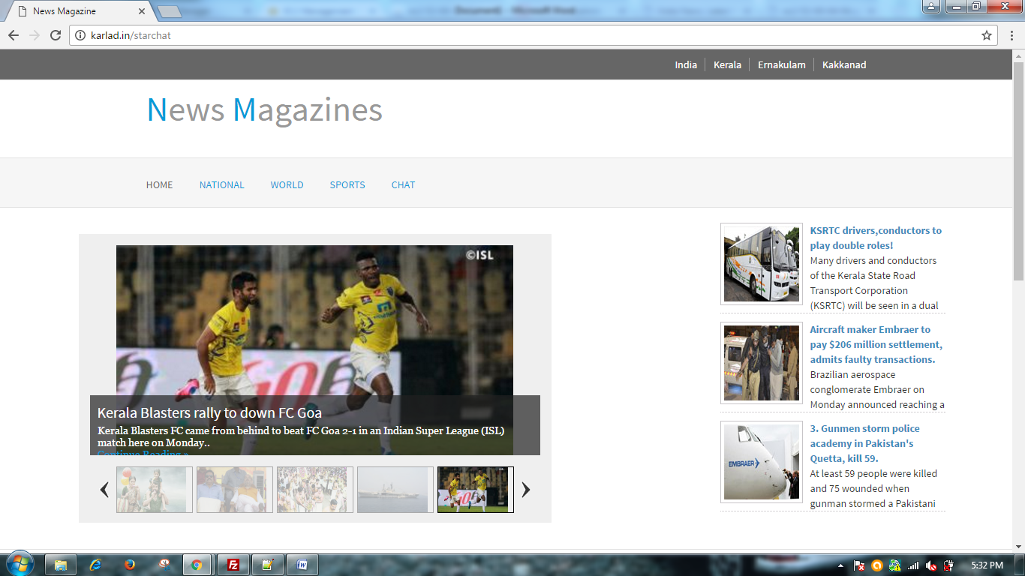
Screenshots

Slide 6
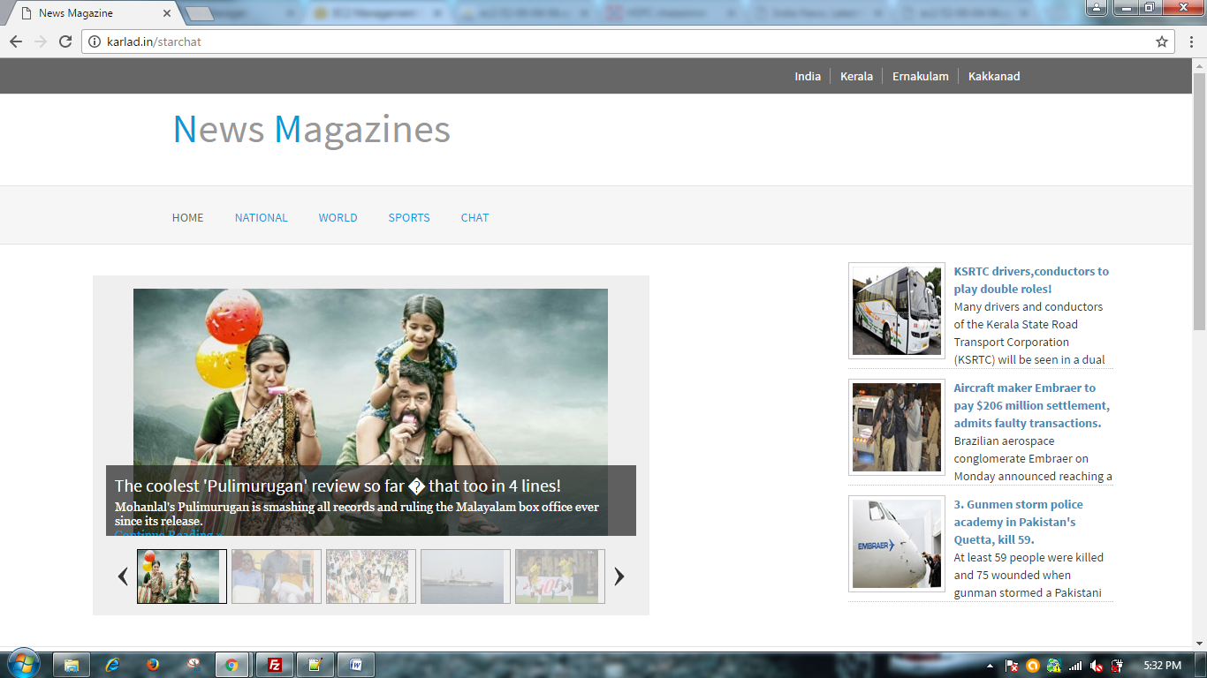

Slide 7
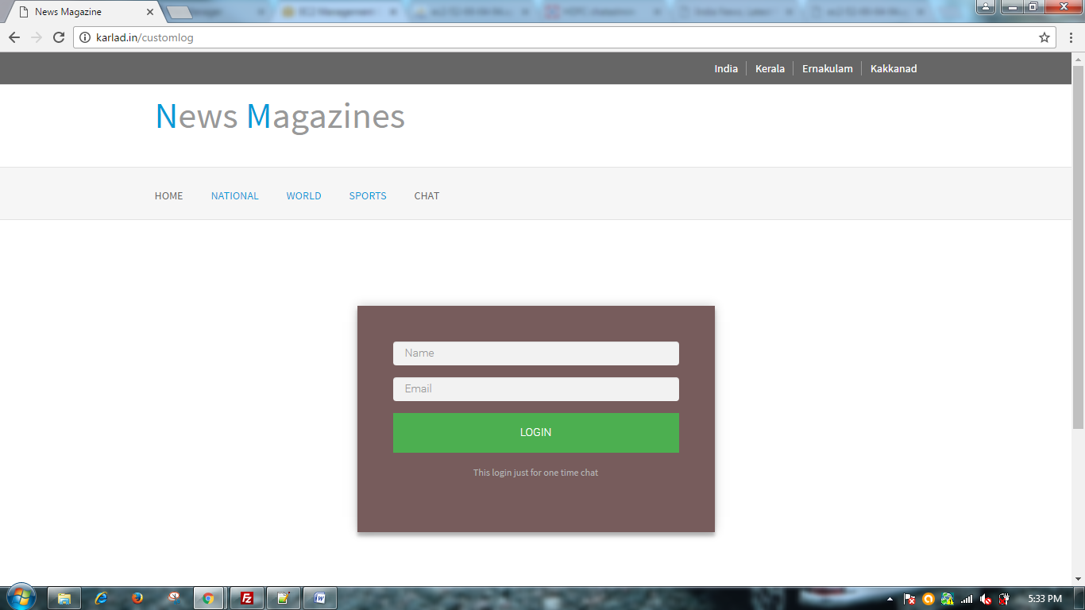

Slide 8
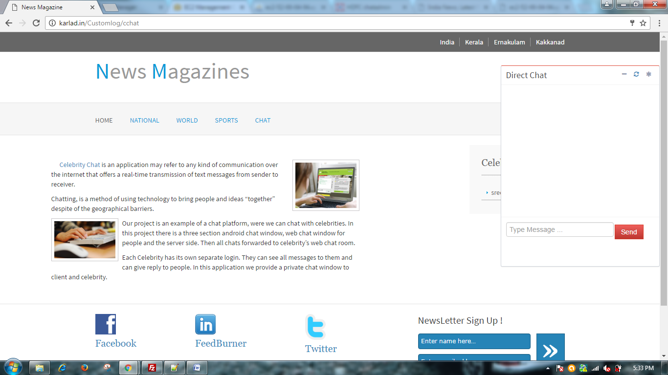

Slide 9
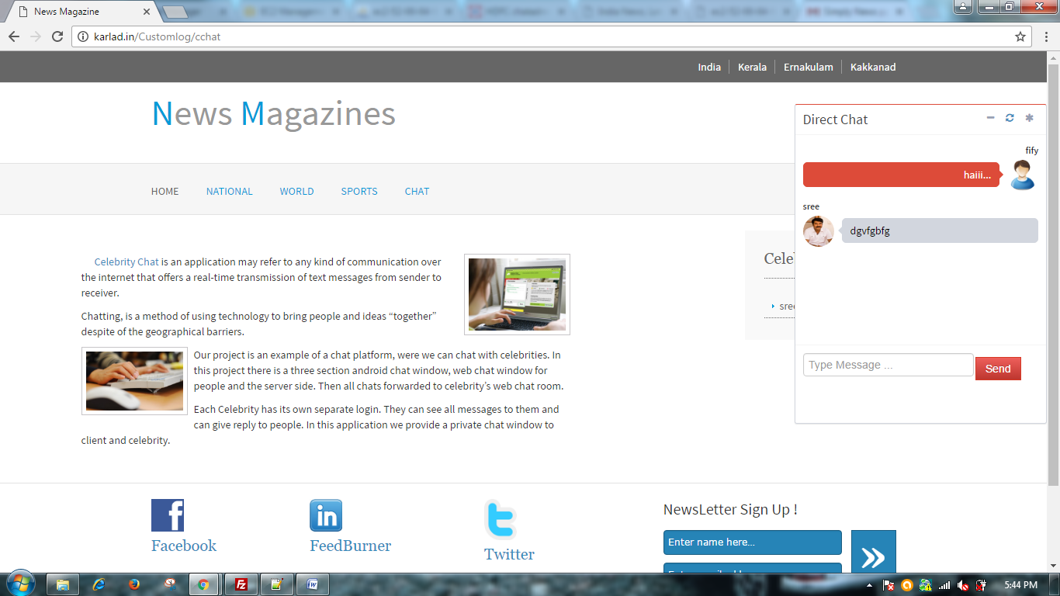

Slide 10

THANK YOU

