Slide 1


Slide 2
NEWS happen TODAY, but to be READ from YESTERDAY’s
What’s the logical sequence of Demonetization?
What happened during US Elections?

Slide 3
Get LATEST TRENDIEST Search EASY Create DYNAMIC TIMELINES Store SEARCHES

Slide 4
UNDERSTAND a NEWS while you READ it CHRONOLOGY LOGIC
What Happened?
When Happened?
Why Happened?
How Happened?

Slide 5
Next to Come HOAX or TRUTH? PREDICT WHAT TO HAPPEN?

Slide 6
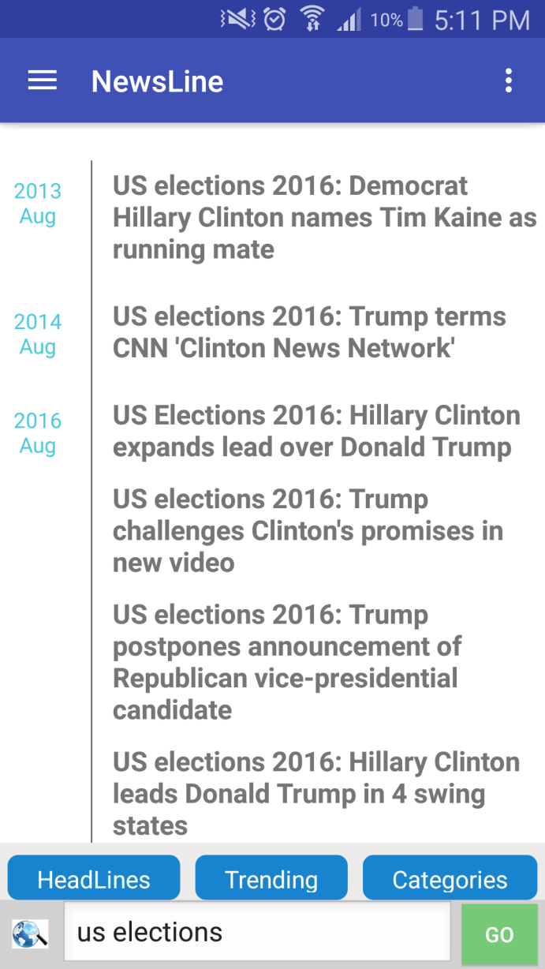
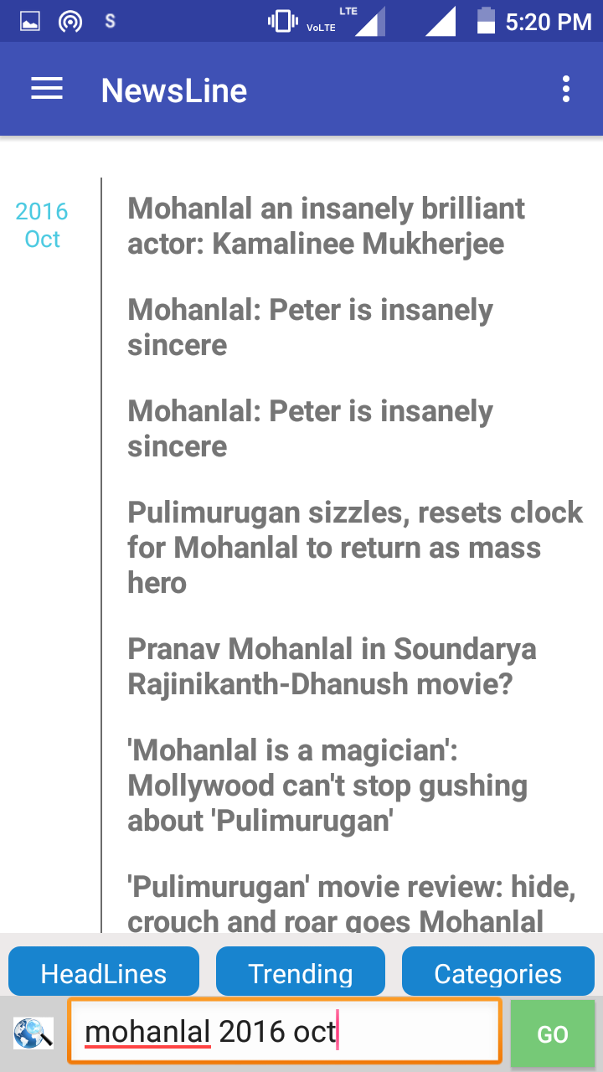

Slide 7
