Slide 1
T1A3 Portfolio
Tessa Peterson

Slide 2
Where to start?
Getting back to my roots
The place I first started coding...

Slide 3
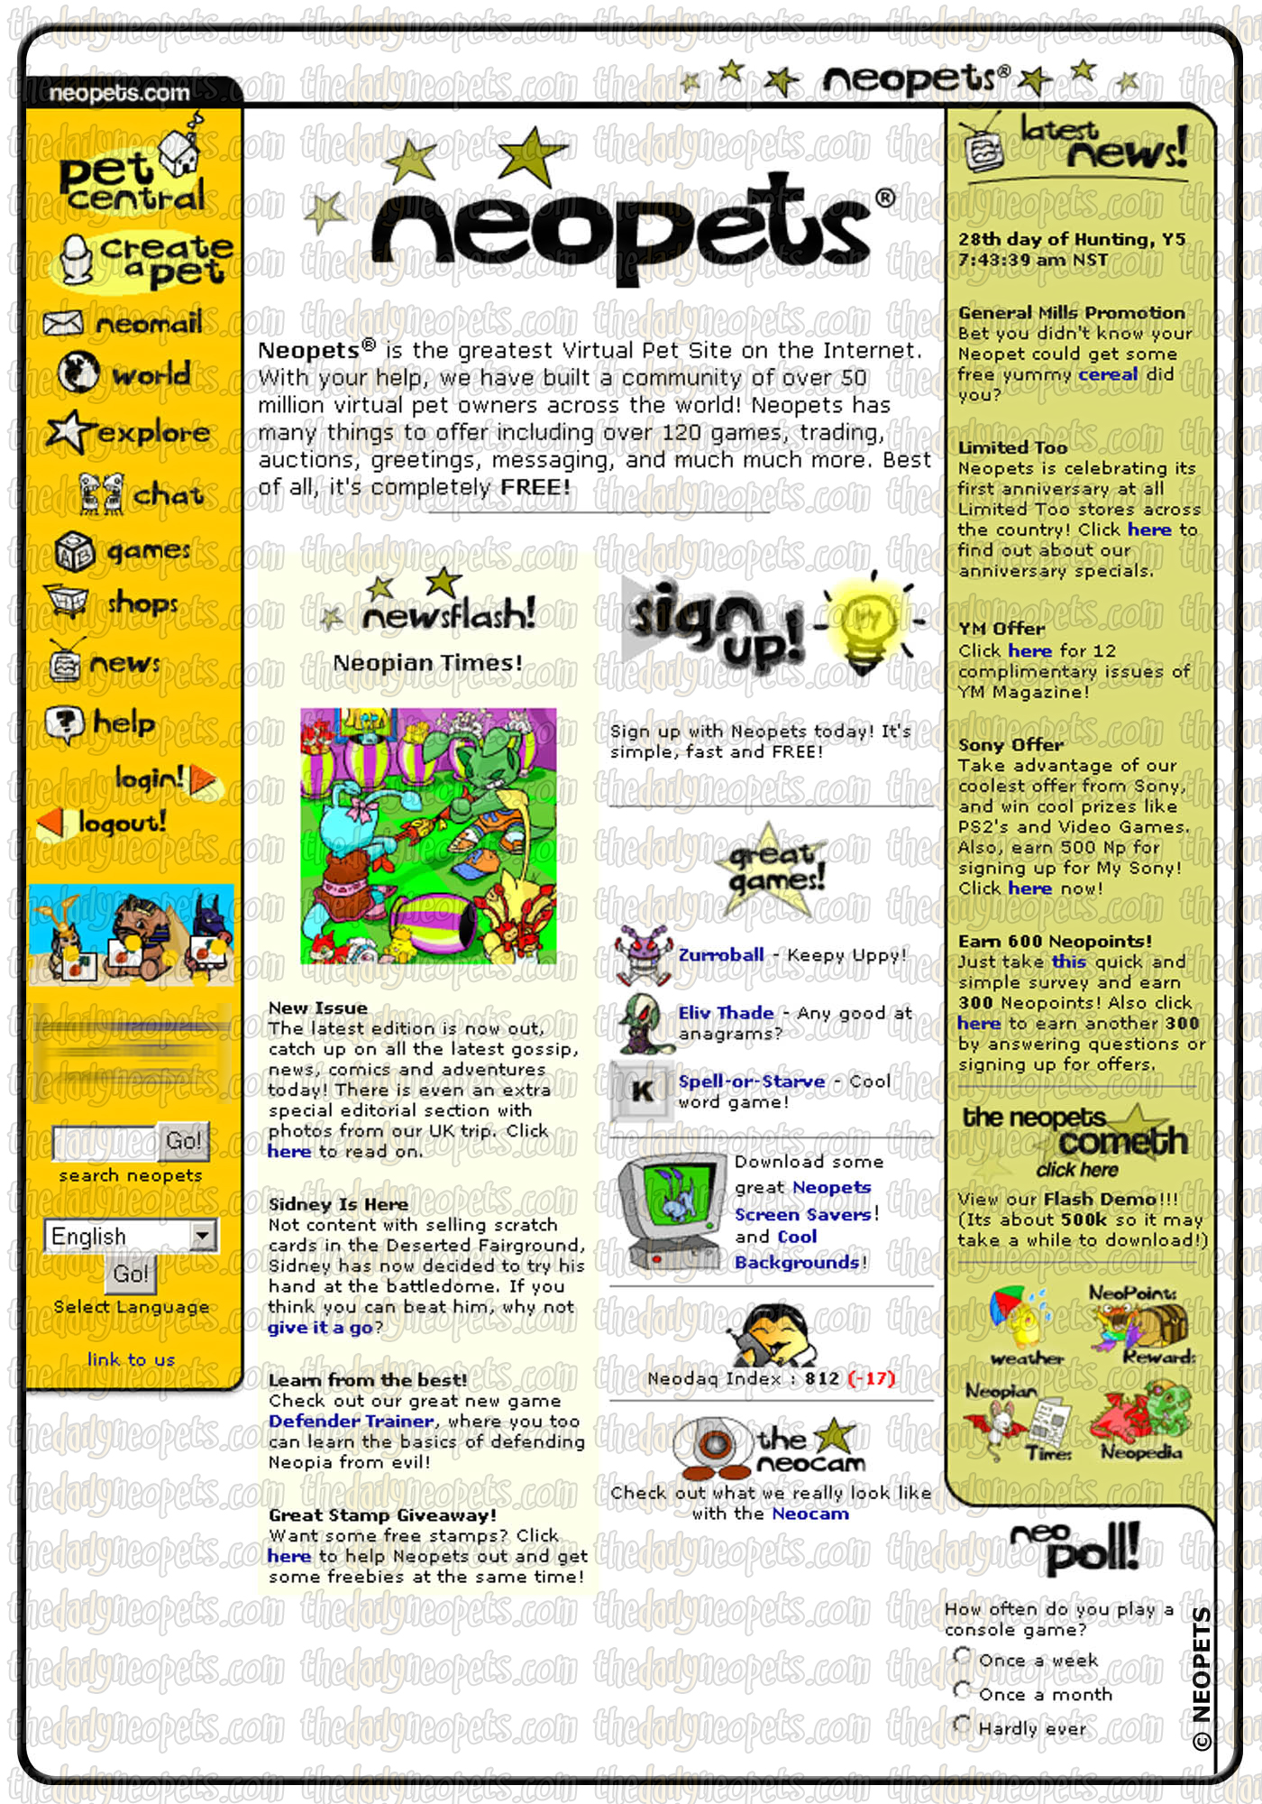
Inspiration
Neopets
(Specifically, the old style Neopets layout)
Recreate a similar feel but a bit more modern and prettier (hopefully)

Slide 4
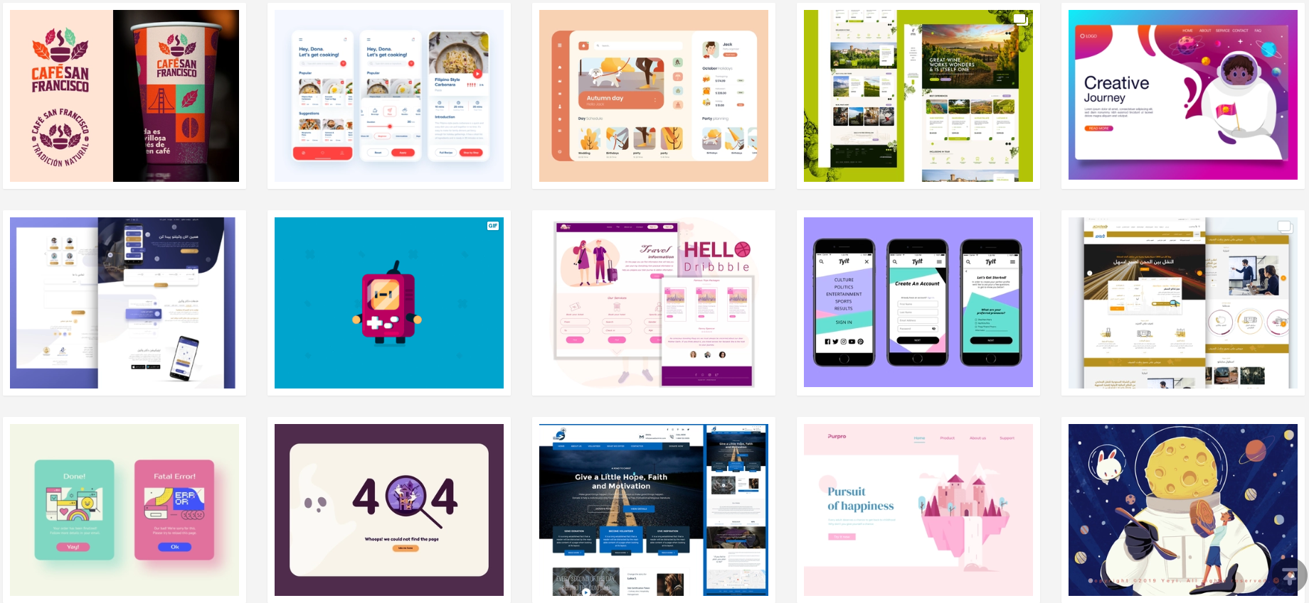
Inspiration

Slide 5
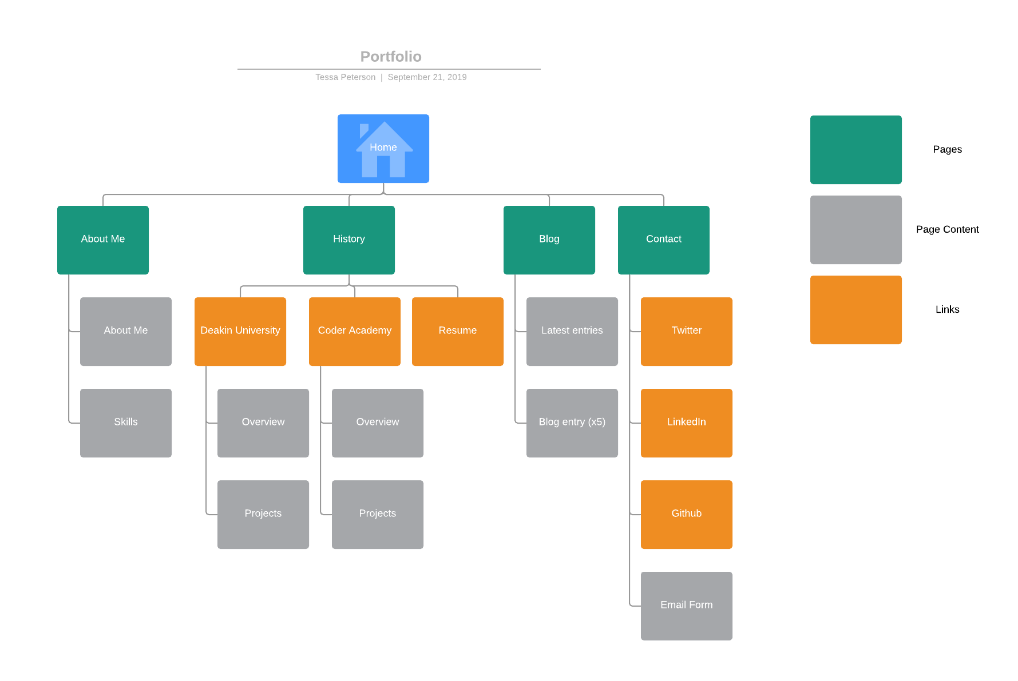
Sitemap

Slide 6
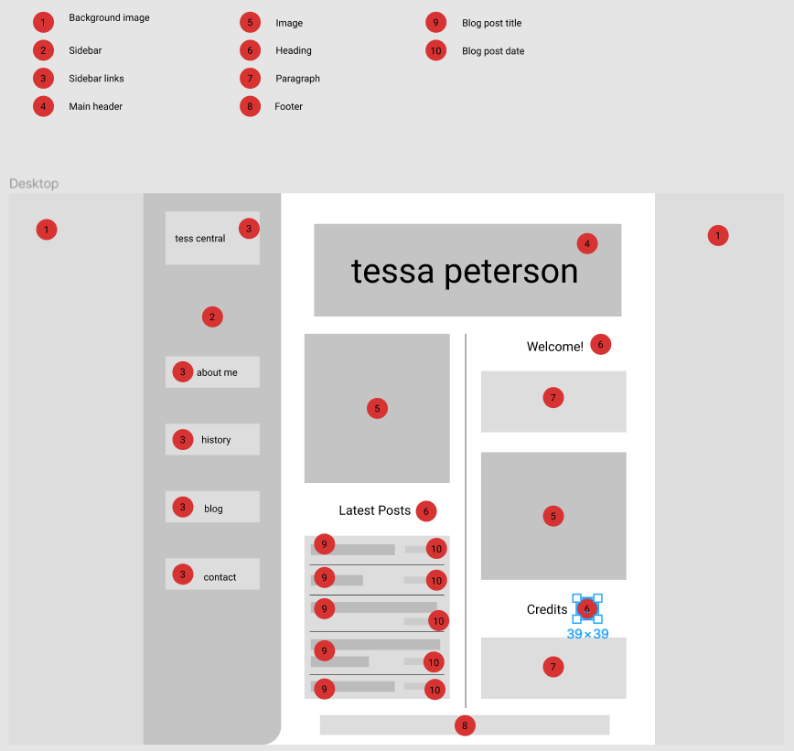
Features
Index page
Column layout like the old Neopets index page
Main heading looks like the Neopets header

Slide 7
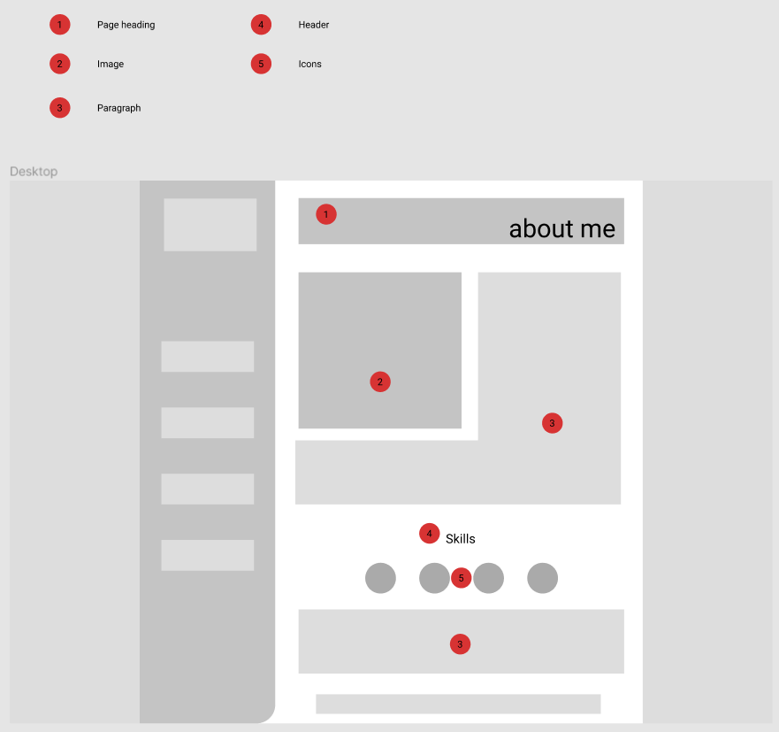

Features
About page with profile pic, description and list of tech skills
Page header also resembles the old Neopets headers

Slide 8
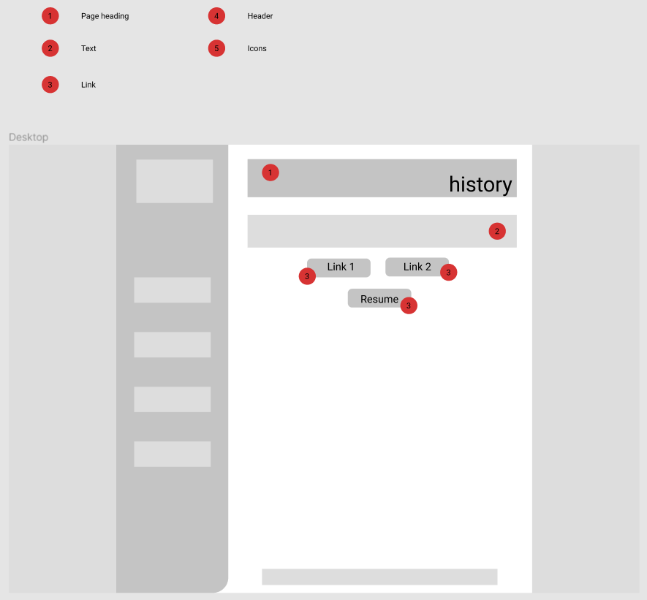
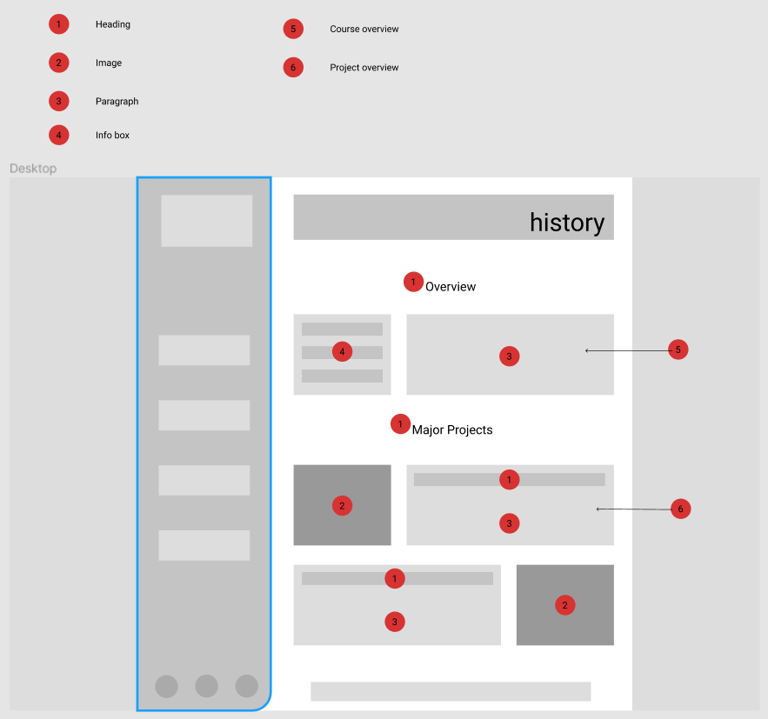
Features

Slide 9
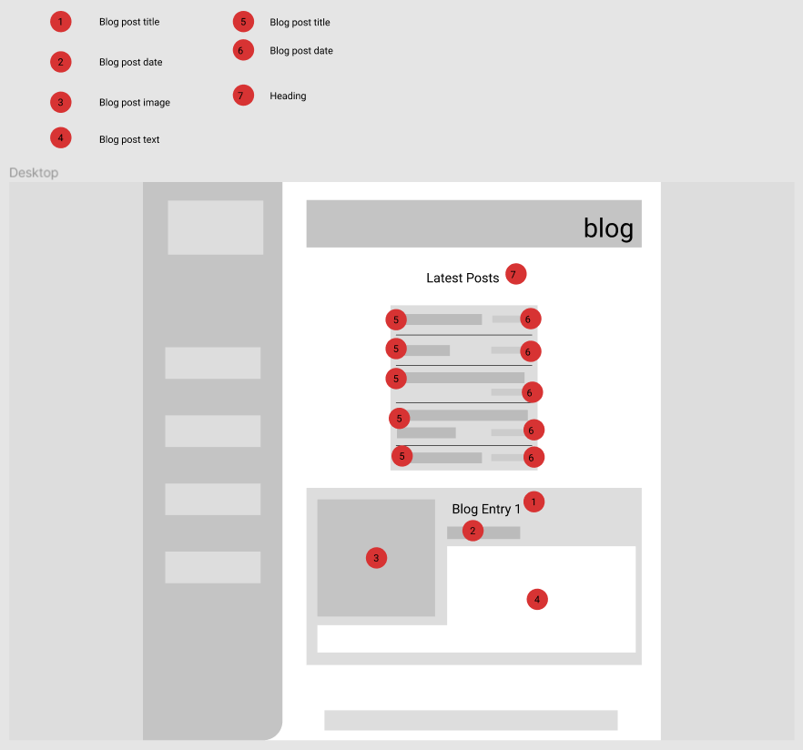
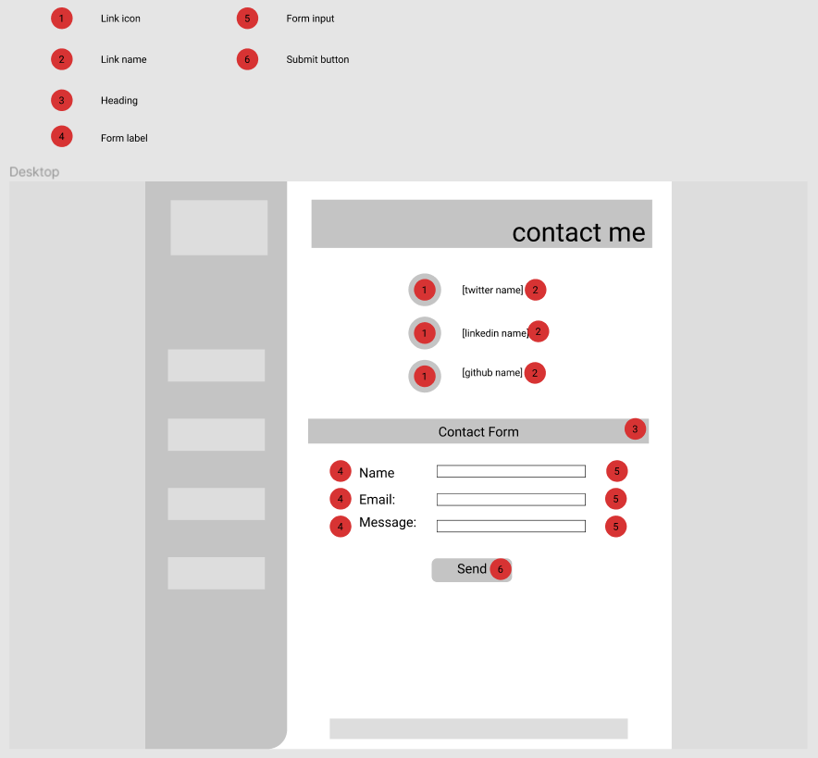
Features

Slide 10
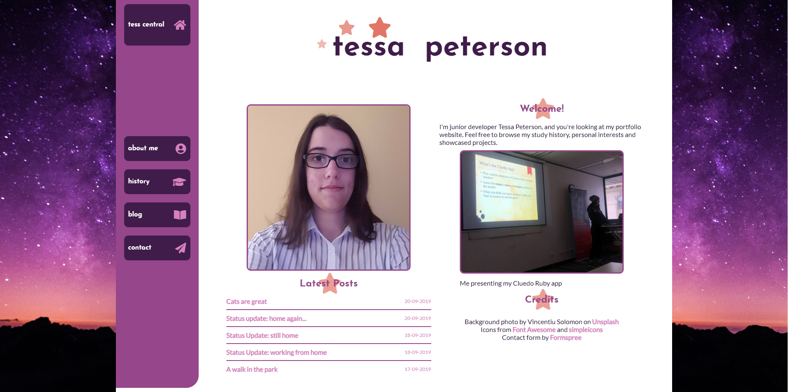
Ta-da!

Slide 11
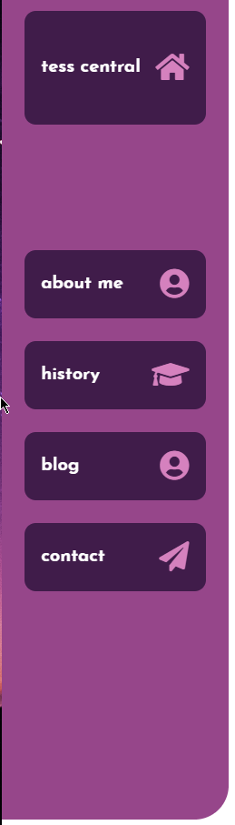
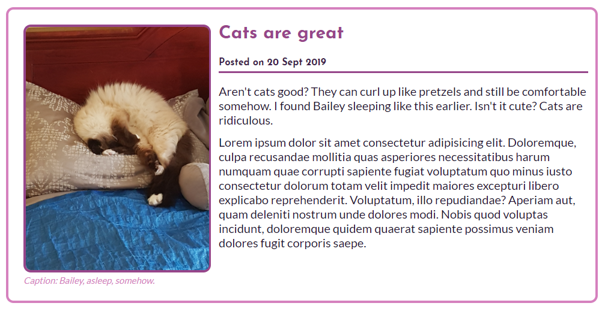


Components
Nav sidebar
Graphic header
Icons for tech/brands
Blog post container
Image with border and caption

Slide 12
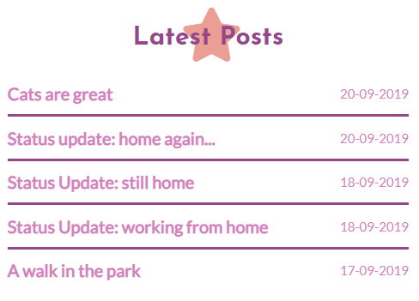

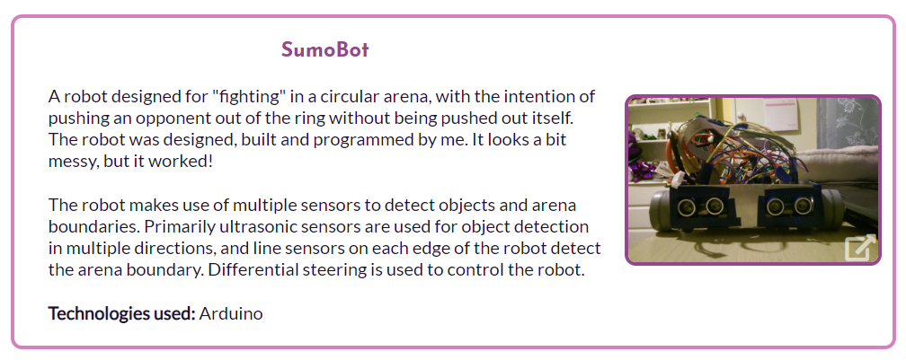
Components
List of blog posts with links to individual posts
Decorative header elements
Button-style links
Info container for projects
Small bordered image that links to full size image

Slide 13
Let’s check it out!
https://techspeterson-portfolio.netlify.com/

