Slide 1
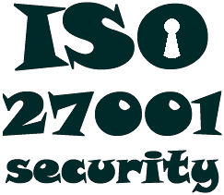
The ISO27k Standards
http://www.iso27001security.com/html/toolkit.html
List contributed and maintained by Gary Hinson
Last updated in February 2019
Please consult the ISO website for further, definitive information: this is not an official ISO/IEC listing and may be inaccurate and/or incomplete
The following ISO/IEC 27000-series information security standards (the “ISO27k standards”) are either published or in draft:
Copyright © 2019 ISO27k Forum

Slide 2
# | Standard | Published | Title | Notes
1 | ISO/IEC 27000 | 2018 | Information security management systems — Overview and vocabulary | Overview/introduction to the ISO27k standards as a whole plus a glossary of terms; FREE!
2 | ISO/IEC 27001 | 2013 | Information security management systems — Requirements | Formally specifies an ISMS against which thousands of organizations have been certified compliant
3 | ISO/IEC 27002 | 2013 | Code of practice for information security controls | A reasonably comprehensive suite of information security control objectives and generally-accepted good practice security controls
4 | ISO/IEC 27003 | 2017 | Information security management system implementation guidance | Sound advice on implementing ISO27k, expanding section-by-section on the main body of ISO/IEC 27001
5 | ISO/IEC 27004 | 2016 | Information security management ― Measurement | Much improved second version, with useful advice on security metrics
6 | ISO/IEC 27005 | 2018 | Information security risk management | Discusses information risk management principles in general terms without specifying or mandating particular methods. Major revision in progress

Slide 3
# | Standard | Published | Title | Notes
7 | ISO/IEC 27006 | 2015 | Requirements for bodies providing audit and certification of information security management systems | Formal guidance for the certification bodies, with several grammatical errors – needs revision
8 | ISO/IEC 27007 | 2017 | Guidelines for information security management systems auditing | Auditing the management system elements of the ISMS
9 | ISO/IEC TR 27008 | 2011 | Guidelines for auditors on information security controls | Auditing the information security elements of the ISMS
10 | ISO/IEC 27009 | 2016 | Sector-specific application of ISO/IEC 27001 – requirements | Guidance for those developing new ISO27k standards (i.e. ISO/IEC JTC1/SC27 – an internal committee standing document really)
11 | ISO/IEC 27010 | 2015 | Information security management for inter-sector and inter-organisational communications | Sharing information on information security between industry sectors and/or nations, particularly those affecting “critical infrastructure”
12 | ISO/IEC 27011 | 2016 | Information security management guidelines for telecommunications organizations based on ISO/IEC 27002 | Information security controls for the telecoms industry; also called “ITU-T Recommendation x.1051”
13 | ISO/IEC 27013 | 2015 | Guidance on the integrated implementation of ISO/IEC 27001 and ISO/IEC 20000-1 | Combining ISO27k/ISMS with IT Service Management/ITIL
14 | ISO/IEC 27014 | 2013 | Governance of information security | Governance in the context of information security; will also be called “ITU-T Recommendation X.1054”
16 | ISO/IEC TR 27016 | 2014 | Information security management – Organizational economics | Economic theory applied to information security

Slide 4
# | Standard | Published | Title | Notes
17 | ISO/IEC 27017 | 2015 | Code of practice for information security controls for cloud computing services based on ISO/IEC 27002 | Information security controls for cloud computing
18 | ISO/IEC 27018 | 2014 | Code of practice for controls to protect personally identifiable information processed in public cloud computing services | Privacy controls for cloud computing
19 | ISO/IEC TR 27019 | 2017 | Information security management guidelines based on ISO/IEC 27002 for process control systems specific to the energy industry | Information security for ICS/SCADA/embedded systems (not just used in the energy industry!), excluding the nuclear industry
20 | ISO/IEC 27021 | 2017 | Competence requirements for information security management professionals | Guidance on the skills and knowledge necessary to work in this field
21 | ISO/IEC 27023 | 2015 | Mapping the revised editions of ISO/IEC 27001 and ISO/IEC 27002 | Belated advice for those updating their ISMSs from the 2005 to 2013 versions
22 | ISO/IEC 27030 | DRAFT | Guidelines for security and privacy in Internet of Things (IoT) | A standard about the information risk, security and privacy aspects of IoT
23 | ISO/IEC 27031 | 2011 | Guidelines for information and communications technology readiness for business continuity | Continuity (i.e. resilience, incident management and disaster recovery) for ICT, supporting general business continuity
24 | ISO/IEC 27032 | 2012 | Guidelines for cybersecurity | Ignore the vague title: this standard actually concerns Internet security
25 | ISO/IEC 27033 | -1 2015 | Network security overview and concepts | Various aspects of network security, updating and replacing ISO/IEC 18028

Slide 5
# | Standard | Published | Title | Notes
26 |  | -2 2012 | Guidelines for the design and implementation of network security
27 |  | -3 2010 | Reference networking scenarios - threats, design techniques and control issues
28 |  | -4 2014 | Securing communications between networks using security gateways
29 |  | -5 2013 | Securing communications across networks using Virtual Private Networks (VPNs)
30 |  | -6 2016 | Securing wireless IP network access
31 | ISO/IEC 27034 | -1 2011 | Application security — Overview and concepts | Multi-part application security standard Promotes the concept of a reusable library of information security control functions, formally specified, designed and tested
32 |  | -2 2015 | Organization normative framework
33 |  | -3 2018 | Application security management process
34 |  | -4 DRAFT | Application security validation
35 |  | -5 2017 | Protocols and application security control data structure
36 |  | -5-1 2018 | Protocols and application security control data structure, XML schemas
37 |  | -6 2016 | Case studies
38 |  | -7 2018 | Application security assurance prediction framework

Slide 6
# | Standard | Published | Title | Notes
39 | ISO/IEC 27035 | -1 2016 | Information security incident management — Principles of incident management | Replaced ISO TR 18044 Actually concerns incidents affecting IT systems and networks, specifically
40 |  | -2 2016 | — Guidelines to plan and prepare for incident response
41 |  | -3 DRAFT | — Guidelines for incident response operations?? | Part 3 drafting restarted – due out in 2019 or 2020
42 | ISO/IEC 27036 | -1 2014 | Information security for supplier relationships – Overview and concepts (FREE!) | Information security aspects of ICT outsourcing and services
43 |  | -2 2014 | — Common requirements
44 |  | -3 2013 | — Guidelines for ICT supply chain security
45 |  | -4 2016 | — Guidelines for security of cloud services
46 | ISO/IEC 27037 | 2012 | Guidelines for identification, collection, acquisition, and preservation of digital evidence | One of several IT forensics standards
47 | ISO/IEC 27038 | 2014 | Specification for digital redaction | Redaction of digital documents
48 | ISO/IEC 27039 | 2015 | Selection, deployment and operations of intrusion detection and prevention systems (IDPS) | IDS/IPS
49 | ISO/IEC 27040 | 2015 | Storage security | IT security for stored data
50 | ISO/IEC 27041 | 2015 | Guidelines on assuring suitability and adequacy of incident investigative methods | Assurance of the integrity of forensic evidence is absolutely vital

Slide 7
# | Standard | Published | Title | Notes
51 | ISO/IEC 27042 | 2015 | Guidelines for the analysis and interpretation of digital evidence | IT forensics analytical methods
52 | ISO/IEC 27043 | 2015 | Incident investigation principles and processes | The basic principles of eForensics
53 | ISO/IEC 27050 | -1 2016 | Electronic discovery – overview and concepts | More eForensics advice
54 |  | -2 2018 | Guidance for governance and management of electronic discovery | Advice on treating the risks relating to eForensics
55 |  | -3 2017 | Code of practice for electronic discovery | A how-to-do-it guide to eDiscovery
56 |  | -4 DRAFT | ICT readiness for electronic discovery | Guidance on eDiscovery technology (tools, systems and processes)
57 | ISO/IEC 27070 | DRAFT | Security requirements for establishing virtualized roots of trust | Concerns trusted cloud computing
58 | ISO/IEC 27099 | DRAFT | Public key infrastructure - practices and policy framework | Infosec management requirements for Certification Authorities
59 | ISO/IEC 27100 | DRAFT | Cybersecurity – overview and concepts | Perhaps this standard will clarify, once and for all, what ‘cybersecurity’ actually is. Perhaps not.
60 | ISO/IEC 27101 | DRAFT | Cybersecurity framework development guidelines | Given the above, we can barely guess what this might turn out to be
61 | ISO/IEC 27102 | DRAFT | Information security management guidelines for cyber insurance | Advice on obtaining insurance to reduce the costs of cyber incidents
62 | ISO/IEC TR 27103 | 2018 | Cybersecurity and ISO and IEC standards | Explains how ISO27k and other ISO and IEC standards relate to ‘cybersecurity’ (without actually defining the term!)

Slide 8
# | Standard | Published | Title | Notes
63 | ISO/IEC 27550 | DRAFT | Privacy engineering | How to address privacy throughout the lifecycle of IT systems
64 | ISO/IEC 27551 | DRAFT | Requirements for attribute-based unlinkable entity authentication | Seems more like an authentication standard than ISO27k … scope creep?
65 | ISO/IEC 27552 | DRAFT | Extension to ISO/IEC 27001 and to ISO/IEC 27002 for privacy management — Requirements and guidelines | Explains extensions to an ISO27k ISMS for privacy management
66 | ISO/IEC 27553 | DRAFT | Security requirements for authentication using biometrics on mobile devices | High-level requirements attempting to standardize the use of biometrics on mobile devices
67 | ISO/IEC 27554 | DRAFT | Application of ISO 31000 for assessment of identity management-related risk | About applying the ISO 31000 risk management process to identity management
68 | ISO/IEC 27555 | DRAFT | Establishing a PII deletion concept in organizations | A conceptual framework, of all things, for deleting personal information
69 | ISO 27799 | 2016 | Health informatics — Information security management in health using ISO/IEC 27002 | Infosec management advice for the health industry

Slide 9
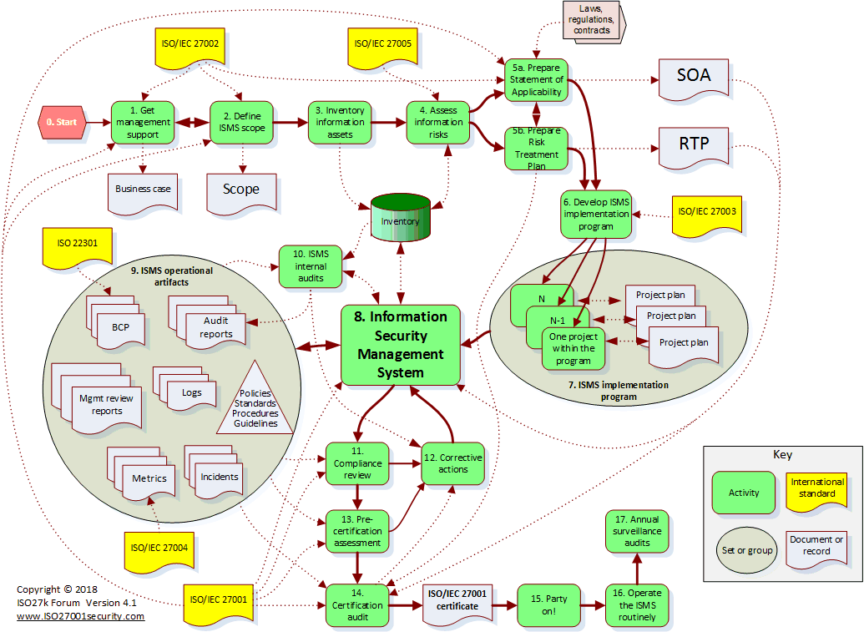
ISMS implementation and certification

Slide 10

Note
The official titles of all the ISO27k standards (apart from ISO 27799 “Health informatics”) start with “Information technology — Security techniques —” which is derived from the name of ISO/IEC JTC1/SC27, the committee responsible for the standards. However this is a misnomer since, in reality, the ISO27k standards concern information security rather than IT security. There’s more to it than securing computer systems, networks and data, or indeed ‘cyber’!
Copyright
This work is copyright © 2019, ISO27k Forum, some rights reserved. It is licensed under the Creative Commons Attribution-Noncommercial-Share Alike 4.0 International license. You are welcome to reproduce, circulate, use and create derivative works from this provided that (a) it is not sold or incorporated into a commercial product, (b) it is properly attributed to the ISO27k Forum at www.ISO27001security.com, and (c) if shared, derivative works are shared under the same terms as this.

