Slide 1

Docker
By TechSwitch

Slide 2

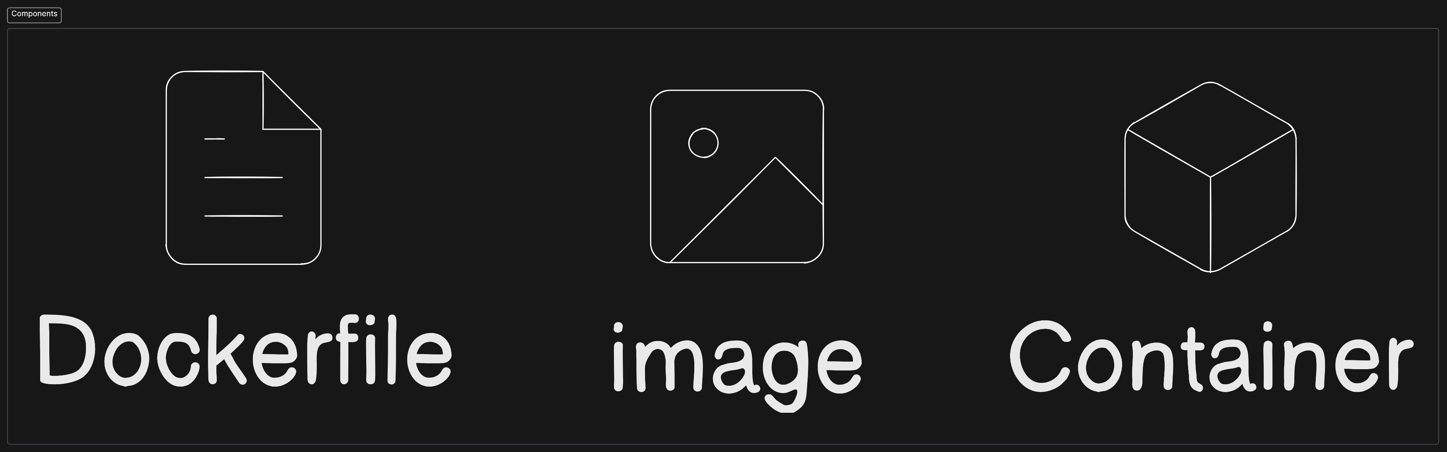
Docker Components

Slide 3
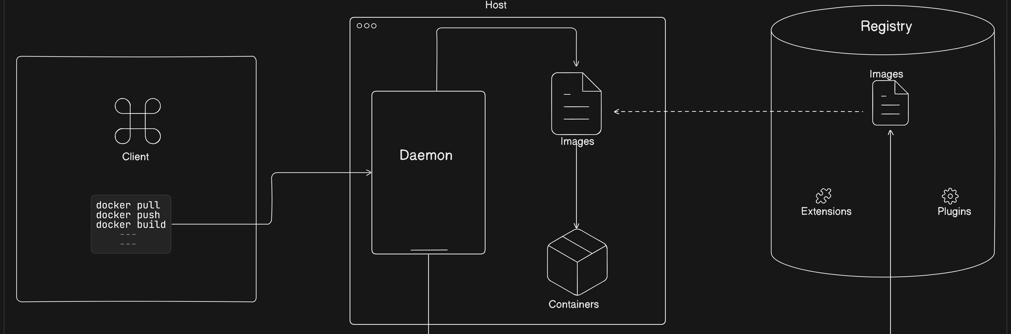
Docker Architecture

Slide 4

Dockerfile
# Use Ubuntu 22.04 as the base image
FROM ubuntu:22.04
# Update package lists and install Python
RUN apt-get update && apt-get install -y python
# Set the working directory (optional)
WORKDIR /app
# Copy your Python application files into the container
COPY . /app
# Specify the default command to run your Python script CMD ["python", "./script.py"]

Slide 5
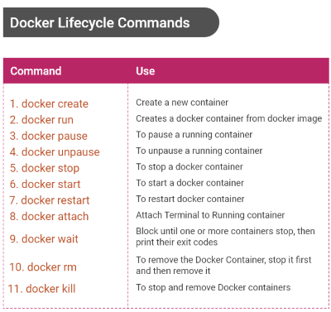
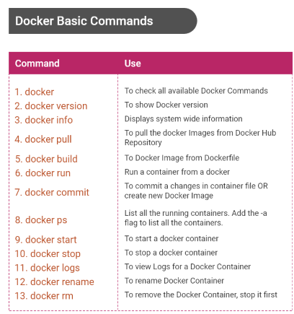
Docker Commands

Slide 6
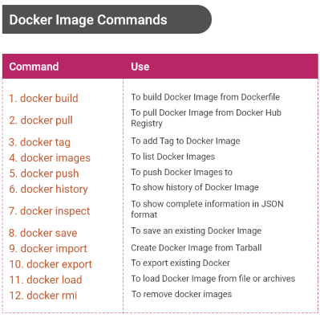
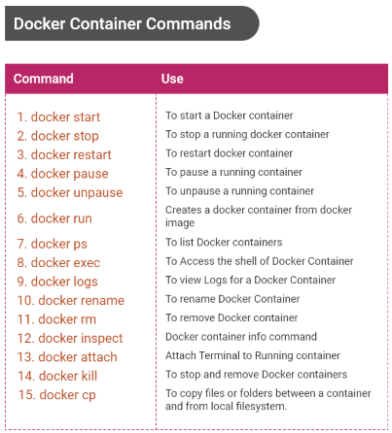
Docker Commands

Slide 7
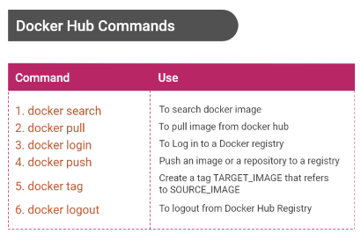
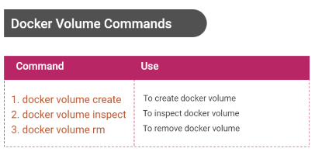
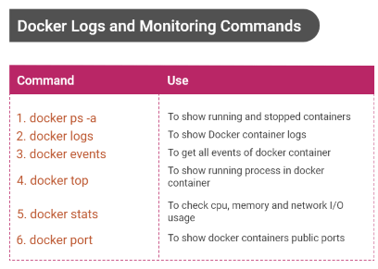
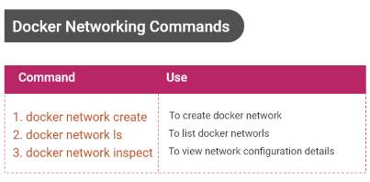
Docker Commands

Slide 8
Docker Commands

Slide 9
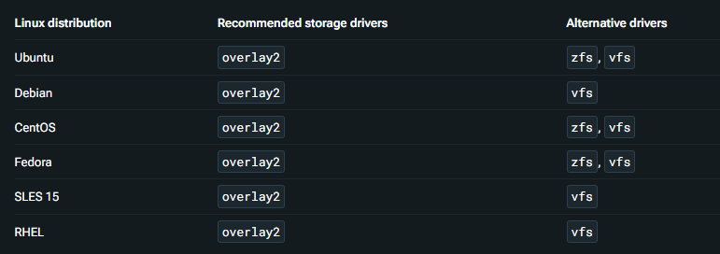
Docker Storage

Slide 10
Docker Volumes
List available volumes
docker volume ls
Create a volume
docker volume create test1
Mount volume with –v flag
docker run -d --name nginx2 -v test1:/tmp2/fs nginx docker run -v /tmp/forcontainer:/app nginx
(or)
Mount volume with –mount flag
docker run -d --name httpd --mount source=test1,target=/tmp/fs httpd
Check the volume details
docker inspect test1
Remove volume
docker volume rm test1

Slide 11
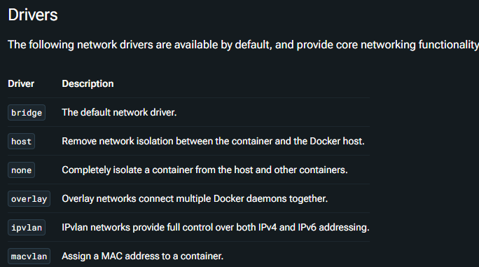
Docker Network

Slide 12
Docker Network
List available networks
docker network ls
Create a network
docker network create -d bridge net1
Check the network details
docker network inspect bridge
Remove network
docker network rm net1

Slide 13
Docker Compose
version: '3'
services:
web:
image: nginx
ports:
- "8000:80"
volumes:
- ./config/nginx:/etc/nginx/conf.d
depends_on:
- app
app:
build: ./app
environment:
- REDIS_HOST=cache
cache:
image: redis
volumes:
app-data:

Slide 14
Docker Multistage Builds
# Build stage
FROM golang:1.16 AS builder
WORKDIR /app
COPY . .
RUN go build -o main .
# Final stage
FROM alpine:latest
WORKDIR /app
COPY --from=builder /app/main .
CMD ["./main"]

Slide 15
Docker Optimization
Use Multistage builds
Use caching
Minimal base images
Minimize layers
Add .dockerignore to image directory
Tools : Dive, Slim Toolkit, Squash

Slide 16
Docker Security
Add flag for run, create, exec
--userns=host
Disable namespace remapping for a container
Use Trusted images from Registry

