Slide 1
DISCOVERY PHASE & PRODUCT ARCHITECTURE
Process Manuals Agent
Administrative consulting · Process documentation
Business requirements for review: inputs, compensation logic and the structure of the manual
Version 1.0 · September 2026 · Draft for review
Notes:
Purpose: agree what the agent captures, how it behaves when the client has no corporate documents, and what the finished manual looks like, so development can start architecture mapping.

Slide 2
The agent at a glance
A complete process manual, built from what process owners confirm
WHAT IT DOES
It interviews process owners with a structured questionnaire, reads any corporate documents the client has, and produces a full manual: BPMN flowcharts, a step-by-step narrative, a RACI matrix, policies and business rules, a risk and control matrix, and the blank forms staff use to prove the work was done.
3
4
required input blocks
optional corporate inputs
WHY IT MATTERS
11
100%
Knowledge stops depending on a few people, every component describes the same process in the same words, and small clients without documents still get a usable manual.
standard blocks per procedure
of content tagged by origin
One rule above all: the manual describes the client's real operation. Anything the agent proposes is marked as a proposal until a named person accepts it.
Process Manuals Agent · Business Requirements · Review
2
Notes:
If only one thing is remembered: the agent documents reality and labels every proposal.

Slide 3
Why we need it
Documenting processes by hand is slow, and manuals that describe the wrong reality are not used
TODAY
WITH THE AGENT
1
Knowledge sits with a few people
Structured questionnaire with each process owner
2
Old manuals describe a company that no longer exists
Old documents read as history, checked against owners
3
Small firms have no chart, profiles or policies
Sized baseline proposed, clearly marked for validation
4
Flowchart, narrative and RACI contradict each other
All components built from one register
5
Steps documented, but not risks or evidence
Risks, controls and evidence forms for every procedure
Process Manuals Agent · Business Requirements · Review
3

Slide 4
Built on recognised practice
We followed formats that auditors, certifiers and staff already know, rather than inventing one
International standards
Latin American practice
Company size
ISO 9001 / ISO 10013
Government technical guides
Micro and small
Control of documented information; guidance on structure
SRE, Secretaría de Salud, SCJN, UNAM, CONALEP (Mexico)
Know-how in people's heads; few documents; duties cannot always be separated
BPMN 2.0 (ISO/IEC 19510)
Common structure
Medium
Standard notation, descriptive level
Objective, scope, operating policies, narrative table, flowchart, records, change history
Some policies and profiles, often out of date
COSO 2013 · IIA Three Lines
Records table
Large or regulated
Policies, control activities, lines of responsibility
Code, location, retention period, responsible
Formal architecture, internal audit, document control
APQC PCF · SIPOC · RACI
Franklin Fincowsky
Consequence
Process catalogue, one-page view, one accountable per step
"Organización de empresas": manuals as a core tool
Same structure, different depth
Process Manuals Agent · Business Requirements · Review
4

Slide 5
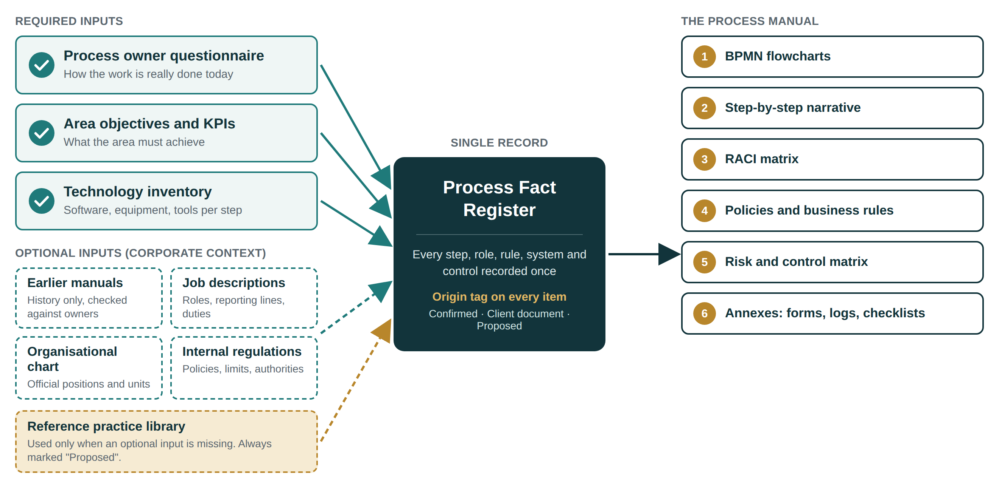
Client reality first: one register for every fact
Each step, role, rule, system and control is recorded once, with its origin. Every component reads from it.
Process Manuals Agent · Business Requirements · Review
5

Slide 6
Six rules applied to every item
The development team designs around them, not the other way round
1
2
3
The owner's account comes first
Every item carries its origin
Proposals are never passed off as fact
How work is done today comes from the process owner. Old manuals and reference practice never overwrite it.
Confirmed, Client document, or Proposed.
Marked until a named person accepts, adjusts or rejects them.
4
5
6
Conflicts are recorded, not hidden
No legal statement without a source
One fact, used everywhere
The manual follows the owner; the difference goes to the gap log.
Legal duties, deadlines and retention periods only when the client confirms them.
A role, step or limit reads the same in every component.
Process Manuals Agent · Business Requirements · Review
6

Slide 7
Required inputs
Three blocks are mandatory. If one is missing for a process, the agent asks for it instead of assuming.
1
Process owner questionnaire
2
Area objectives and KPIs
3
Technology inventory
How the work is really done today (As-Is)
What the area must achieve
What is used at each step
Identity and boundaries
Steps, roles and decisions
Inputs, outputs and handoffs
Systems, volume, records
Problems, risks and rules
At least one stated objective
Indicator card: formula, source, frequency, target, owner
No KPIs yet? Candidates proposed; targets left to the client
Software and systems
Machinery and equipment
Informal tools: spreadsheets, messaging, paper forms
Completeness gate. No procedure is drafted until questionnaire blocks 1 to 6 are answered: owner, start and end, steps and roles, decisions, handoffs and systems ("none" is a valid answer).
Process Manuals Agent · Business Requirements · Review
7

Slide 8
Optional inputs: corporate context
Documents describe what someone once decided; the questionnaire describes what happens now
Earlier manuals
Job descriptions
Adds: Structure, historical rules, form codes
Adds: Titles, reporting lines, duties
Read as history. Checked item by item against the owners; differences go to the gap log.
Mapped to RACI roles. Duties done but not described, or described but not done, are flagged.
Organisational chart
Internal regulations
Adds: Official positions and units
Adds: Policies, limits, delegation of authority
Becomes the role catalogue for flowchart lanes and RACI columns.
Source of policies and rules, cited by clause. Conflicts with practice are raised, not settled silently.
Process Manuals Agent · Business Requirements · Review
8

Slide 9
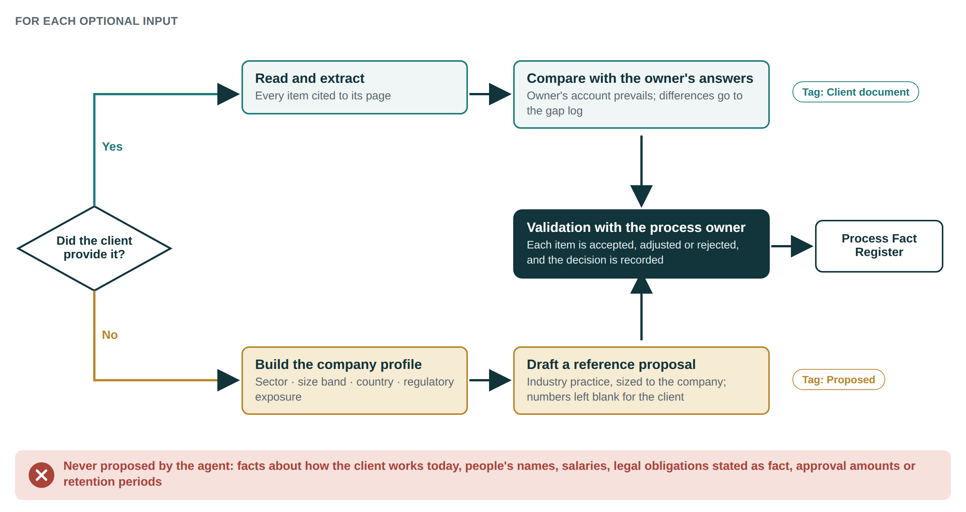
Compensation logic
When an optional input is missing, the agent drafts a sized, sector-appropriate proposal and marks it
Process Manuals Agent · Business Requirements · Review
9

Slide 10
What the agent proposes, and what it never does
Proposals give the client something concrete to react to; the client decides
PROPOSED WHEN MISSING
Never proposed by the agent
Role profiles
Responsibilities from confirmed steps; competencies proposed
✕
Facts about how the client works today
Organisational chart
✕
Names of people
Functional chart from interviews; reference structure by size
Baseline policies and rules
✕
Pay, grading or performance judgements
Authorisation, segregation of duties, records, access, exceptions
✕
Legal obligations, deadlines or retention periods stated as fact
Indicators
Three to five per objective, with formula and source
✕
Approval amounts, thresholds or indicator targets
Every proposal carries its reason and its basis, and is decided in the Validation Record: accept, adjust or reject.
Process Manuals Agent · Business Requirements · Review
10

Slide 11
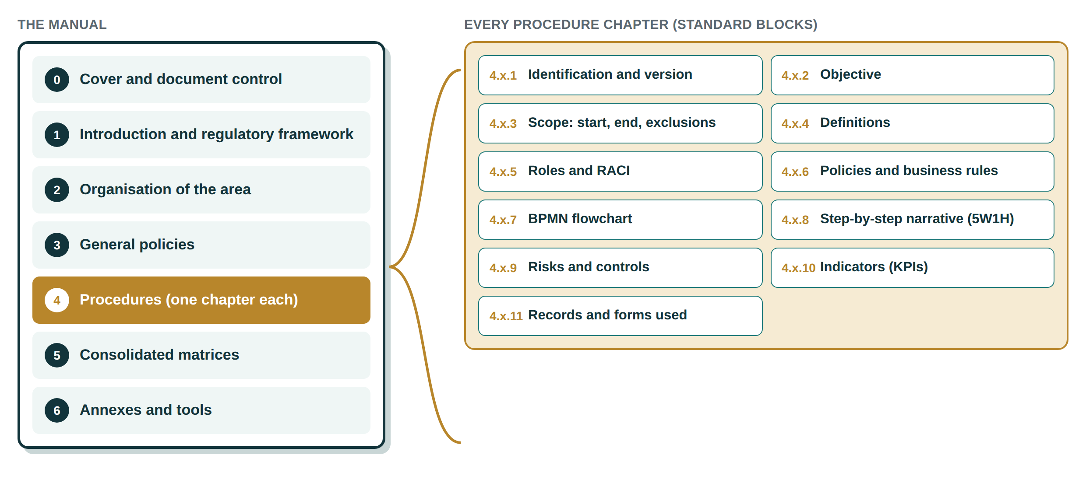
The deliverable: one structure for every manual
Size changes the depth of each part, never the order
Process Manuals Agent · Business Requirements · Review
11

Slide 12
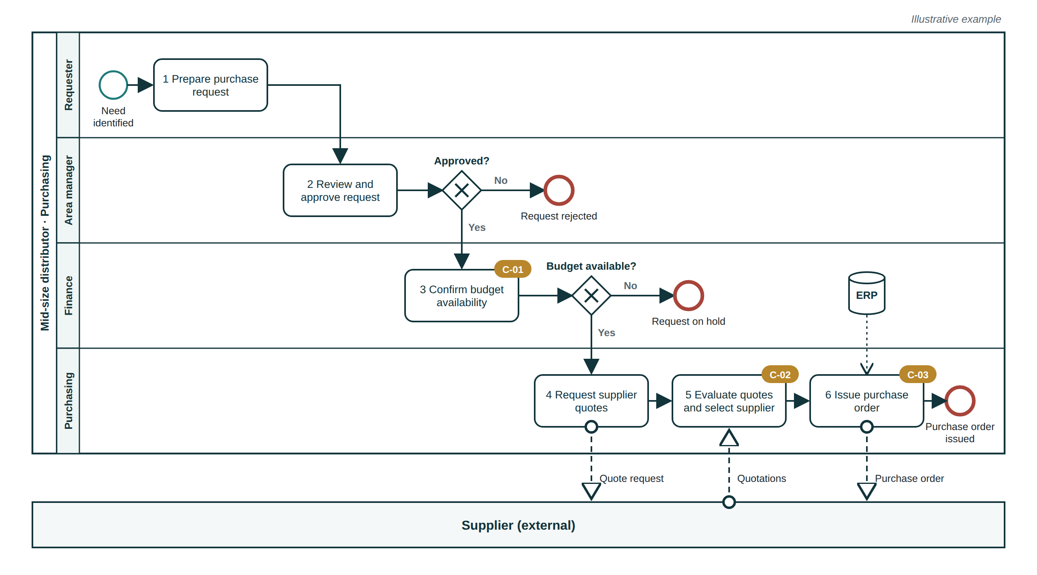
Flowcharts: BPMN 2.0, descriptive level
Twelve style rules keep every diagram readable and consistent with the narrative
Key rules
✓
Lanes are positions, never names
✓
Tasks: verb + object, numbered like the narrative
✓
Gateways asked as questions; every exit labelled
✓
One end event per outcome, named
✓
Control flags link to the risk matrix
✓
Delivered as .bpmn XML plus image
Process Manuals Agent · Business Requirements · Review
12

Slide 13
Narrative, RACI, policies and rules
Three formats that share the same step numbers and role names
Step-by-step narrative (5W1H)
RACI matrix
Policies and business rules
One row per step, numbered as the flowchart
What · Who · How · When · Where · Output
One action per step; decisions written as conditions
No vague words unless defined
Rows = steps, columns = positions
Exactly one A per step; at least one R
Every lane appears in the RACI
Segregation-of-duties conflicts flagged; compensating control shown
Policy = commitment; rule = testable condition
ID, statement, type, applies to, source, owner
Exceptions and who may authorise them
Amounts left blank for the client
Process Manuals Agent · Business Requirements · Review
13

Slide 14
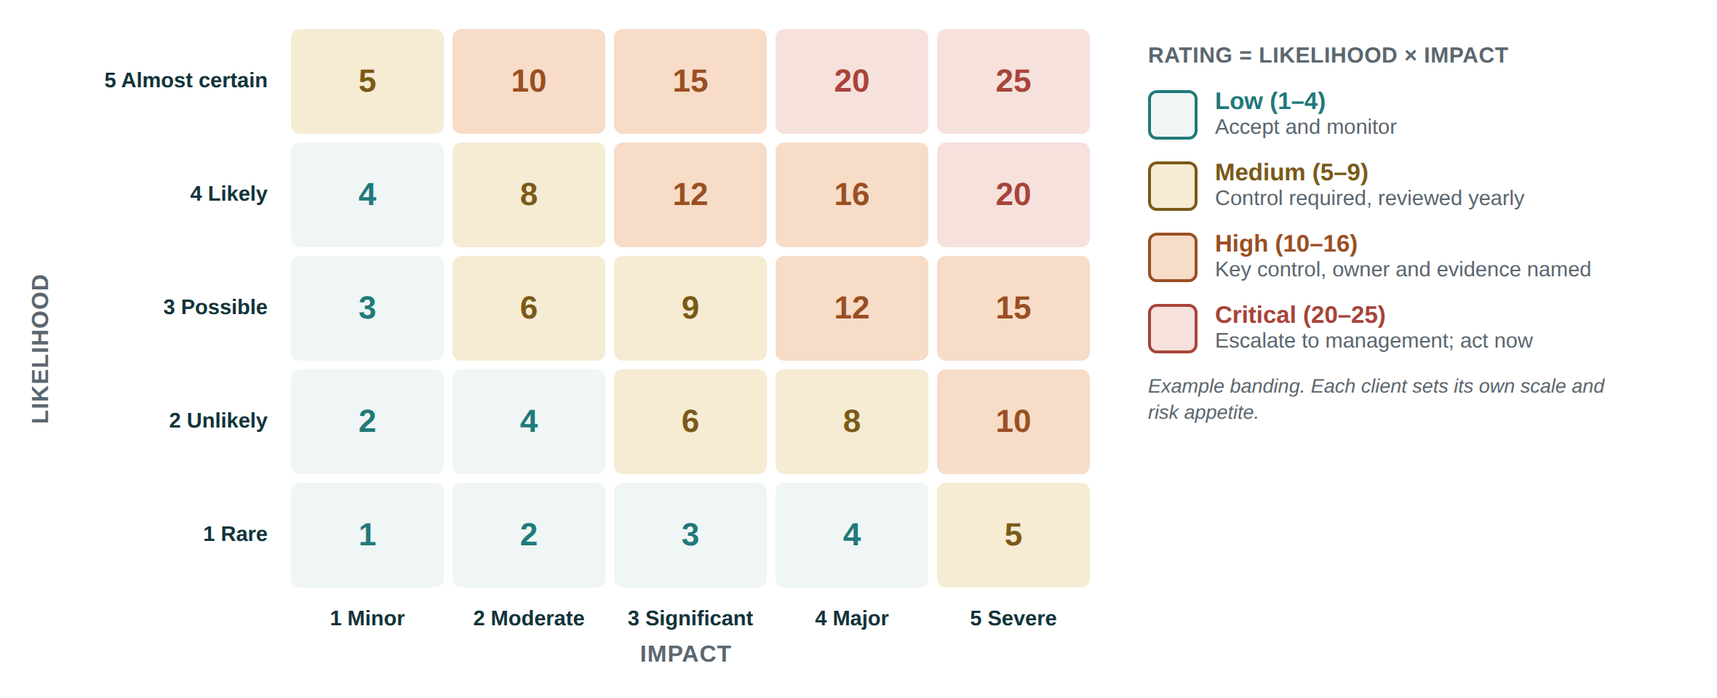
Risk and control matrix
Each control is tied to a step, an owner and the form that proves it ran
Each row records
Risk: event, cause, consequence
Category and inherent rating
Control: who, what, when, how
Preventive / detective / corrective
Manual or automated; frequency
Owner and evidence form
Key control; line of responsibility
Residual rating
Where duties cannot be separated (common in small firms), the matrix shows the compensating control.
Process Manuals Agent · Business Requirements · Review
14

Slide 15
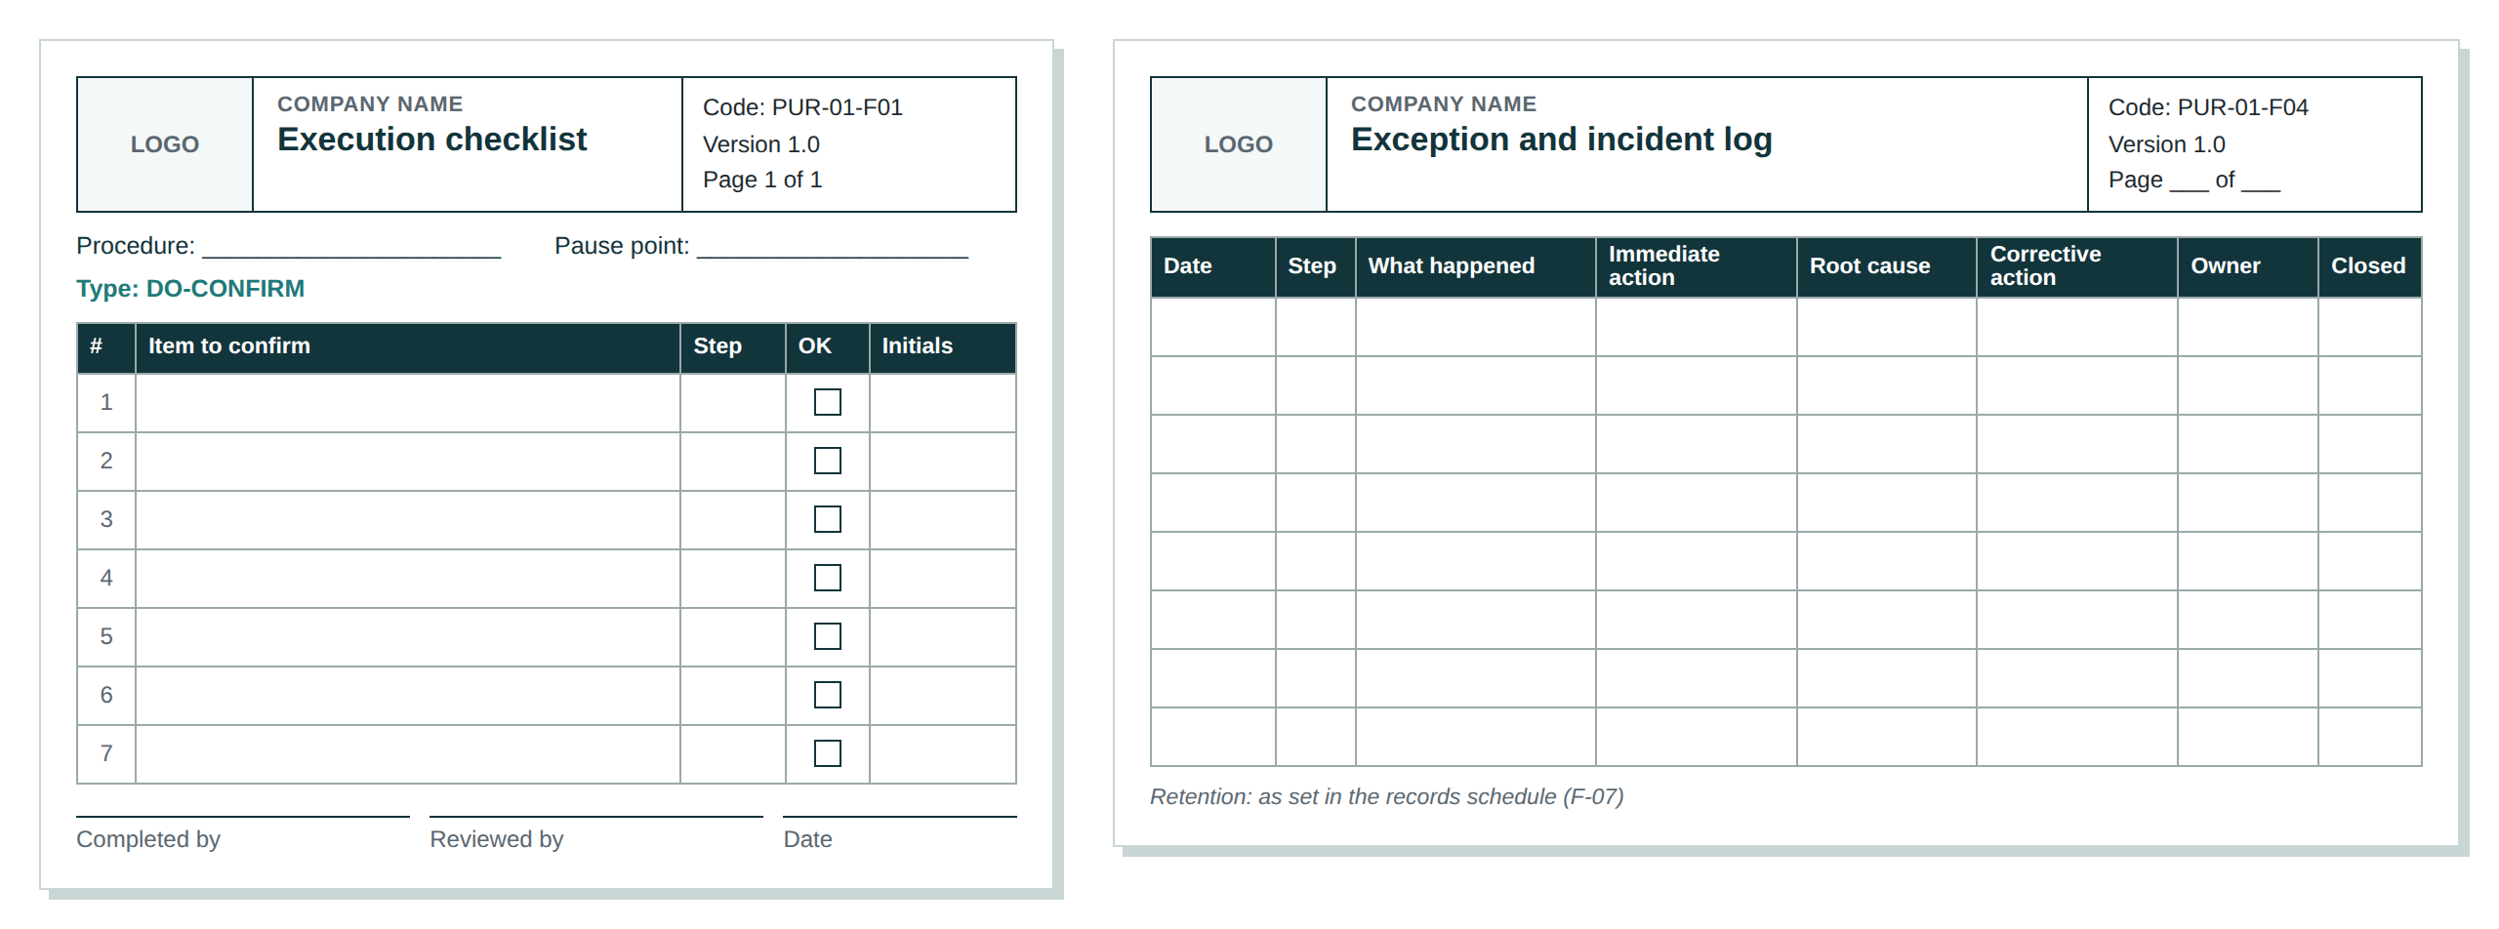
Annexes: the forms staff fill in
Ten standard formats, one design: header, code, instructions, fields, sign-off, retention
F-01
Execution checklist
F-02
Activity log
F-03
Approval form
F-04
Exception and incident log
F-05
Control evidence log
F-06
Indicator tracking sheet
F-07
Records retention schedule
F-08
Change request and revision history
Checklist rules
READ-DO for rare or complex tasks, DO-CONFIRM for routine work. A defined pause point. Five to nine critical items. One page.
F-09
Read-and-understood record
F-10
Validation record
Process Manuals Agent · Business Requirements · Review
15

Slide 16
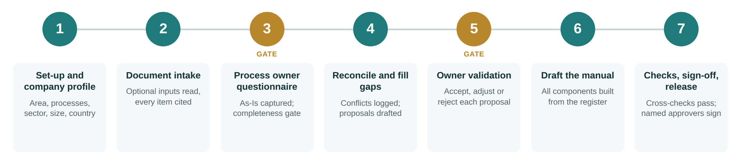
How the agent works
Seven steps from set-up to release; two of them are gates
WHAT MANAGEMENT CAN RELY ON
Right depth from the start
Every item traceable
No drafting on assumptions
One agreed version of each fact
The client decides
Components agree by construction
Checked and approved by people
Process Manuals Agent · Business Requirements · Review
16

Slide 17
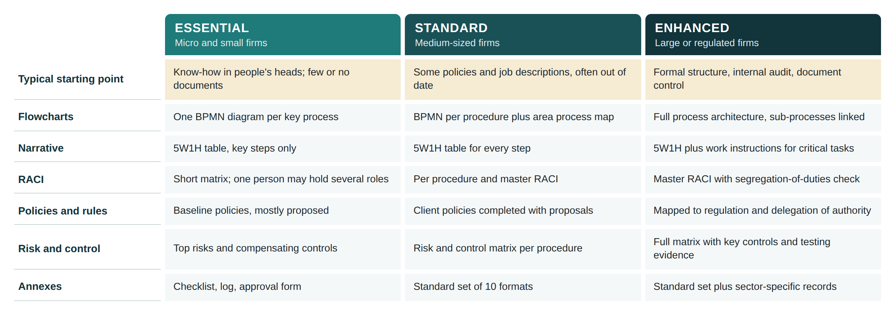
One structure, three depths
The manual is proportionate: short and usable for a micro business, audit-ready for a regulated group
Process Manuals Agent · Business Requirements · Review
17

Slide 18
Scope: what the agent will and will not do
The blueprint boundary for the development team. Anything outside needs a separate decision.
The agent WILL
The agent will NOT
✓
Document the current operation, as confirmed by owners
✕
Present a proposal as current practice
✓
Stop and ask when a required input is missing
✕
Invent steps, roles, systems or timings
✓
Cite every item taken from a client document
✕
Name individuals in flowcharts, RACI or controls
✓
Propose missing charts, profiles, policies, controls and KPIs, clearly marked
✕
Propose pay, grading or performance judgements
✓
Produce BPMN, 5W1H narrative, RACI, rules, risk matrix, KPIs and forms
✕
State legal duties or retention periods without confirmation
✓
Keep all components consistent
✕
Set approval amounts, thresholds or KPI targets
✓
Log conflicts and improvement ideas separately
✕
Redesign processes beyond accepted improvements
✓
Size the manual to the company
✕
Certify compliance or replace client and consultant sign-off
Process Manuals Agent · Business Requirements · Review
18

Slide 19
How we will know it works
Acceptance criteria for the built agent
None
100%
None
procedures drafted with an incomplete required input
of working-draft items carry an origin tag
open proposals in policies, accountabilities or controls in an approved edition
100%
100%
100%
of flowchart tasks match a narrative step in number and wording
of steps have exactly one Accountable role
of controls link to a step and an existing evidence form
And: every .bpmn file validates, no individual is named, and no manual is released without named client approval.
Process Manuals Agent · Business Requirements · Review
19

Slide 20
Decisions requested
To settle during architecture mapping
1
Approve the input model: three required blocks, four optional inputs and the completeness gate
Size bands per country
Owner and upkeep of the reference practice library
Questionnaire delivery: guided session, online form, or both
Default risk scale for small clients
Who signs the approved edition at the client
Languages of the manual
Tool used to validate BPMN files
2
Confirm the "client reality first" rules and the limits on what the agent may propose
3
Approve the manual structure and output standards as the development blueprint
Next phase: architecture mapping, using the BRD as the blueprint.

