Slide 1
=
Notes:
java: problems, solutions, limitations.
Typeclass approach
Haskell.

Slide 2

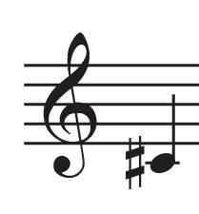

=
.equals(...)
Structural Equality
Value Equality

Slide 3
= ?
Same value
Conditional statements
Testing
Substitution
Identity
Searching
Uniqueness

Slide 4
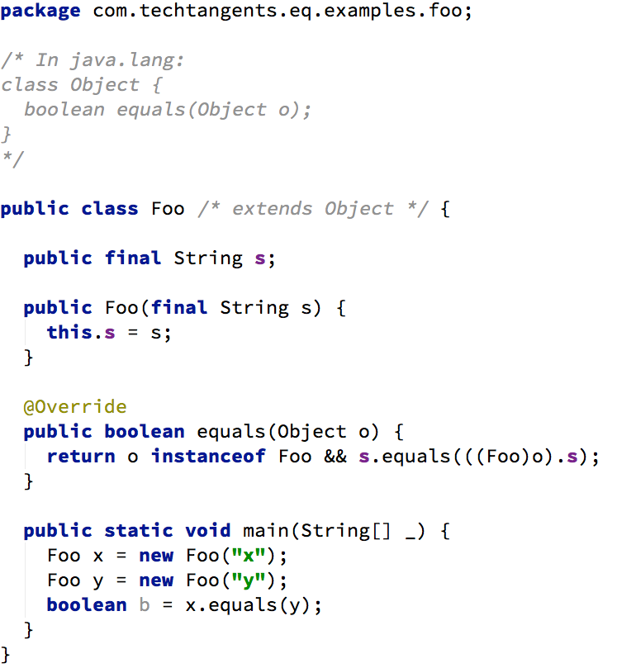

Slide 5
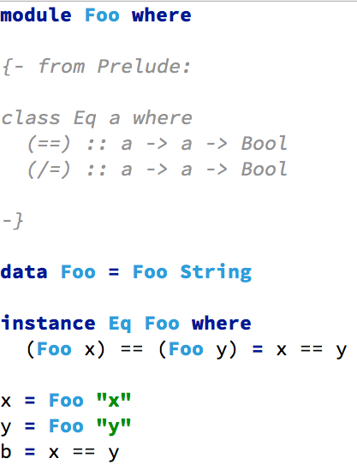

Slide 6
class / interface
type class
class
data type
type class instance

Slide 7
x
x

Slide 9
Foo("x") == 72; -- compile error
new Foo("x").equals(72);
-- false

Slide 10
new Foo("x").equals(Color.purple); -- false

Slide 11
new Foo("x").equals( new com.sun.java.swing.plaf.nimbus. InternalFrameInternalFrameTitlePane InternalFrameTitlePaneMaximizeButton Painter(null, 3) ); -- false

Slide 12

= on values of
different types
is silly
we already know
they're different!

Slide 13
"... in general, the aim [of a type system] is to prevent operations expecting a certain kind of value from being used with values for which that operation does not make sense (logic errors);"
- https://en.wikipedia.org/wiki/Type_system

Slide 14
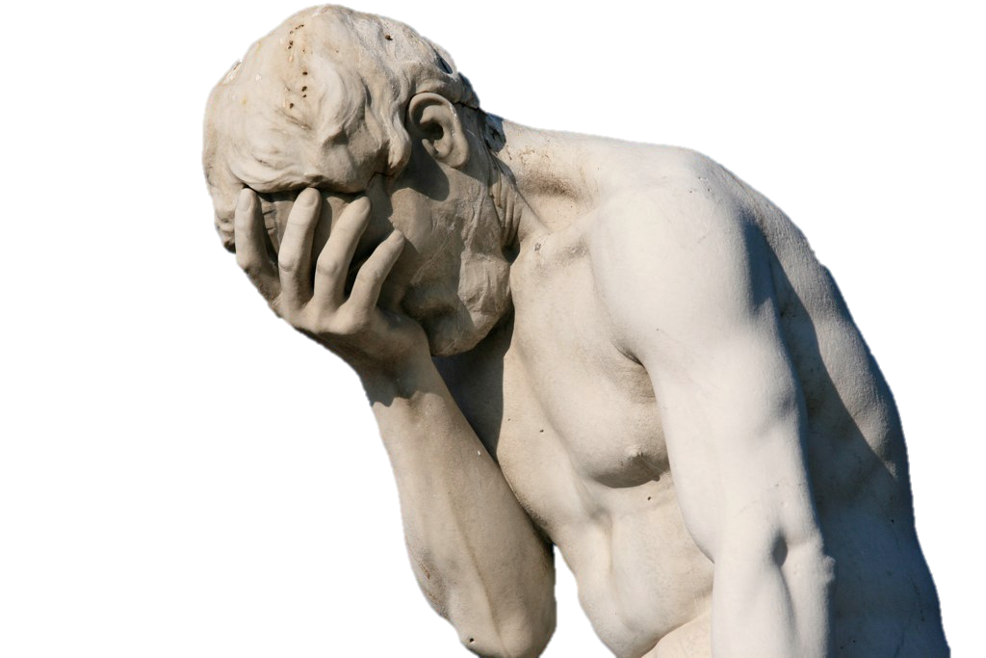
public class Object {
....
public boolean equals(Object obj) {
...
}
....
}

Slide 15
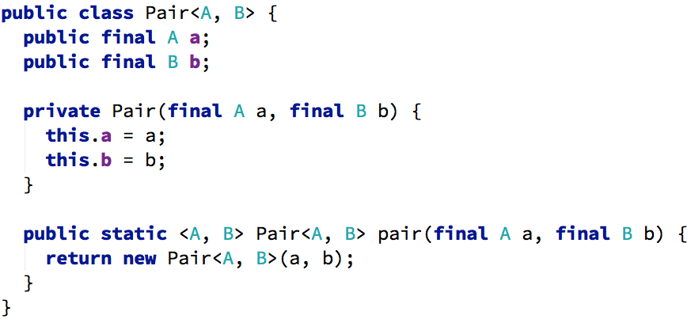

Slide 16
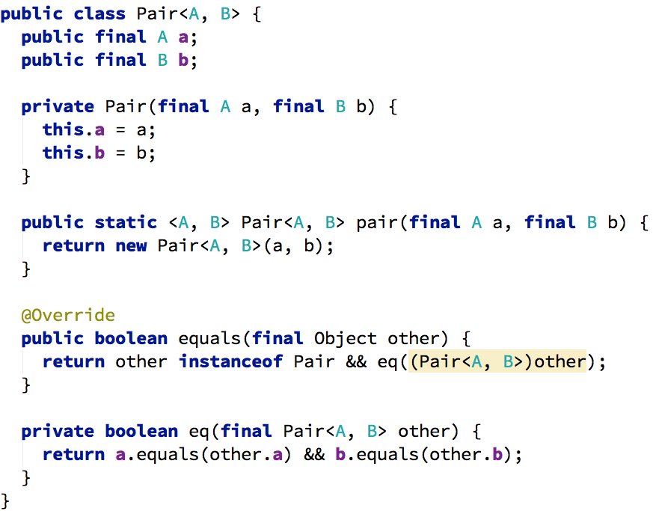

Slide 18
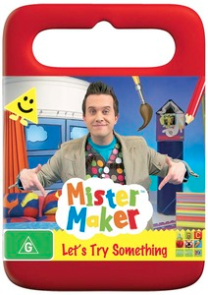

Slide 19

Notes:
- like Comparable<T>

Slide 20
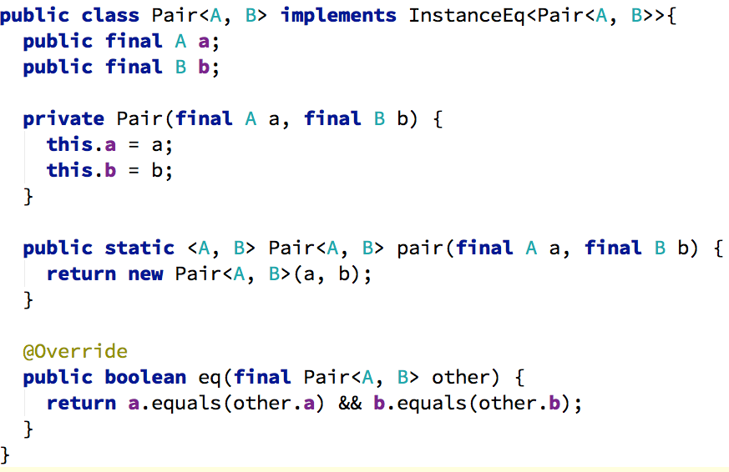

Slide 21

public class Cheese implements Eq<Chalk> {
...
}
http://licehunter.files.wordpress.com/2010/06/head_scratch_final_2.jpg

Slide 23
= on parameterized types requires
= on type parameters

Slide 24
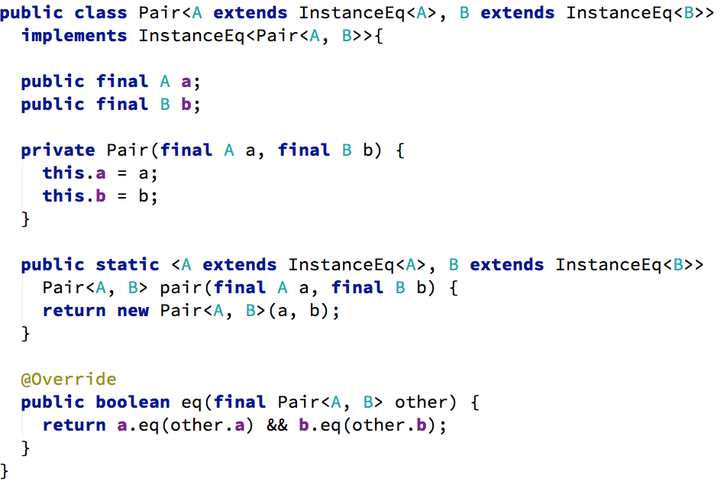

Slide 25
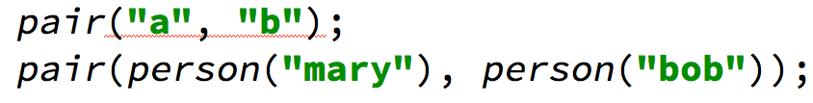
String implements InstanceEq<String>
Notes:
Inheritance. Wrapping. Even if it could...

Slide 26
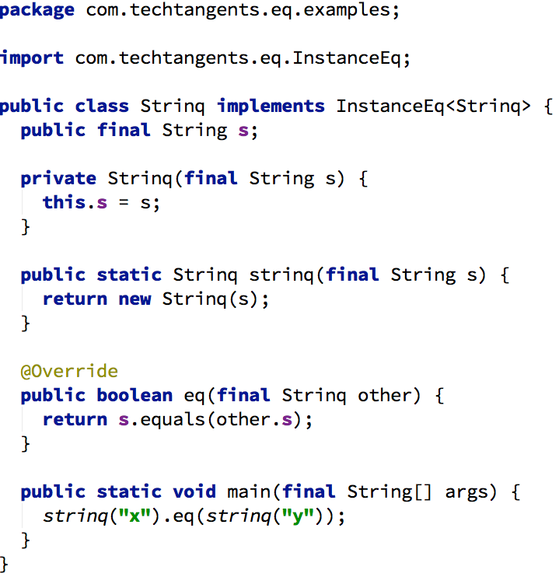

Slide 27
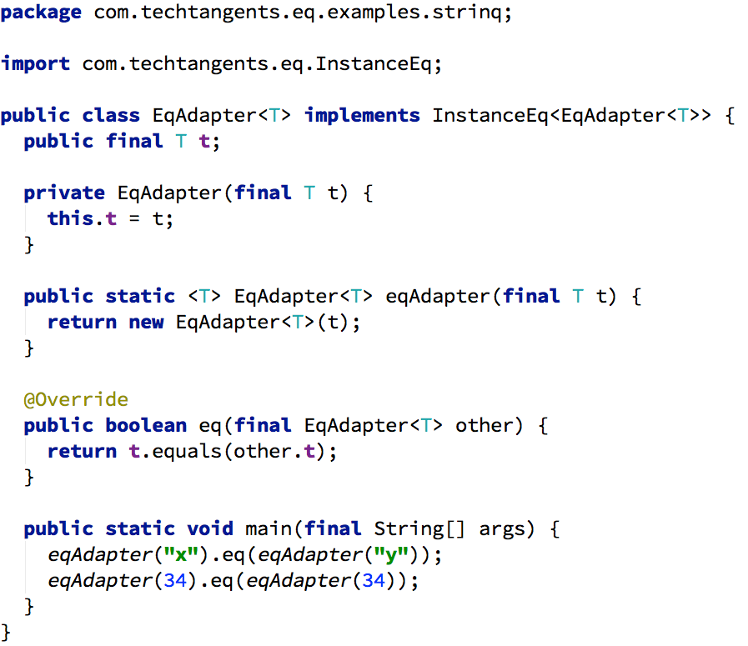

Slide 28
Do all types have equality?

Slide 29

Integer
String
List*
Maybe*
Tree*
Unit

Slide 30
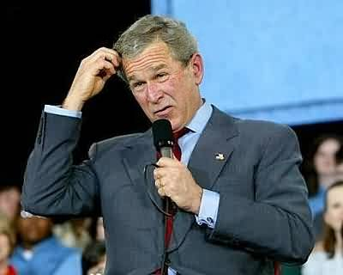
Void
Stream
IO
Function
Irrational number
Random number generator

Slide 31

Do all types have equality?

Slide 32

Can all types be in Pairs?

Slide 34
(this<A, B>)

Slide 35
= on parameterized types requires
= on type parameters
...
but only for the = function

Slide 37
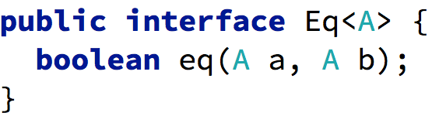
class Eq a where
(==) :: a -> a -> Bool

Slide 38
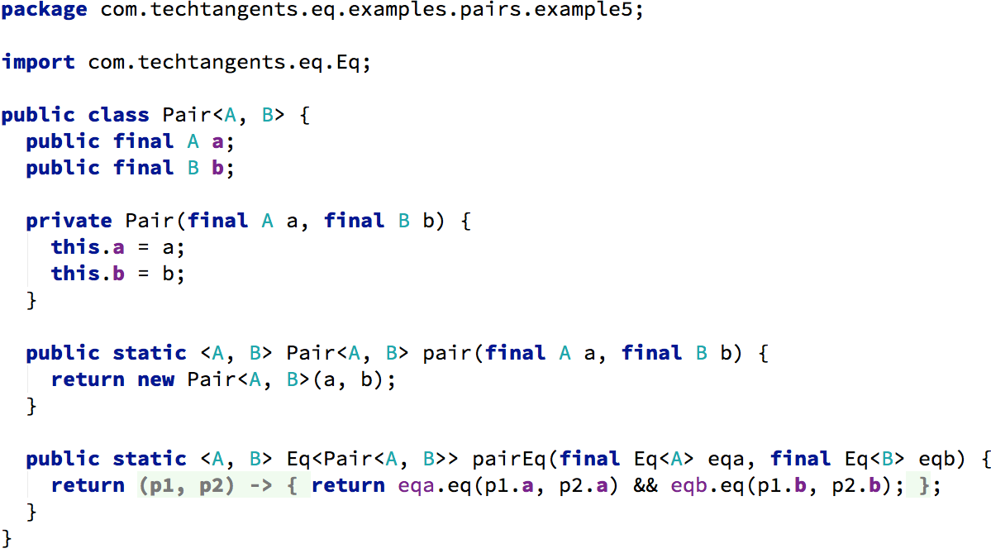

Slide 39
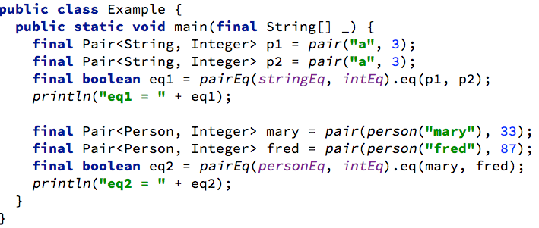

Slide 40
data Pair a b = Pair a b
instance (Eq a, Eq b) => Eq (Pair a b) where
(Pair a b) == (Pair a' b') = a == a' && b == b'
q = (Pair "cat" 7) == (Pair "dog" 7)
instance (Eq a, Eq b) => Eq (a, b) where
(a, b) == (a', b') = a == a' && b == b'
r = ("cat", 7) == ("dog", 7)

Slide 41
data Pair a b = Pair a b deriving Eq

Slide 42
Object
InstanceEq<A>
Eq<A>
Pair<A, B>
Pair<A, B>
Pair<A, B>
Eq<Pair<...>>
Eq a
Pair
instance Eq Pair

Slide 43
Conditional
implementation
of interface

Slide 44
data Pair a b = Pair a b
instance (Eq a, Eq b) => Eq (Pair a b) where
(Pair a b) == (Pair a' b') = a == a' && b == b'

Slide 45
interface InstanceEq {
boolean eq(this other)
}
public class Pair<A, B>
implements InstanceEq
(when A extends InstanceEq, B extends InstanceEq)
{
@Override
eq(Pair<A, B> other) {
...
}
}

Slide 46
interface InstanceEq {
boolean eq(this other)
}
public class Pair<A, B>
implements InstanceEq {
@Override
when (A extends InstanceEq, B extends InstanceEq)
eq(Pair<A, B> other) {
...
}
}

Slide 47
class Object { boolean equals(Object other) }
- overriden method
interface InstanceEq<T> { boolean eq(T t); }
- instance method
interface Eq<T> { boolean eq(T a, T b); }
- static method
class Eq a where
(==) :: a

Slide 48
Object
InstanceEq<A>
Eq<A>
Pair<A, B>
Pair<A, B>
Pair<A, B>
Eq<Pair<...>>
Eq a
Pair
instance Eq Pair

