Slide 1
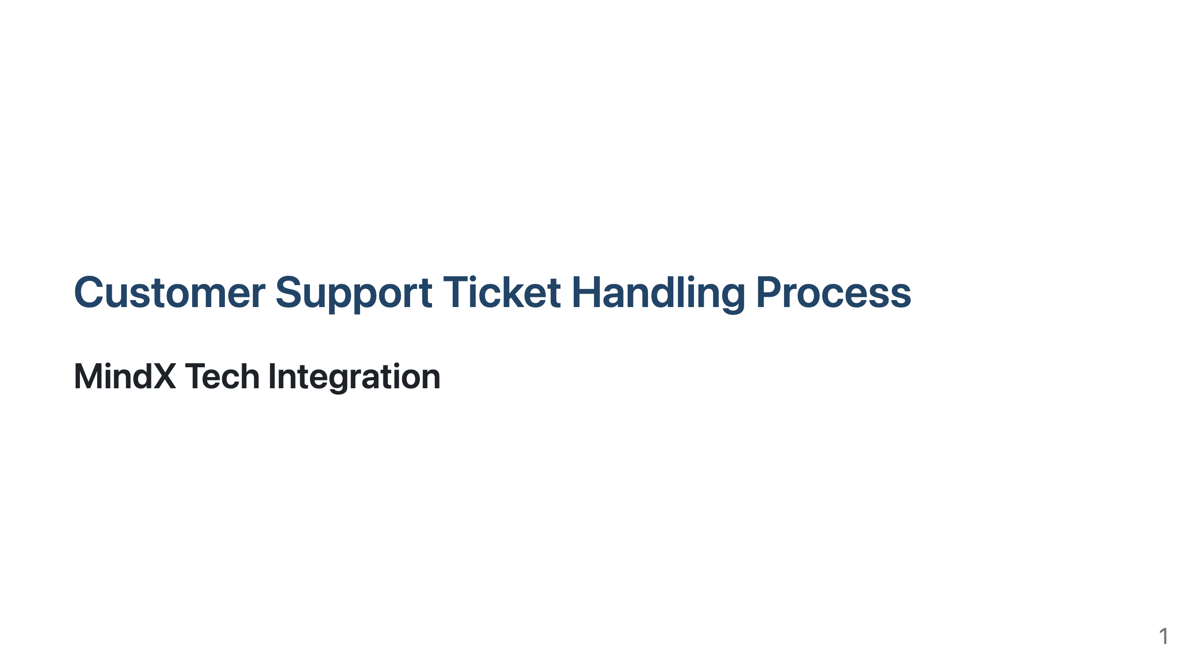
Notes:
Slide 1: Title Slide

Slide 2
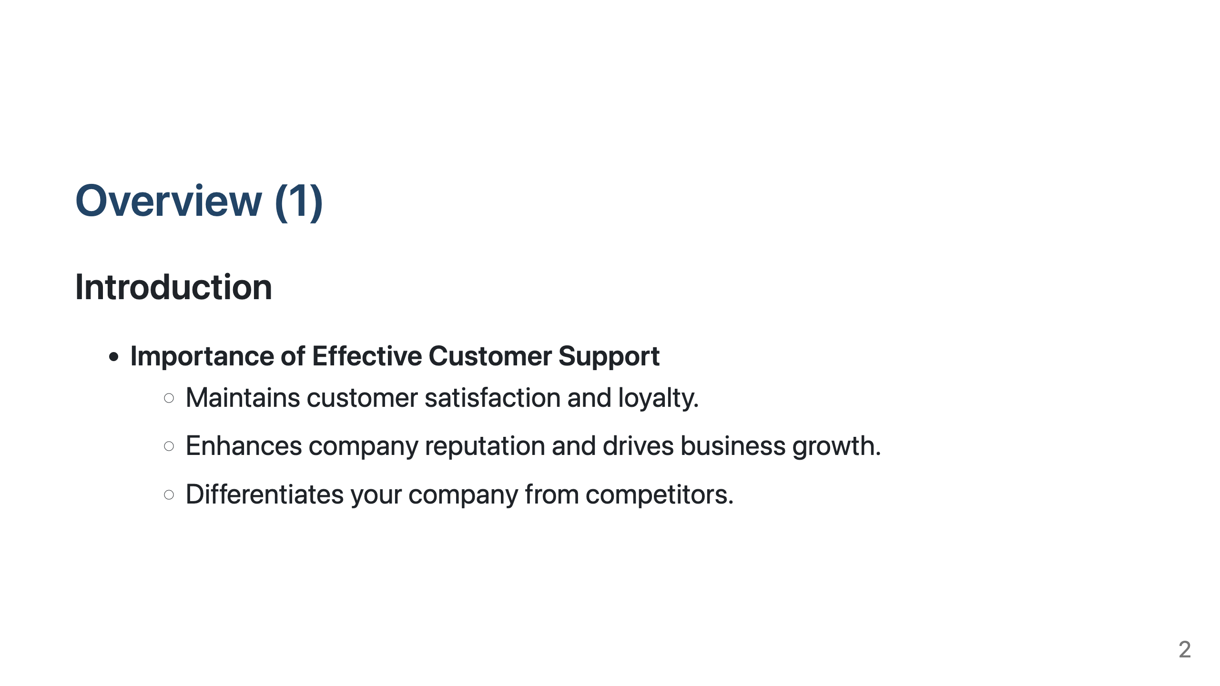
Notes:
Slide 2: Overview

Slide 3
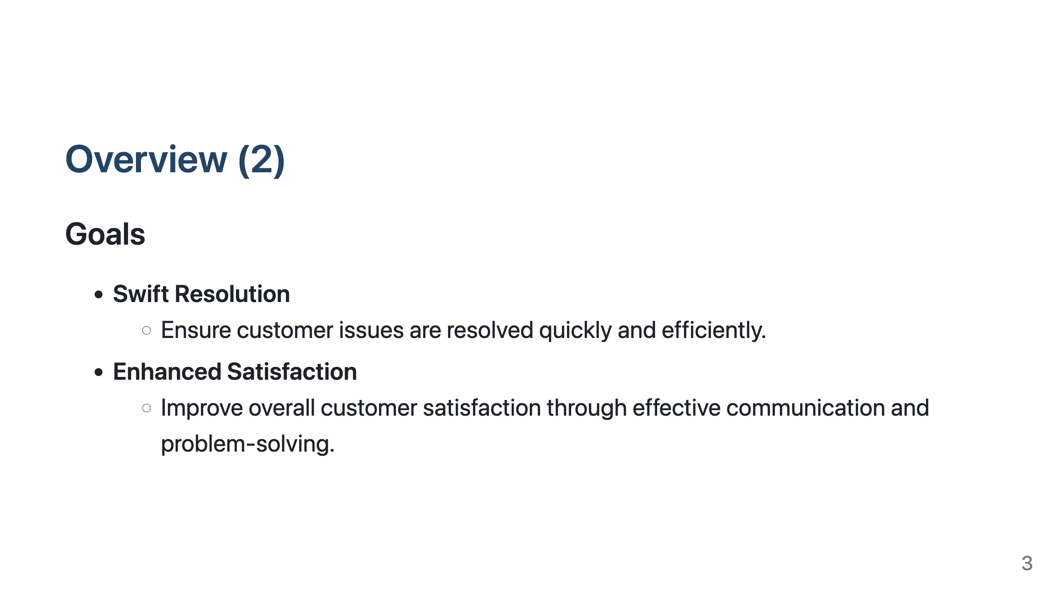
Notes:
Slide 2: Overview

Slide 4
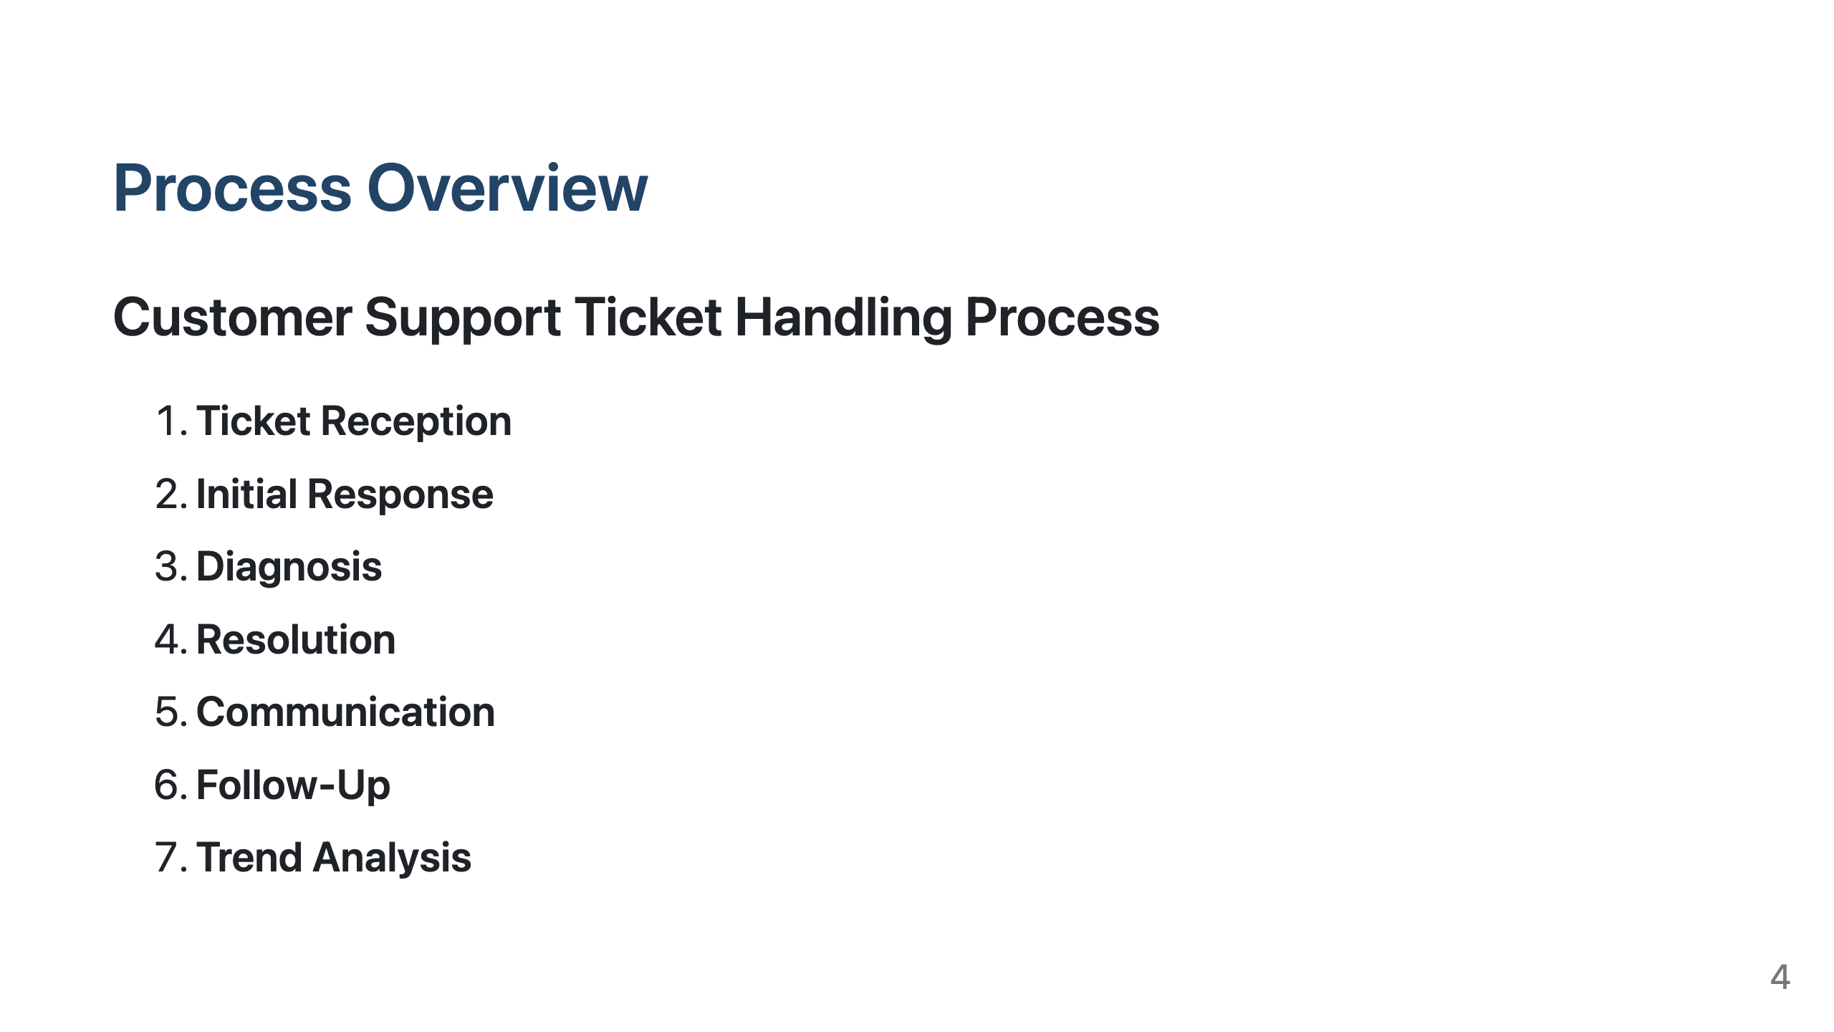
Notes:
Slide 3: Process Overview

Slide 5
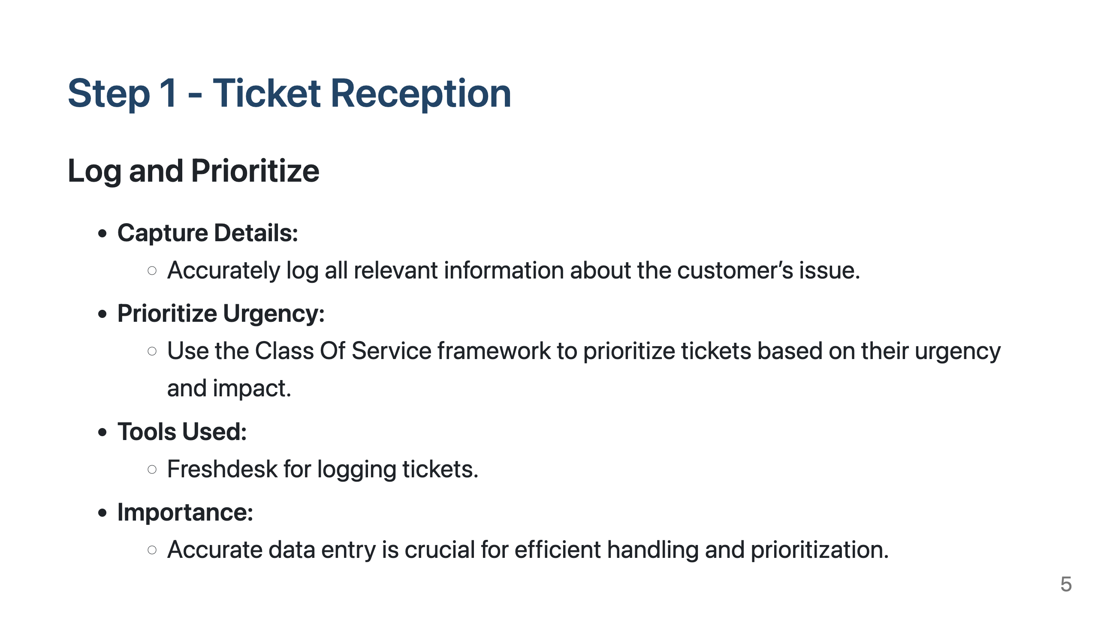
Notes:
Slide 4: Step 1 - Ticket Reception

Slide 6
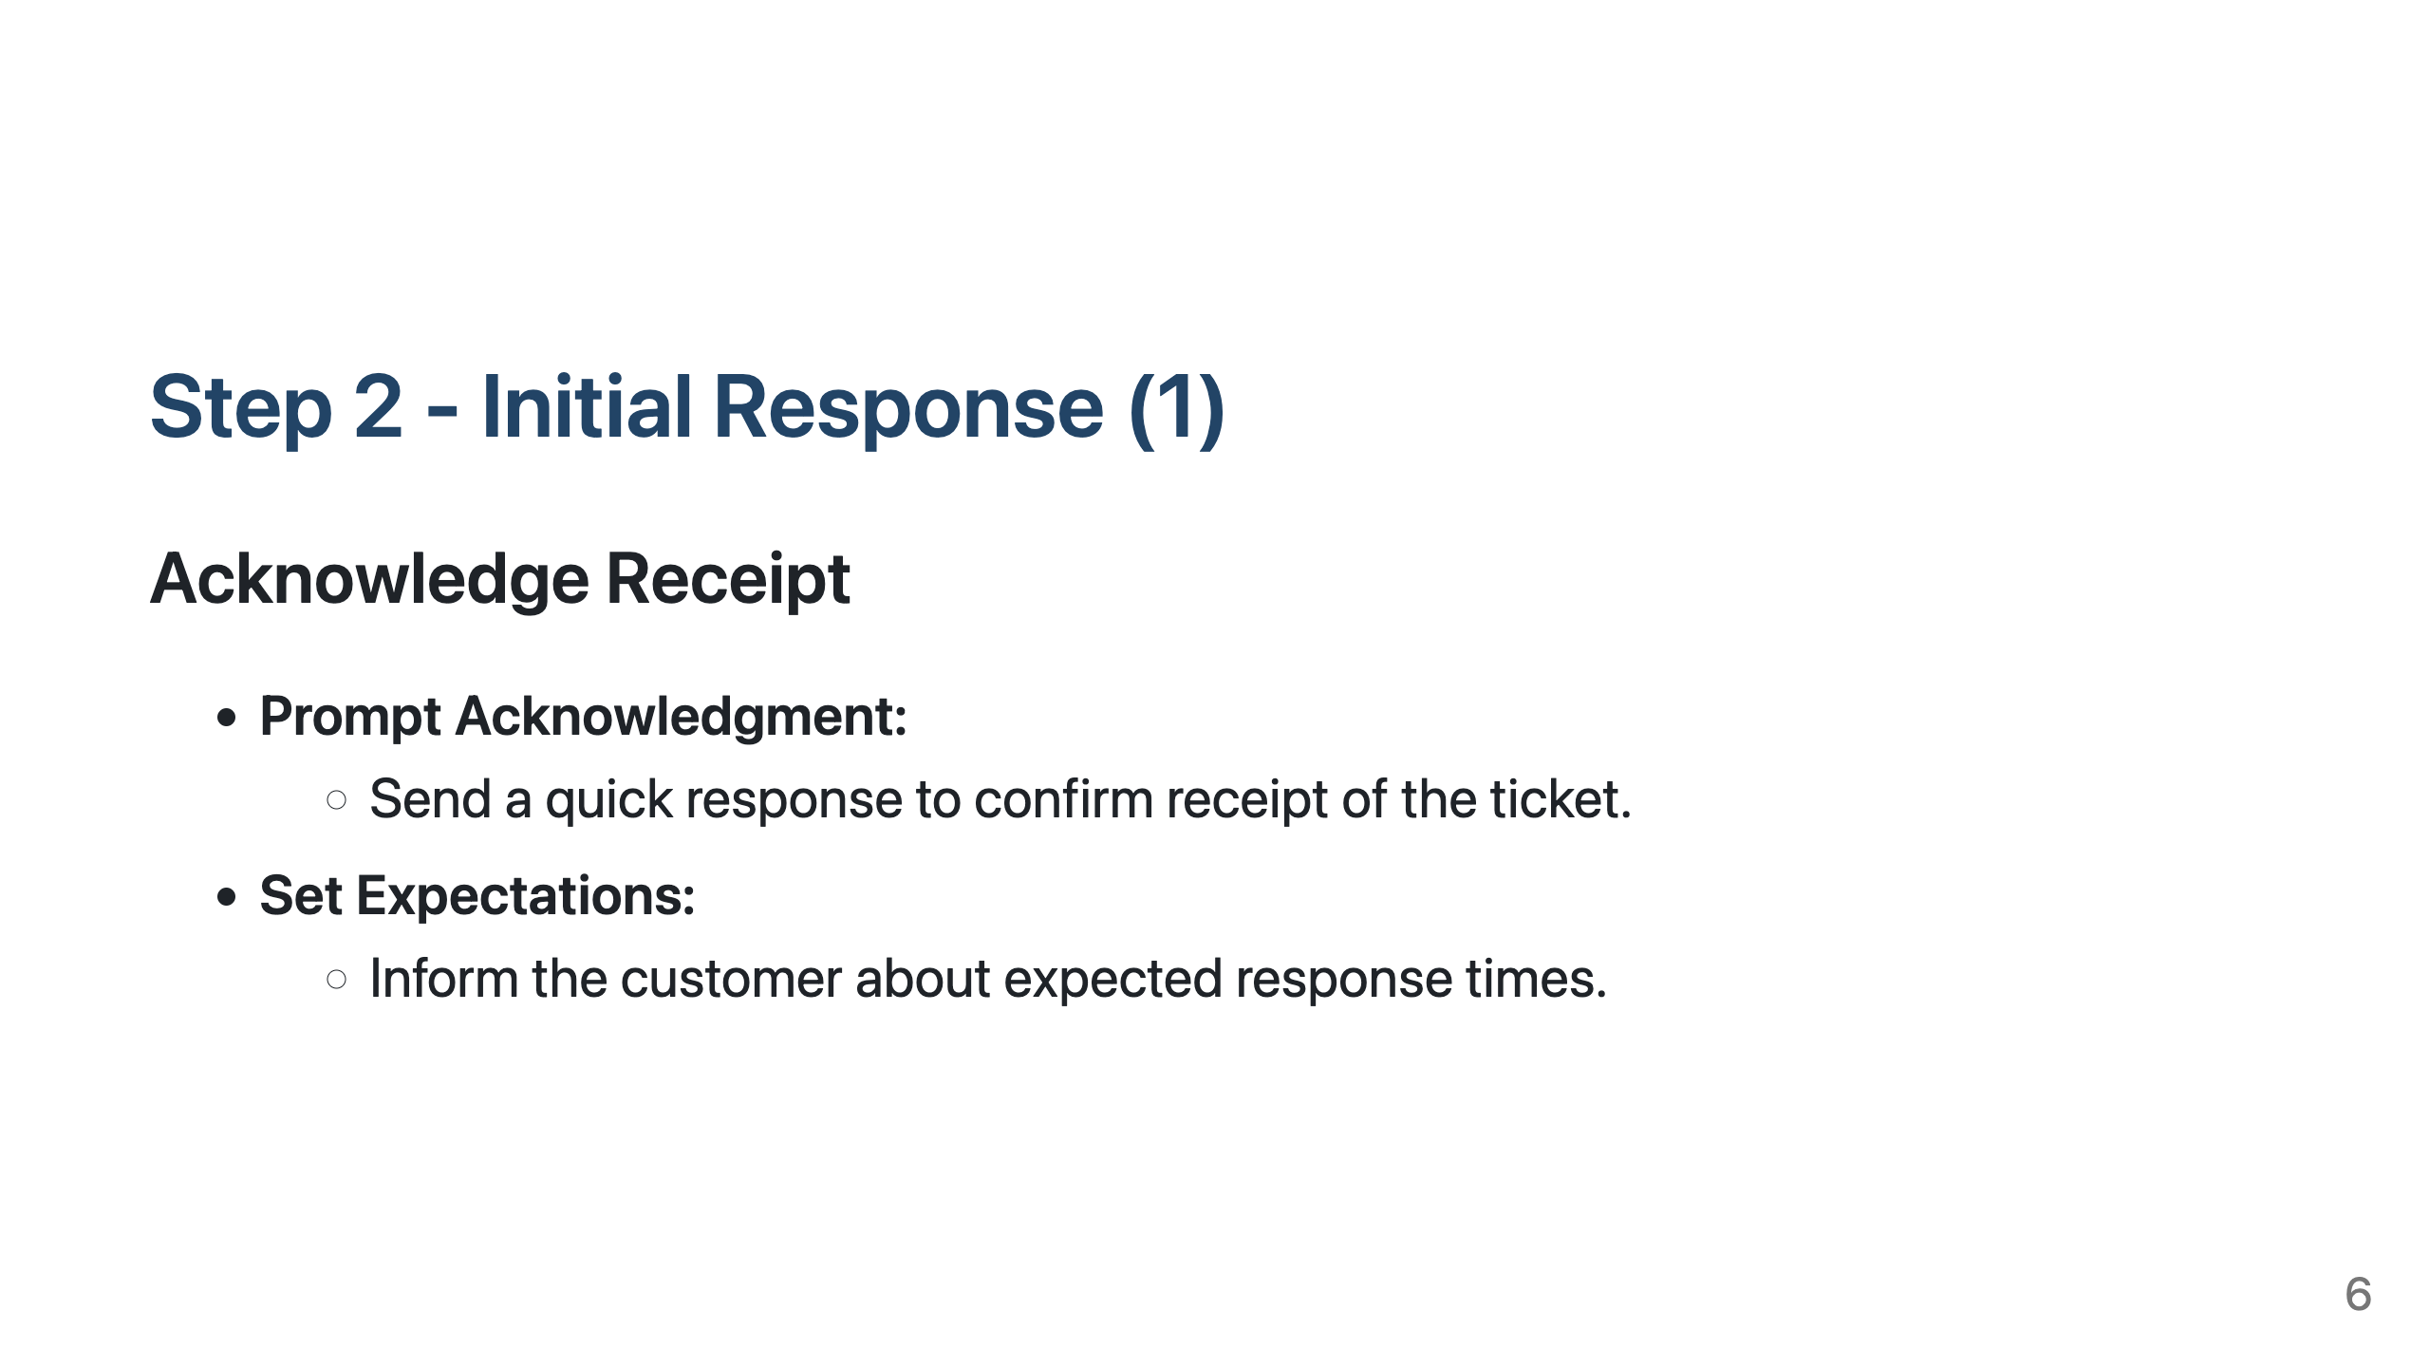
Notes:
Slide 5: Step 2 - Initial Response

Slide 7
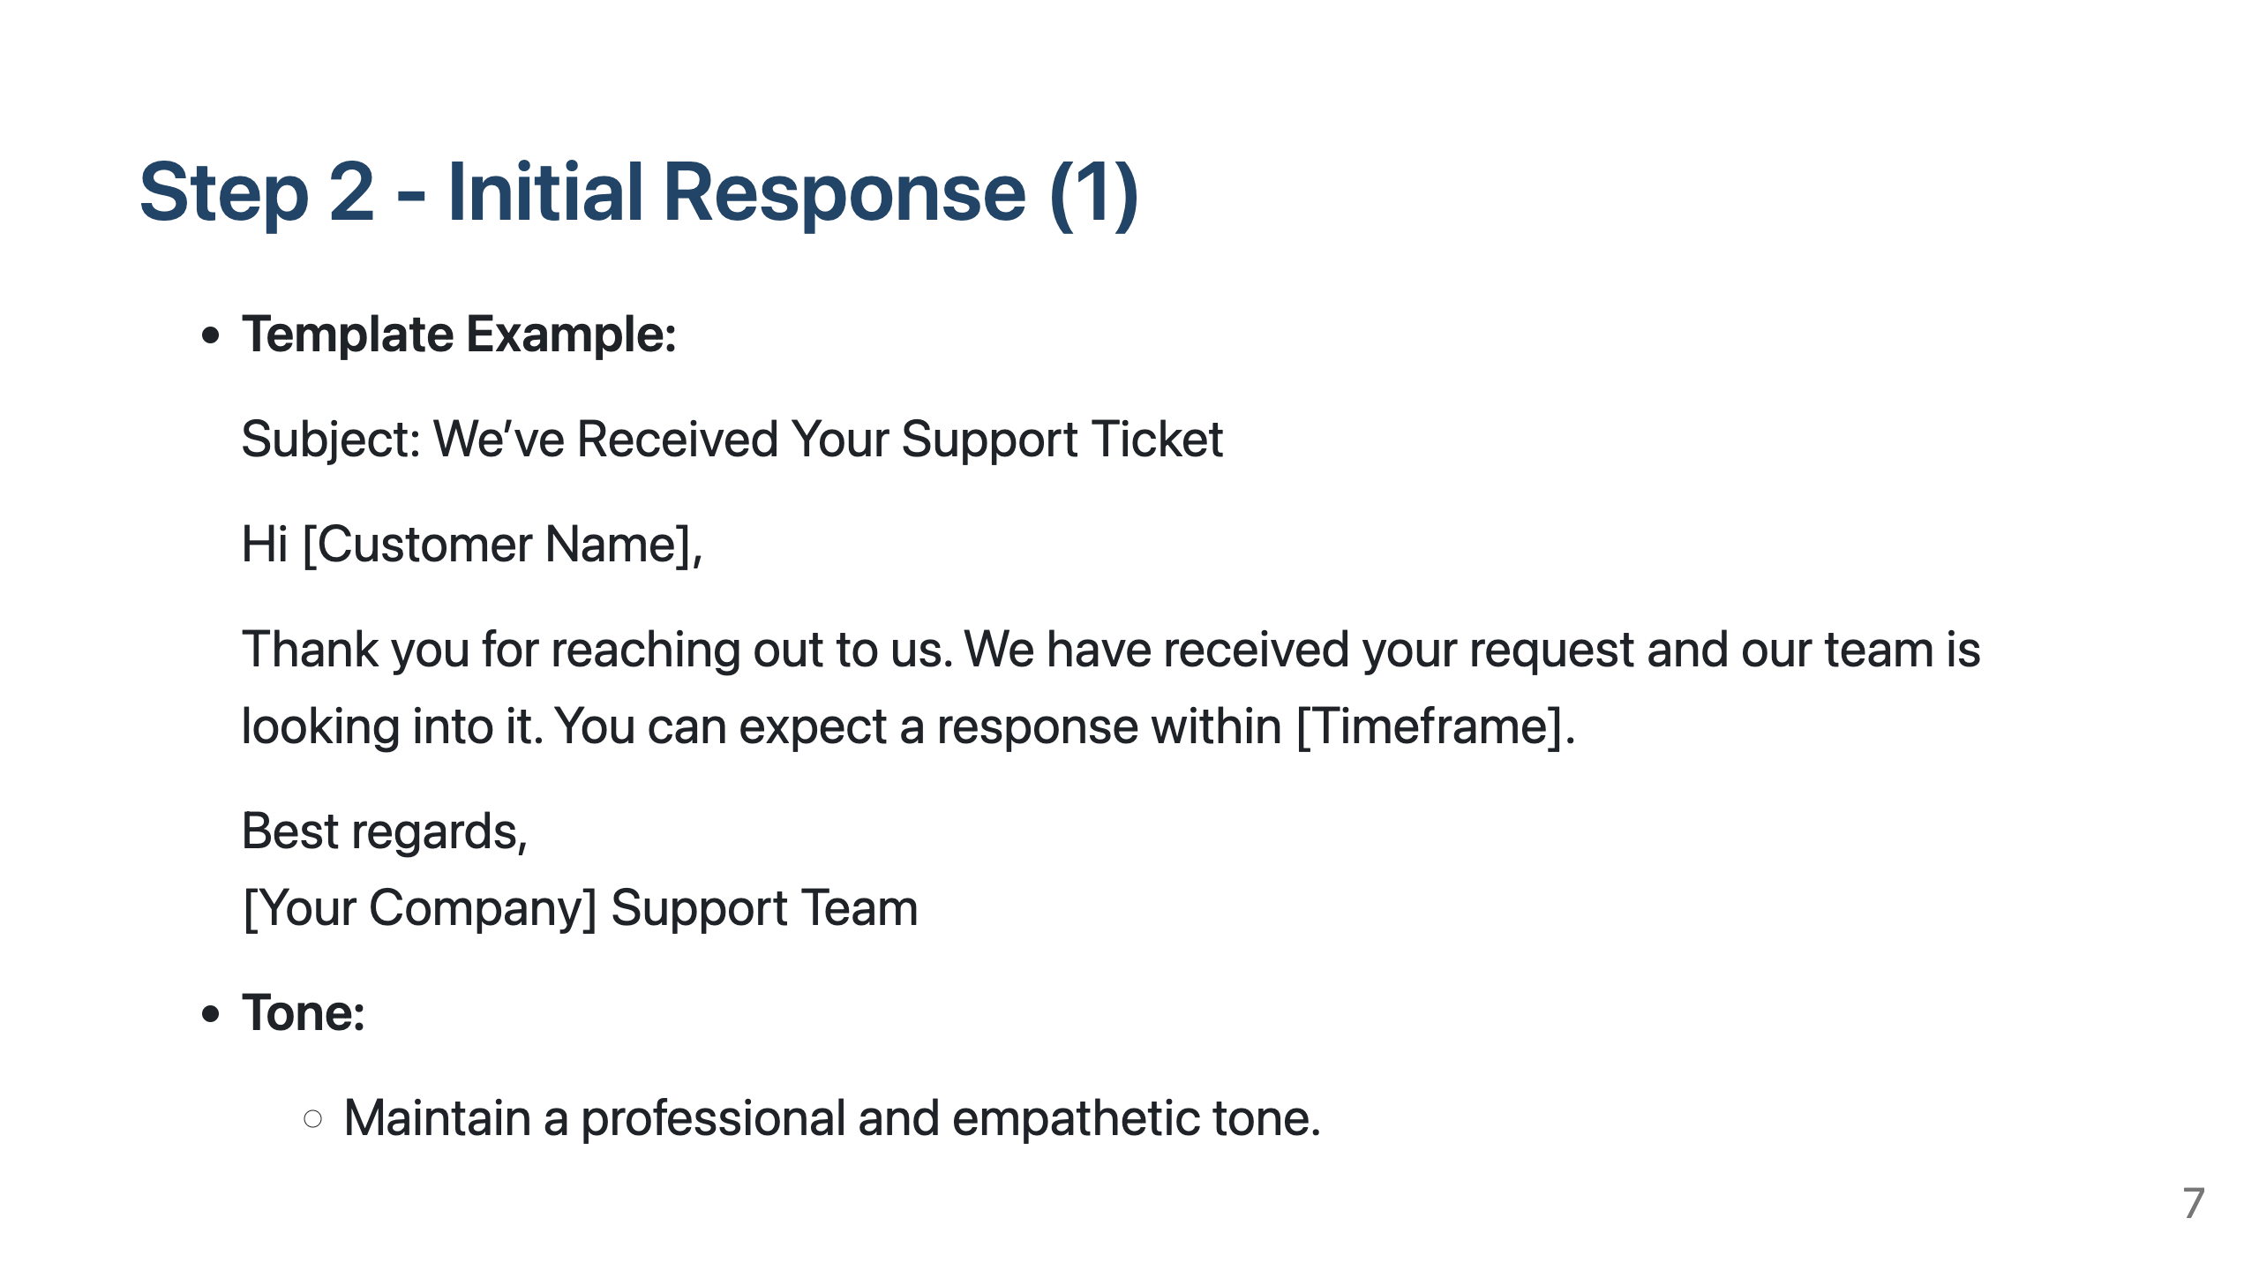
Notes:
Slide 5: Step 2 - Initial Response

Slide 8
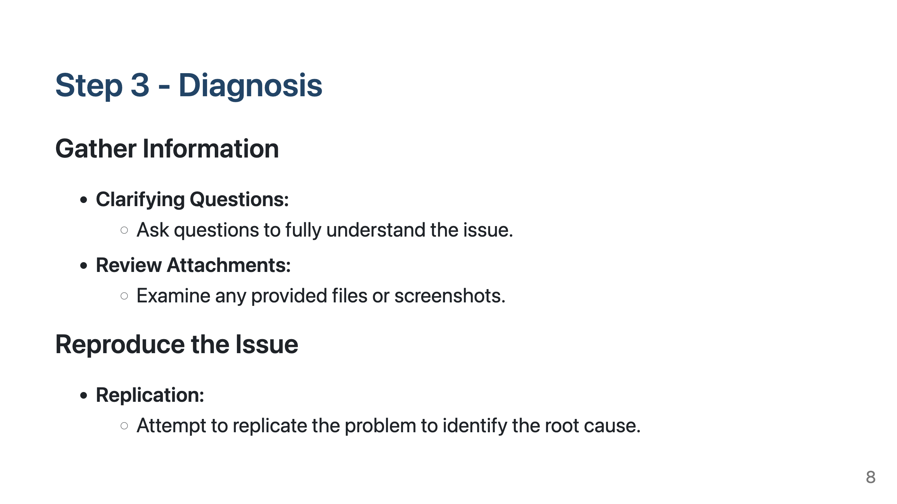
Notes:
Slide 6: Step 3 - Diagnosis

Slide 9
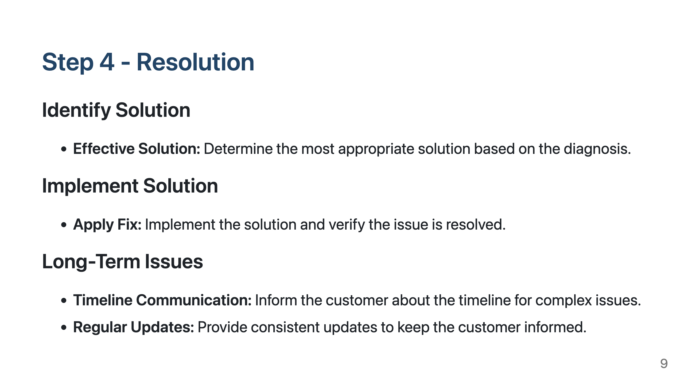
Notes:
Slide 7: Step 4 - Resolution

Slide 10
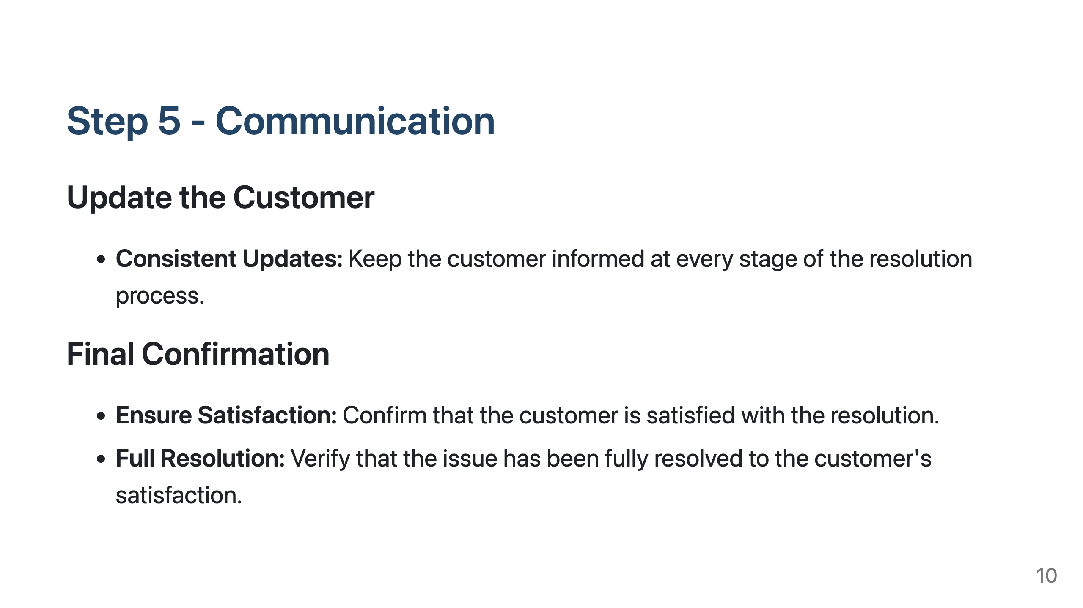
Notes:
Slide 8: Step 5 - Communication

Slide 11
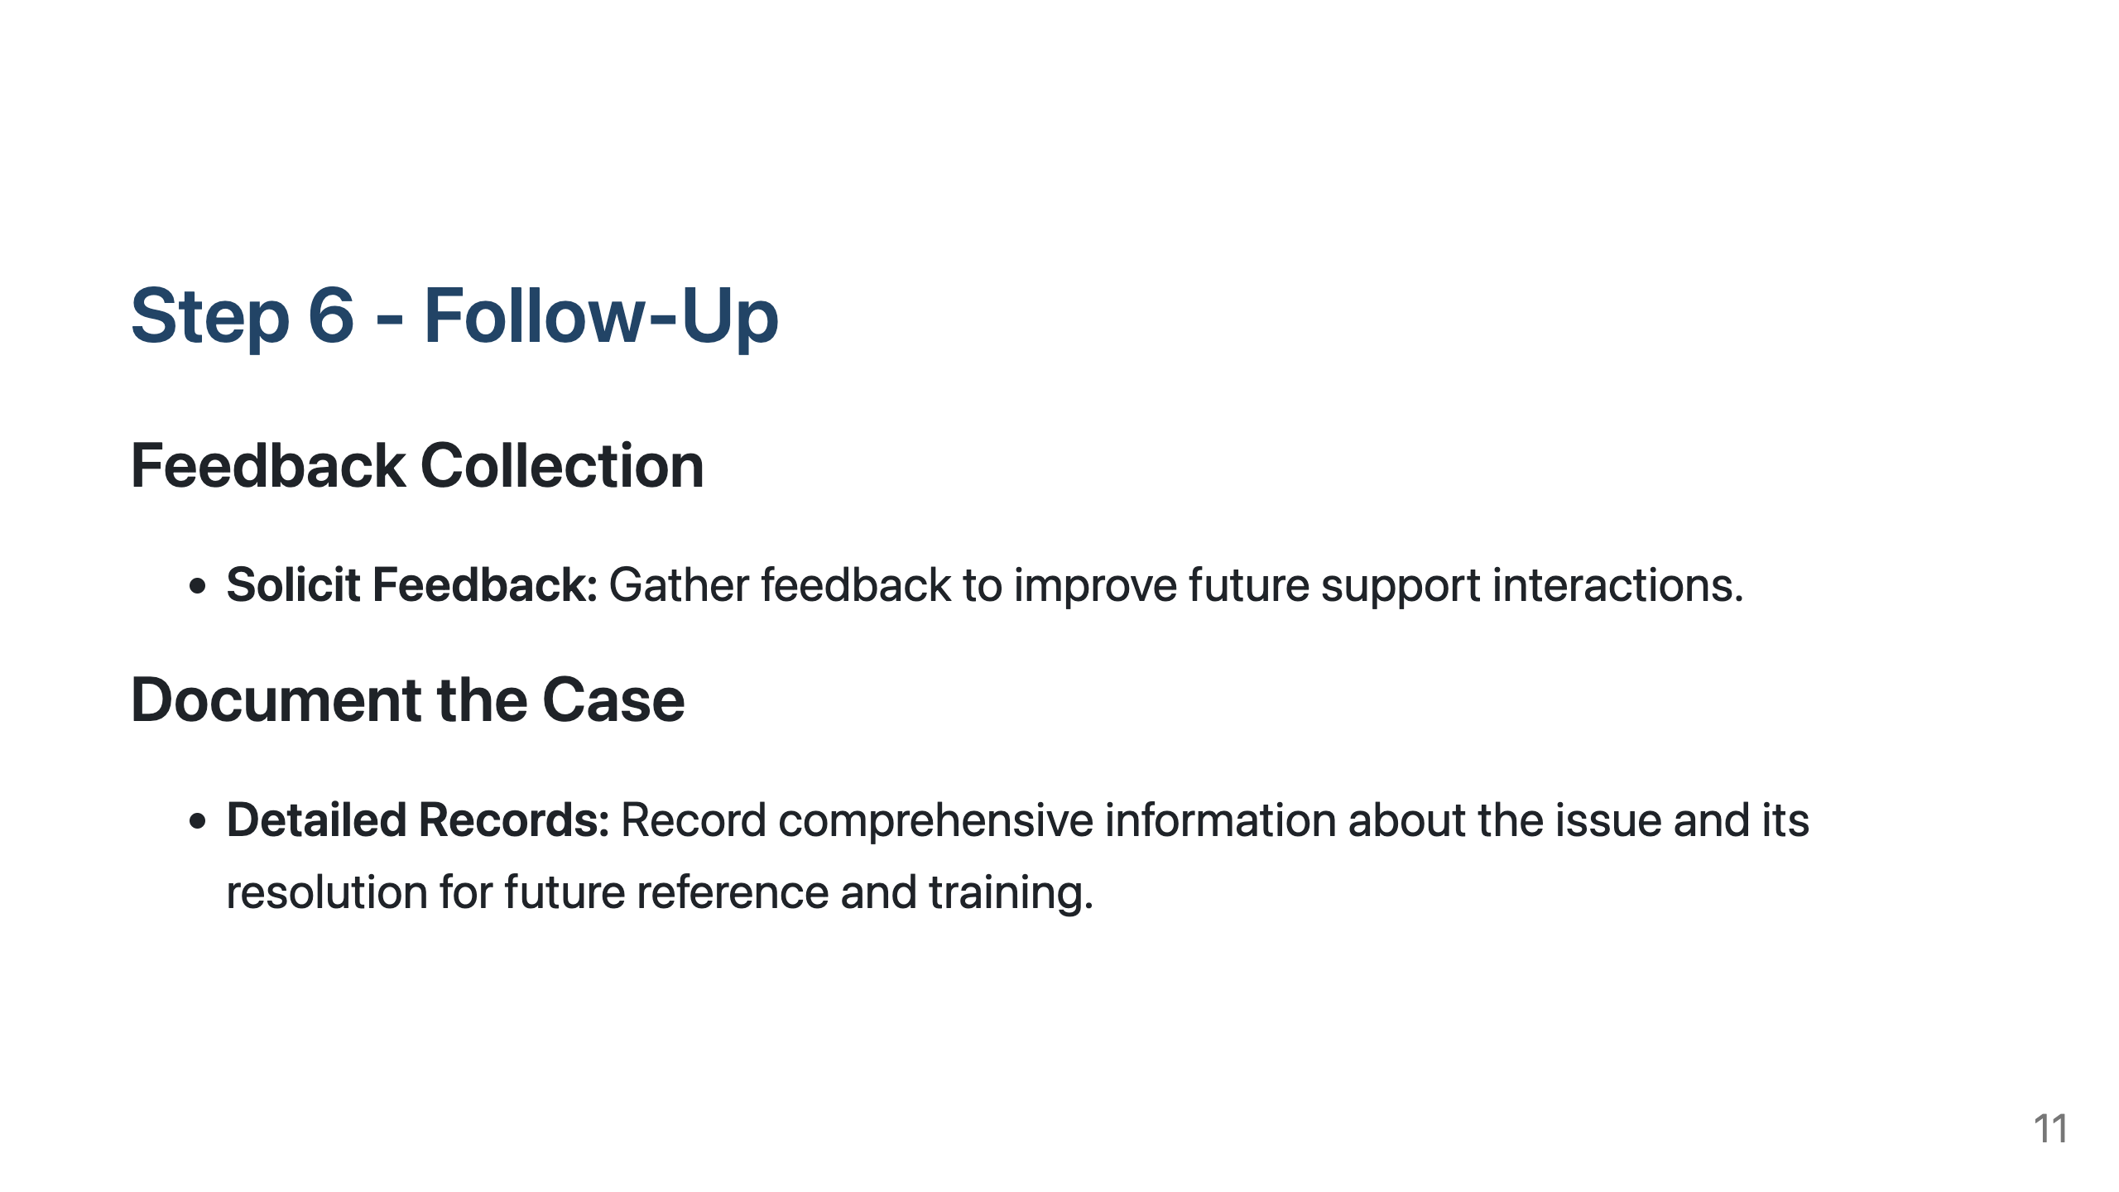
Notes:
Slide 9: Step 6 - Follow-Up

Slide 12
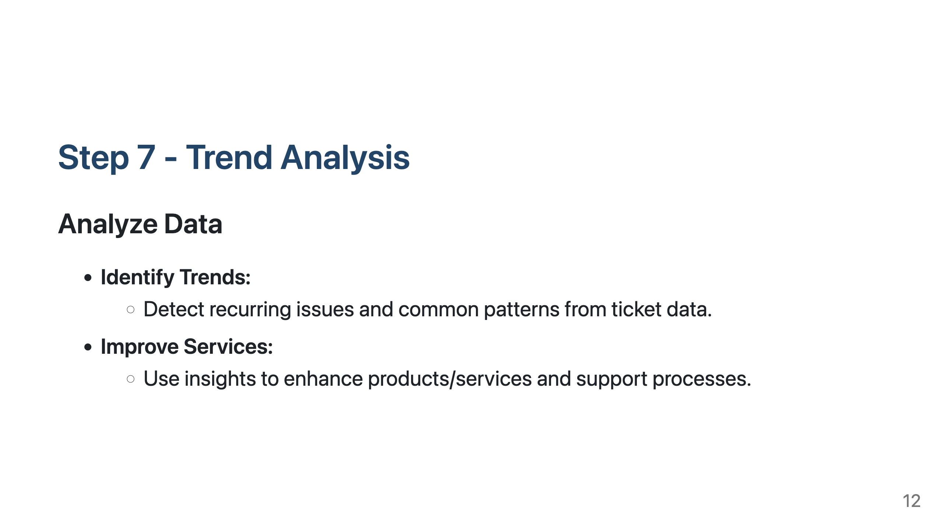
Notes:
Slide 10: Step 7 - Trend Analysis

Slide 13
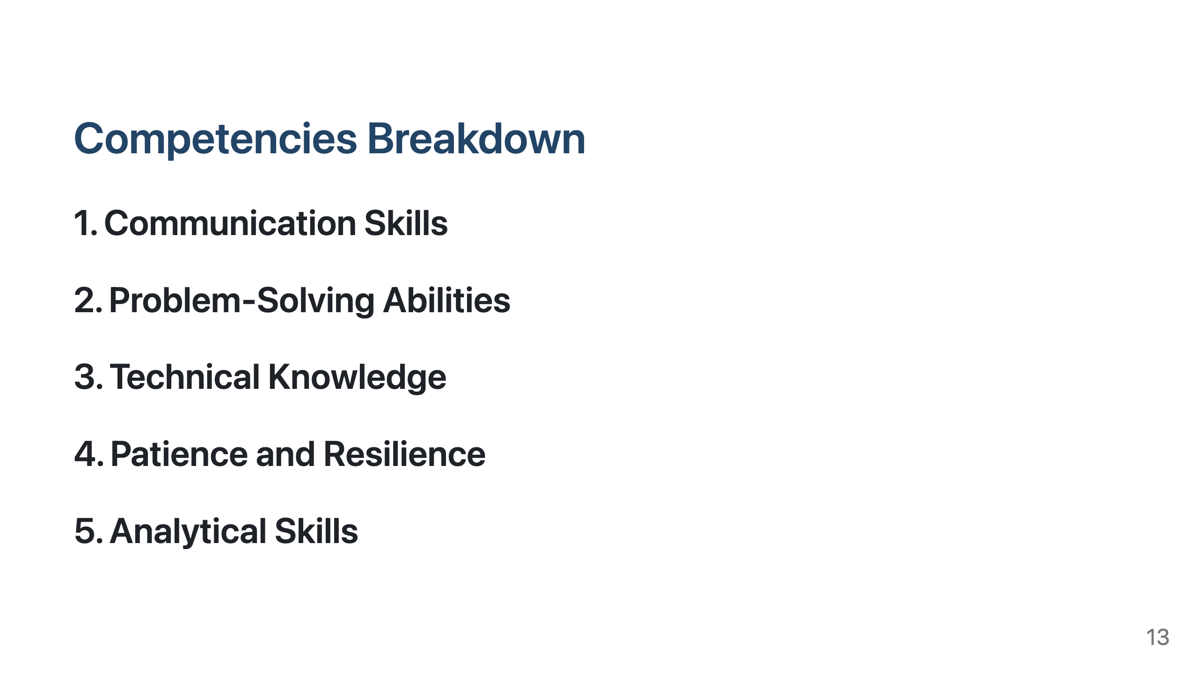
Notes:
Slide 11: Competencies Breakdown

Slide 14
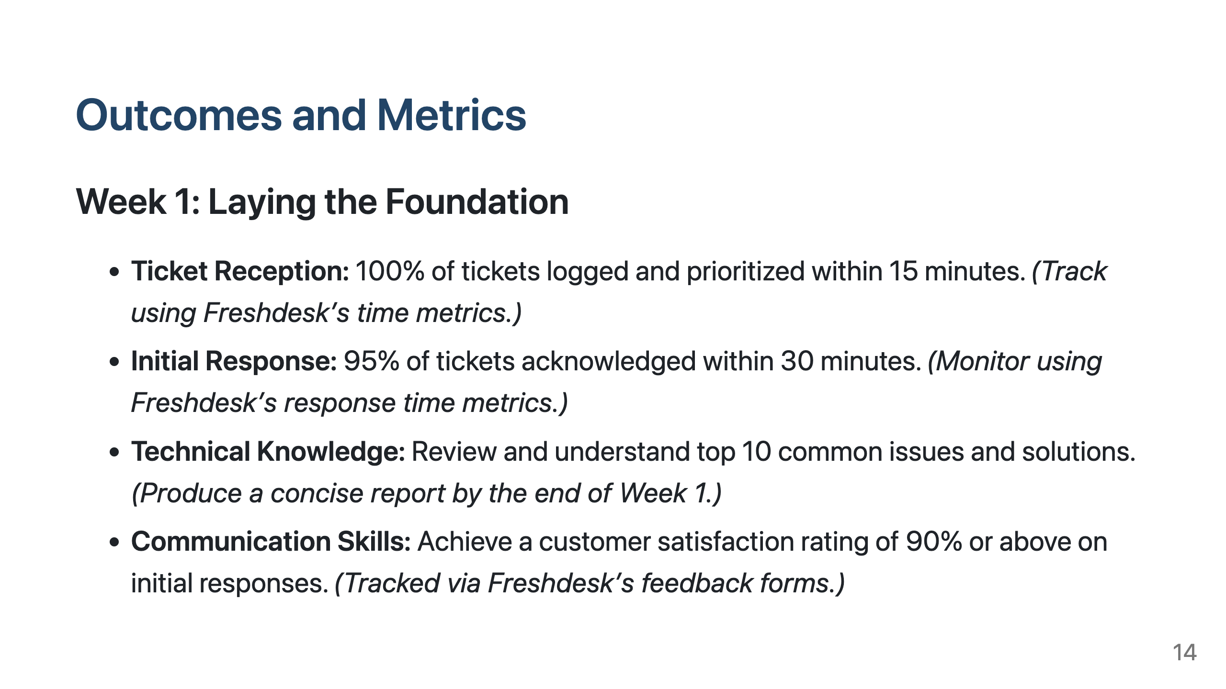
Notes:
Slide 12: Outcomes and Metrics

Slide 15
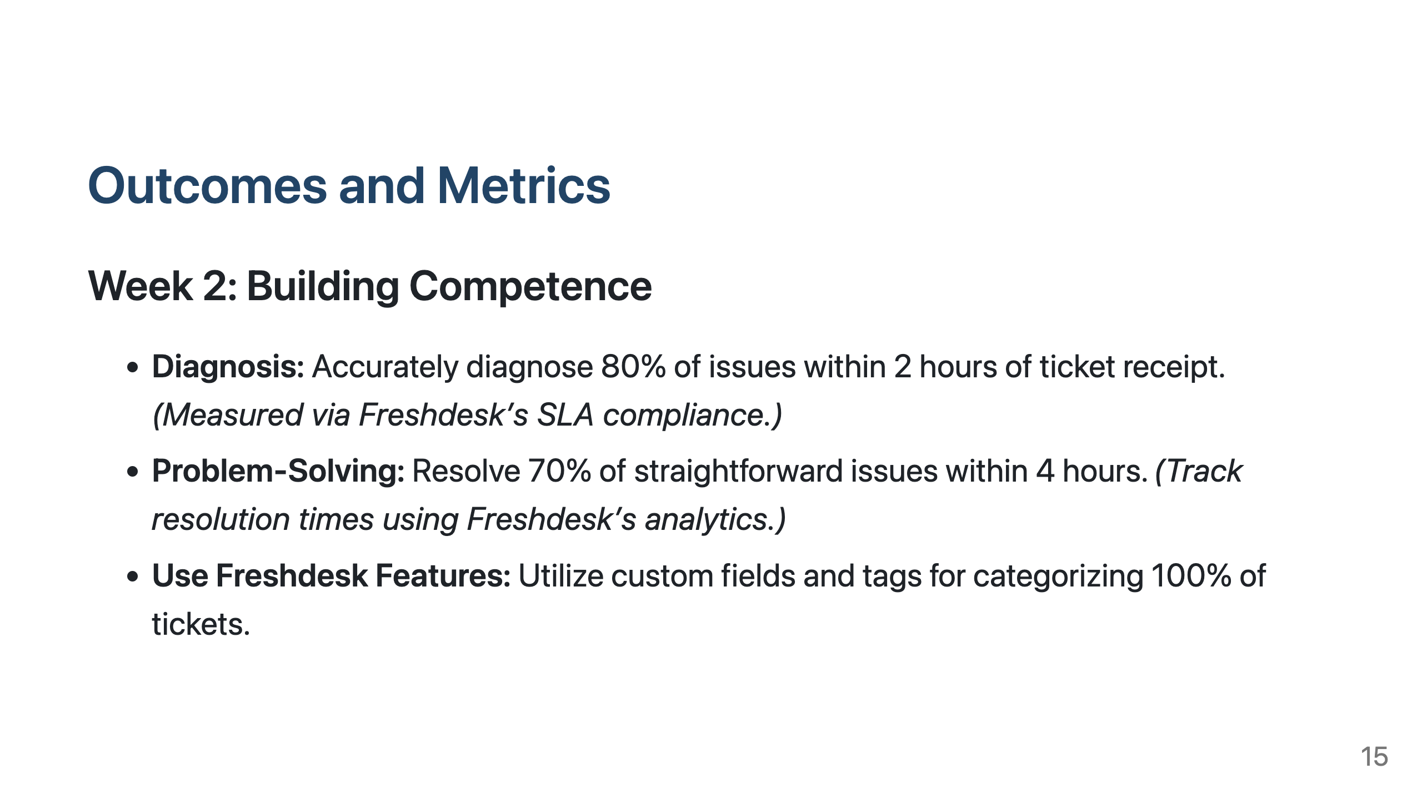
Notes:
Slide 12: Outcomes and Metrics

Slide 16
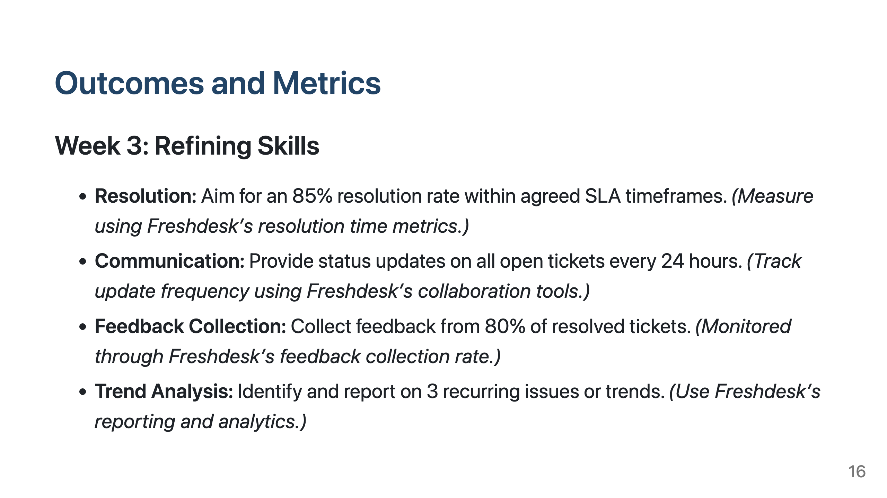
Notes:
Slide 12: Outcomes and Metrics

Slide 17
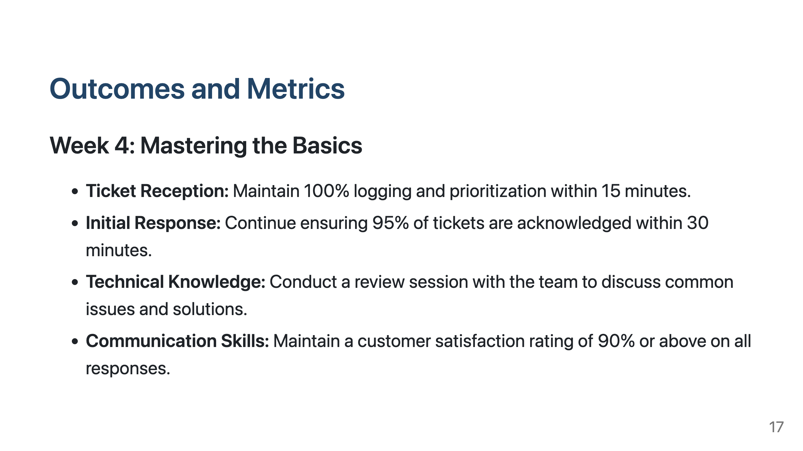
Notes:
Slide 12: Outcomes and Metrics

Slide 18
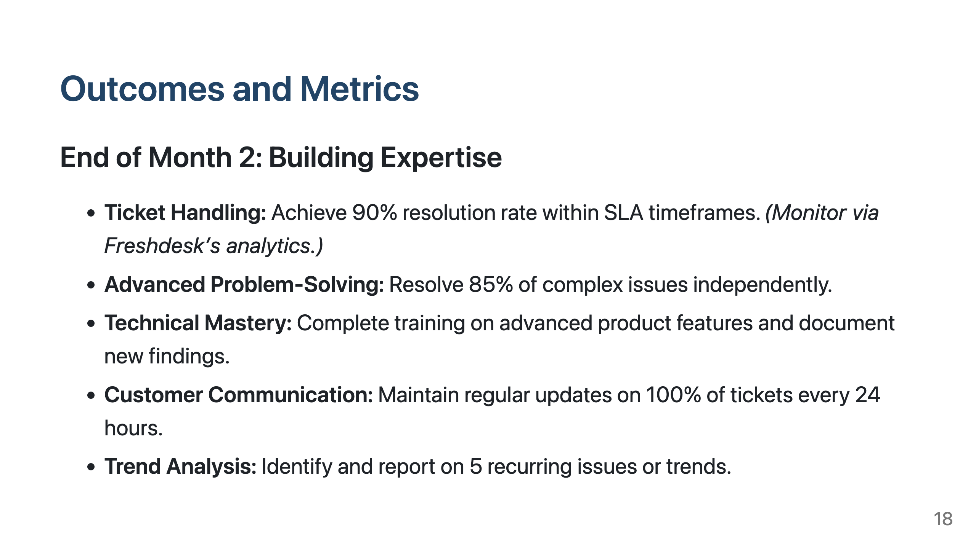
Notes:
Slide 12: Outcomes and Metrics

Slide 19
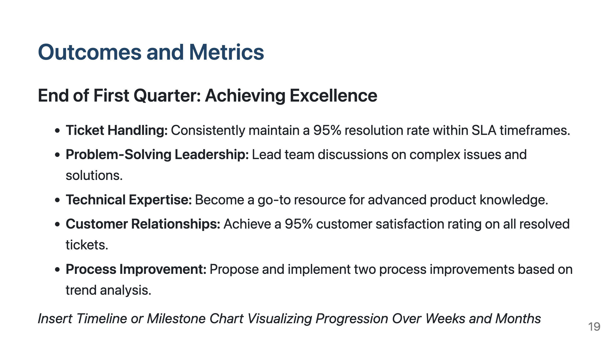
Notes:
Slide 12: Outcomes and Metrics

Slide 20
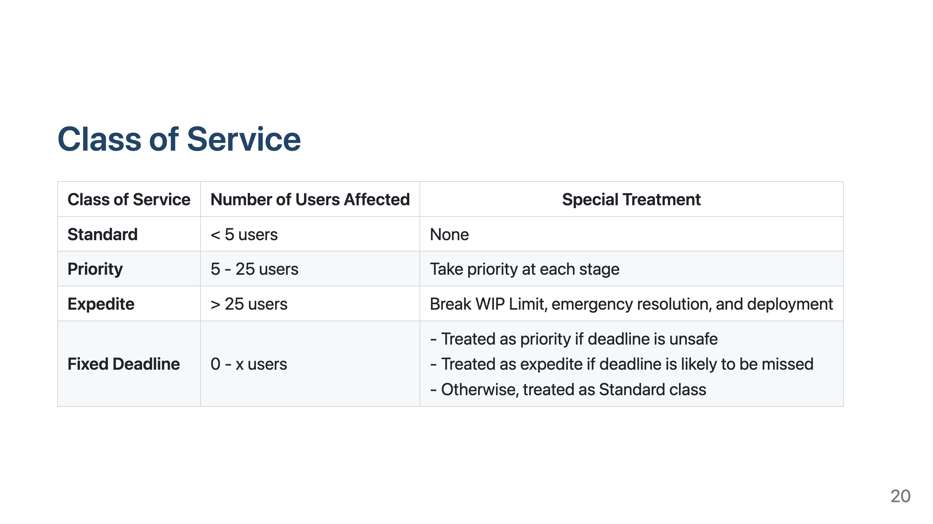
Notes:
Slide 13: Class of Service

Slide 21
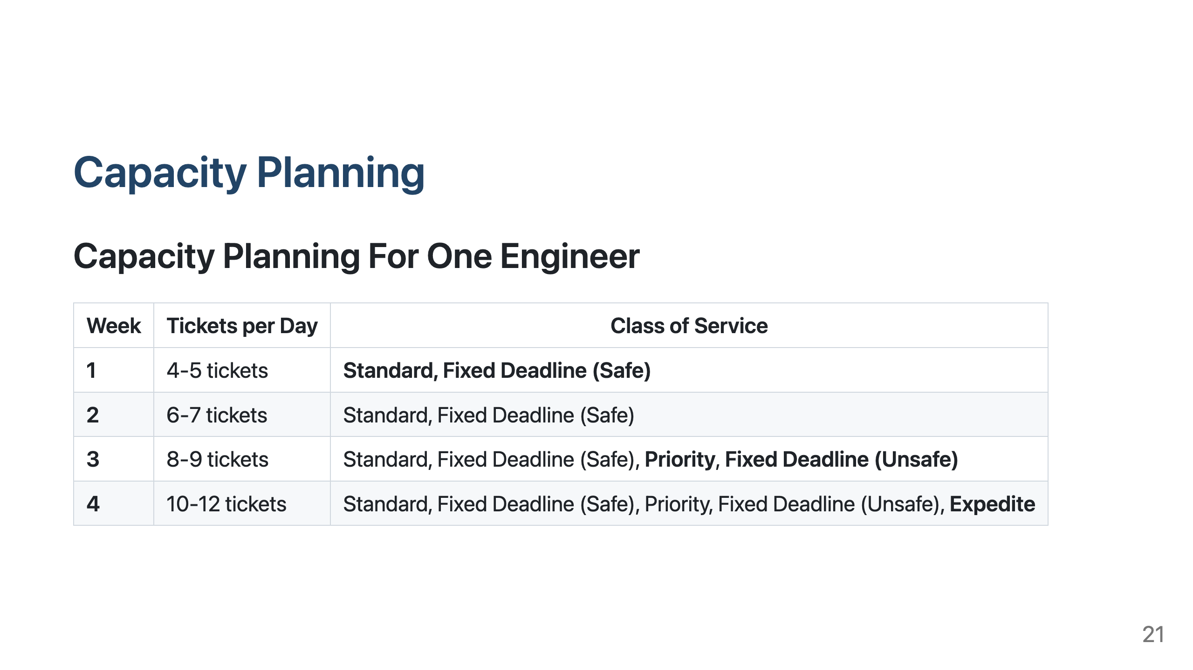
Notes:
Slide 14: Capacity Planning

Slide 22

Notes:
Slide 15: Closing

