Slide 1
WEB BASED GAME DEVELOPMENT -FOR IMPROVING YOUR TYPING SKILLS
ANIRRUD – 192110648 CHRISTopher - 192111040

Slide 2

Scope of the Project
The scope of this project is to improve the typing ability and speed of the user by incorporating typing based game.
Since it’s a game many people will get competitive and try to score their highest score as a result they will better their own typing skills.
Games are always considered to be not useful and just a way of wasting their time and since typing is a valuable skill we incorporated it to enhance their skill and entertain them at the same time.

Slide 3
Existing Systems
There are pre existing systems similar to this system but they are mainly focused on finding wpm (words per minute) or time taken to type a full paragraph.
It will get boring after some time since its not that engaging so its better to make it on a game concept.
Since this game is based on wpm it’s a term which people who are not interested in typing would mind off. Since score is a common term so many people will try to beat the personal best

Slide 4
Proposed System
Our system focuses on making typing engaging to people who are normally not into typing too since our interface is more similar to a game.
Since our system is similar to a game and people have now normalized that all games are useless. So we would love to make gaming a bit useful for your career or even life.
People can play it even for 5 minutes a day consistently and see visible typing speed increase in few days.

Slide 5

Architecture Diagram
Client side
(HTML/CSS/JavaScript)
Server side PHP
index.html
login.php
login.html
AJAX / Form |Submission
signup.php
admin.html
admin.php
Styles.css
Game.js
Login.js
database.php
Frontend Assets
|Handles DB Connections
SQL DATABASE
USERS
WORDS

Slide 6

Modules
Login and Signup Module->
login.html
login.php
signup.php
login.js
Game Module->
index.html
styles.css
game.js
Admin Module->
admin.css
admin.html
admin.php
Database Module->
database.php

Slide 7
Module description
Login and Signup Module:
login.html: Contains the HTML structure for the login and signup forms.
login.js: Manages the client-side validation and transitions between login and signup forms.
login.php: Processes login requests by verifying the user credentials against the database.
signup.php: Handles user registration by saving new user credentials into the database.
Game Module:
index.html: The main page where the game is played. Includes elements like the game area, score display, health display, word input field, and game over menu.
game.js: Implements the game logic. Generates enemies (words), handles user input, updates the score and health, and manages the game over state.
styles.css: Provides the styling for the game interface, including the layout, colors, fonts, and transitions.
Admin Module:
admin.html: Shares the login page with additional functionality for admin users. Provides an interface for adding words and deleting users.
admin.php: Processes admin actions such as adding new words to the game database and deleting user accounts.
admin.css: (Optional) Provides specific styling for the admin interface, included in styles.css.
Database Module:
database.php: Manages the connection to the MySQL database and executes SQL queries for user authentication and word management.
MySQL Database:
users table: Structure - id, username, password. Stores user credentials for login and signup.
words table: Structure - id, word. Stores the words that appear in the ga

Slide 8

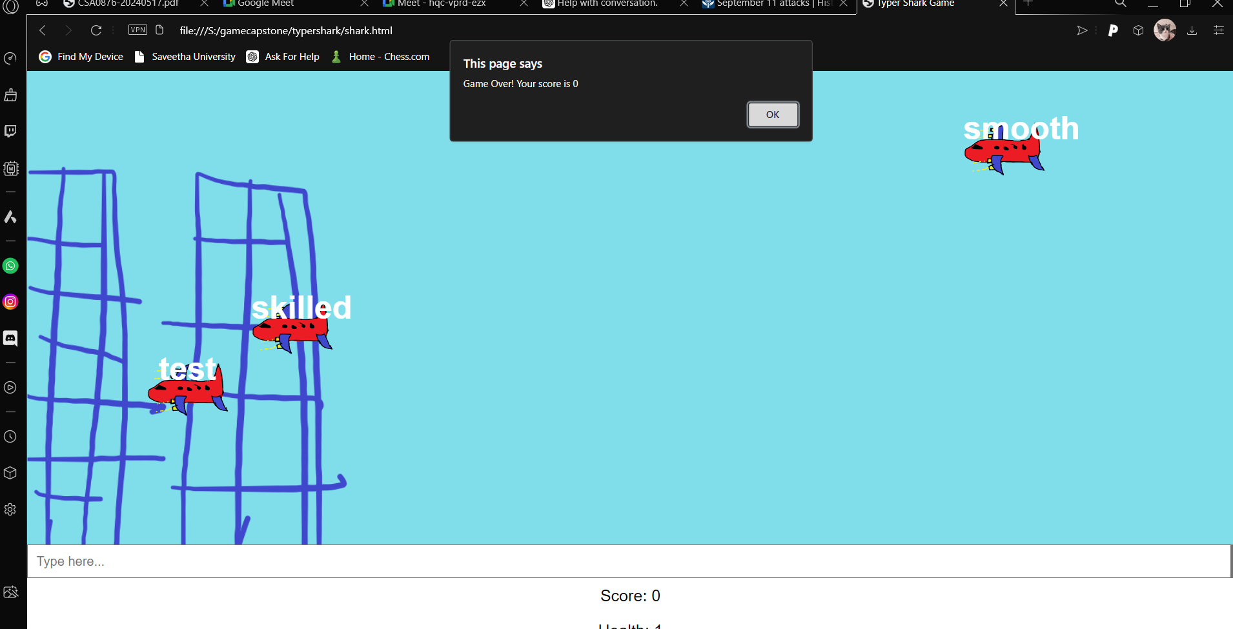
Output

Slide 9
Reference
https://play.typeracer.com -> another typing game which included multiplayer
https://store.steampowered.com/app/3450/Typer_Shark_Deluxe/-> game influence
https://www.britannica.com/event/September-11-attacks -> game idea
https://www.youtube.com/@TECHTHAMBIlovesyou some one’s YouTube channel we learned the game development from… I recommend you watching this and even subscribing
https://chatgpt.com -> the place which helped us to rectify the errors we faced

Slide 10
Conclusion
This project involved the development of an interactive typing game, inspired by popular games like Type Racer and Typer Shark, which includes user authentication and admin functionalities. The primary objective was to create an engaging and educational game that helps users improve their typing skills while providing a secure and user-friendly platform for login and administration.
Through this project, we successfully implemented a dynamic typing game where words appear on the screen, and players must type them correctly to score points. The game includes a health system, score tracking, and a game-over menu that allows players to restart or quit. Additionally, we integrated a user authentication system that securely manages user credentials and provides admin functionalities to manage game words and user accounts.
Throughout the development process, we encountered several challenges, particularly with synchronizing the client-side interactions with the server-side processing and ensuring a seamless user experience. By leveraging modern web development technologies such as HTML, CSS, JavaScript, PHP, and MySQL, we were able to overcome these challenges and create a robust and functional application.

Slide 11

Thanks!
I thank my Friend Christo and myself anirrud soo much for taking over this project... we worked very hard on this for day and night without any sleep.. If you wish to donate you can do it at 9344831636@icici

