Slide 1
Nomination on Best Pancake Flipper
Thiyanes

Slide 2
Problem Statement
Arielle and Boris compete in pancake flipping
There is an hypothesis that half of the people considered Arielle as best pancake flipper and rest half as Boris.
The best one need to be decided (using ML algorithm) based on below features.
The contestant's name,
The match day,
Which hand they used to flip the pancakes,
Their score (how many pancakes they flipped successfully), and
How many total pancakes they attempted to flip

Slide 3
Need for Study
The dataset explains about the number of pancakes flipped successfully out of 20.
While trying to create a data science solutions the below set of features are considered to build the solution
Match day
Winner Name
Winner Hand
Success Rate%
The below formula is being used to calculate success rate percentage
= (No of Successful attempts / Total No of Attempts) *100 (in %)

Slide 4
Flow Diagram
Pre-processing
Creation of successful_attempt variable
Label Encoding of Name variable
Label Encoding of Hand variable
Pancake flip dataset
Dataset Analysis
ML Engine
Logistic Regression
Gaussian NB
Decision Tree
Random Forest
XGBoost
Arielle
Performance Analysis
Accuracy
Precision and Recall
F1 score
Boris

Slide 5
Dataset Analysis
winner_hand is highly correlated with percentage_successful_attempt
percentage_successful_attempt is highly correlated with winner_hand
match_day is uniformly distributed
match_day has unique values
Dataset statistics
Number of variables | 4
Number of observations | 50
Missing cells | 0
Missing cells (%) | 0.00%
Duplicate rows | 0
Duplicate rows (%) | 0.00%
Variable types
Numeric | 2
Categorical | 2

Slide 6
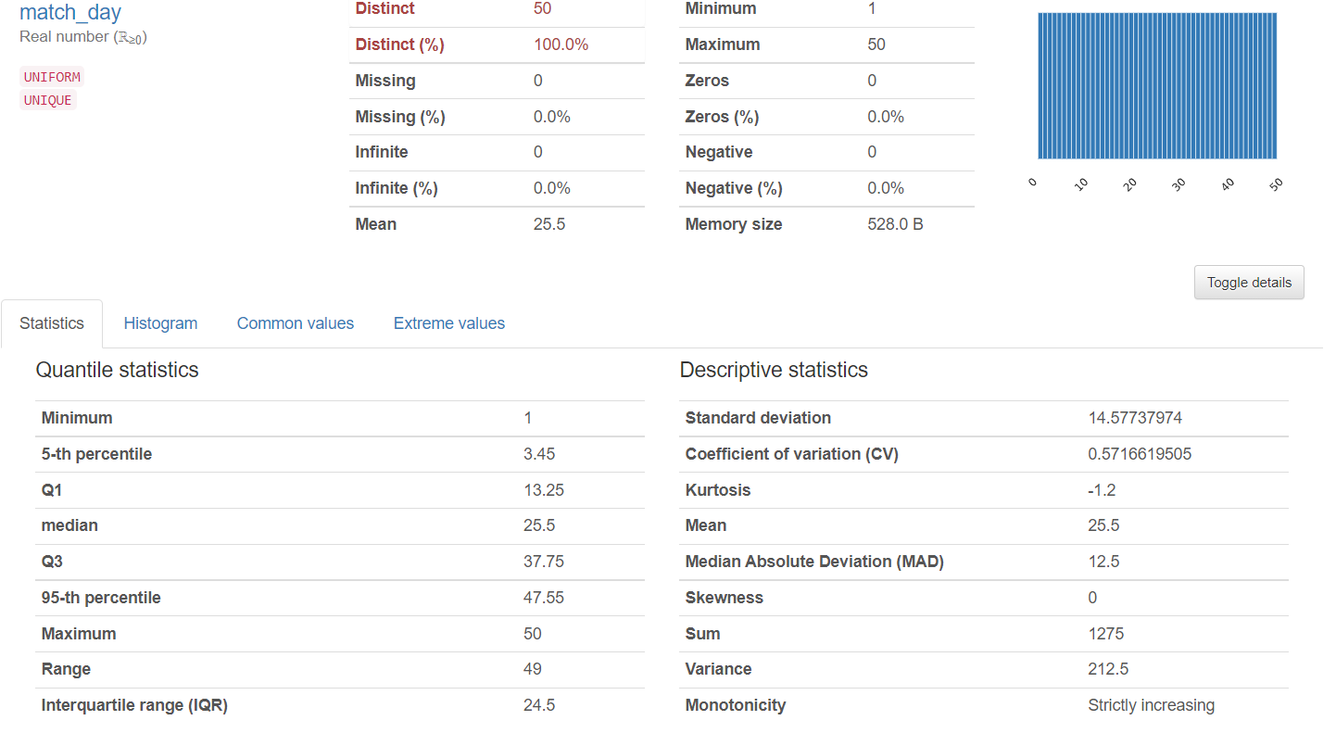
Data Set Analysis

Slide 7
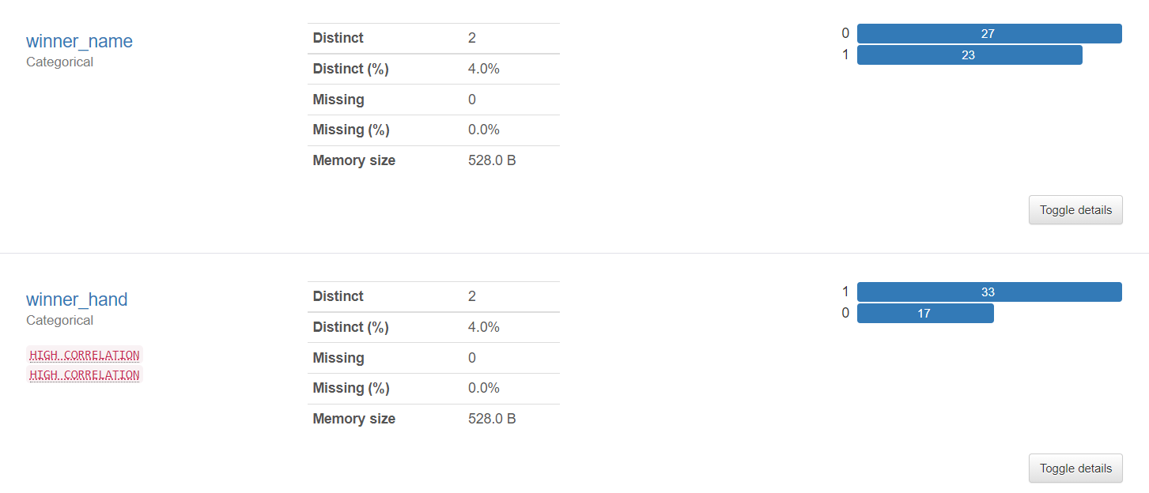
Data Set Analysis

Slide 8
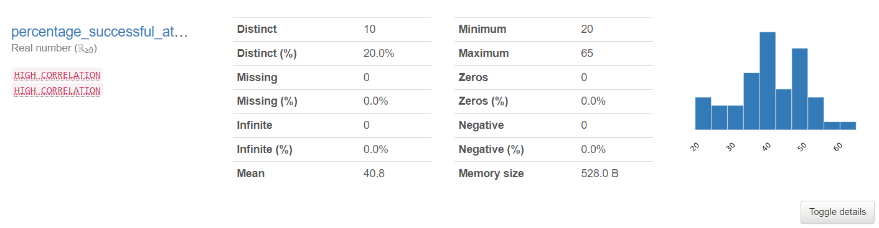
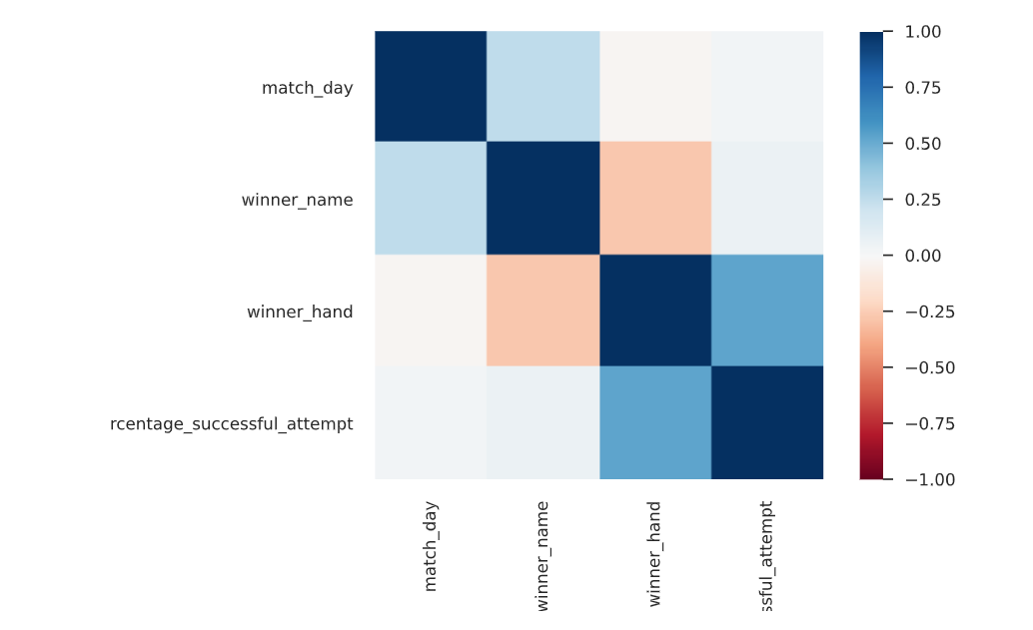
Data Set Analysis

Slide 9
Summary of Model Performance
Model | Accuracy | AUC | Recall | Precision | F1 Score
logit Train | 0.634615 | 0.781065 | 0.63 | 0.62 | 0.64
logit Test | 0.8 | 0.75 | 0.89 | 1 | 0.8
NaiveBayes Train | 0.673077 | 0.763314 | 0.67 | 0.65 | 0.68
NaiveBayes Test | 0.6 | 0.75 | 0.75 | 0.75 | 0.75
DecisionTree Train | 0.692308 | 0.692308 | 0.72 | 0.81 | 0.66
DecisionTree Test | 0.6 | 0.375 | 0.75 | 0.75 | 0.75
RandomForest Train | 0.5 | 0.5 | 0.67 | 1 | 0.5
RandomForest Test | 0.8 | 0.5 | 0.89 | 1 | 0.8
SVM Train | 0.75 | 0.822485 | 0.73 | 0.69 | 0.78
SVM Test | 0.8 | 0.75 | 0.89 | 1 | 0.8
LDA Train | 0.634615 | 0.776627 | 0.63 | 0.62 | 0.64
LDA Test | 0.8 | 0.5 | 0.89 | 1 | 0.8
AdaBoost Train | 1 | 1 | 1 | 1 | 1
AdaBoost Test | 0.4 | 0.25 | 0.57 | 0.5 | 0.67
KNN Train | 0.788462 | 0.848373 | 0.8 | 0.85 | 0.76
KNN Test | 0.8 | 0.875 | 0.86 | 0.75 | 1
XGBoost Train | 0.807692 | 0.923077 | 0.78 | 0.69 | 0.9
XGBoost Test | 0.6 | 0.75 | 0.75 | 0.75 | 0.75
ANN Train | 0.653846 | 0.79142 | 0.65 | 0.65 | 0.65
ANN Test | 0.6 | 0.75 | 0.75 | 0.75 | 0.75

Slide 10
Consolidated Model Performance Chart

Slide 11
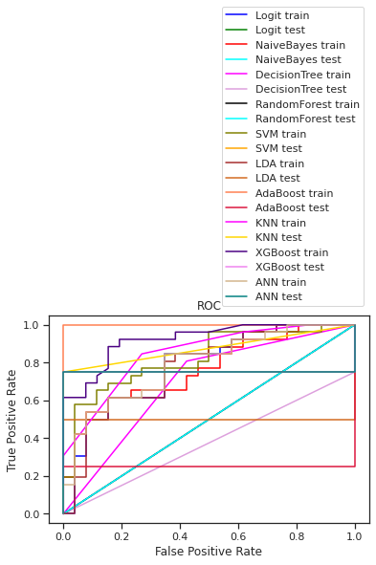
Consolidated AUC ROC Plot

Slide 12
Model Performance Analysis
By analyzing the various models, it seems like the models like logistics regression, Support vector Machine and K nearest neighbor models are performing better. The other models are showing either lower training accuracy/testing accuracy.
Model is already balanced and it does not require any oversampling to make it balanced.
Based on cluster analysis,
Clus_kmeans4 | Avg_percentage_successful_attempt | sil_width | freq
0 | 42.61905 | 0.396137 | 21
1 | 34.375 | 0.208674 | 8
2 | 28.75 | 0.34308 | 8
3 | 49.23077 | 0.385567 | 13
clusters_Hirerchial | Avg_percentage_successful_attempt | Freq
1 | 40.38462 | 26
2 | 46.31579 | 19
3 | 22 | 5

Slide 13
Recommendation & Inference
By analyzing with the various models, Boris could be recommended for best pancake flipper award.
INFERENCES
From that dataset it can be inferred that Boris used Left-hand frequently and hence he should be natural left-handed person. Also, the scores obtained by him using left-hand is higher than right-hand. Hence the person with left-hand is having more chance to win
Maximum scores obtained by Boris is at the later games than the earlier one. But Arielle obtained maximum scores earlier than later. Hence consistency of players at the later stage decides the winner.

Slide 14
Thank you !!!!

