Slide 1
◆
OpsBrain
The operations brain for the plant floor.
Ask your plant's manuals, work orders and safety standards in plain language — and get a cited answer back in seconds.
ET AI Hackathon 2.0 · Problem Statement 8 — Industrial Knowledge Intelligence
Divyanshi Jain · github.com/techwack/opsbrain

Slide 2
THE PROBLEM
Engineers don't have a data problem.
They have a retrieval problem.
A single refinery runs on tens of thousands of pages — OEM manuals, P&IDs, work orders, OISD standards, incident reports — spread across binders, shared drives and three generations of software. When a pump trips at 2 a.m., the answer almost always exists somewhere. Finding it is the hard part.
Scattered
Manuals, drawings and logs live in different systems that don't talk to each other.
Tribal
The engineer who remembers the 2019 failure is the search index. When they retire, it's gone.
Buried
Compliance obligations sit inside 200-page PDFs nobody re-reads until after an incident.

Slide 3
WHY IT'S WORTH SOLVING
The cost shows up as time, repeated mistakes, and risk.
~35%
Repeat
After
of a process engineer's day goes to searching for information that already exists.
failures recur because the last work order on that asset is never read before the next job.
the incident is usually when a buried compliance gap finally gets noticed.
Heavy industry is India's manufacturing backbone. Small percentages here are crores in lost productivity and avoidable downtime.

Slide 4
WHAT OPSBRAIN IS
One place to ask — grounded in your own documents.
?
✓
◇
Ask
Audit
Map
Plain-language questions get an answer that cites the exact document and page, with a confidence score so you know when to trust it.
Point it at an asset and it checks the operational record against OISD and Factory Act clauses, then ranks the gaps it finds.
It pulls equipment tags, failure modes, systems and standards out of the corpus and draws the relationships between them.

Slide 5
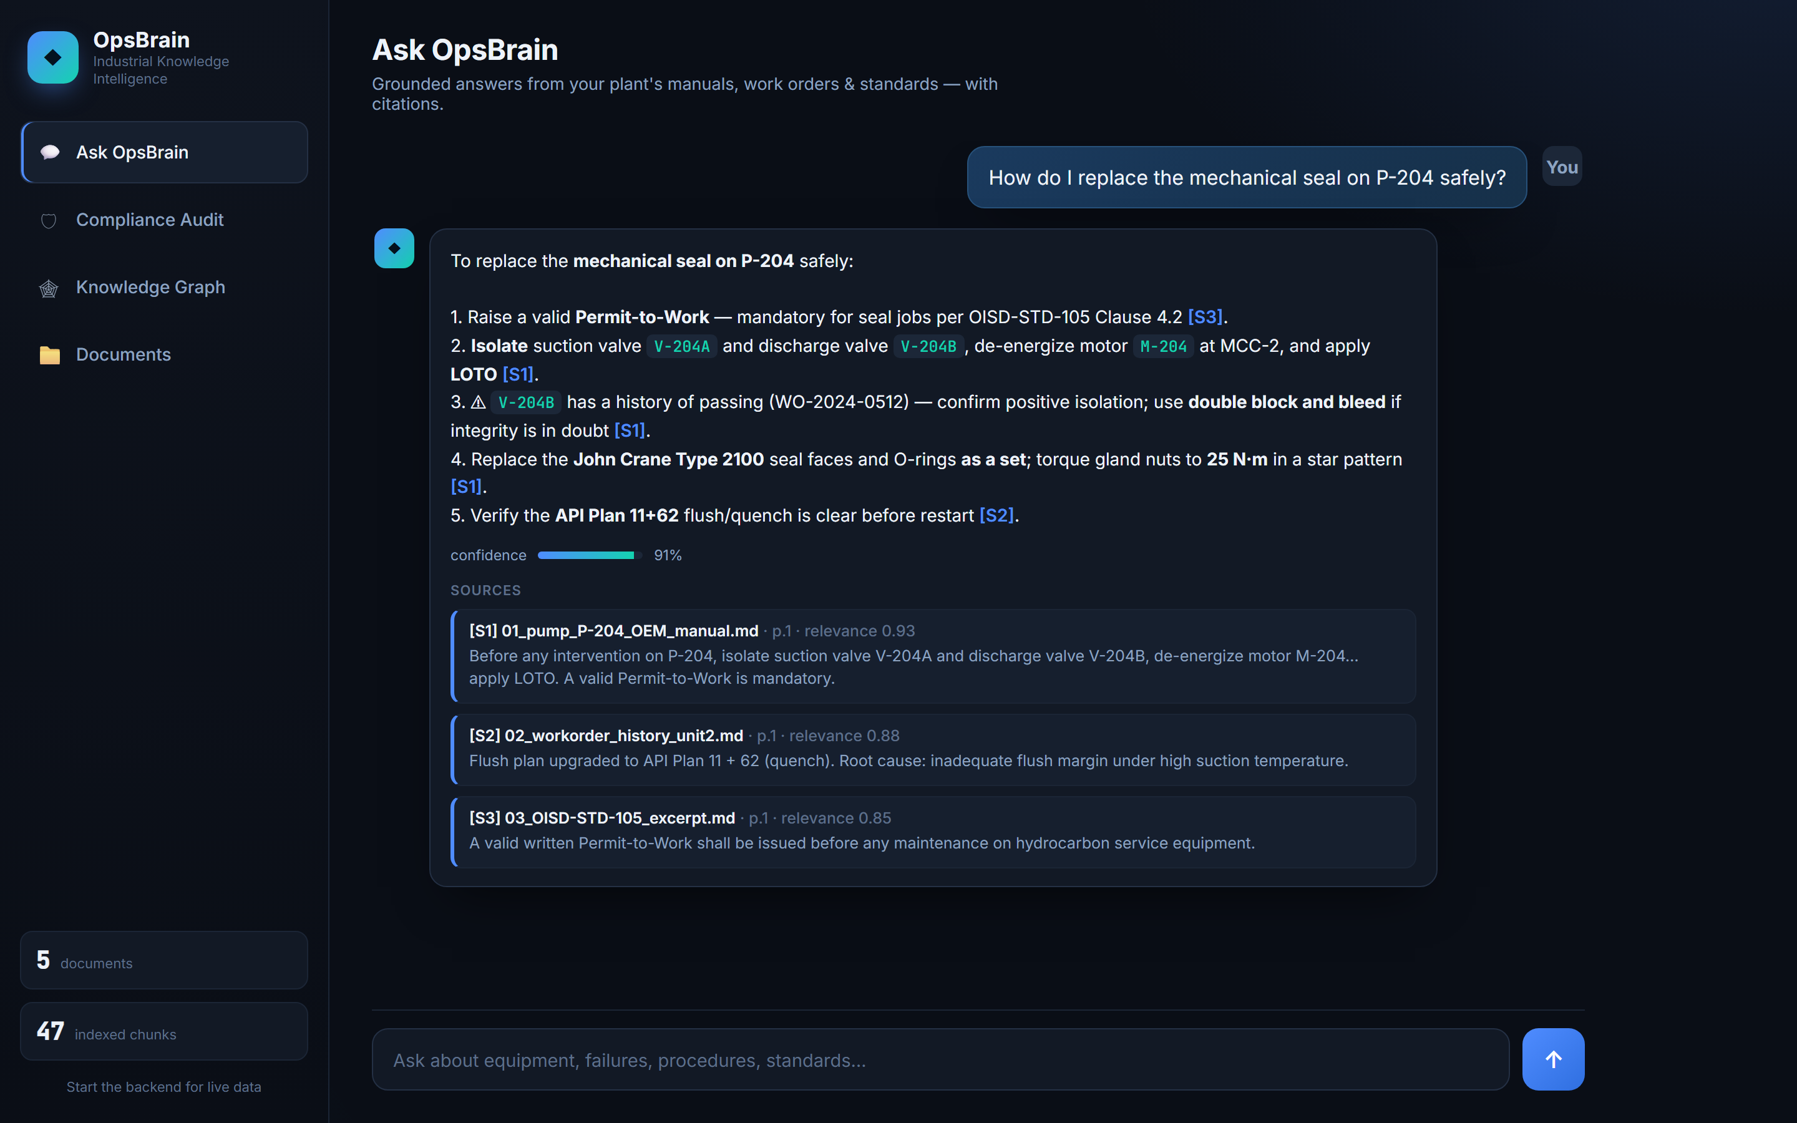
LIVE PRODUCT — ASK
Every answer carries its sources.
A field tech asks how to swap the seal on P-204; OpsBrain answers with the steps, the torque spec, and a safety flag — each line cited back to a document.

Slide 6
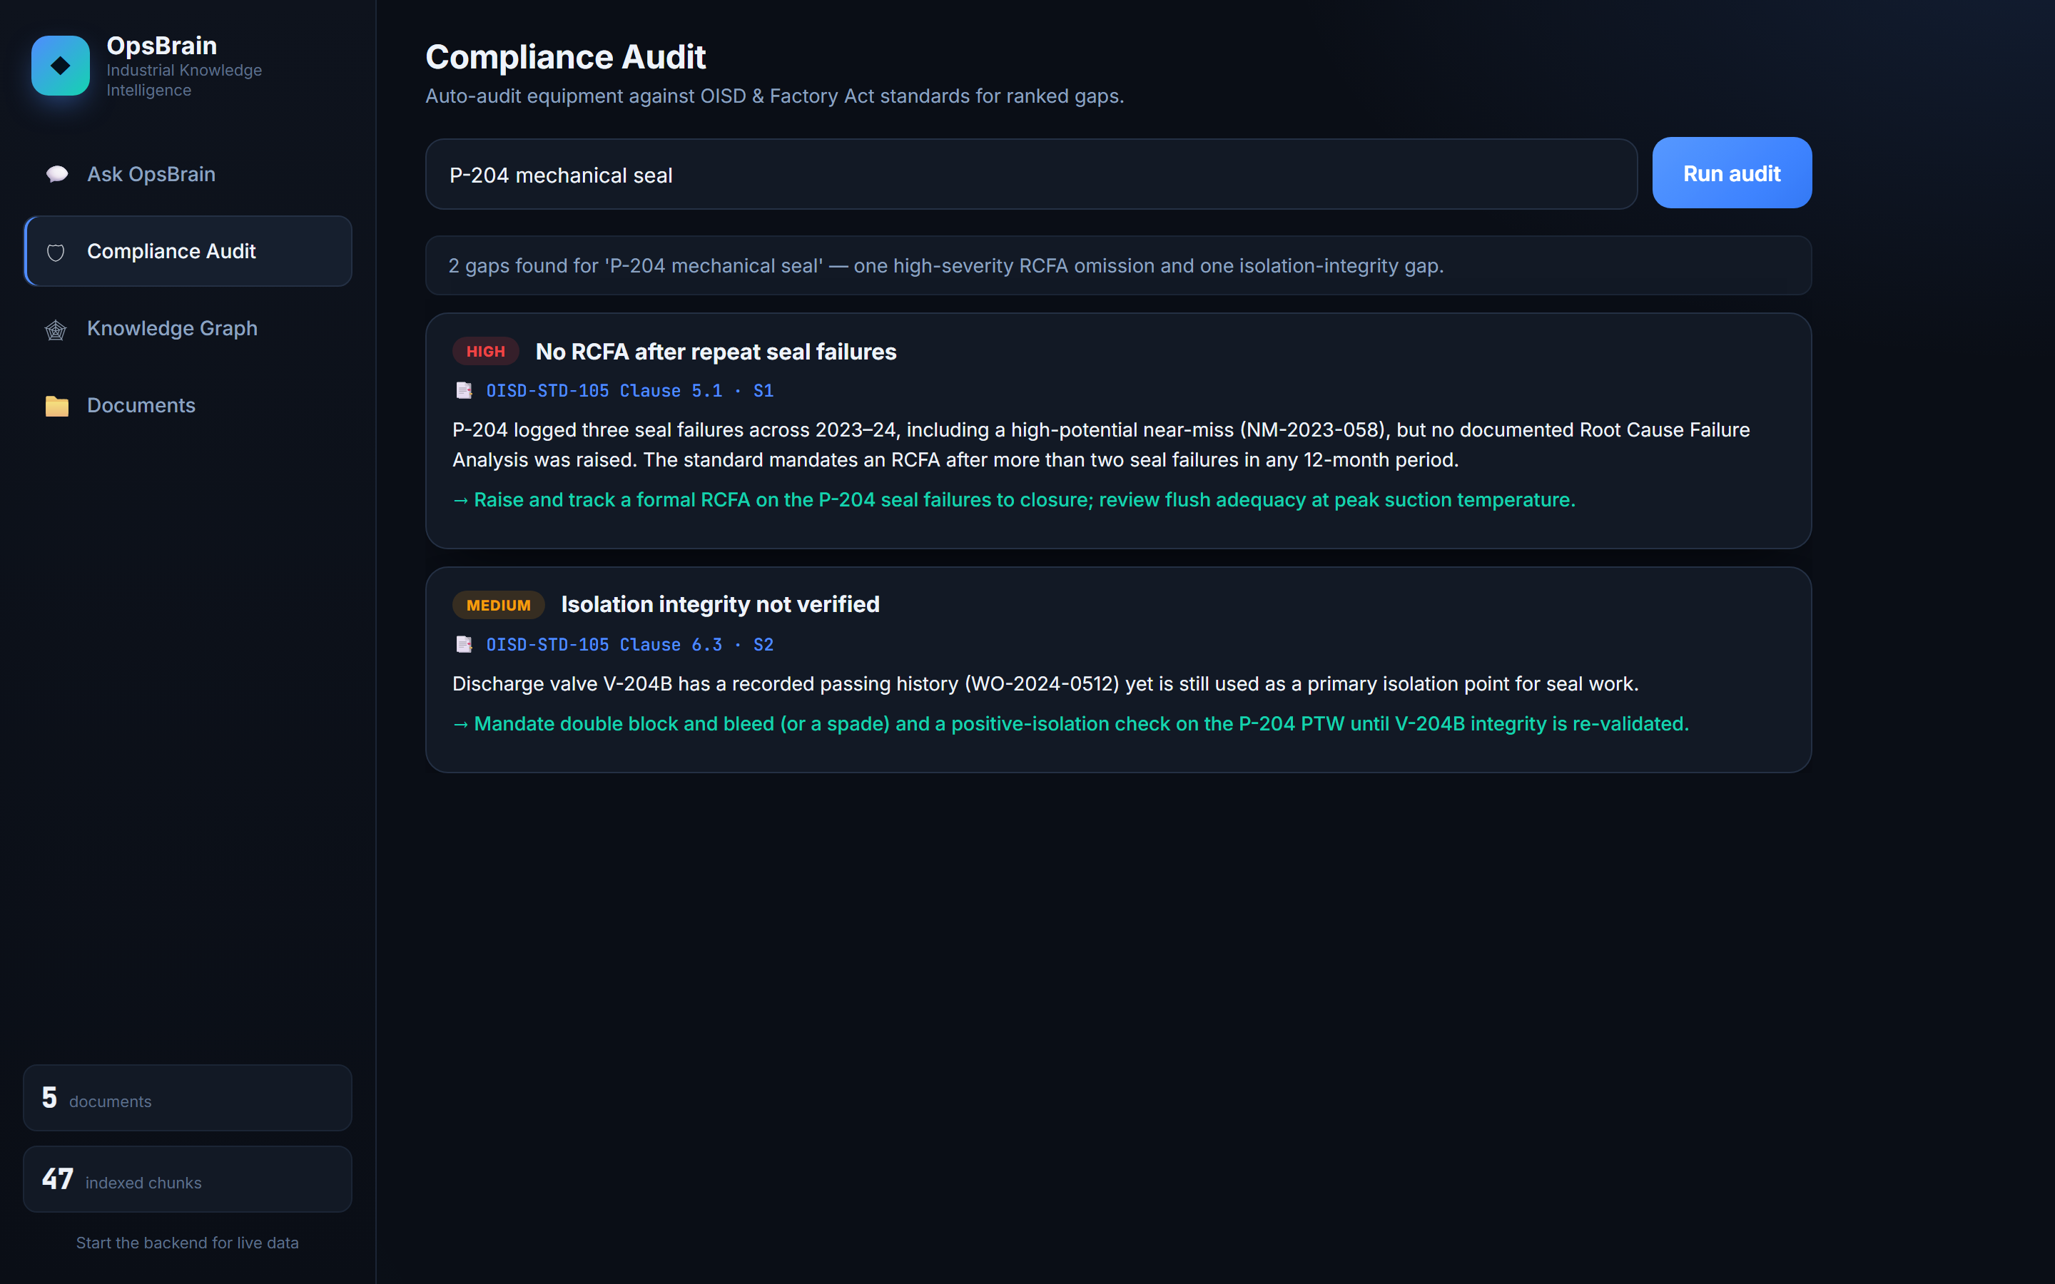
LIVE PRODUCT — COMPLIANCE
It finds the gap before the auditor does.
Audit 'P-204 mechanical seal' and it surfaces a missing root-cause analysis after repeat failures and an isolation-integrity gap, ranked by severity.

Slide 7
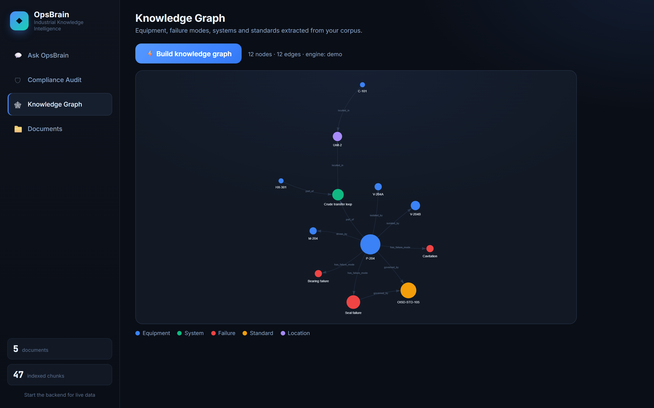
LIVE PRODUCT — KNOWLEDGE GRAPH
The plant, as a graph.
Equipment, failure modes and the standards that govern them, extracted automatically from the same documents that power the answers.

Slide 8
HOW IT WORKS
One service. Retrieval that runs anywhere. Claude for the reasoning.
Web UI — Ask · Compliance · Knowledge Graph · Documents
Single-page front end, served by the same process. No build step, no CORS.
FastAPI service
/ask /compliance /graph /upload /reindex /health
Retrieval
Agents
Ingestion
TF-IDF + cosine over chunked docs.
Pure-Python, pluggable for embeddings.
QA · Compliance · Graph.
Grounded prompts, JSON-structured output.
pypdf → sentence-aware
chunking → index.
Agents call → Anthropic Claude (claude-opus-4-8)

Slide 9
ENGINEERING CHOICES
The decisions I'd defend in a review.
Single service over a microservice split
TF-IDF retrieval over a heavyweight vector DB
FastAPI serves the API and the UI from one process. The whole thing runs with one command — which matters more for a demo and a small team than premature separation.
A managed vector store needs a GPU or a C++ build chain to install. TF-IDF clones and runs on any laptop. The store is behind an interface, so swapping in embeddings later is a one-file change.
Works with no API key
Citations and a confidence score, always
Retrieval and the knowledge graph run offline; answers fall back to cited extracts. The product is never a blank screen, key or not.
An operations tool that can't show its source is a liability. Every answer points back to a document and page.

Slide 10
WHERE IT GOES
Same platform, different document corpus.
Nothing in OpsBrain is specific to one plant. Point it at a different corpus and it works for steel, oil & gas, pharma or power — the documents change, the engine doesn't.
Now
Next
Then
Later
Cited Q&A, compliance gap detection, knowledge graph, document upload — running end to end.
OCR for scanned P&IDs so legacy drawings become searchable, not just typed docs.
Connectors into CMMS / SCADA (SAP PM, Maximo) so live work orders and readings flow in.
Predictive maintenance scoring from the work-order and sensor history it already holds.

Slide 11
◆
Built in a weekend.
Designed to run in a plant.
OpsBrain — Industrial Knowledge Intelligence
github.com/techwack/opsbrain Divyanshi Jain

