Slide 1
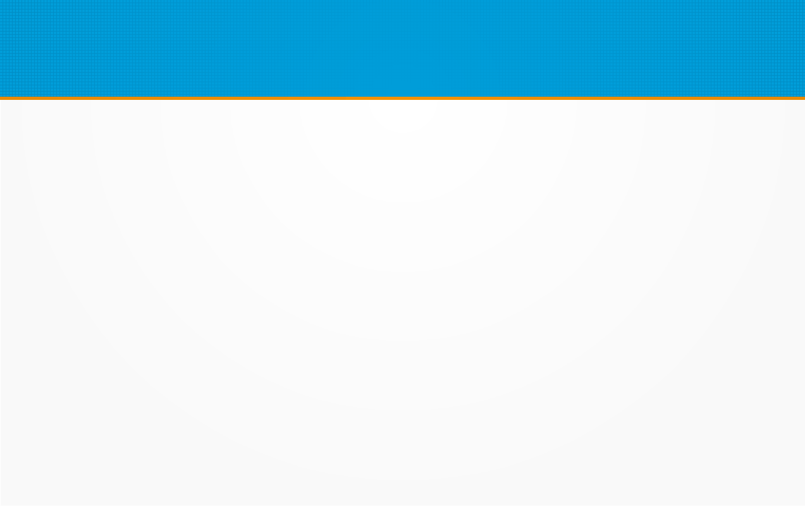
React JS – Intro
What You Should Already Know
Before starting with React.JS, you should have intermediate experience in:
HTML
CSS
JavaScript
You should also have some experience with the new JavaScript features introduced in ECMAScript 6 (ES6)

Slide 2
React JS – Intro
React is a JavaScript library for building user interfaces.
React is used to build single page applications.
React allows us to create reusable UI components.

Slide 3
React JS – Intro
How does React Work?
React creates a VIRTUAL DOM in memory.
Instead of manipulating the browser's DOM directly, React creates a virtual DOM in memory, where it does all the necessary manipulating, before making the changes in the browser DOM. React only changes what needs to be changed!

Slide 4
React JS – Intro
React finds out what changes have been made, and changes only what needs to be changed.
You will learn basics of what React does this in the rest of this tutorial.

Slide 5
React JS – Intro
Create React App:
In order to learn and test React, you should set up a React Environment on your computer.
This tutorial uses the create-react-app.
The create-react-app is an officially supported way to create React applications.
If you have NPM and Node.js installed, you can create a React application by first installing the create-react-app.

Slide 6
React JS – Intro
Install create-react-app by running this command in your terminal:
C:\Users\Your Name>npm install -g create-react-app
You are now ready to create your first React application!
Run this command to create a React application named myfirstreact:
C:\Users\Your Name>npx create-react-app myfirstreact
The create-react-app will set up everything you need to run a React application.

Slide 7
React JS – Intro
Run the React Application
If you followed the two commands above, you are ready to run your first real React application!
Run this command to move to the myfirstreact directory:
C:\Users\Your Name>cd myfirstreact

Slide 8
React JS – Intro
Run this command to execute the React application myfirstreact:
C:\Users\Your Name\myfirstreact>npm start
A new browser window will pop up with your newly created React App! If not, open your browser and type localhost:3000 in the address bar.

Slide 9
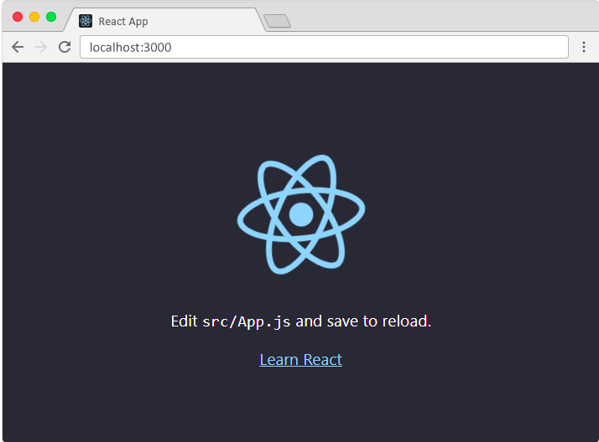
React JS – Intro

