Slide 1

microframework

Slide 2

About Me
Nick Zalabak
Slides and code examples for this presentation:
git@github.com:techwhizbang/sinatra_slideshow.git
git@github.com:techwhizbang/sinatra_slideshow_code.git
My Blog: http://techwhizbang.com
Twitter: @techwhizbang

Slide 3
Compelling Reasons
Sinatra is a “microframework” built on Rack
Easy, practical, go fast!
Made with extensibility in mind
Not crufty or bloated like larger web frameworks
Small memory footprint as compared to other frameworks
On par performance-wise to other frameworks
Works well with many web servers
Works great with JRuby
Notes:
These are just some compelling reasons to give Sinatra a strong consideration the next time you start a new project

Slide 4
Sinatra 101
Sinatra is more DSL atop Rack than your typical “framework”
DSL Configuration
DSL Routing
Works with many popular template/view libraries
Has before and after filters similar to Rails
Handles all typical response codes and mime types nicely
Easy testing with popular test frameworks/libraries
Notes:
To further qualify that Sinatra is more DSL than framework take a close look at the implementation details to the some of the more important things like
logging, sessions, method override. These are all implemented by Rack, not Sinatra.

Slide 5
Project Layout
There is no set project layout per se
Use best practices and judgment
Nobody likes a “fiddly little snowflake app”
Notes:
I’ve seen some configure their Sinatra app like a gem, some like a Rails stack, and some are of the simple containing 1 or 2 files

Slide 6
Configuration
Sinatra is configurable
“Out of box” settings are usually OK
enable/disable are often overlooked
set RACK_ENV=dev|test|prod
Notes:
All configuration settings are documented here http://www.sinatrarb.com/configuration.html
Web server configurations will be discussed later in the deck

Slide 7
Sessions
Surprise! Sessions are off by default
Default cookie based sessions via Rack
Memory? Rack::Session::Pool
Distributed? Rack::Session::Memcache
Notes:
Refer to the cookie_sessions_controller.rb, memcache_sessions_controller.rb, memory_sessions_controller.rb
If you need to customize your session cookie timeout, domain, or secret key
use Rack::Session::Cookie, :key => 'rack.session', :domain => 'foo.com', :path => '/', :expire_after => 2592000, # In seconds :secret => 'change_me’
You can pass in the standard Memcache options, look at the memcache-client gem for more about the config settings
Both the memory and memcache session stores still use the cookie to store the session key
DON’T use enable :session or :session, true with alternate session stores
Demonstrate the differences of the memory vs memcache by stopping and restarting the server

Slide 8
Cookies
response.set_cookie(“viewed_products”, “1,2,3”)
reponse.set_cookie(“viewed_products”, [1,2,3])
reponse.delete_cookie(“viewed_products”)
request.cookies[“viewed_products”]
Notes:
Refer to products_controller.rb view_products method
Cookie implementation is again Rack::Request and Rack::Response based, not Sinatra
Can serialize Array objects, but you must parse them out yourself when delimited by &’s
Can modify the domain, path, and expiration of the cookie
Strings will need to be manually escaped
Look in the products controller show method

Slide 9
Serving css, js, etc
By default Sinatra serves from ‘public’
public, root, views are configurable
use Rack::Static when not standalone
Notes:
Refer to the search_controller.rb
If Sinatra isn’t in standalone mode and your using another web server be sure to specify Rack::Static

Slide 10
Routing
It’s as simple as GET, POST, PUT, DELETE
Notes:
URI definition should look similar to Rails
Mention splatting
get '/say/*/to/*' do # matches /say/hello/to/world
params["splat"] # => ["hello", "world"] end

Slide 11
Templating
Erb, HAML, Sass, Erubis, Builder support
erb :template, sass :template, etc
Named templating
Inline templating
Notes:
Refer to the standalone_controller.rb
Mention the gotcha with the XML builder templates, the xml variable in the template is automatically initialized for you

Slide 12
Filters
Rails inspired before/after filters similar

Slide 13
Helpers
Can be used in templates and controllers
Notes:
Refer to the search_controller.rb

Slide 14
Database Connectivity
“Roll your own” strategy
Connections
Migrations
Extensions
sinatra-activerecord
sinatra-mongo
sinatra-sequel
Notes:
Refer to the products_controller.rb

Slide 15
Load your Rake tasks
Load your own Rake tasks
Notes:
Go back to the db_migrate task to show how easy db:migrate can be done yourself

Slide 16
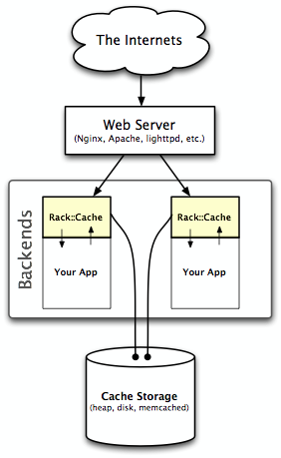
Caching Gems & Extensions
sinatra-cache
rack-cache
Notes:
sinatra-cache extension does file based page and fragment caching, this is completely file based
sinatra-cache is implemented in the search controller and views within the examples
For rack-cache refer to products_controller.rb
rack-cache is HTTP based caching based on Etag and Last modified headers that supports memory, disk, and memcache stores
Entity stores are used to cache response bodies across requests.
Meta stores are used for request/response pair keyed by the request's URL
rack-cache is a lightweight alternative to squid or other high throughput proxy servers
rack-cache is implemented in the products controller within the examples

Slide 17
Logging
Use a plain Ruby logger
sinatra-logger extension

Slide 18
Testing Sinatra
gem rack-test
include Rack::Test::Methods
last_response variable provides access to response body, headers, status, etc
last_request variable provides access to host, cookies, referrer, params, post?, get?, delete?, put?, path, etc

Slide 19
Ways to ‘start’ Sinatra
Basic standalone mode
ruby basic_startup.rb
Use a Rackup file - config.ru
thin -s 2 -C config.yml -R config.ru start

Slide 20
It would lead to Rack
If Sinatra were a gateway drug…

Slide 21
Handy Rack Middlewarez
rack-contrib
rack-throttle
rack-bug
rack-flash
warden
See for yourself and search “rack” on GitHub

Slide 22

Sinatra + Bundler
Get the bundler gem
bundle init
Edit your Gemfile
Add Bundler.setup
Notes:
Bundler is great since it makes your application completely portable without worrying about gems on the deploy server
It is also keeps you honest

Slide 23
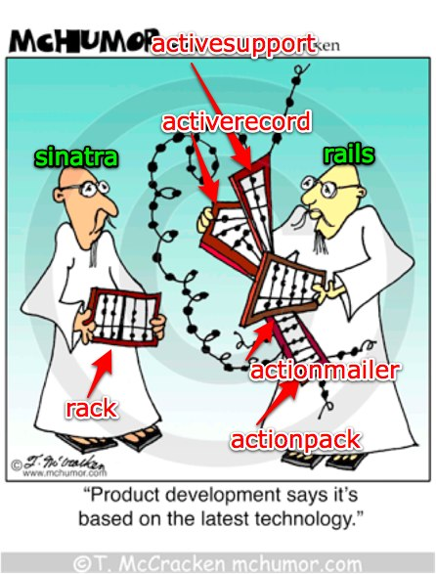
Code Counter
Sinatra lines of code for tests?
3685
Sinatra actual lines of library code?
2248
Rails 2.3.x
approx 156000
Notes:
find . -name *.rb -print0 | xargs -0 wc -l

Slide 24
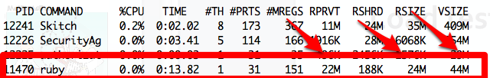
Load testing Sinatra
How does it perform under load?
Sinatra is thread safe (try w/JRuby)
Notes:
Start up Jmeter and top to monitor

Slide 25
Sinatra + Jruby + Warbler
jruby –S gem install warbler
mkdir config
warble config
Check config/warble.rb
Notes:
Jruby-rack Jar allows us to interface to all rack based apps via servlet filter in the web.xml
Have to change config/warble.rb to accommodate your Sinatra app layout
Deployable to your favorite JEE/Servlet container Tomcat, Jboss, Glassfish…
http://github.com/nicksieger/jruby-rack/tree/master/examples
http://github.com/nicksieger/jruby-rack.git

Slide 26
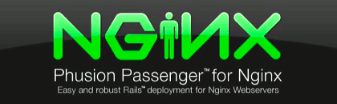
Passenger is Rack friendly
root points to apps ‘public’ dir
config.ru must be present
Notes:
Use passenger gem to install nginx and passenger
/opt/nginx/conf/sites-available /opt/nginx/conf/sites-enabled
Make sure you run nginx as the proper user:group, not root or nobody!

Slide 27
Sinatra on Heroku
Version your app with Git(hub) (git init)
Use Bundler or .gems file to manage Gems
sudo gem install heroku
heroku create
git push heroku master
See your gems installed in the terminal
It really is that easy!
http://stormy-earth-60.heroku.com/products

Slide 28
Sinatra in Action
GitHub resque gem
Github Watchtower
Heroku: processing background jobs
Cafepress: internal RESTful services
Notes:
Resque is background job processor with Sinatra UI for monitoring queues, jobs, workers
Watchtower is a combo of Mongo DB, Mustache templating, and Sinatra UI

Slide 29
Q&A

